Slide 1

Customer Shopping Behavior Analysis
Summary of insights from 3,900 transactions to guide product, pricing, and retention strategies.

Slide 2
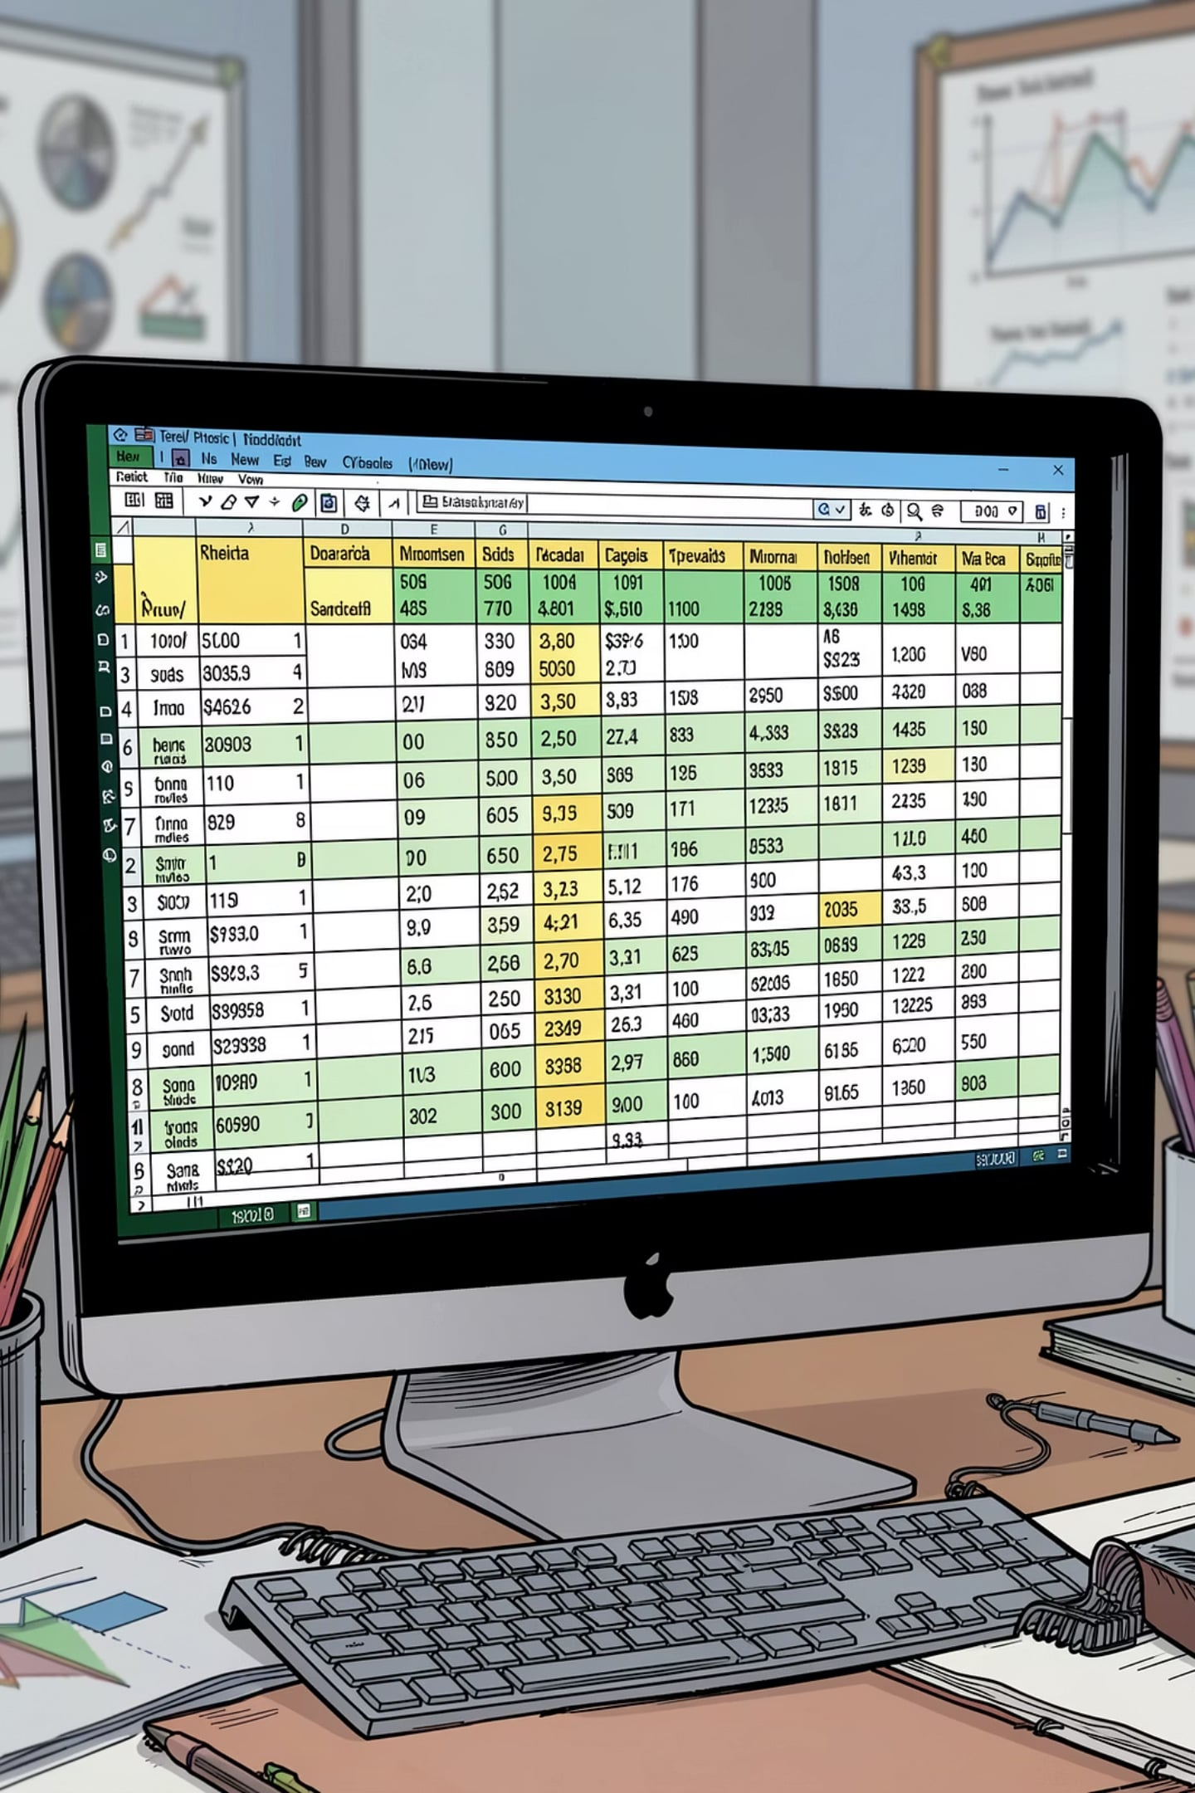
Project & Dataset Overview
Scope
Structure
3,900 purchases across categories to uncover spending patterns, segments, and subscription behavior.
18 columns: demographics, purchase details, behavior, payment, and shipping.
Missing Data
37 nulls in Review Rating; handled during cleaning.

Slide 3

Data Preparation & Feature Engineering
01
Cleaning
Loaded with pandas, checked df.info() and describe().
02
Imputation
Filled missing Review Rating with category median.
03
Transforms
Renamed to snake_case; created age_group and purchase_frequency_days.
04
Pruning
Dropped redundant promo_code_used after checking discount_applied.

Slide 4

Database Integration
Connected cleaned DataFrame to PostgreSQL for structured SQL analysis and reporting.
Enabled repeatable queries for revenue, segmentation, and product-level metrics.

Slide 5
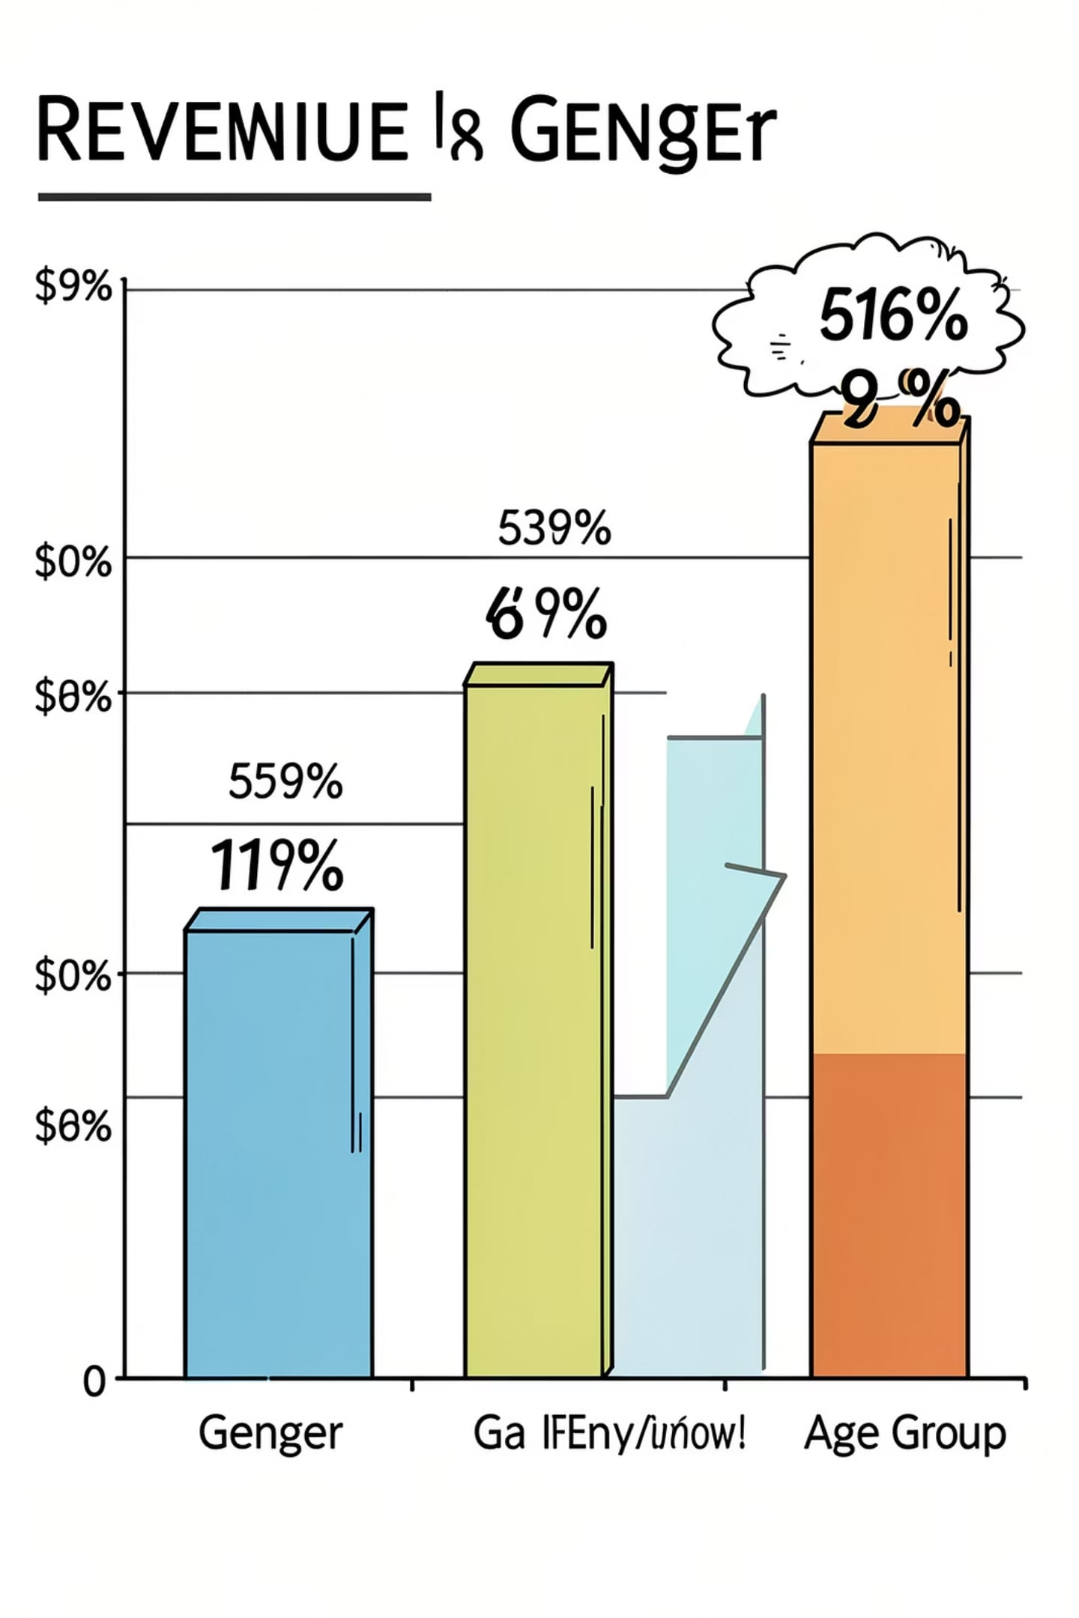



Key SQL Findings — Revenue & Demographics
Revenue by Gender
Female: 75,191 • Male: 157,890 — clear skew toward male revenue in this dataset.
Revenue by Age Group
Young Adult: 62,143 • Middle-aged: 59,197 • Adult: 55,978 • Senior: 55,763.
Subscribers vs Non-Subscribers
Subscribers (1,053): avg $59.49; Non-subscribers (2,847): avg $59.87. Non-subscribers drive larger total revenue.

Slide 6
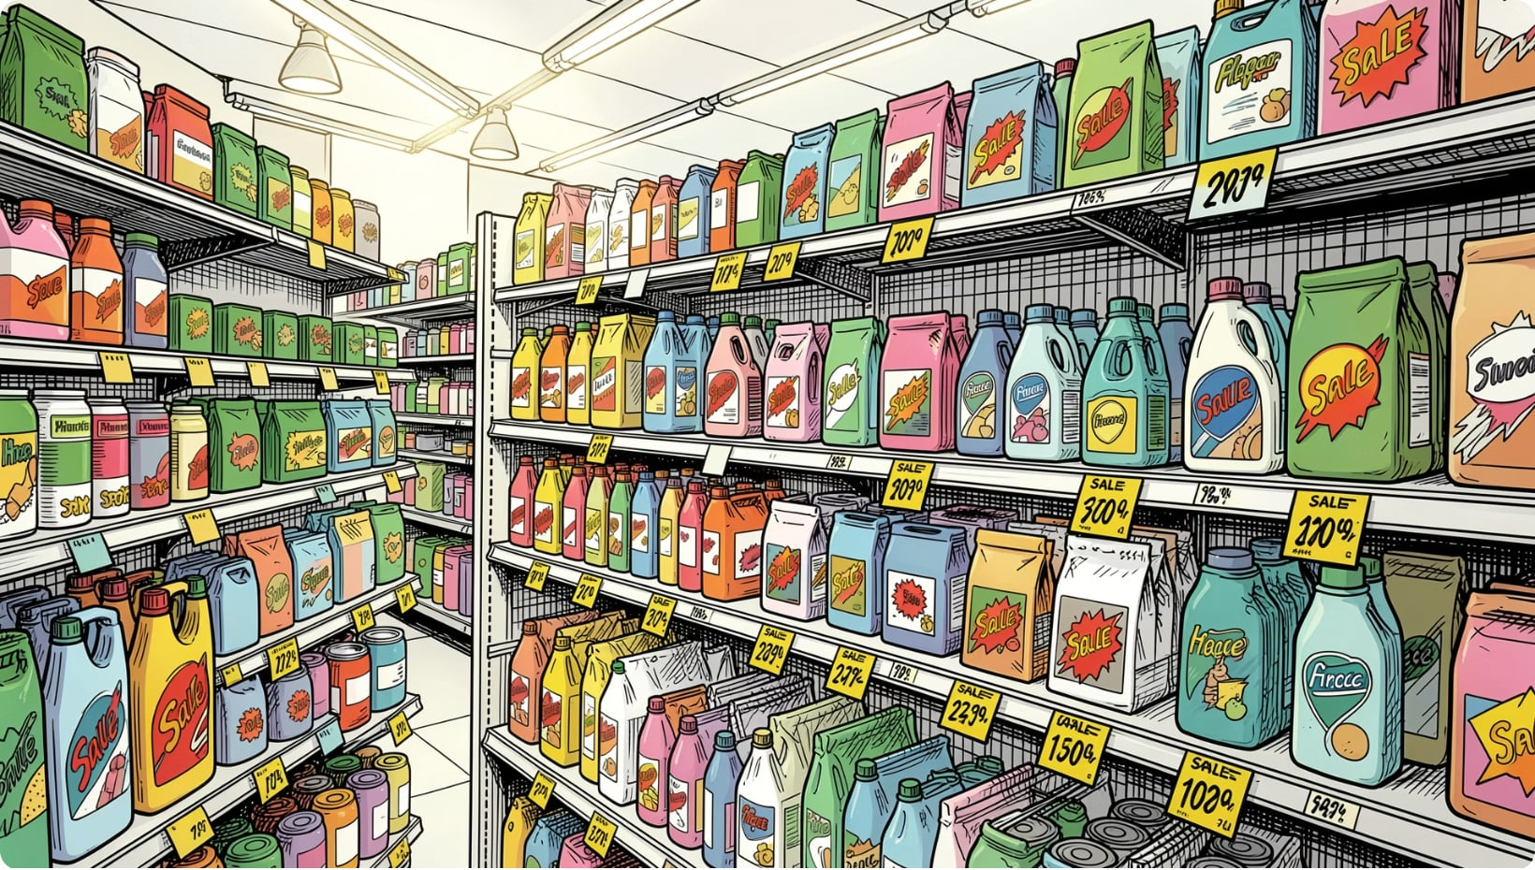
Product & Discount Insights
Top-rated products: Gloves (3.86), Sandals (3.84), Boots (3.82), Hat (3.80), Skirt (3.78).
Discount-heavy items: Hat (50%), Sneakers (49.66%), Coat (49.07%), Sweater (48.17%), Pants (47.37%).
High-spending discount users: 839 rows flagged — customers who used discounts but spent above average.

Slide 7

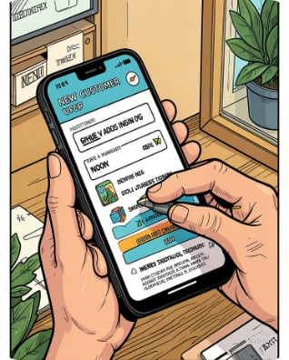
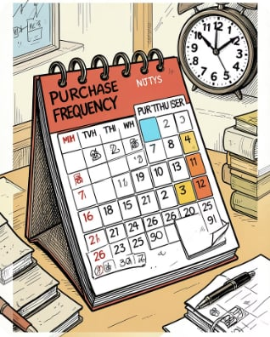
Behavior & Segmentation
Loyal Segment
New & Returning
Purchase Frequency
3,116 customers classified as Loyal — prime targets for retention and upsell.
New: 83 • Returning: 701 — small but important growth cohorts.
Engineered purchase_frequency_days to understand cadence and subscription propensity.

Slide 8
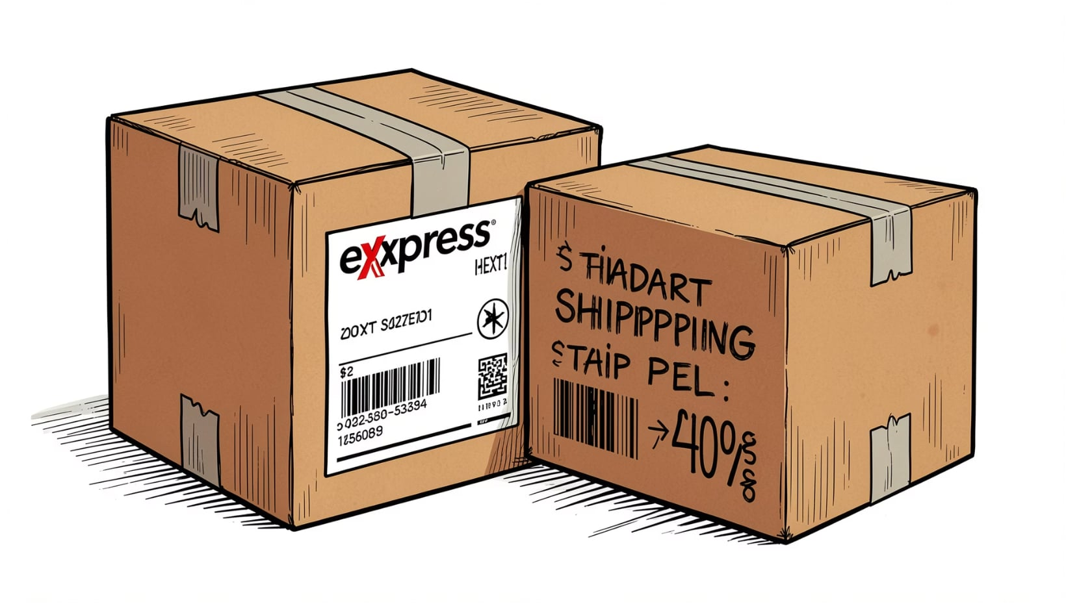
Shipping & Payment Patterns
Shipping comparison:
Standard avg purchase: $58.46
Express avg purchase: $60.48
Payment method: PayPal frequently used; shipping choice correlates modestly with purchase amount.

Slide 9
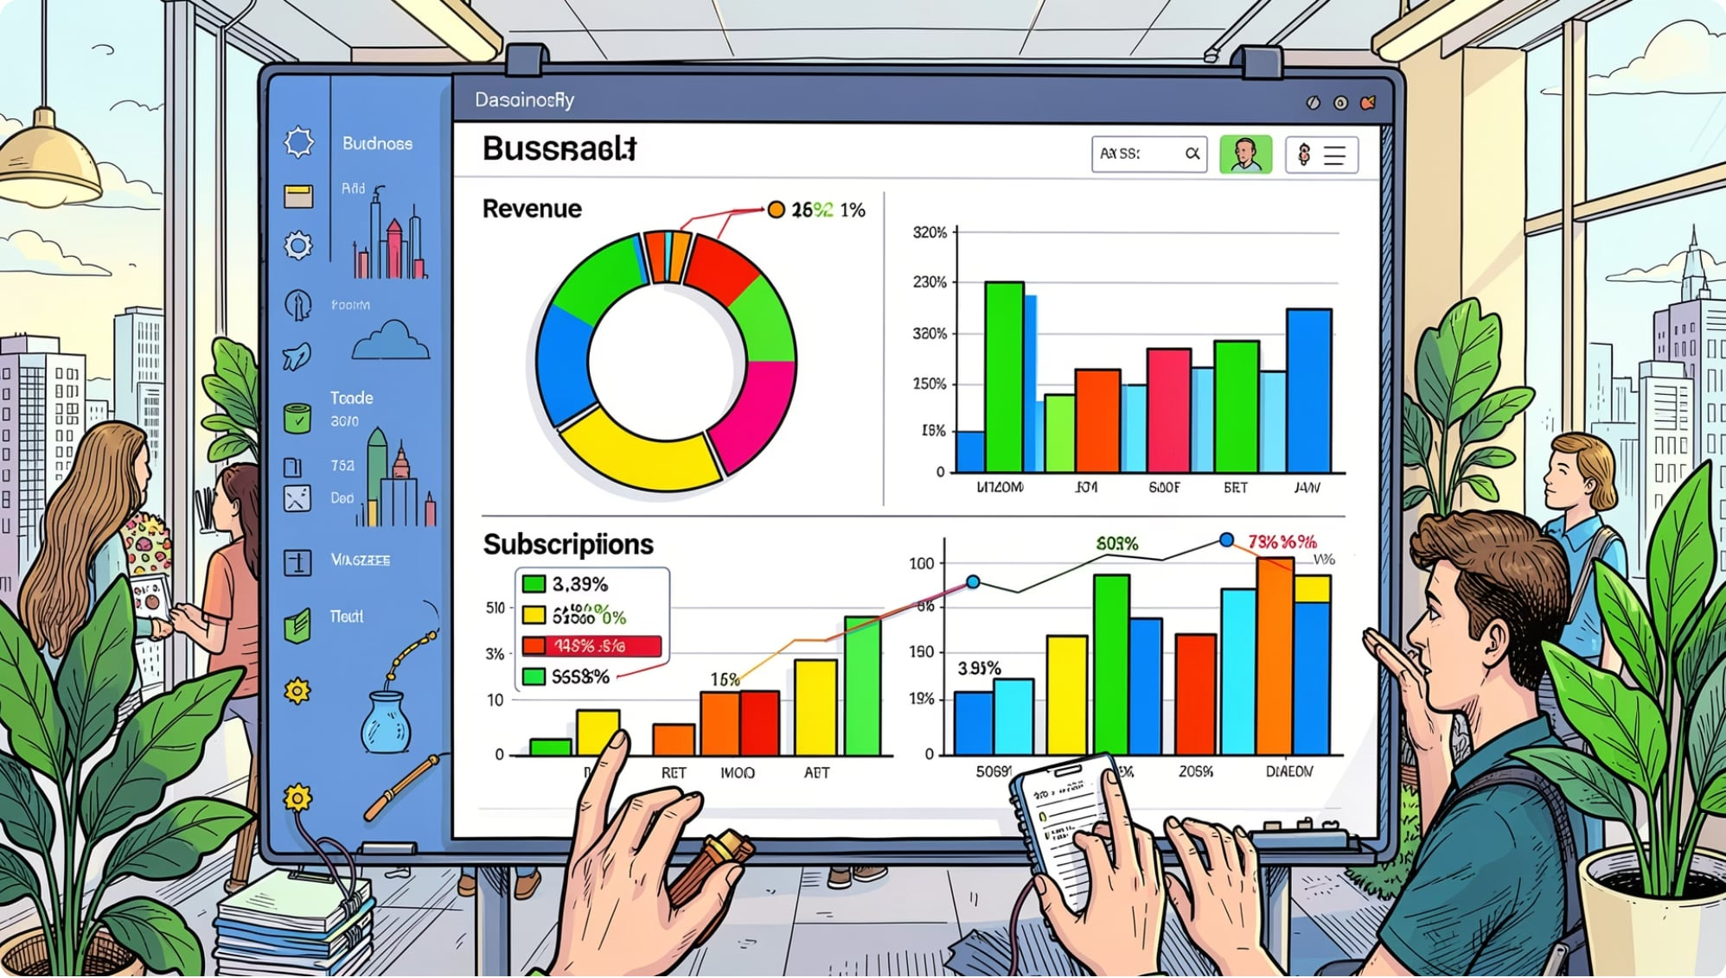
Power BI Dashboard
Interactive visuals created to surface subscription mix, revenue by category, top sellers, and age-group performance.
3.9K customers • Avg purchase $59.76 • Avg rating 3.75
Subscription split: Yes 27% / No 73%
Dashboard supports filtering by gender, category, and shipping type for exploratory analysis.

Slide 10
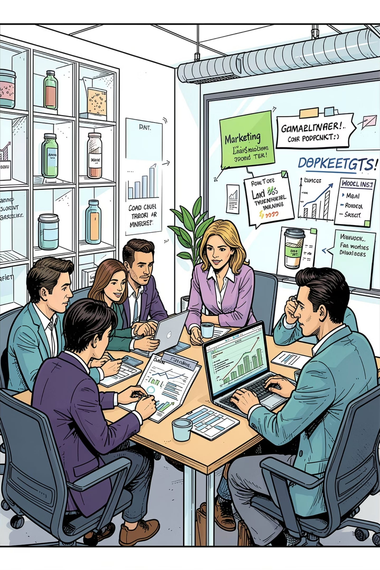



Business Recommendations
Boost Subscriptions
Loyalty Programs
Promote exclusive subscriber benefits to increase recurring revenue and retention.
Reward repeat buyers to convert Returning customers into Loyal segment (3,116 existing loyal customers show program potential).
Review Discount Policy
Product Positioning & Targeting
Balance discounts (high on hats, sneakers) with margin control; target discounts to high-conversion items.
Highlight top-rated and best-selling items in campaigns; focus marketing on high-revenue age groups and express-shipping users.
Next step: operationalize dashboards and run targeted campaigns for subscribers and loyal customers.

