Slide 1
FINAL-YEAR MECHANICAL ENGINEERING PROJECT
A physics-based bearing diagnosis and RUL framework
Rolling bearing fault diagnosis and remaining useful life estimation
6205-2RS nominal geometry | 12 kHz synthetic vibration
Four diagnosis classes | 30 simulated run-to-failure lives
SYNTHETIC-ONLY RESULTS
All reported scores are from simulated data, not physical bearings
Verified in an isolated copy | 2026

Slide 2
01 / PROBLEM
02
Why bearing condition matters
A local defect can become an unplanned machine outage
Diagnosis asks: which fault pattern best explains the vibration?
RUL asks: how long until a defined condition threshold is reached?
Project goal: demonstrate a reproducible physics + signal + ML workflow
This is a method demonstration, not a maintenance-ready product.
SIMULATED DATA | NOT FIELD VALIDATION

Slide 3
02 / MECHANICS
03
Bearing geometry sets the impact rates
Nominal 6205 geometry: 9 balls, d = 7.938 mm, D = 39.04 mm, theta = 0 deg
FTF = fr/2 * (1 - d/D cos(theta))
BPFO/BPFI = n fr/2 * (1 +/- d/D cos(theta))
BSF = D fr/(2d) * (1 - (d/D cos(theta))^2)
At 1,800 rpm: BPFO 107.55 Hz | BPFI 162.45 Hz | BSF 70.72 Hz | FTF 11.95 Hz
SIMULATED DATA | NOT FIELD VALIDATION

Slide 4
03 / SIGNAL PROCESSING
04
Impacts ring at high frequency; the envelope reveals their rhythm
The synthetic fault impacts excite a damped 2-4 kHz structural resonance
Band-pass the resonance region, then form the Hilbert envelope.
The envelope spectrum exposes lower BPFO, BPFI, or BSF repetition rates.
Seeded 5 s checks measured 162.6, 107.6, and 70.8 Hz for inner, outer, and ball faults.
Timing jitter is 1.5%; speed/load change between windows, not within a window.
SIMULATED DATA | NOT FIELD VALIDATION

Slide 5
04 / DATA
05
Two synthetic datasets, explicit assumptions
Generated by this project's simulator; no external vibration dataset was used
Diagnosis: 4,000 windows, 1,000/class, 4,096 samples at 12 kHz.
Classes: Healthy, Inner Race, Outer Race, Ball; 80 runs total.
RUL: 30 lives x 40 observations; exponential severity toward threshold 0.90.
CWRU archive attempt returned HTTP 404. Real-data validation was not done.
SIMULATED DATA | NOT FIELD VALIDATION

Slide 6
05 / FEATURES
06
Features connect vibration to bearing mechanics
24 signal features, plus operating variables used by the models
Time: RMS, kurtosis, skewness, crest factor, peak-to-peak, mean absolute value.
FFT: centroid, entropy, dominant frequency, and five band-energy ratios.
Envelope: RMS, centroid, energy at BPFO/BPFI/BSF/FTF and their second harmonics.
Classifier uses 26 numeric inputs; RUL uses 27, including a simulated health indicator.
SIMULATED DATA | NOT FIELD VALIDATION

Slide 7
06 / EVALUATION DESIGN
07
Group splits keep runs and lives intact
The main evaluation does not randomly divide neighboring windows
Classification: 56 train runs / 12 validation runs / 12 test runs.
RUL: 21 train lives / 4 validation lives / 5 test lives.
Validation selects the classical model; test metrics are held out for reporting.
Global median imputation is coded before splitting; generated feature tables had zero numeric NaNs.
SIMULATED DATA | NOT FIELD VALIDATION

Slide 8
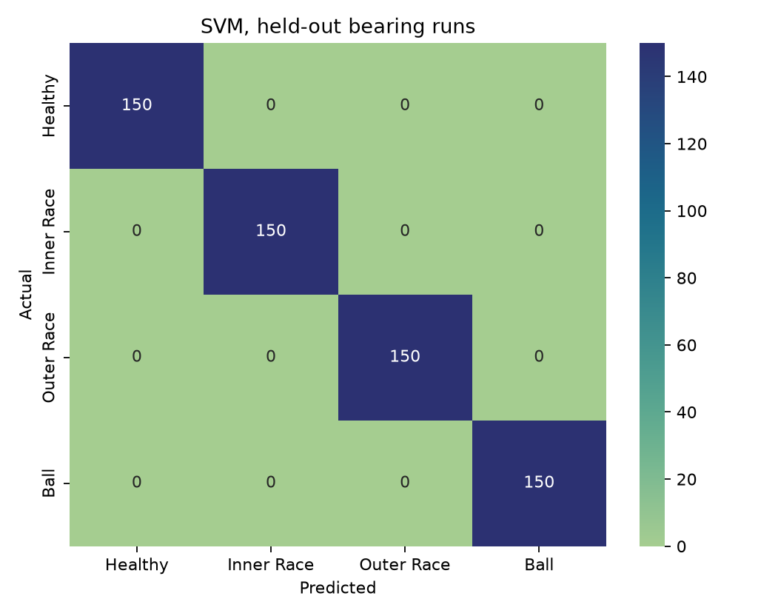
07 / DIAGNOSIS RESULTS
08
Classical models separate the synthetic labels perfectly
600 held-out windows: 150 per class, from 12 held-out runs
SVM, Random Forest, KNN, Gradient Boosting: each accuracy = 1.000, weighted F1 = 1.000.
The validation-selected classical model was SVM.
Interpretation: simulator class separability, not proven industrial accuracy.
SVM test confusion matrix: 150 correct per class; no off-diagonal errors.
SIMULATED DATA | NOT FIELD VALIDATION

Slide 9
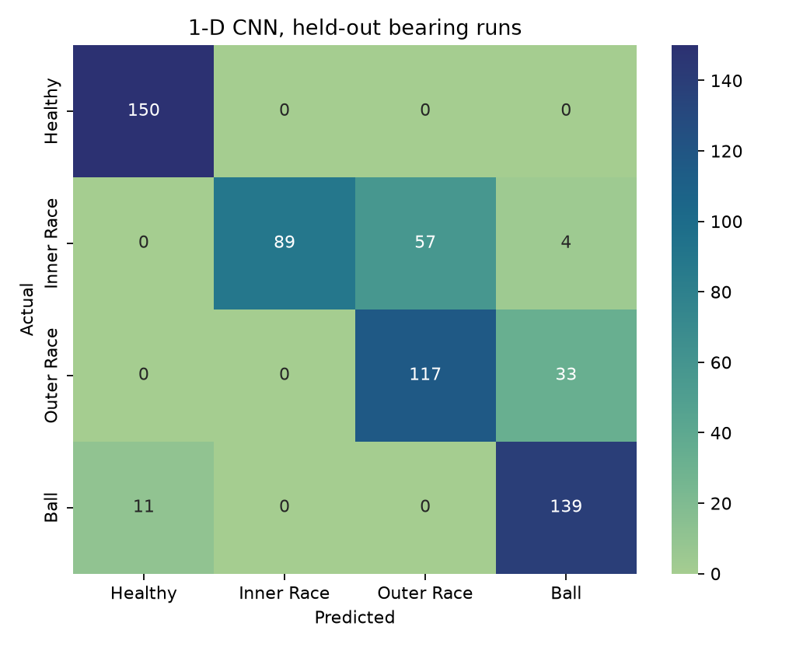
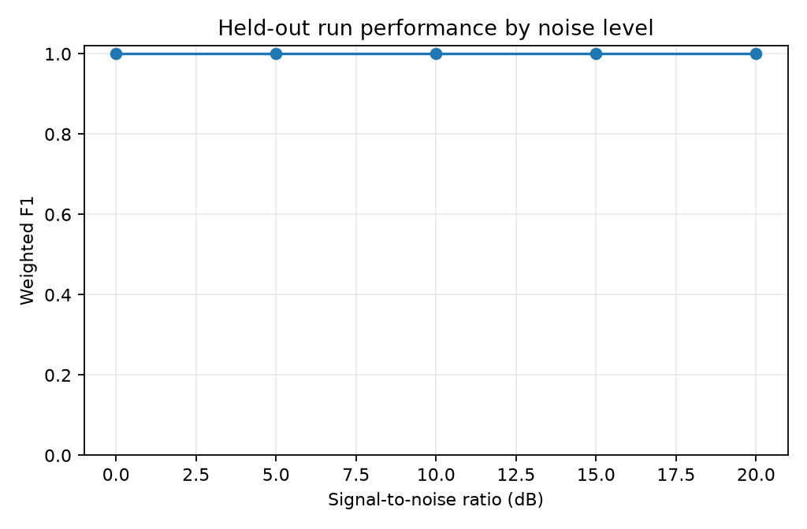
08 / DIAGNOSIS RESULTS
09
The raw CNN shows where class boundaries overlap
1-D CNN: accuracy 0.825 | weighted F1 0.821
Most errors: inner race predicted as outer race (57 of 150).
Outer race predicted as ball 33 times; ball predicted healthy 11 times.
The noise curve is for the selected classical model, not the CNN.
CNN confusion matrix, held-out simulated runs.
SIMULATED DATA | NOT FIELD VALIDATION

Slide 10
09 / ROBUSTNESS
10
Operating-domain shift is harder than the main split
A separate low-speed/load to high-speed/load experiment
Train on 1,400 low-domain windows from training runs.
Evaluate on 2,000 high-domain windows.
Accuracy 0.9125 | weighted F1 0.9097.
Noise weighted F1 for the selected classical model was 1.000 at each tested SNR: 0, 5, 10, 15, 20 dB.
SIMULATED DATA | NOT FIELD VALIDATION

Slide 11
10 / PROGNOSTICS
11
RUL labels come from an assumed degradation law
Each synthetic life approaches a severity threshold of 0.90
Severity begins near 0.025 and grows exponentially over a random 40-100 h life.
HI = severity plus noise; target RUL = simulated failure time minus current age.
Model inputs include HI and vibration features; direct age and severity are excluded.
HI is a privileged synthetic proxy, not a real sensor-derived health score.
SIMULATED DATA | NOT FIELD VALIDATION

Slide 12
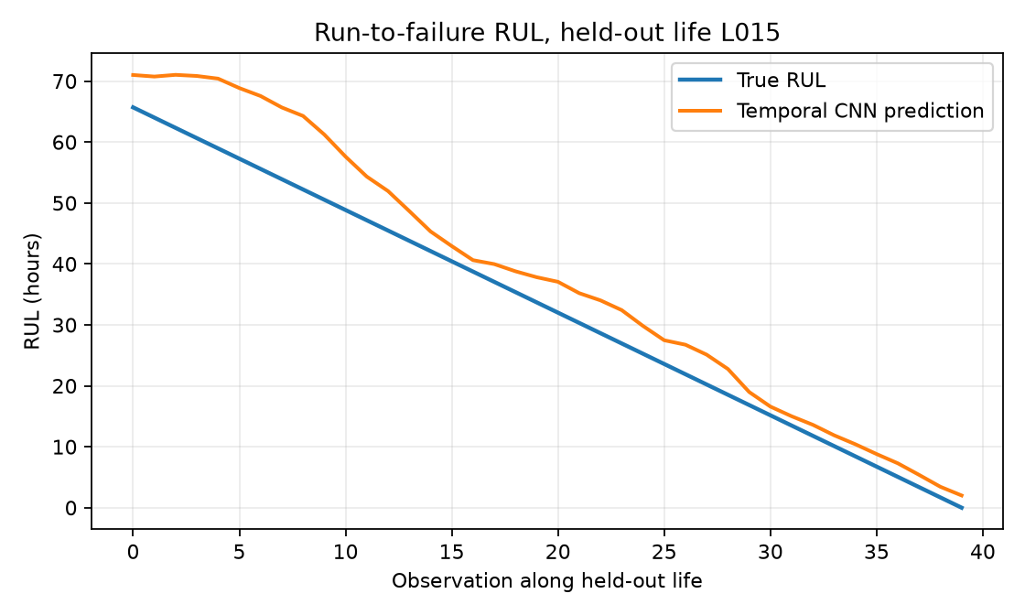
11 / RUL RESULTS
12
RUL comparison on five held-out synthetic lives
Validation selected Gradient Boosting; the test set contains 200 correlated observations
Random Forest: RMSE 9.92 h | MAE 7.37 h | implemented score 1.362.
Gradient Boosting: RMSE 10.22 h | MAE 7.70 h | implemented score 1.860.
Temporal CNN: RMSE 12.72 h | MAE 9.51 h | implemented score 2.097.
One example test life (L015), not an aggregate life trajectory.
Score caveat: code penalizes equal underestimates more than dangerous RUL overestimates.
SIMULATED DATA | NOT FIELD VALIDATION

Slide 13
12 / INTERFACE
13
Dashboard: useful visual demo, synthetic input only
Choose class, speed, load, severity, noise, and a repeatable seed
Waveform and amplitude FFT show the generated 4,096-sample window.
Envelope spectrum shows calculated BPFO/BPFI/BSF/FTF markers.
Saved sklearn models display a fault label and classical RUL point estimate.
It does not ingest accelerometer files or a live sensor stream; outputs are not maintenance advice.
SIMULATED DATA | NOT FIELD VALIDATION

Slide 14
13 / TAKEAWAYS
14
Conclusion: the pipeline runs; physical validation remains
Full isolated-copy run passed; six tests passed; the dashboard rendered and was stopped
Synthetic physics + features + grouped ML is reproducible on this CPU setup.
Perfect classical diagnosis scores should be presented as simulator results only.
Next: real rig data, exact SKF source, more independent lives, uncertainty, corrected RUL score.
Questions
SIMULATED DATA | NOT FIELD VALIDATION

