Slide 1



Presentation on
AI-Powered Coding Practice Platform (Syntiq)
Internal Guide:
Prof. (Dr) Prashant Lakkadwala
Presented By:
Puneet Kumar - 0827IT231106 Shivam Chouhan - 0827IT231124 Shivani Prajapati - 0827IT231126 Shubhi Sahu - 0827IT231131
External Guide:
Mr. Harshwardhan Songirkar

Slide 2


Contents
Introduction
Overview
Purpose
Literature Review
Problem Statement 4.Proposed Solution
Objectives
Theoretical Analysis
Block Diagram
Hardware Requirements
Software Requirements
Applications
References

Slide 3
1. Introduction
1.1 Overview:
AI-Powered Coding Practice Platform helps users improve programming skills through interactive coding challenges.
It provides topic-wise and difficulty-based coding problems for structured learning.
AI analyzes user performance and recommends suitable problems with instant feedback.
1.2 Purpose:
To provide an intelligent coding practice platform.
To improve programming and problem-solving skills.
To deliver AI-based personalized learning.
To support coding interview and competitive programming preparation.

Slide 4
2. Literature Review
Existing coding platforms provide a wide range of programming problems but offer limited personalized learning support.
Sr. no. | Name of Solutions/System | Features | Limitations/Drawbacks
1. | LeetCode | Coding challenges, contests, interview preparation. | Limited AI-based guidance and personalized feedback.
2. | HackerRank | Skill assessments, certifications, multiple languages. | Generic recommendations and limited adaptive learning.
3. | CodeChef | Competitive programming contests and practice problems. | Less focus on beginner-friendly personalized learning.
4. | Codeforces | Advanced algorithmic problems and global rankings. | Complex for beginners and lacks intelligent learning support.

Slide 5
3. Problem Statement
Many beginners find it difficult to select coding problems that match their current skill level and learning pace.
Existing coding platforms mainly focus on problem solving and provide limited personalized feedback or AI-based guidance.
Users often spend significant time identifying errors and improving their solutions without proper assistance.
The absence of adaptive learning and performance-based recommendations slows skill development and interview preparation.

Slide 6

4. Proposed Solution
AI-Powered Problem Recommendation: Analyzes user performance and suggests coding problems based on skill level, accuracy, and learning progress.
Automated Code Evaluation: Executes submitted programs against predefined test cases and provides instant results with detailed feedback.
Intelligent Hint & Code Analysis: Generates AI-based hints, identifies logical errors, and explains concepts without directly revealing the complete solution.
Personalized Progress Dashboard: Tracks solved problems, coding streaks, topic-wise performance, and overall improvement through interactive analytics.
Online Coding Environment: Integrates a secure code editor, multi-language support, and real-time execution to create a seamless coding practice experience.

Slide 7

5. Objectives
Enhance Coding Skills: Provide a structured platform for practicing coding problems across different topics and difficulty levels.
Integrate Artificial Intelligence: Utilize AI to deliver personalized problem recommendations, hints, and performance insights.
Automate Code Evaluation: Execute user submissions against test cases and generate instant, accurate feedback.
Track Learning Progress: Maintain coding history, accuracy, solved problems, and topic-wise performance through an interactive dashboard.
Support Interview Preparation: Help students strengthen problem-solving abilities and improve confidence for technical interviews and competitive programming.

Slide 8
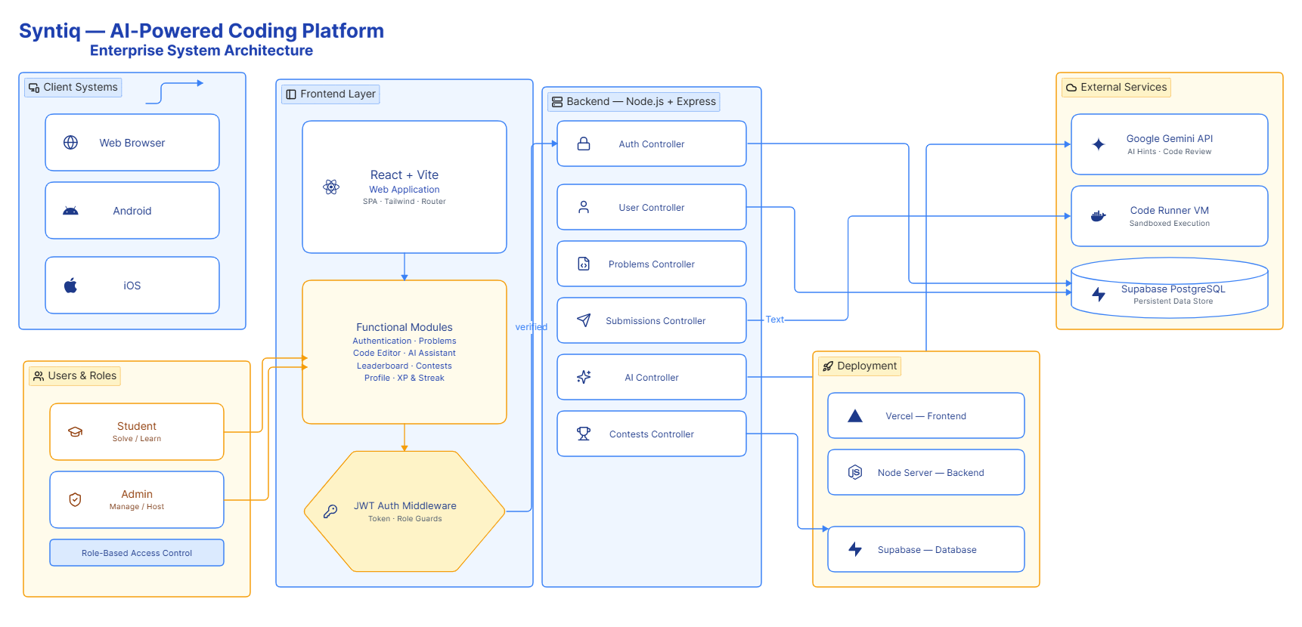
6. Theoretical Analysis
6.1 System Architecture & Flow:
9

Slide 9
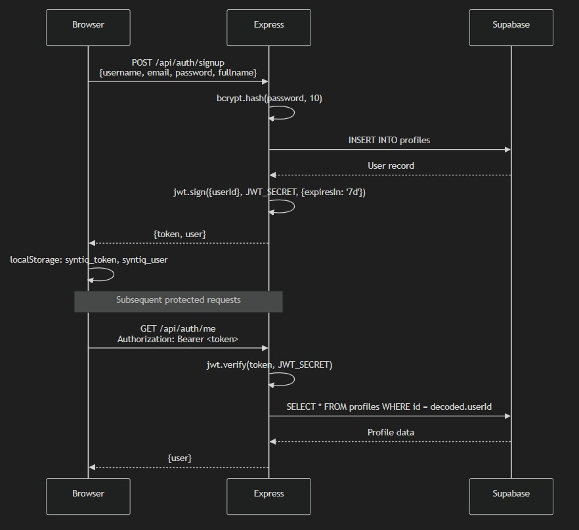
Database Architecture:
9

Slide 10
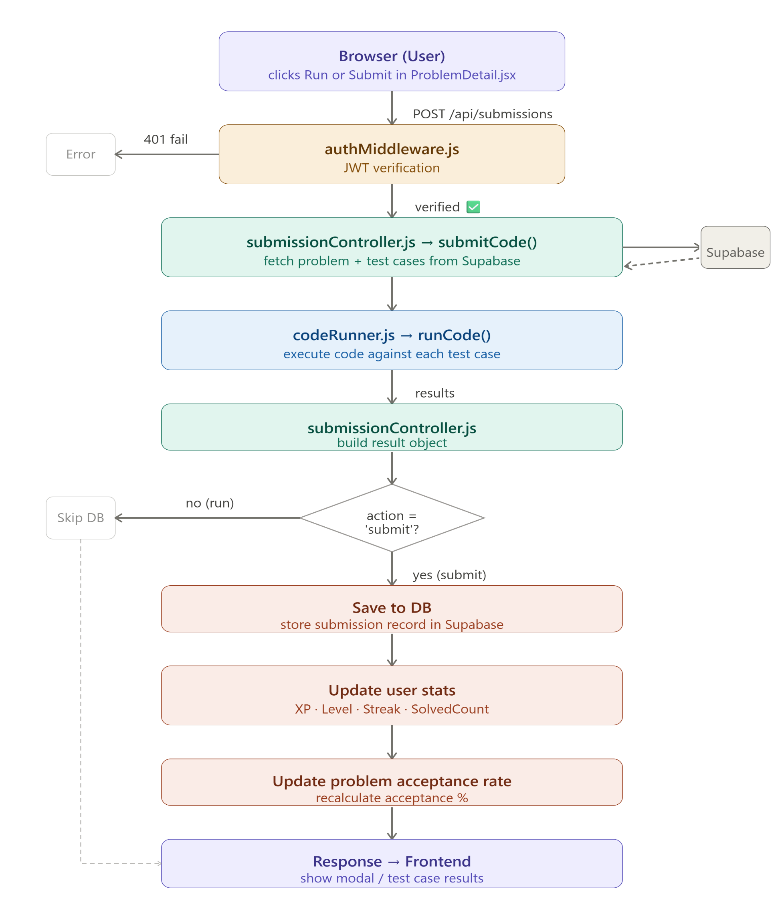
Submission Flow:
9

Slide 11
6. Theoretical Analysis
6.2 Hardware Requirements:
Processor: Intel Core i3/i5 or equivalent.
RAM: Minimum 4 GB (8 GB recommended).
Storage: 5 GB free disk space.
Network: Stable internet connection for AI API access.
6.3 Software Requirements:
Operating System: Windows 10/11, Linux, or macOS.
Frontend: React.js, HTML, CSS, JavaScript.
Backend: Node.js, Express.js.
Database: MongoDB.
AI Integration: Gemini API/OpenAI API.
9

Slide 12
7.Applications
Programming Education: Helps students strengthen coding and problem-solving skills through regular practice.
Technical Interview Preparation: Provides structured coding challenges for placement and interview readiness.
Competitive Programming: Enables users to improve coding speed, accuracy, and algorithmic thinking.
Academic Learning: Supports colleges and training institutes by offering an interactive coding practice environment.
10

Slide 13
GitHub Link
https://github.com/Shivamchouhan7/Syntiq-Coding-Platfrom
11

Slide 14
REFERENCES
[1]. Keuning, H., Jeuring, J., & Heeren, B. (2018).
A Systematic Literature Review of Automated Feedback Generation for Programming Exercises.
ACM Transactions on Computing Education.
[2]. Ihantola, P., Ahadi, A., Karavirta, V., & Petersen, A. (2015).
Educational Data Mining and Learning Analytics in Programming Education.
[3].Edwards, S. H. (2003).
Improving Student Performance by Evaluating How Well Students Test Their Own Programs.
[4].Combéfis, S., Beresnevičius, G., & Dagienė, V. (2016).
Learning Programming Through Contest: Benefits of Online Judge Systems.
12

Slide 15
Thank You
Queries ?
13

