Slide 1
Aadhaar Monthly Enrolment Data Analysis
Dataset: Enrolment_data_March-July.csv
Tools: PySpark, Pandas, Matplotlib, Seaborn
Email: shivambhandari200413@gmail.com
LinkedIn: www.linkedin.com/in/shivam-bhandari-7854552b4

Slide 2
Project Overview
• Source: https://www.data.gov.in/resource/aadhaar-monthly-enrolment-data
• Total Records: 3332
• Time Period: March – July 2025
• Goal: Analyze enrolment patterns by State, District, Age Group, and Time
• Tools Used: PySpark, Matplotlib, Seaborn
• Outcome: Extract insights on Aadhaar enrolment trends across India

Slide 3
Dataset Description
Columns: Date, State, District, Pincode, Age_0_5, Age_5_17, Age_18_greater
Cleaning Steps:
-> Converted Date to dd-MM-yyyy format
-> Added 'Total_Enrolments' column
-> Removed null/invalid records

Slide 4
Total Enrolments Overview
• Total Records in Dataset: 3,332
• Total Enrolments: [calculated using PySpark = sum of Total_Enrolments column]
• Average Enrolments per District: [calculated using PySpark mean]
• Top Pincode by Enrolments: [pincode with highest enrolments]
Observations:
• The dataset covers Aadhaar enrolments from March to July 2025.
• Each record represents enrolment data for a specific Pincode and date.
• Adding the 'Total_Enrolments' column helped in computing aggregated insights for State and District levels.

Slide 5
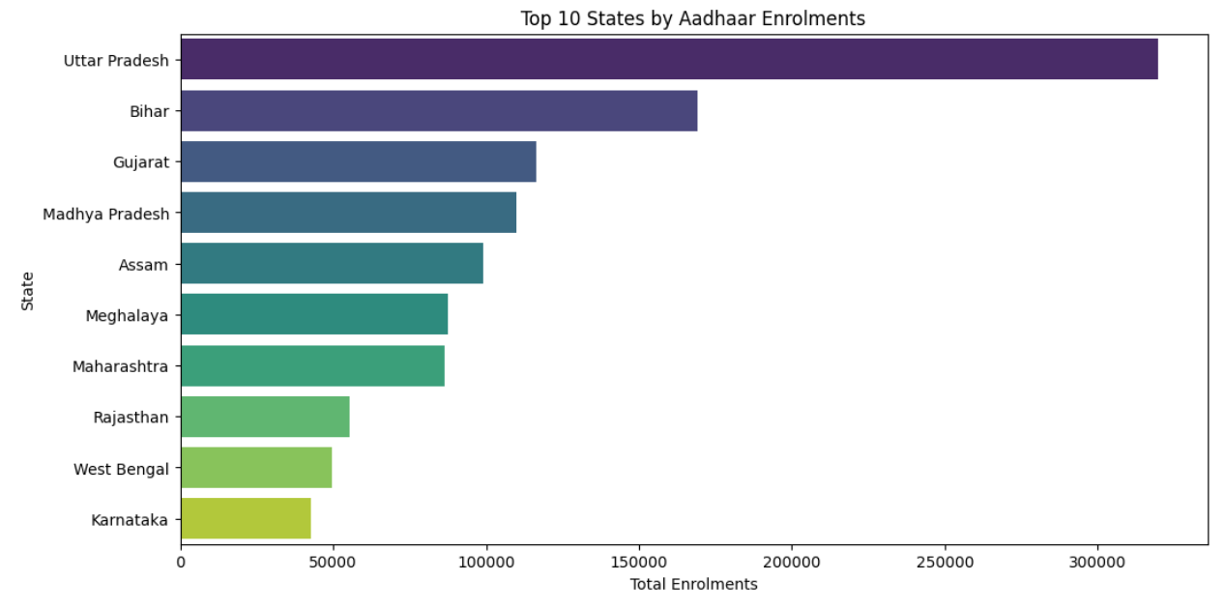
Top 10 States by Enrolments
• Observation: Highlight states with highest Aadhaar enrolments

Slide 6
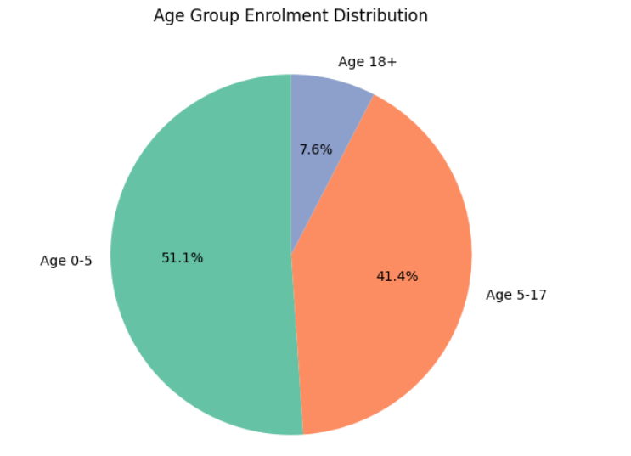
Age Group Distribution
• Observation: Proportion of 0–5 yrs, 5–17 yrs, and 18+ enrolments

Slide 7
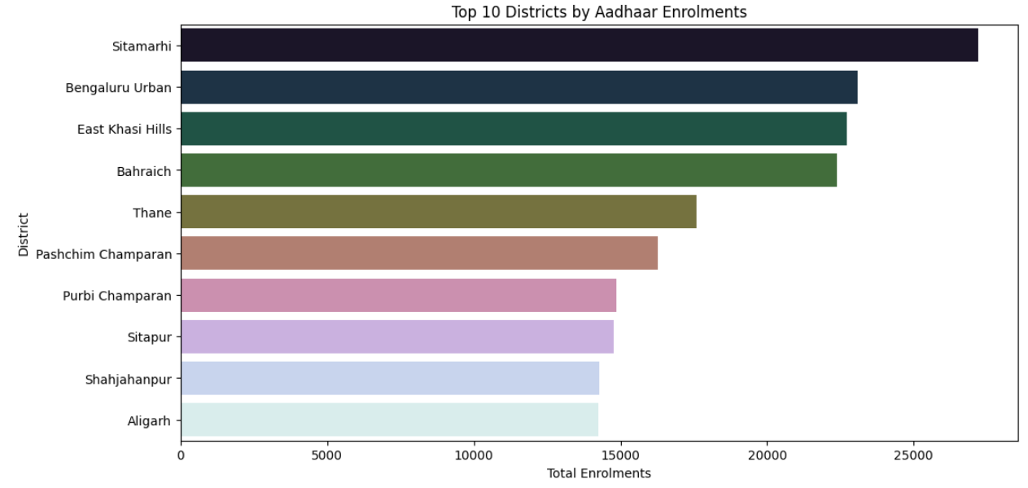
District Analysis
• Observation: Top 10 districts with highest Aadhaar enrolments

Slide 8
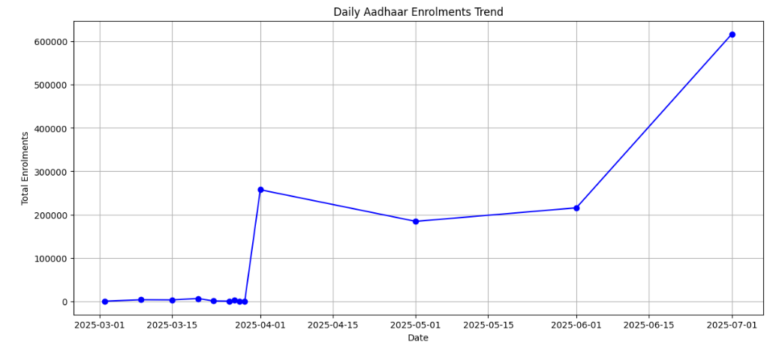
Time Trend Analysis
• Observation: Enrolment pattern trends from March–July 2025

Slide 9
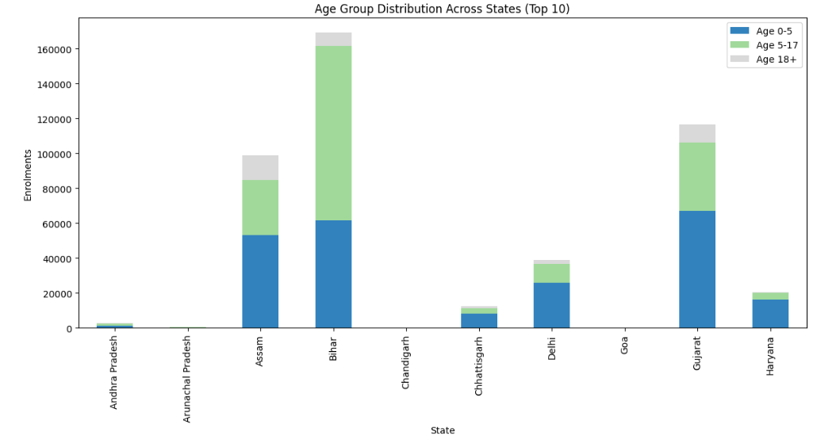
Statewise Age Group Comparison
• Observation: Age-wise enrolment variations across top states

Slide 10
Extra PySpark Insights
• Top 5 Pincodes by Enrolments
• State with Minimum Enrolments
• Average Aadhaar Enrolments per District
• Outputs generated using Spark DataFrames (.show())

Slide 11
Key Insights
Total records: 3,332
Total enrolments (sum of all age groups): 1,291,042
Age group breakdown:
-> Age 0–5: 659,287 (51.1%) — largest share of enrolments
-> Age 5–17: 534,018 (41.4%)
-> Age 18+: 97,737 (7.6%)
Top geographic performers:
-> Top state: Uttar Pradesh — 319,776 enrolments
-> Top district: Sitamarhi — 27,188 enrolments
-> Top pincode: 244001 — 10,380 enrolments
Trend: Daily enrolments are increasing (from 109 → 616,868).
Insights:
-> 0–5 age group dominates Aadhaar enrolment activity.
-> Strong growth trend indicates focused child enrolment drives.
-> 18+ share is relatively low — possibly because adults were enrolled earlier in previous drives.

Slide 12
Conclusion
• Aadhaar enrolment shows strong regional and age-based variations.
• PySpark effectively managed and analyzed large-scale data.
• Visual insights support data-driven policy planning.
• Demonstrates real-world application of Big Data Analytics.

