Slide 1

School of Computing Science and Engineering
Course Code: BCSE2370 Course Name: Data Communication & Networking
UNIT – 1
INTRODUCTION TO DATA COMMUNICATION & NETWORKING
(Lecture # 4)
Faculty Name: Shilpy Gupta Program Name: B.Tech CSE

Slide 2
School of Computing Science and Engineering
Course Code: BCSE2370 Course Name: Data Communication & Networking
Topics to be covered:
Switching Techniques
Circuit Switching
Message Switching
Packet Switching
Faculty Name: Shilpy Gupta Program Name: B.Tech CSE

Slide 3
School of Computing Science and Engineering
Course Code: BCSE2370 Course Name: Data Communication & Networking
Switching Techniques:
In large networks there might be multiple paths linking sender and receiver. Information may be switched as it travels through various communication channels.
The switching technique will decide the best route for data transmission
Switching technique is used to connect the systems for making one-to-one communication.
Faculty Name: Shilpy Gupta Program Name: B.Tech CSE

Slide 4
School of Computing Science and Engineering
Course Code: BCSE2370 Course Name: Data Communication & Networking
Switching Techniques: Types
There are three typical switching techniques available for digital traffic.
Circuit Switching
Message Switching
Packet Switching
Faculty Name: Shilpy Gupta Program Name: B.Tech CSE

Slide 5
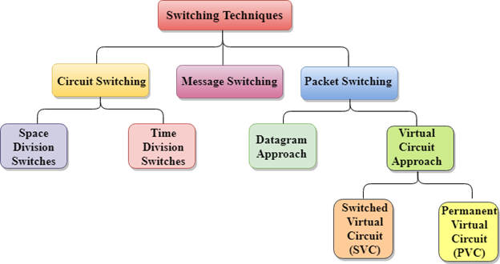
School of Computing Science and Engineering
Course Code: BCSE2370 Course Name: Data Communication & Networking
Switching Techniques: Types
Faculty Name: Shilpy Gupta Program Name: B.Tech CSE

Slide 6
School of Computing Science and Engineering
Course Code: BCSE2370 Course Name: Data Communication & Networking
Circuit Switching:
Circuit switching is a technique that directly connects the sender and the receiver in an unbroken path.
Telephone switching equipment, for example, establishes a path that connects the caller's telephone to the receiver's telephone by making a physical connection.
With this type of switching technique, once a connection is established, a dedicated path exists between both ends until the connection is terminated.
Routing decisions must be made when the circuit is first established, but there are no decisions made after that time.
Faculty Name: Shilpy Gupta Program Name: B.Tech CSE

Slide 7
School of Computing Science and Engineering
Course Code: BCSE2370 Course Name: Data Communication & Networking
Circuit Switching:
Circuit switching in a network operates almost the same way as the telephone system works.
A complete end-to-end path must exist before communication can take place.
The computer initiating the data transfer must ask for a connection to the destination.
Once the connection has been initiated and completed to the destination device, the destination device must acknowledge that it is ready and willing to carry on a transfer.
Faculty Name: Shilpy Gupta Program Name: B.Tech CSE

Slide 8
School of Computing Science and Engineering
Course Code: BCSE2370 Course Name: Data Communication & Networking
Circuit Switching:
Communication through circuit switching has 3 phases:
Circuit establishment
Data transfer
Circuit Disconnect
Faculty Name: Shilpy Gupta Program Name: B.Tech CSE

Slide 9
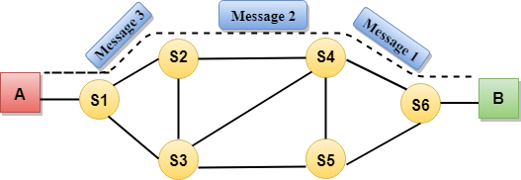
School of Computing Science and Engineering
Course Code: BCSE2370 Course Name: Data Communication & Networking
Circuit Switching:
Faculty Name: Shilpy Gupta Program Name: B.Tech CSE

Slide 10
School of Computing Science and Engineering
Course Code: BCSE2370 Course Name: Data Communication & Networking
Circuit Switching:
Advantages:
The communication channel (once established) is dedicated.
Disadvantages:
Possible long wait to establish a connection, (10 seconds,
more on long- distance or international calls.) during which
no data can be transmitted.
More expensive than any other switching techniques,
because a dedicated path is required for each connection.
Inefficient use of the communication channel, because the
channel is not used when the connected systems are not
using it.
Faculty Name: Shilpy Gupta Program Name: B.Tech CSE

Slide 11
School of Computing Science and Engineering
Course Code: BCSE2370 Course Name: Data Communication & Networking
Message Switching:
With message switching there is no need to establish a dedicated path between two stations.
When a station sends a message, the destination address is appended to the message.
The message is then transmitted through the network, in its entirety, from node to node.
Each node receives the entire message, stores it in its entirety on disk, and then transmits the message to the next node.
This type of network is called a store-and-forward network.
Faculty Name: Shilpy Gupta Program Name: B.Tech CSE

Slide 12
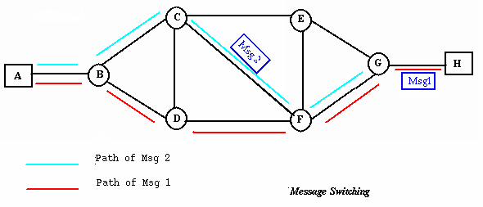
School of Computing Science and Engineering
Course Code: BCSE2370 Course Name: Data Communication & Networking
Message Switching:
Faculty Name: Shilpy Gupta Program Name: B.Tech CSE

Slide 13
School of Computing Science and Engineering
Course Code: BCSE2370 Course Name: Data Communication & Networking
Message Switching:
A message-switching node is typically a general-purpose computer. The device needs sufficient secondary-storage capacity to store the incoming messages, which could be long. A time delay is introduced using this type of scheme due to store- and-forward time, plus the time required to find the next node in the transmission path.
Faculty Name: Shilpy Gupta Program Name: B.Tech CSE

Slide 14
School of Computing Science and Engineering
Course Code: BCSE2370 Course Name: Data Communication & Networking
Message Switching:
Advantages:
Channel efficiency can be greater compared to circuit-switched systems, because more devices are sharing the channel.
Traffic congestion can be reduced, because messages may be temporarily stored in route.
Message priorities can be established due to store-and-forward technique.
Message broadcasting can be achieved with the use of broadcast address appended in the message.
Faculty Name: Shilpy Gupta Program Name: B.Tech CSE

Slide 15
School of Computing Science and Engineering
Course Code: BCSE2370 Course Name: Data Communication & Networking
Message Switching:
Disdvantages:
Message switching is not compatible with interactive applications.
Store-and-forward devices are expensive, because they must have large disks to hold potentially long messages.
Faculty Name: Shilpy Gupta Program Name: B.Tech CSE

Slide 16
School of Computing Science and Engineering
Course Code: BCSE2370 Course Name: Data Communication & Networking
Packet Switching:
The packet switching is a switching technique in which the message is sent in one go, but it is divided into smaller pieces, and they are sent individually.
The message splits into smaller pieces known as packets and packets are given a unique number to identify their order at the receiving end.
Every packet contains some information in its headers such as source address, destination address and sequence number.
Faculty Name: Shilpy Gupta Program Name: B.Tech CSE

Slide 17
School of Computing Science and Engineering
Course Code: BCSE2370 Course Name: Data Communication & Networking
Packet Switching:
Packets will travel across the network, taking the shortest path as possible.
All the packets are reassembled at the receiving end in correct order.
If any packet is missing or corrupted, then the message will be sent to resend the message.
If the correct order of the packets is reached, then the acknowledgment message will be sent.
Faculty Name: Shilpy Gupta Program Name: B.Tech CSE

Slide 18
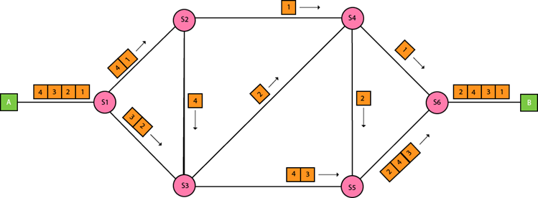
School of Computing Science and Engineering
Course Code: BCSE2370 Course Name: Data Communication & Networking
Packet Switching:
Faculty Name: Shilpy Gupta Program Name: B.Tech CSE

Slide 19
School of Computing Science and Engineering
Course Code: BCSE2370 Course Name: Data Communication & Networking
Packet Switching:
There are two approaches to Packet Switching:
Datagram Packet switching
Virtual Circuit Switching
Faculty Name: Shilpy Gupta Program Name: B.Tech CSE

Slide 20
School of Computing Science and Engineering
Course Code: BCSE2370 Course Name: Data Communication & Networking
Packet Switching: Datagram
Datagram packet switching is similar to message switching in that each packet is a self-contained unit with complete addressing information attached.
This fact allows packets to take a variety of possible paths through the network.
So the packets, each with the same destination address, do not follow the same route, and they may arrive out of sequence at the exit point node (or the destination).
Reordering is done at the destination point based on the sequence number of the packets.
It is possible for a packet to be destroyed if one of the nodes on its way is crashed momentarily. Thus all its queued packets may be lost.
Faculty Name: Shilpy Gupta Program Name: B.Tech CSE

Slide 21
School of Computing Science and Engineering
Course Code: BCSE2370 Course Name: Data Communication & Networking
Packet Switching: Virtual Circuit
In the virtual circuit approach, a preplanned route is established before any data packets are sent.
A logical connection is established when a sender send a "call request packet" to the receiver and the receiver send back an acknowledge packet "call accepted packet" to the sender if the receiver agrees on conversational parameters.
The conversational parameters can be maximum packet sizes, path to be taken, and other variables necessary to establish and maintain the conversation.
Virtual circuits imply acknowledgements, flow control, and error control, so virtual circuits are reliable.
That is, they have the capability to inform upper-protocol layers if a transmission problem occurs.
Faculty Name: Shilpy Gupta Program Name: B.Tech CSE

Slide 22
School of Computing Science and Engineering
Course Code: BCSE2370 Course Name: Data Communication & Networking
Packet Switching: Virtual Circuit
In virtual circuit, the route between stations does not mean that this is a dedicated path, as in circuit switching.
A packet is still buffered at each node and queued for output over a line.
The difference between virtual circuit and datagram approaches:
With virtual circuit, the node does not need to make a routing decision for each packet.
It is made only once for all packets using that virtual circuit.
Faculty Name: Shilpy Gupta Program Name: B.Tech CSE

Slide 23
School of Computing Science and Engineering
Course Code: BCSE2370 Course Name: Data Communication & Networking
Packet Switching: Virtual Circuit
VC's offer guarantees that
the packets sent arrive in the order sent
with no duplicates or omissions
with no errors (with high probability)
regardless of how they are implemented internally.
Faculty Name: Shilpy Gupta Program Name: B.Tech CSE

Slide 24
School of Computing Science and Engineering
Course Code: BCSE2370 Course Name: Data Communication & Networking
Packet Switching: Advantages
Packet switching is cost effective, because switching devices do not need massive amount of secondary storage.
Packet switching offers improved delay characteristics, because there are no long messages in the queue (maximum packet size is fixed).
Packet can be rerouted if there is any problem, such as, busy or disabled links.
The advantage of packet switching is that many network users can share the same channel at the same time. Packet switching can maximize link efficiency by making optimal use of link bandwidth.
Faculty Name: Shilpy Gupta Program Name: B.Tech CSE

Slide 25
School of Computing Science and Engineering
Course Code: BCSE2370 Course Name: Data Communication & Networking
Packet Switching: Disadvantages
Protocols for packet switching are typically more complex.
It can add some initial costs in implementation.
If packet is lost, sender needs to retransmit the data.
Another disadvantage is that packet-switched systems still
can’t deliver the same quality as dedicated circuits in
applications requiring very little delay - like voice
conversations or moving images.
Faculty Name: Shilpy Gupta Program Name: B.Tech CSE

Slide 26
School of Computing Science and Engineering
Course Code: BCSE2370 Course Name: Data Communication & Networking
THANK YOU
Faculty Name: Shilpy Gupta Program Name: B.Tech CSE

