Slide 1
Tower of Hanoi

Slide 2
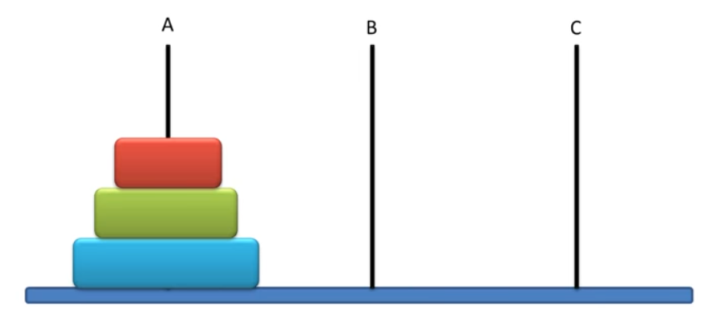
Introduction
Tower of Hanoi is a very famous game.
In this game there are 3 pegs and N number of disks placed one over the other in decreasing size. The objective of this game is to move the disks one by one from the first peg to the last peg. And there is only ONE condition, we can not place a bigger disk on top of a smaller disk.

Slide 3
Notation followed
In order to solve we will use a general notation:
T(N, Beg, Aux, End)
T denotes our procedure N denotes the number of disks Beg is the initial peg Aux is the auxiliary peg End is the final peg
Therefore for our example:
Objective is:
T(3,A,B,C)

Slide 4
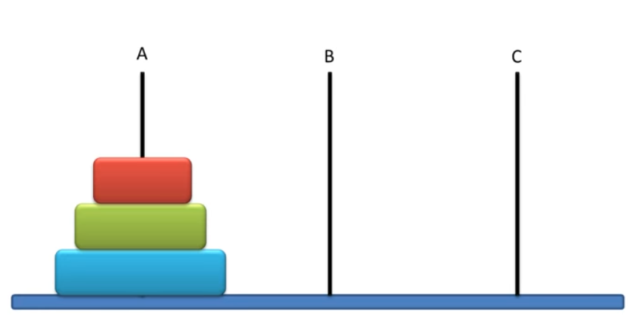
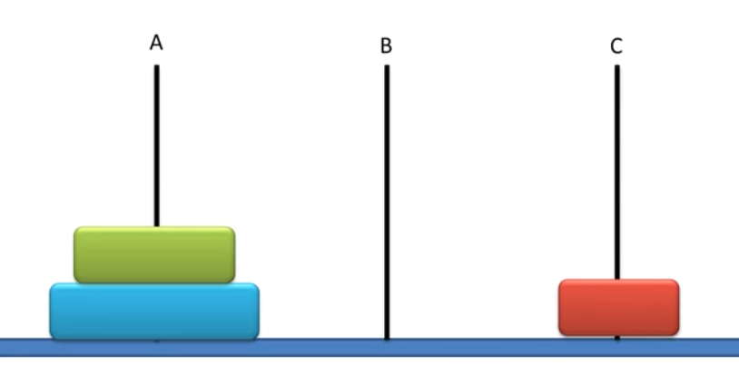
Recursive Approach
Base Case:
T(1,Beg, Aux, End) : Move 1 disk from Beg to End peg. (Beg -> End)
For example:
T(1,A,B,C) : Move 1 disk from Beg (i.e. A) to End (i.e. C) peg. (A->C)

Slide 5
Try the solve Tower Hanoi Problem for N=2
Solve for T(2,A,B,C) ?

Slide 6
Steps to solve Tower of Hanoi Problem for N=2
T(2,A,B,C)
{
T(1,A,C,B) : Move a disk (A->B)
T(1,A,B,C) : Move a disk (A ->C)
T(1,B,A,C) : Move a disk (B->C)
}

Slide 7
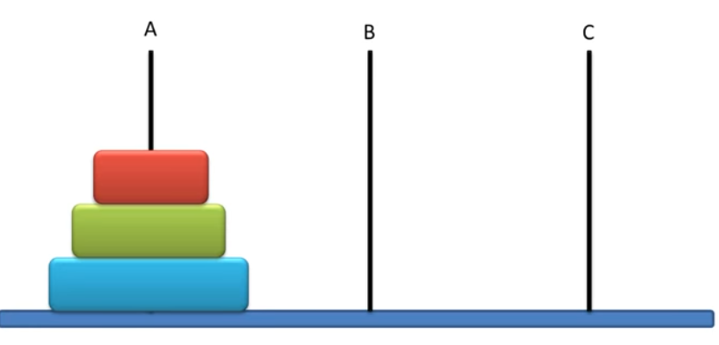
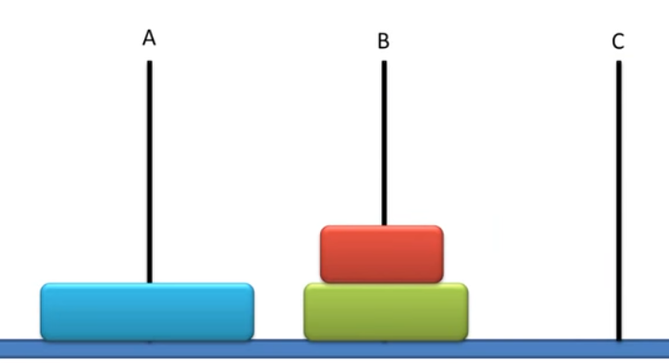
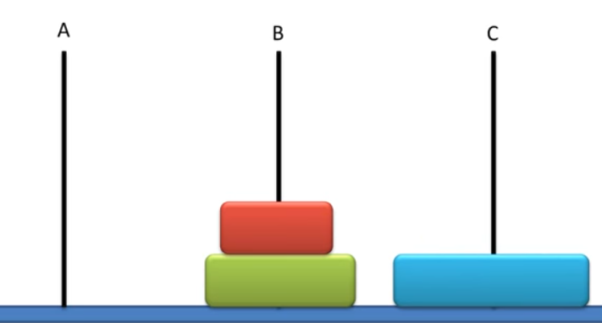
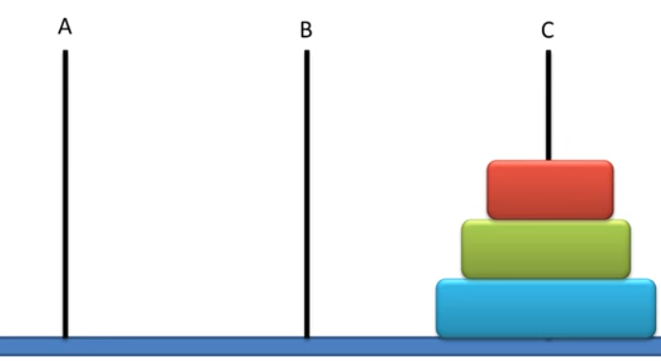
Recursive Steps
T(N, Beg, Aux, End)
{
T(N-1, Beg, End, Aux) : Move top (N-1) disks from Beg to Aux peg.
T(1, Beg, Aux, End) : Move 1 disk from Beg to End peg. (Beg -> End)
T(N-1, Aux, Beg, End) : Move top (N-1) disks from Aux to End peg.
}
Result after T(N-1, Beg, End, Aux) T(1, Beg, Aux, End) T(N-1, Aux, Beg, End)

Slide 8
Solution for N=3:
T(3,A,B,C)
{
T(2,A,C,B) Move top 2 disks from A to B peg.
T(1,A,B,C) Move 1 disk from A to C peg. (A->C)
T(2,B,A,C) Move top 2 disks from B to C peg.
}
Result after: T(2,A,C,B) T(1,A,B,C) T(2,B,A,C)

Slide 9
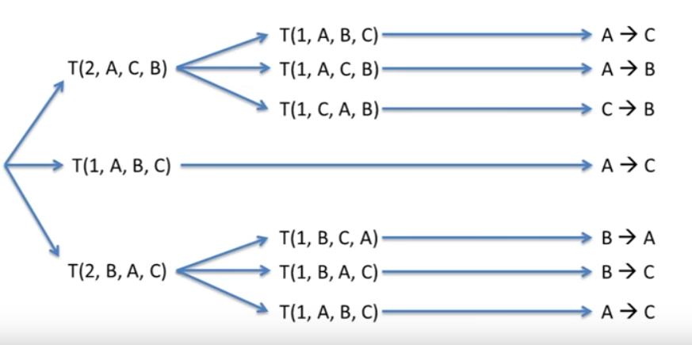
Unfolding the recursion of Tower of Hanoi for N=3 T(3,A,B,C)

Slide 10
Time Complexity
Calculate the number of Moves required for various values of N
For N=2, Number of Moves = 3
For N=3, Number of Moves = 7
For N=4, Number of Moves = 15
For N=5, Number of Moves = ???

Slide 11
Time Complexity
In general for N disks, the number of moves needed = (2^N) – 1
Hence time complexity is O(2^N)

Slide 12
References
https://www.dyclassroom.com/recursion-algorithm/tower-of-hanoi

