Slide 1

SENTIMENT ANALYSIS
Presented By:-
Shivam, Suneetha, Reema, Saheb

Slide 2
About me
Proactive Data Science trainee passionate about leveraging data to derive insights and solve complex problems. Proficient in Python with foundational knowledge in machine learning, deep learning, object detection, and data analysis techniques. Eager to apply skills to real-world projects and support data-driven decision-making. Skilled in using GitHub for version control and collaboration, demonstrating adherence to best practices. Competent in Microsoft Office Suite, facilitating effective communication and data presentation.

Slide 3
Agenda
Business Problem
Objective: To analyze and understand public sentiment towards various topics on Twitter by classifying tweets into positive, neutral, and negative sentiments.
Use Case: Sentiment analysis can help businesses monitor customer opinions, track brand reputation, and make informed decisions based on public feedback.
Business Problem and Use Case Domain Understanding Domain
Social Media Sentiment Analysis

Slide 4
Objective of the Project
The primary objective is to build a robust machine learning model to classify tweets into positive, neutral, and negative sentiments. This involves preprocessing the data, building and tuning an LSTM model, and deriving insights from the analysis to help stakeholders understand public sentiment trends.

Slide 5
Summary of the Data Dataset
Columns: target, ids, date, flag, user, text
Target: Sentiment labels (0 and 4) representing negative and positive sentiments.
Text: Actual tweet content.
Date: Timestamp of the tweet.
User: User who posted the tweet.
Flag: Non-informative column (constant value).

Slide 6
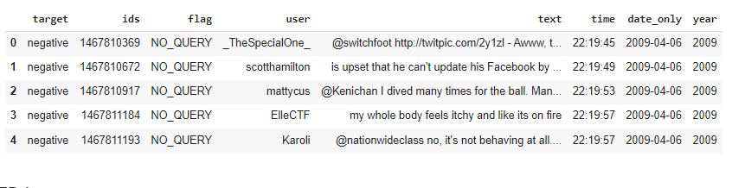
Exploratory Data Analysis
Data Cleaning Steps
Column Renaming:
Renamed columns for better readability.,Example: date to date_only, text to tweet_text.
Target Mapping:
Mapped target values: 0 to negative, 4 to positive.
Date Parsing:
Parsed date column to extract date_only, time, and year.
Dropped Irrelevant Columns:
Dropped the flag column as it contained a single constant value.

Slide 7
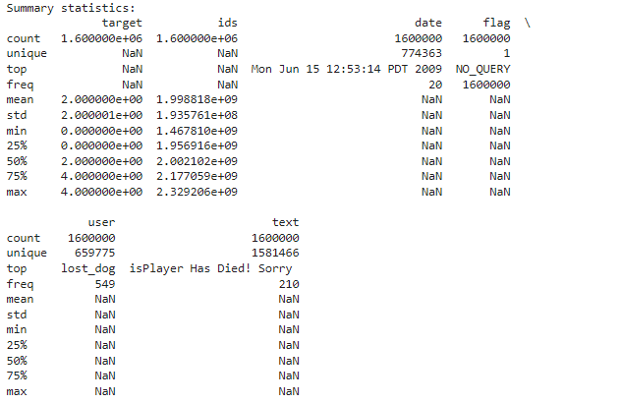
Exploratory Data Analysis
Data Manipulation Steps
Tokenization:
Converted tweet text into sequences of tokens using Keras Tokenizer.
Padding:
Padded sequences to a fixed length (300) for consistent input to the model.
Label Encoding:
Encoded target labels into numerical values for model training.

Slide 8
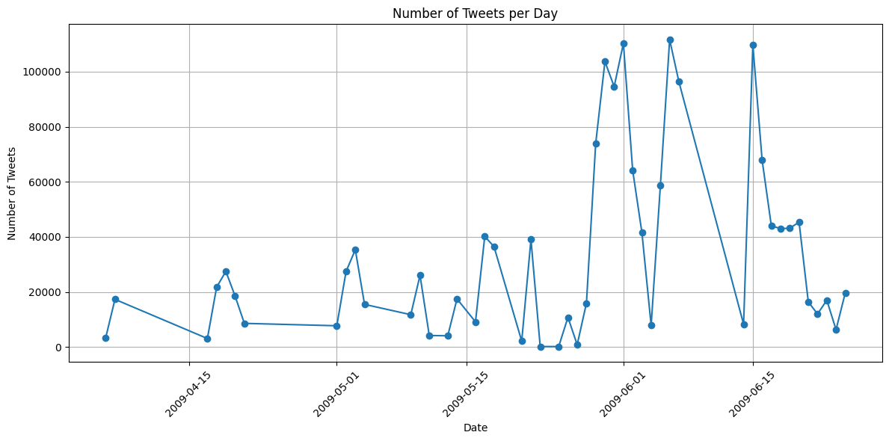
Exploratory Data Analysis
Univariate Analysis Steps
Class Distribution:
Plotted the distribution of sentiment classes to check for balance.
Tweet Frequency by Date:
Analyzed the number of tweets per day to identify peak activity periods.

Slide 9
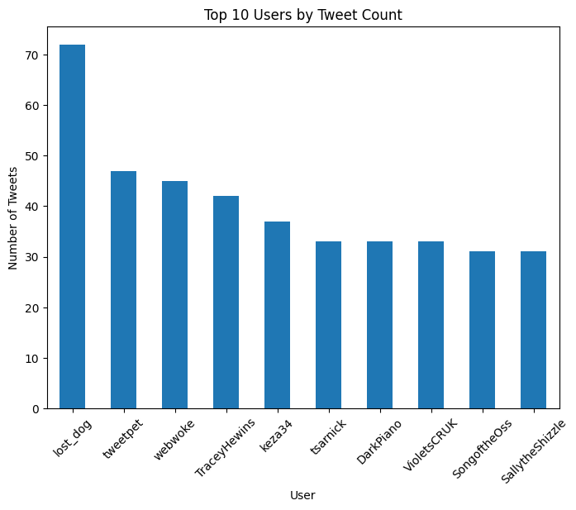
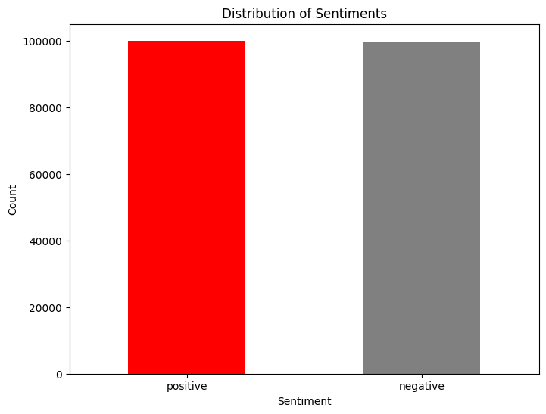
Exploratory Data Analysis
Bivariate Analysis Steps
Sentiment by Date:
Examined sentiment trends over time to understand how sentiment varies by date.
Sentiment by User:
Analyzed the distribution of sentiments by user to identify any significant patterns.

Slide 10
Key Business Question
How does public sentiment towards various topics on Twitter fluctuate over time, and what are the primary factors influencing these trends?
Conclusion (Key Findings Overall)
Data Quality:
Cleaned and preprocessed data, including handling date-time formats and dropping irrelevant columns.
Sentiment Distribution:
Identified potential class imbalance, with more tweets labeled as negative than positive.
Peak Activity:
Found certain days with higher tweet activity, indicating potential events or news driving public engagement.
Model Performance:
Built and tuned an LSTM model, achieving good accuracy in classifying tweet sentiments.
Future Improvements:
Addressing class imbalance, exploring advanced embeddings, and using cross-validation could further improve model performance.

Slide 11
Q&A Slide
What is the purpose of this sentiment analysis project?
To classify tweets into sentiments to understand public opinion trends.
How was the data collected?
For this project, a pre-collected dataset was used. In practice, tools like Twitter API can be used for data collection.
What preprocessing steps were taken?
Data cleaning, tokenization, padding, and label encoding.
What model was used for sentiment analysis?
An LSTM model with hyperparameter tuning using Keras Tuner.
What were the key findings?
Discovered class imbalances and peak tweet days, built a performant LSTM model.

Slide 12
Challenges:
Handling imbalanced data which can affect model performance.
Parsing complex date-time formats and extracting meaningful features.
Ensuring consistent and accurate preprocessing steps to avoid errors in subsequent analysis
Experience:
Gained hands-on experience in data preprocessing, exploratory data analysis, and building machine learning models.
Learned to use tools like Keras Tuner for hyperparameter optimization.

Slide 13
Final Conclusion
After extensive data preprocessing, exploratory analysis, text processing, and model building with hyperparameter tuning, the LSTM model achieved satisfactory performance in classifying tweets into positive and negative sentiments

Slide 14
Recommendations for Future Work:
Addressing Class Imbalance: Implement techniques like class weighting or resampling to handle class imbalance.
Advanced Embeddings: Experiment with more advanced embeddings (e.g., BERT, GloVe) to capture richer text semantics.
Model Complexity: Explore more complex architectures or hybrid models to further improve performance.
Cross-Validation: Use cross-validation to ensure robustness and generalizability of the model.

Slide 16

THANK YOU

