Slide 1

IT SUPPORT PERFORMANCE DASHBOARD
Data-Driven Analysis of IT Support Operations (97k+ Tickets)
Shivam Gupta | Newton School Project | March 2026

Slide 2
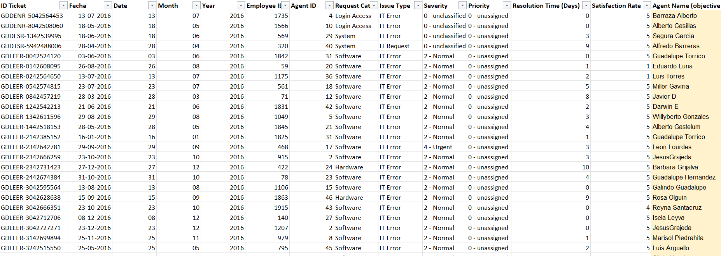
Problem Statement
The purpose of this analysis is to evaluate the IT support ticket management system in order to measure agent performance, resolution efficiency, and employee satisfaction levels. The study aims to identify top and underperforming IT agents, examine the overall effectiveness of the support team, and highlight areas where the ticket resolution process can be improved. Ultimately, the objective is to support data-driven staffing decisions—such as hiring, termination, and training—to improve service quality and enhance overall team performance.

Slide 3
Data overview
This analysis is conducted using a dataset of 97,498 IT support tickets obtained from an internal service management system to assess help desk performance and uncover important patterns and trends.
The dataset is organized into two primary files: a Tickets Sheet, which contains detailed records of all support requests, and an IT Agents Sheet, which provides information about the support staff.
Key performance indicators (KPIs) include Resolution Time, with an average of 4.55 days, and Employee Satisfaction, measured on a scale from 4.10/5.
The help desk handles a steady volume of work, receiving approximately 53 new tickets per day on average.
Each ticket is classified by Request Category (such as Login Access or System), along with Issue Type, Severity, and Priority, enabling a comprehensive analysis of support requirements.
By connecting the ticket records with agent information through the Agent ID, it becomes possible to evaluate performance metrics at the individual agent level, as well as analyze trends based on agent demographics.

Slide 4
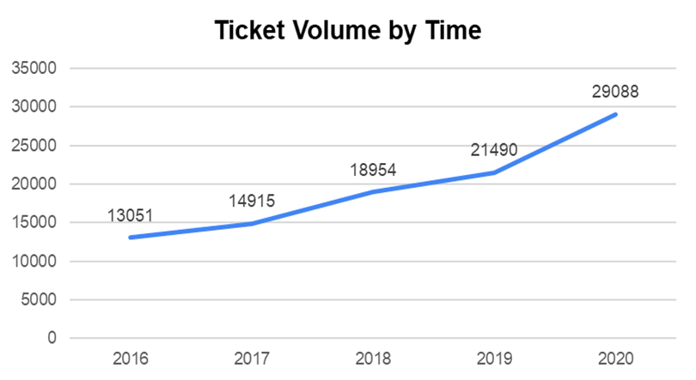
Ticket Volume Trend
Key Insights:
Ticket volume increased from 13,051 in 2016 to 29,088 in 2020
This represents a 123% growth over five years
Sharpest rise observed between 2019 and 2020

Slide 5
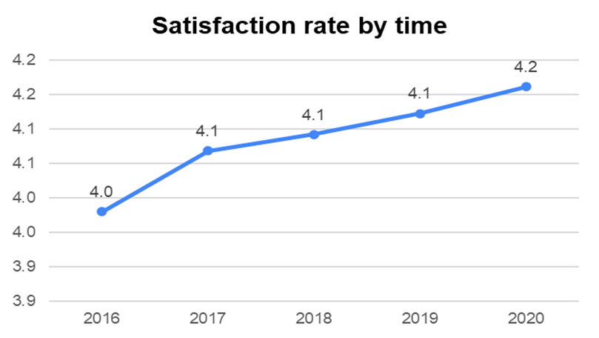
Satisfaction Rate Trend
Key Insights:
Customer satisfaction improved from 4.0 in 2016 to 4.2 in 2020
Improvement remained steady despite rising ticket volume
Shows consistent service quality under increasing workload

Slide 6
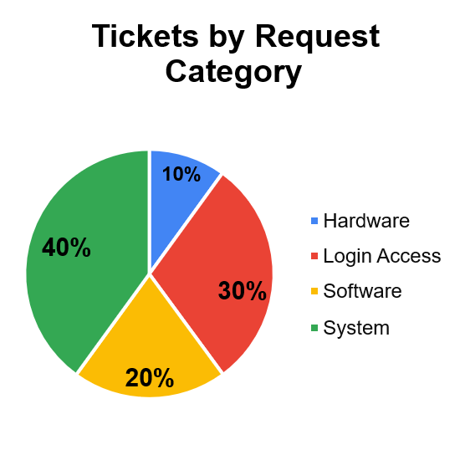
Ticket Distribution by Category
Key Insights:
System and Login Access together account for 70% of total tickets
Hardware contributes only 10% of the volume
These two categories drive most of the helpdesk workload

Slide 7
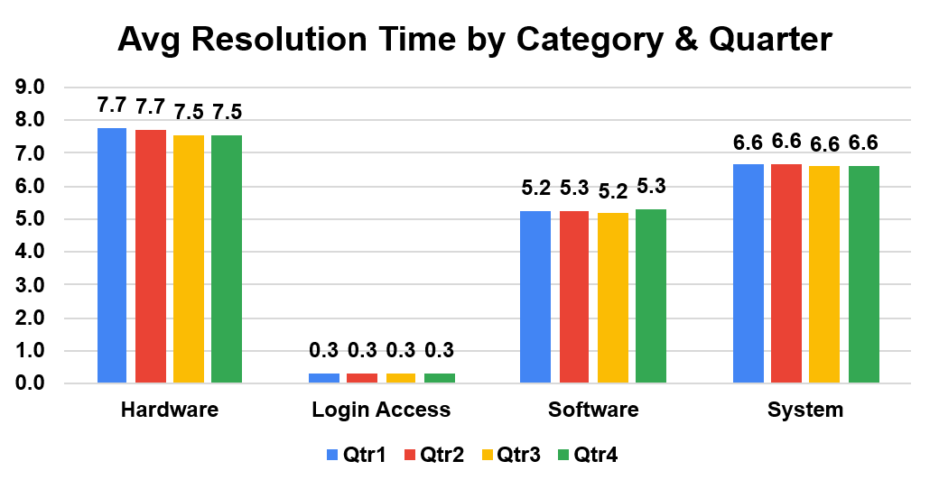
Resolution Time by Category
Key Insights:
Hardware takes the longest time (average 7.63 days)
System category also shows high resolution time (6.62 days)
Login Access is resolved fastest (0.31 days)

Slide 8
Severity Distribution
Key Insights:
91% of tickets are of Normal severity
Major and Urgent tickets are fewer but critical
Majority of workload is routine in nature
Tickets by Severity
4 - Urgent
1392
3 - Major
4836
2 - Normal
88656
1 - Minor
2258
0 - Unclasified
356
0
20000
40000
60000
80000
100000

Slide 9
Satisfaction Score Distribution
Key Insights:
50,770 tickets received the highest rating of 5/5
Approximately 19,166 tickets received low ratings (1–3)
Indicates a consistency gap in service delivery
Distribution by Satisfaction
Score (1
–
5)
60000
50770
50000
40000
30000
27562
20000
9907
7282
10000
1977
0
1
2
3
4
5

Slide 10
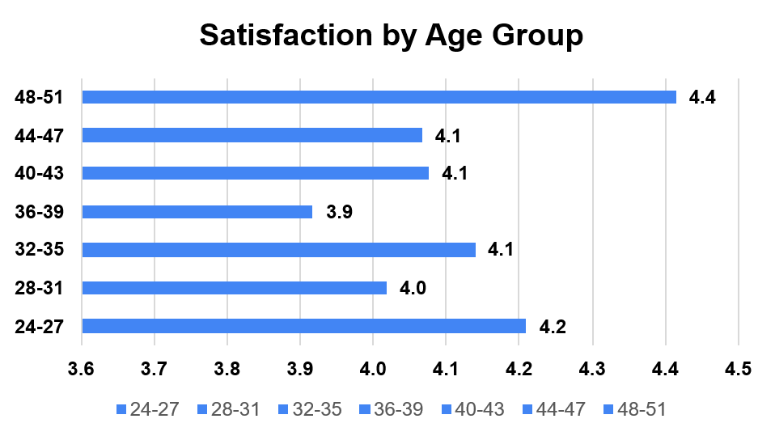
Agent Age Group Satisfaction
Key Insights:
24–27 age group shows highest satisfaction (4.4)
Middle age groups (36–43) have comparatively lower satisfaction
Performance varies significantly across age groups

Slide 11
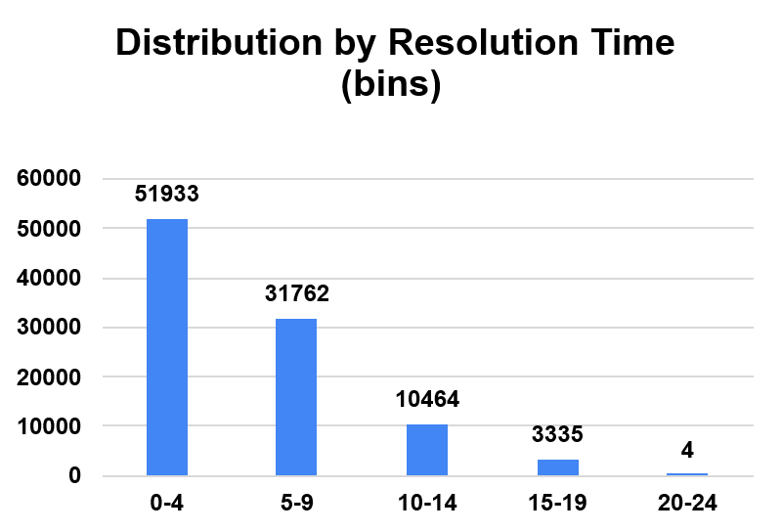
Resolution Time Distribution
Key Insights:
Majority of tickets are resolved within 0–9 days
A smaller portion takes longer than 10 days
Shows good operational efficiency for routine tickets

Slide 12
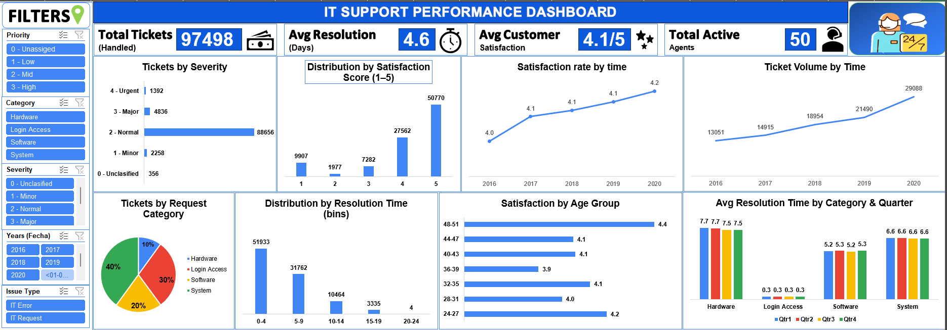
DASHBOARD

Slide 13
Recommended Action Plan
Primary Recommendation:
Upgrade the Ticket Management System. - Automate workflows & priority-severity alignment. - Reduce resolution time in Hardware (7.63 days) & System (6.62 days). - Highest long-term ROI — foundation for all improvements.
Secondary Recommendations:
1. Targeted Training Programs: - Focus on underperforming agents (high resolution time & low satisfaction). - Share best practices from top agents. - Improve speed & customer satisfaction. 2. Hire Additional Agents :
- Only if ticket volume keeps growing after software upgrade. - Reduce workload stress & maintain service quality.
Software Upgrade First → Training → Hiring (Highest ROI)

Slide 14
Conclusion
Key Insights presented step by step:
Step 1: Workload Management
Ticket volume nearly doubled from 13,051 (2016) to 29,088 (2020) — a 123% increase. Despite this rapid growth, the team kept average resolution time stable at 4.55 days — strong workload handling capability.
Step 2: Service Quality Performance
Overall service quality remains high, with a majority of tickets rated 5/5 (50,770 tickets).This shows the team consistently delivers excellent support in most cases.
Step 3: Service Consistency Gap
Around 19,166 tickets received low ratings (1–3), even with high average satisfaction (4.10/5).This highlights a small inconsistency in service delivery that needs standardization.
Step 4: Operational Bottlenecks
Hardware (7.63 days) & System (6.62 days) are main delays — primary contributors to longer resolution times. Login Access remains fastest (0.31 days) — clear contrast in process efficiency.
Upgrade Software + Targeted Training = Best Path to Higher Efficiency & Satisfaction Interactive Filters Used: Year, Priority, Severity, Issue Type, Request Category

