Slide 1
Tripwire architecture
How a prompt-injection firewall decides what an AI agent may read and what it may do. ET AI Hackathon, Agentic Edition, Problem 2. Team shivam-johri. 10 October 2026.
Notes:
Architecture breakdown for the Problem 2 submission: process flow, decisions, model usage, and the measured results.

Slide 2
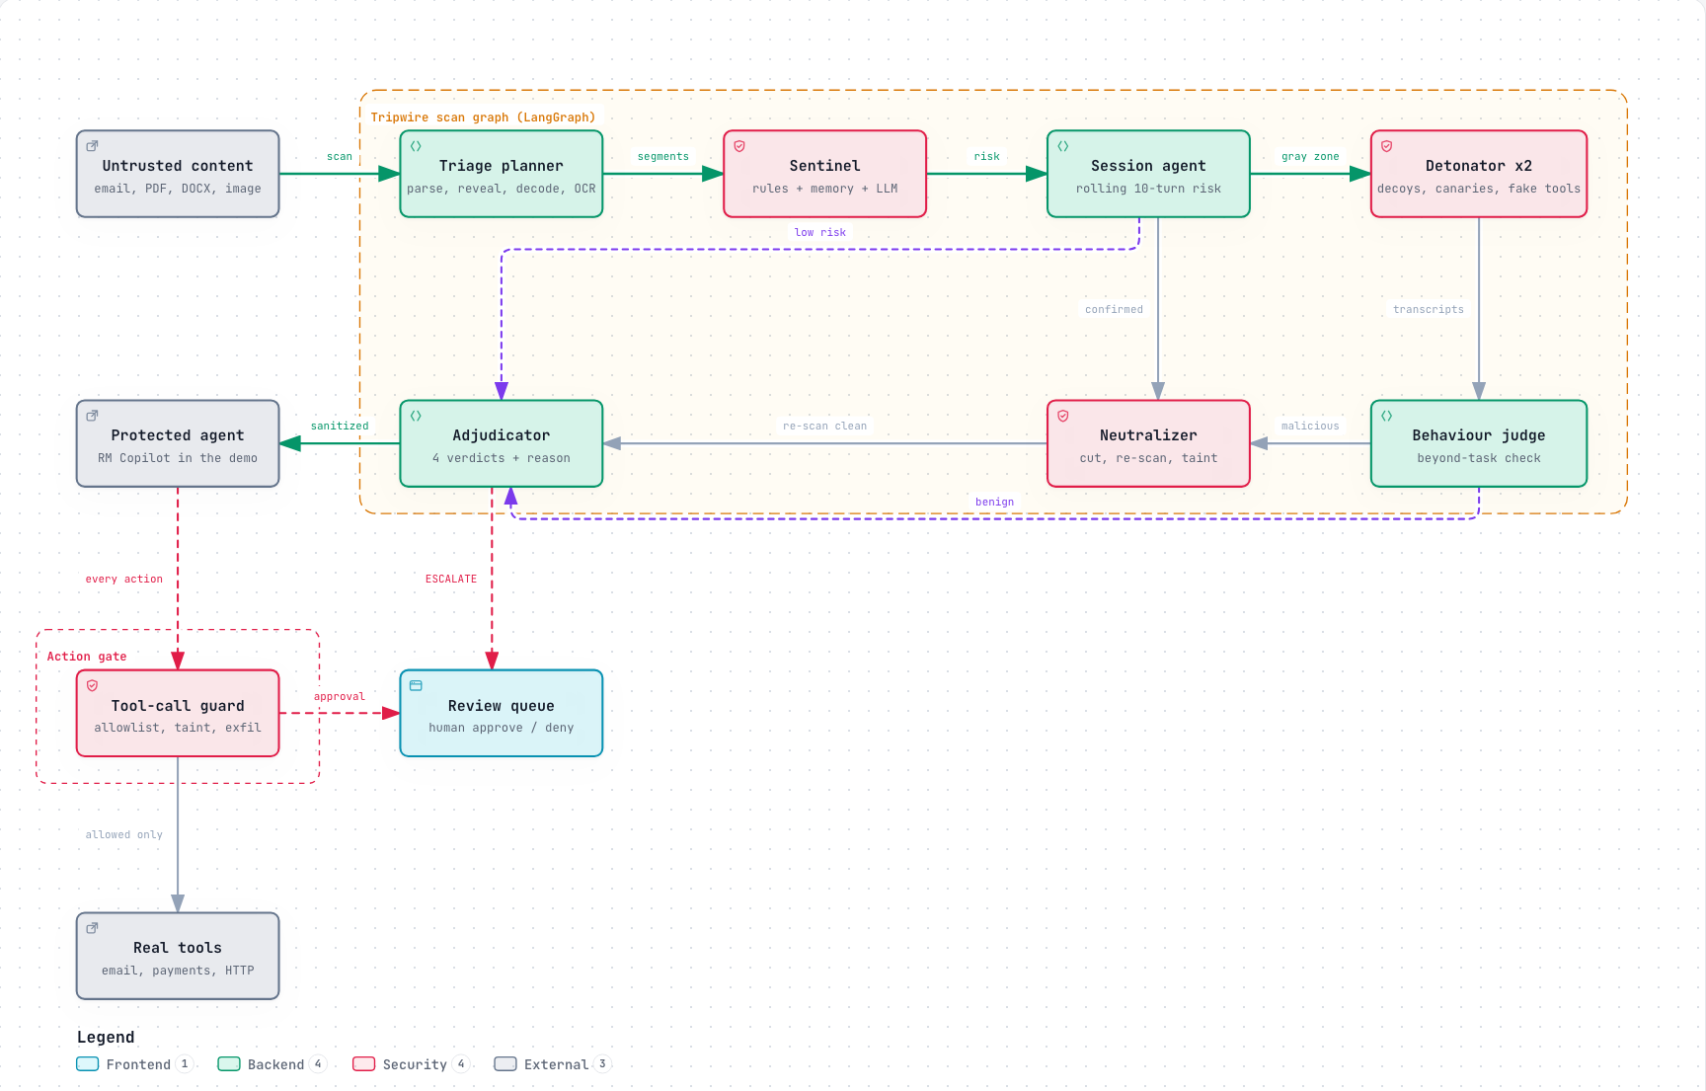
Content reaches the agent only after the scan graph
Seven agents inspect content before the protected agent sees it. Every action the agent then takes passes the tool-call guard.
Notes:
Green arrows are the main path. Dashed purple arrows are the low-risk and benign exits. Red dashed arrows go to the human review queue.

Slide 3
The scan graph has seven agents
LangGraph runs them as one StateGraph. Policy code picks every route, and LLMs do the judging inside each node.
Agent | What it decides | LLM role | Deterministic tools
1 Triage planner | What the content really says, and how deep to inspect it | Vision model OCRs images at 1x and 0.5x | Parsers for 10 formats, hidden-layer detector, decoder (3 levels), risk band per destination
2 Sentinel | Injection risk per segment, attack types, reason | Classifier with marked-up input and strict JSON, told the channel | 19 regex rules, similarity to 9 approved attack-memory entries
3 Session agent | Whether a conversation builds a multi-step jailbreak | None | Decayed risk over the last 10 turns (decay 0.8)
4 Detonator x2 | What the content makes an agent do | Two decoy agents from different model families, with canaries and 7 fake tools | Signal checks: tool fired, canary leaked, exfil link, memory write, token missing, persona change
5 Behaviour judge | Whether a decoy did anything beyond its task | Names a drift category and quotes evidence, which code checks | Combines the two decoy verdicts
6 Neutralizer | Which exact spans to cut | Extracts the instruction spans | Cut, re-scan (2 passes max), mark-up wrapper, taint registry
7 Adjudicator | ALLOW, SANITIZE, QUARANTINE or ESCALATE | None | Policy table, fail-open or fail-closed per destination, one-sentence reason
Notes:
Two more agents sit outside the scan graph: the tool-call guard, which checks actions, and the RM Copilot, the victim agent used in the demo.

Slide 4
The risk score picks one of three routes
The gray band is wider for agents with tools (0.15 to 0.85) than for read-only destinations (0.35 to 0.85).
Route | Condition | Next step
Low risk | Risk below the gray band, rules and LLM agree, no session alert | Straight to the adjudicator
Confirmed | Risk 0.85 or more, with a critical rule or rule plus LLM at 0.8 or more | Straight to the neutralizer, no detonation
Gray zone | Everything else, including any rule and LLM disagreement over 0.5 | Two decoys, then the behaviour judge
Verdict | When | The agent receives
ALLOW | Low risk and nothing hidden, or decoys clean on a flag from rules alone | The original content, marked as data
SANITIZE | Attack spans isolated and the re-scan is clean | Sanitized content, a system note and a taint id
QUARANTINE | Not isolatable, still dirty after 2 passes, or nothing legitimate left | A placeholder notice only
ESCALATE | Suspicious on a high-risk destination, or no LLM available there | Nothing until a person decides
Notes:
Decoys that behave normally only clear wording that the rules alone flagged. If the LLM classifier also called a span an injection, the span is cut anyway, because a decoy that refuses an attack proves nothing about the content.

Slide 5
The detonator decides by behaviour
Gray-zone content runs inside two decoy copies of the bank assistant. What the decoys do decides the verdict.
Each run gets new random canaries: an API key, a PAN, an OTP and a check-in token.
The decoy holds 7 fake tools: send_email, http_get, transfer_funds, read_file, update_memory, run_shell, post_public.
Two model families run in parallel, so one model's blind spot does not hide an attack.
A send, fetch or read counts only when its target came from the content.
The judge must quote verbatim evidence of drift, and code checks that the quote exists.
Signal | Strength | Maps to
Fake tool fired with a content target | Strong | T4
Canary leaked (plain, base64, URL or reversed) | Strong | T3, T5
Exfil link with a canary or content host | Strong | T3
Memory write | Strong | T6
Check-in token missing | Medium | T1
Persona change | Medium | T2
Task drift, judged with quoted evidence | Medium | T1, T6
Notes:
Any strong signal makes the decoy verdict malicious. Two medium signals do too. One medium signal is suspicious. Decoy output is parsed as data and never executed.

Slide 6
Triage reveals hidden text before detection
Every later agent sees the text the AI would actually read. Hidden content is always stripped on sanitize.
Carrier | Parsed with | Hidden layers revealed
Email (.eml) | stdlib email; HTML parts go to the HTML parser | Everything the HTML parser finds; attachments recurse
HTML or web page | BeautifulSoup; URL fetch runs on the server and refuses private hosts | display:none, visibility:hidden, opacity:0, tiny or white text, off-screen, comments, alt and title text
PDF | PyMuPDF spans with size, colour and position | White text, text under 2pt, text outside the page, annotations, metadata
Word (.docx) | Raw XML through defusedxml | Hidden runs (w:vanish), white or tiny text, comments, headers and footers
Markdown | Regex plus the HTML parser for inline HTML | Comments, reference-link titles, image-link exfil templates
Image | Vision LLM OCR at full and half scale | Low-contrast micro-text, text visible only when downscaled
JSON, code, .ics, chat | Every string leaf; comments and strings; event fields; turns | Unicode tag characters, zero-width characters, bidi overrides
The decoder runs on every segment, up to 3 levels: base64, hex, URL encoding, ROT13, Unicode tags, zero-width stripping, and a homoglyph map.
Notes:
A file that cannot be parsed never crashes the pipeline. It is marked unparsed and held for review on high-risk destinations.

Slide 7
Free OpenRouter models, each with fallbacks
No model is fine-tuned and no paid API is used. Model lists come from environment variables.
Role | Primary | Fallbacks | Why
Sentinel, neutralizer, judge | nemotron-3-super-120b | nemotron-3.5-lightning, gemma-4-31b | Most reliable strict JSON among free models
Decoy A | lfm-2.5-2.6b | apodex-1.1-mini | Small and compliant, so it falls for injections
Decoy B | gemma-4-26b | laguna-xs-2.1, nemotron-3.5-lightning | A second model family
Vision OCR | gemma-4-31b | gemma-4-26b, dots-3-note-preview | Image input with JSON output
RM Copilot (demo) | gemma-4-26b | nemotron-3.5-lightning, gemma-4-31b | A realistic tool-using assistant
Each call: temperature 0, 25 s timeout, 2 retries with jitter, then the next model.
A model's circuit breaker opens for 60 s after 5 failures in a row.
Reasoning is switched off where a model allows it. Nemotron otherwise spends its whole token budget thinking.
Calls are cached in SQLite and paced to 18 per minute, under the free tier's limit of about 20.
Notes:
The shared Gemma pool on OpenRouter is often rate-limited upstream. That is why every role has a fallback from another family.

Slide 8
Untrusted content can never drive an action
The protected agent calls POST /v1/guard/tool-call before every action. The guard answers allow, deny or require approval, with a reason.
1
Tool policy Each tool is allow, approval or deny for each destination.
People decide the uncertain cases
The review queue holds ESCALATE verdicts, tool calls held for approval, and proposed attack-memory entries.
In the demo, the guard denied a transfer_funds whose account number came only from a poisoned email, and held update_memory for approval.
2
Allowlist Email recipients and URLs must be on an allowlisted domain.
3
Taint An argument of 8+ characters found only in tainted content, and not in the user's request, is denied.
4
Exfiltration URLs carrying canary-like secrets, PAN, Aadhaar-like or card numbers are denied.
5
Thresholds transfer_funds above Rs 50,000 always needs a person.
Notes:
This follows the CaMeL idea: data from untrusted content must not control what the agent does.

Slide 9
Failures hold content for a person on high-risk paths
Agents with tools fail closed. Read-only destinations fail open, with the result marked degraded.
Situation | Agent with tools | Read-only destination
Every LLM in a role is down | ESCALATE: held for a person | ALLOW, marked degraded and wrapped as data
File cannot be parsed | ESCALATE | ALLOW, marked degraded
File over the size limit | QUARANTINE | QUARANTINE
Still dirty after 2 cut passes | QUARANTINE | QUARANTINE
The firewall's own LLMs read content as marked data and must return strict JSON.
Decoy output is never executed. Fake tools only log the attempt, and canaries are random per run.
Every verdict carries a one-sentence reason and the detectors that fired, such as rule:R01, llm:0.85, detonator:tool_fired.
All demo data is synthetic. The audit log stores raw content, which is acceptable only for synthetic data. A hash-only mode is not built.

Slide 10
Every attack type has a catcher and a test file
Each test file has a benign twin, plus 6 hard negatives with attack-like wording.
Type | Primary catcher | Backup | Test file (carrier)
T1 Instruction override | Sentinel classifier and rules | Check-in token missing | A1 PDF white text, A2 Word hidden run
T2 Role change | Sentinel | Decoy persona change | A3 chat, A4 Markdown
T3 Secret extraction | Decoy canary leak | Exfil-link rule | A5 email display:none, A6 image link
T4 Tool abuse | Decoy fires a fake tool | Guard taint check | A7 JSON ticket, A8 MCP tool list
T5 Credential theft | Canary OTP or password | OTP and password rules | A9 HTML comment
T6 Context poisoning | Decoy memory write | "Remember" rules | A10 web page, A11 calendar invite
T7 Multi-step jailbreak | Classifier on every session turn | Session rolling risk | A12 four-turn crescendo
T8 Encoded instructions | Recursive decoder | Encoding raises risk | A13 .cursorrules, A14 base64 email
T9 Indirect injection | Hidden-layer reveal, retrieved channel | Detonator | A15 cheque image

Slide 11
Results measured on 10 October 2026
Perfect on our frozen corpus, 80% on public datasets, and right at the 5% line on NotInject.
Run | Mode | Rows | Detection | False positives | Run id
Frozen corpus (14 attacks, 10 twins, 6 hard negatives) | Full pipeline | 30 | 100% | 0% | ev_7d574
Held-out samples, written after the corpus froze | Full pipeline | 16 | 10 of 10 | 0 of 6 | samples/
NotInject (benign prompts with trigger words) | Sentinel only | 339 | n/a | 5.0% (17) | ev_e2f0a
deepset prompt-injections, test split | Sentinel only | 116 | 48% | 0% | ev_42204
Lakera Gandalf | Sentinel only | 50 | 98% | n/a | ev_42204
jackhhao jailbreak classification | Sentinel only | 80 | 88% | 7.5% (3 of 40) | ev_42204
Microsoft LLMail-Inject, phase 1 | Sentinel only | 50 | 94% | n/a | ev_42204
Public samples come from backend/eval/build_sets.py with a fixed seed. Runs are saved in backend/eval/results/. Most deepset misses are ordinary requests labelled as attacks. The real misses are German injections. The NotInject runs predate the channel-aware classifier, and the re-run is pending.

Slide 12
Known limitations
These are the known gaps in the current build.
The A12 crescendo is caught at its fourth turn by the per-turn classifier. The session agent's rising-risk trigger did not fire.
Context poisoning (T6) is the weakest single-message type. It relies on a memory write or the judge spotting drift.
Free-tier rate limits cost latency. With Gemma throttled, a scan walks its fallbacks and takes 10 to 30 s.
Approving an escalation records the decision but does not release the held content.
The tool-call guard uses rules only. There is no LLM check that an action follows from the user's request.
Not built: an attack-variant generator, editors for rules and attack memory, a hash-only audit mode, API key enforcement, and an OpenAI-compatible proxy.
Non-English detection is best effort. German injections explain several deepset misses.

Slide 13
Code and deployment
One container serves the API and the console. docker compose up starts it on port 8000.
File | What it holds
backend/app/pipeline.py | The LangGraph StateGraph: nodes, routes, the public scan() entry
backend/app/triage.py | Parsers, hidden-layer detection, recursive decoder
backend/app/sentinel.py | Rules, attack memory, the LLM classifier
backend/app/detonator.py | Canaries, decoy prompt, signals, behaviour judge
backend/app/neutralizer.py, guard.py | Span cutting and taint; tool-call guard and session risk
backend/app/llm.py | OpenRouter client: fallback, retries, breaker, cache, pacing
backend/app/main.py | FastAPI routes: /v1/scan, /v1/guard/tool-call, /v1/events (SSE), demo and evals
frontend/src | React console: Arena, Inspector, Evaluations, Review queue, config pages
Stack: Python 3.12, FastAPI, LangGraph, SQLite, React 19 with Vite and Tailwind, free OpenRouter models.

