Slide 1
Adidas Sales Dashboard Summary
Generated by ChatGPT

Slide 2
Key Metrics Overview
Total Sales: $119,996,275
Total Units Sold: 2,475,611
Total Operating Profit: $33,158,084

Slide 3
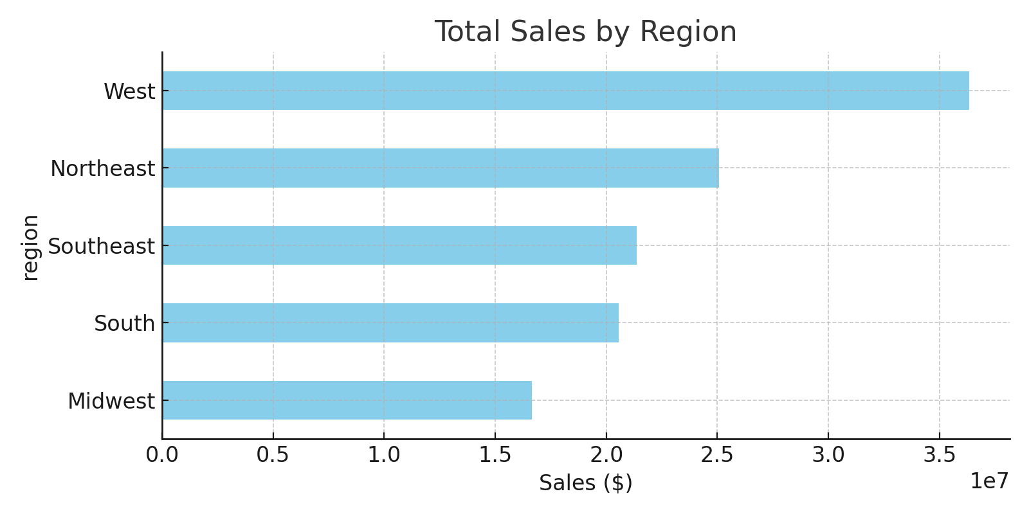
Sales by Region

Slide 4
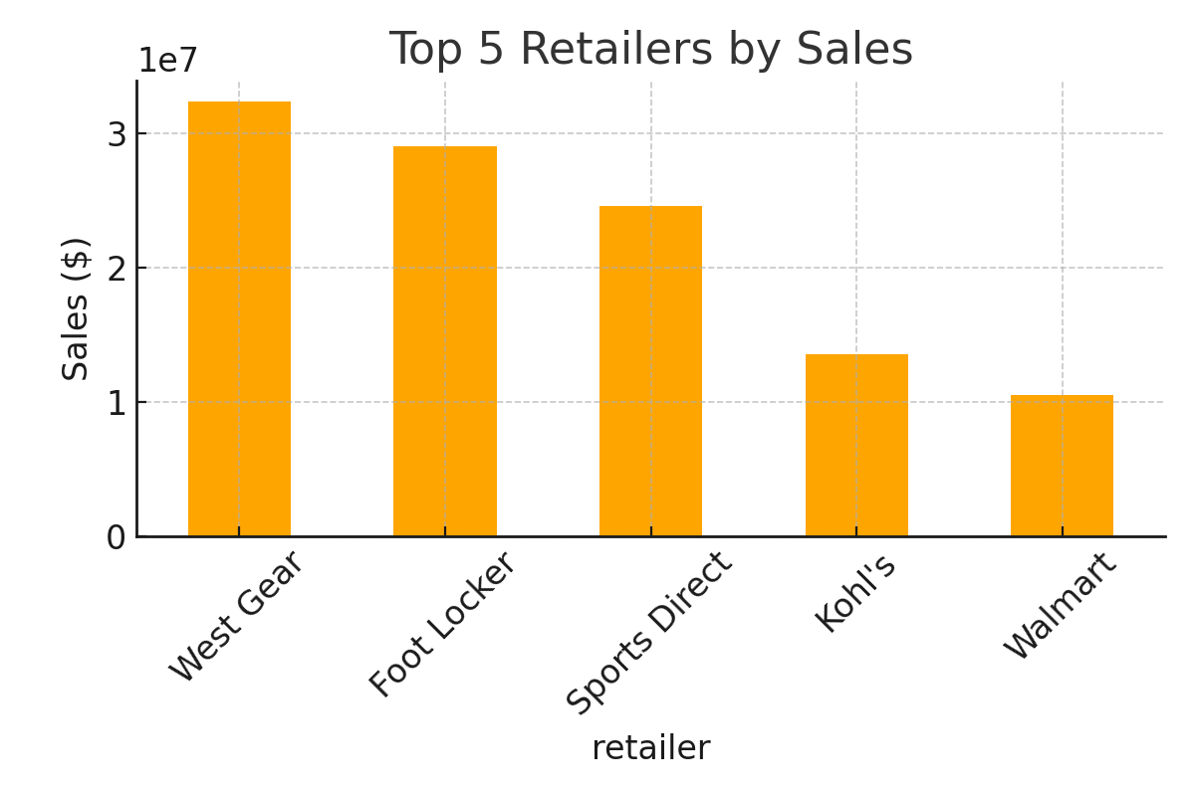
Top 5 Retailers

Slide 5
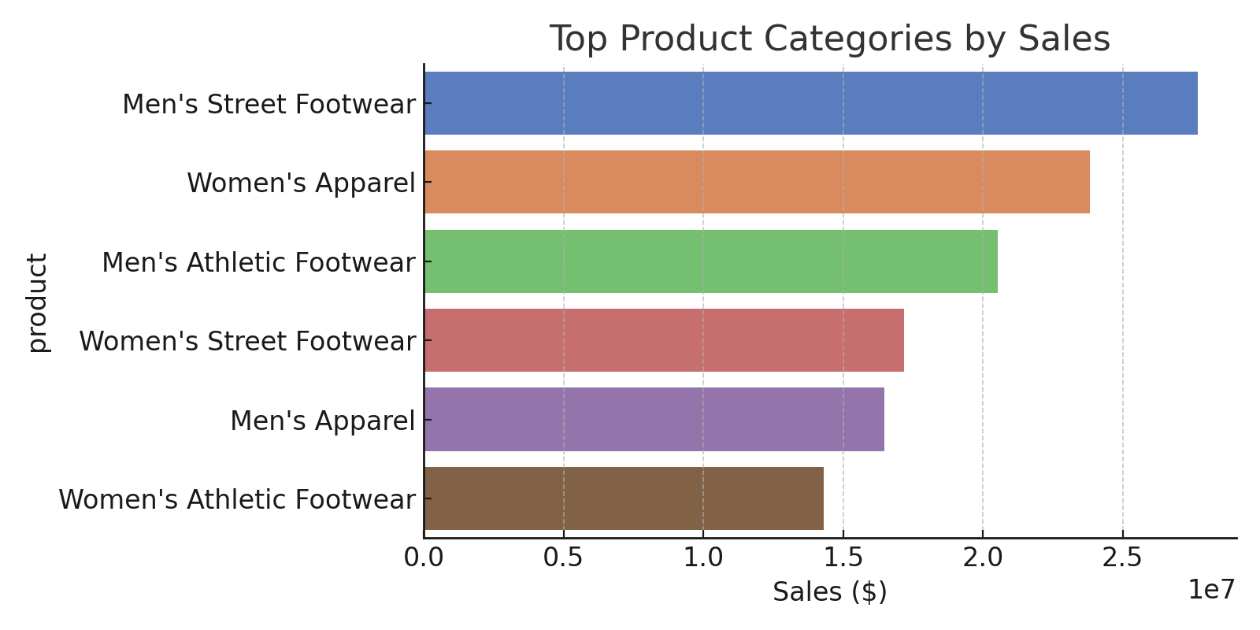
Top Product Categories

Slide 6
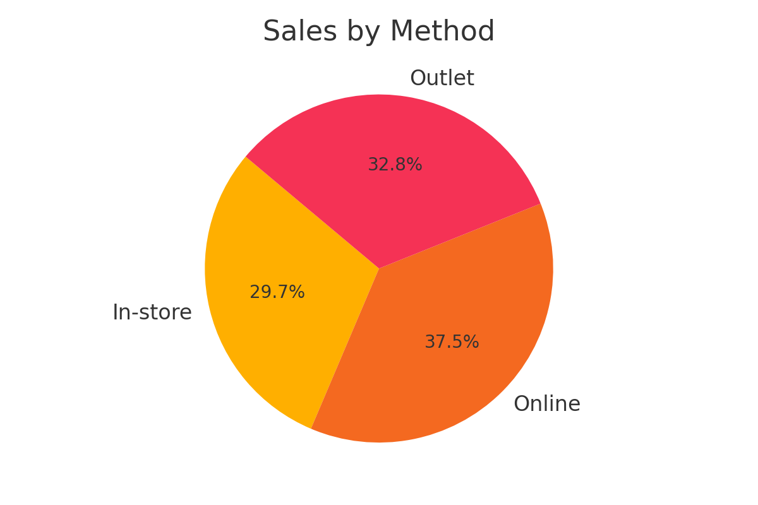
Sales Method Comparison

Slide 7
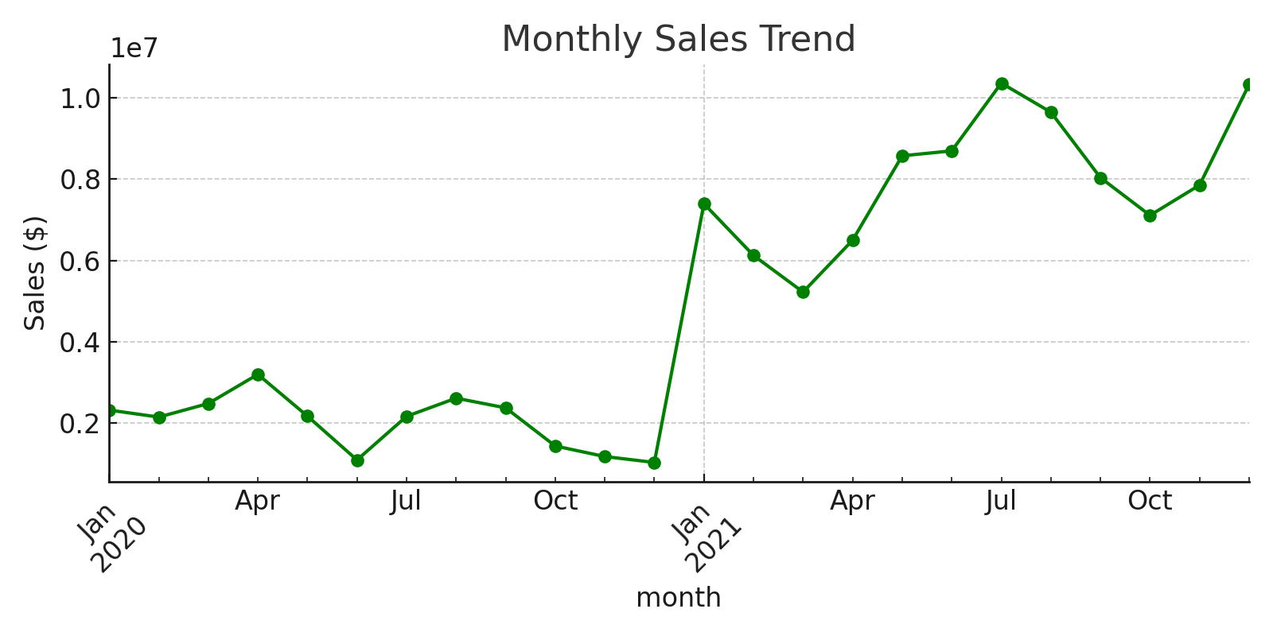
Monthly Sales Trend

