Slide 2
Defining a network
A network is a system of interconnected devices, typically computers, that are linked together to share information, resources, and services. These devices can be connected physically through cables or wirelessly via technologies like Wi-Fi. Networks enable communication and collaboration between users and devices, facilitating tasks like file sharing, printing, and internet access.

Slide 3
Main components of Networking
Devices:
These are any entity connected to the network, including computers, printers, mobile phones, switches, hub, routers and more
Communication Links (Media)
These are the channels connecting devices, which can be physical (e.g., cables) wireless or radio (e.g., Wi-Fi).
Network protocols
These are the rules and standards that govern communication and data transmission between devices.

Slide 4
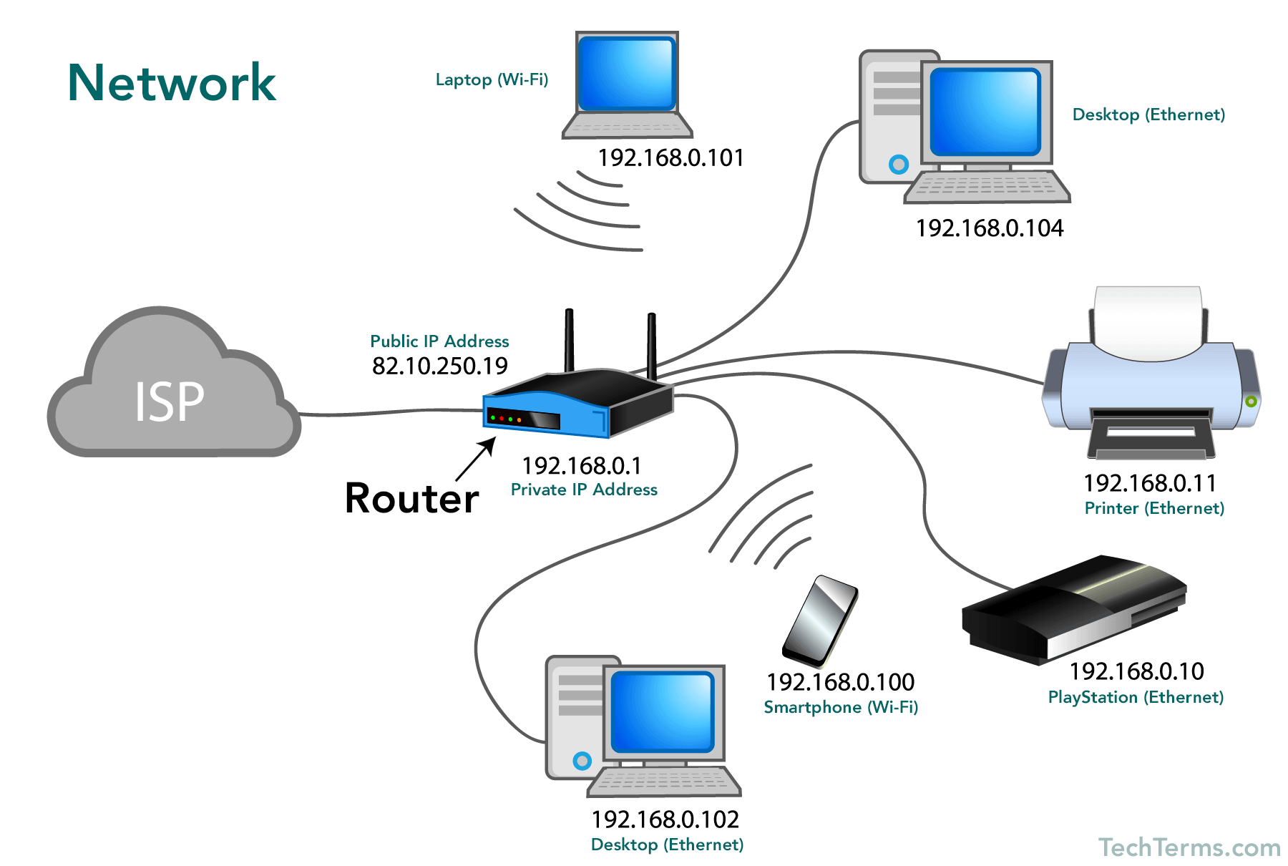

Slide 5
Network
A network consists of two or more computers that are linked in order to share resources (such as printers and CDs), exchange files, or allow electronic communications. The computers on a network may be linked through cables, telephone lines, radio waves, satellites, or infrared light beams.

Slide 6
Benefits of Networking
Resource Sharing:
Enables users to share files, printers, and other resources without individual connections.
Communication:
Facilitates communication between users and devices through email,
instant messaging, and other services. ping
Centralized Management:
Allows for easier management of network resources and user access.
Increased Efficiency:
Streamlines workflows and improves productivity through sharing and collaboration.

Slide 7
Network types
Personal Area Network (PAN):
Connects devices within a very close range, typically a few meters,
like a Bluetooth connection between a phone and a headset.
Local Area Network (LAN):
Connects devices within a limited area, such as a home or office building,
often using Ethernet.

Slide 8
Network types…
Wireless Local Area Network (WLAN):
A LAN that uses wireless communication, typically Wi-Fi, rather than wired cables.
Metropolitan Area Network (MAN):
Connects multiple LANs within a city or metropolitan area,
such as a cable TV network.
Wide Area Network
Connects multiple LANs and MANs across a large geographical area,
such as a country or the world.
Virtual Private Network
Creates a secure, private connection over a public network, often the
internet, using encryption

Slide 9
Types…
Storage Area Network (SAN):
A dedicated network for data storage, typically used by large organizations with high-performance storage needs (data center)
SOHO network
Small Office/Home Office network, is a local network designed for smaller businesses and individuals working from home or small offices. It typically involves a central router or hub connecting devices like computers, printers, and other devices within a single location, allowing them to communicate and share resources.

Slide 10
Network standards
Network standards are the agreed-upon rules and specifications that ensure devices from different manufacturers can communicate effectively across a network. They define how data is transmitted, formatted, and handled, enabling interoperability and smooth communication between devices and networks.

Slide 11
Important points for Network standards
Interoperability:
They ensure that devices from different vendors can communicate with each other.
Compatibility:
They guarantee that devices and networks can work together seamlessly.
Data transmission
They define how data is formatted, encoded, and transmitted across the network.
Protocols
They specify the rules and procedures for communication between
network devices, such as TCP/IP, HTTP, FTP and SMTP.

Slide 12
Importance of networking
A computer network allows for the sharing of resources such as printers, files, and data storage, as well as the ability to communicate with other computers and access the internet. Networking also enables collaboration between individuals and groups and supports the transfer of data and information across a variety of platforms and devices..
Resources
  Printer
  File
  User

Slide 13
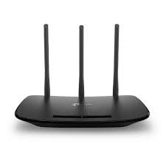
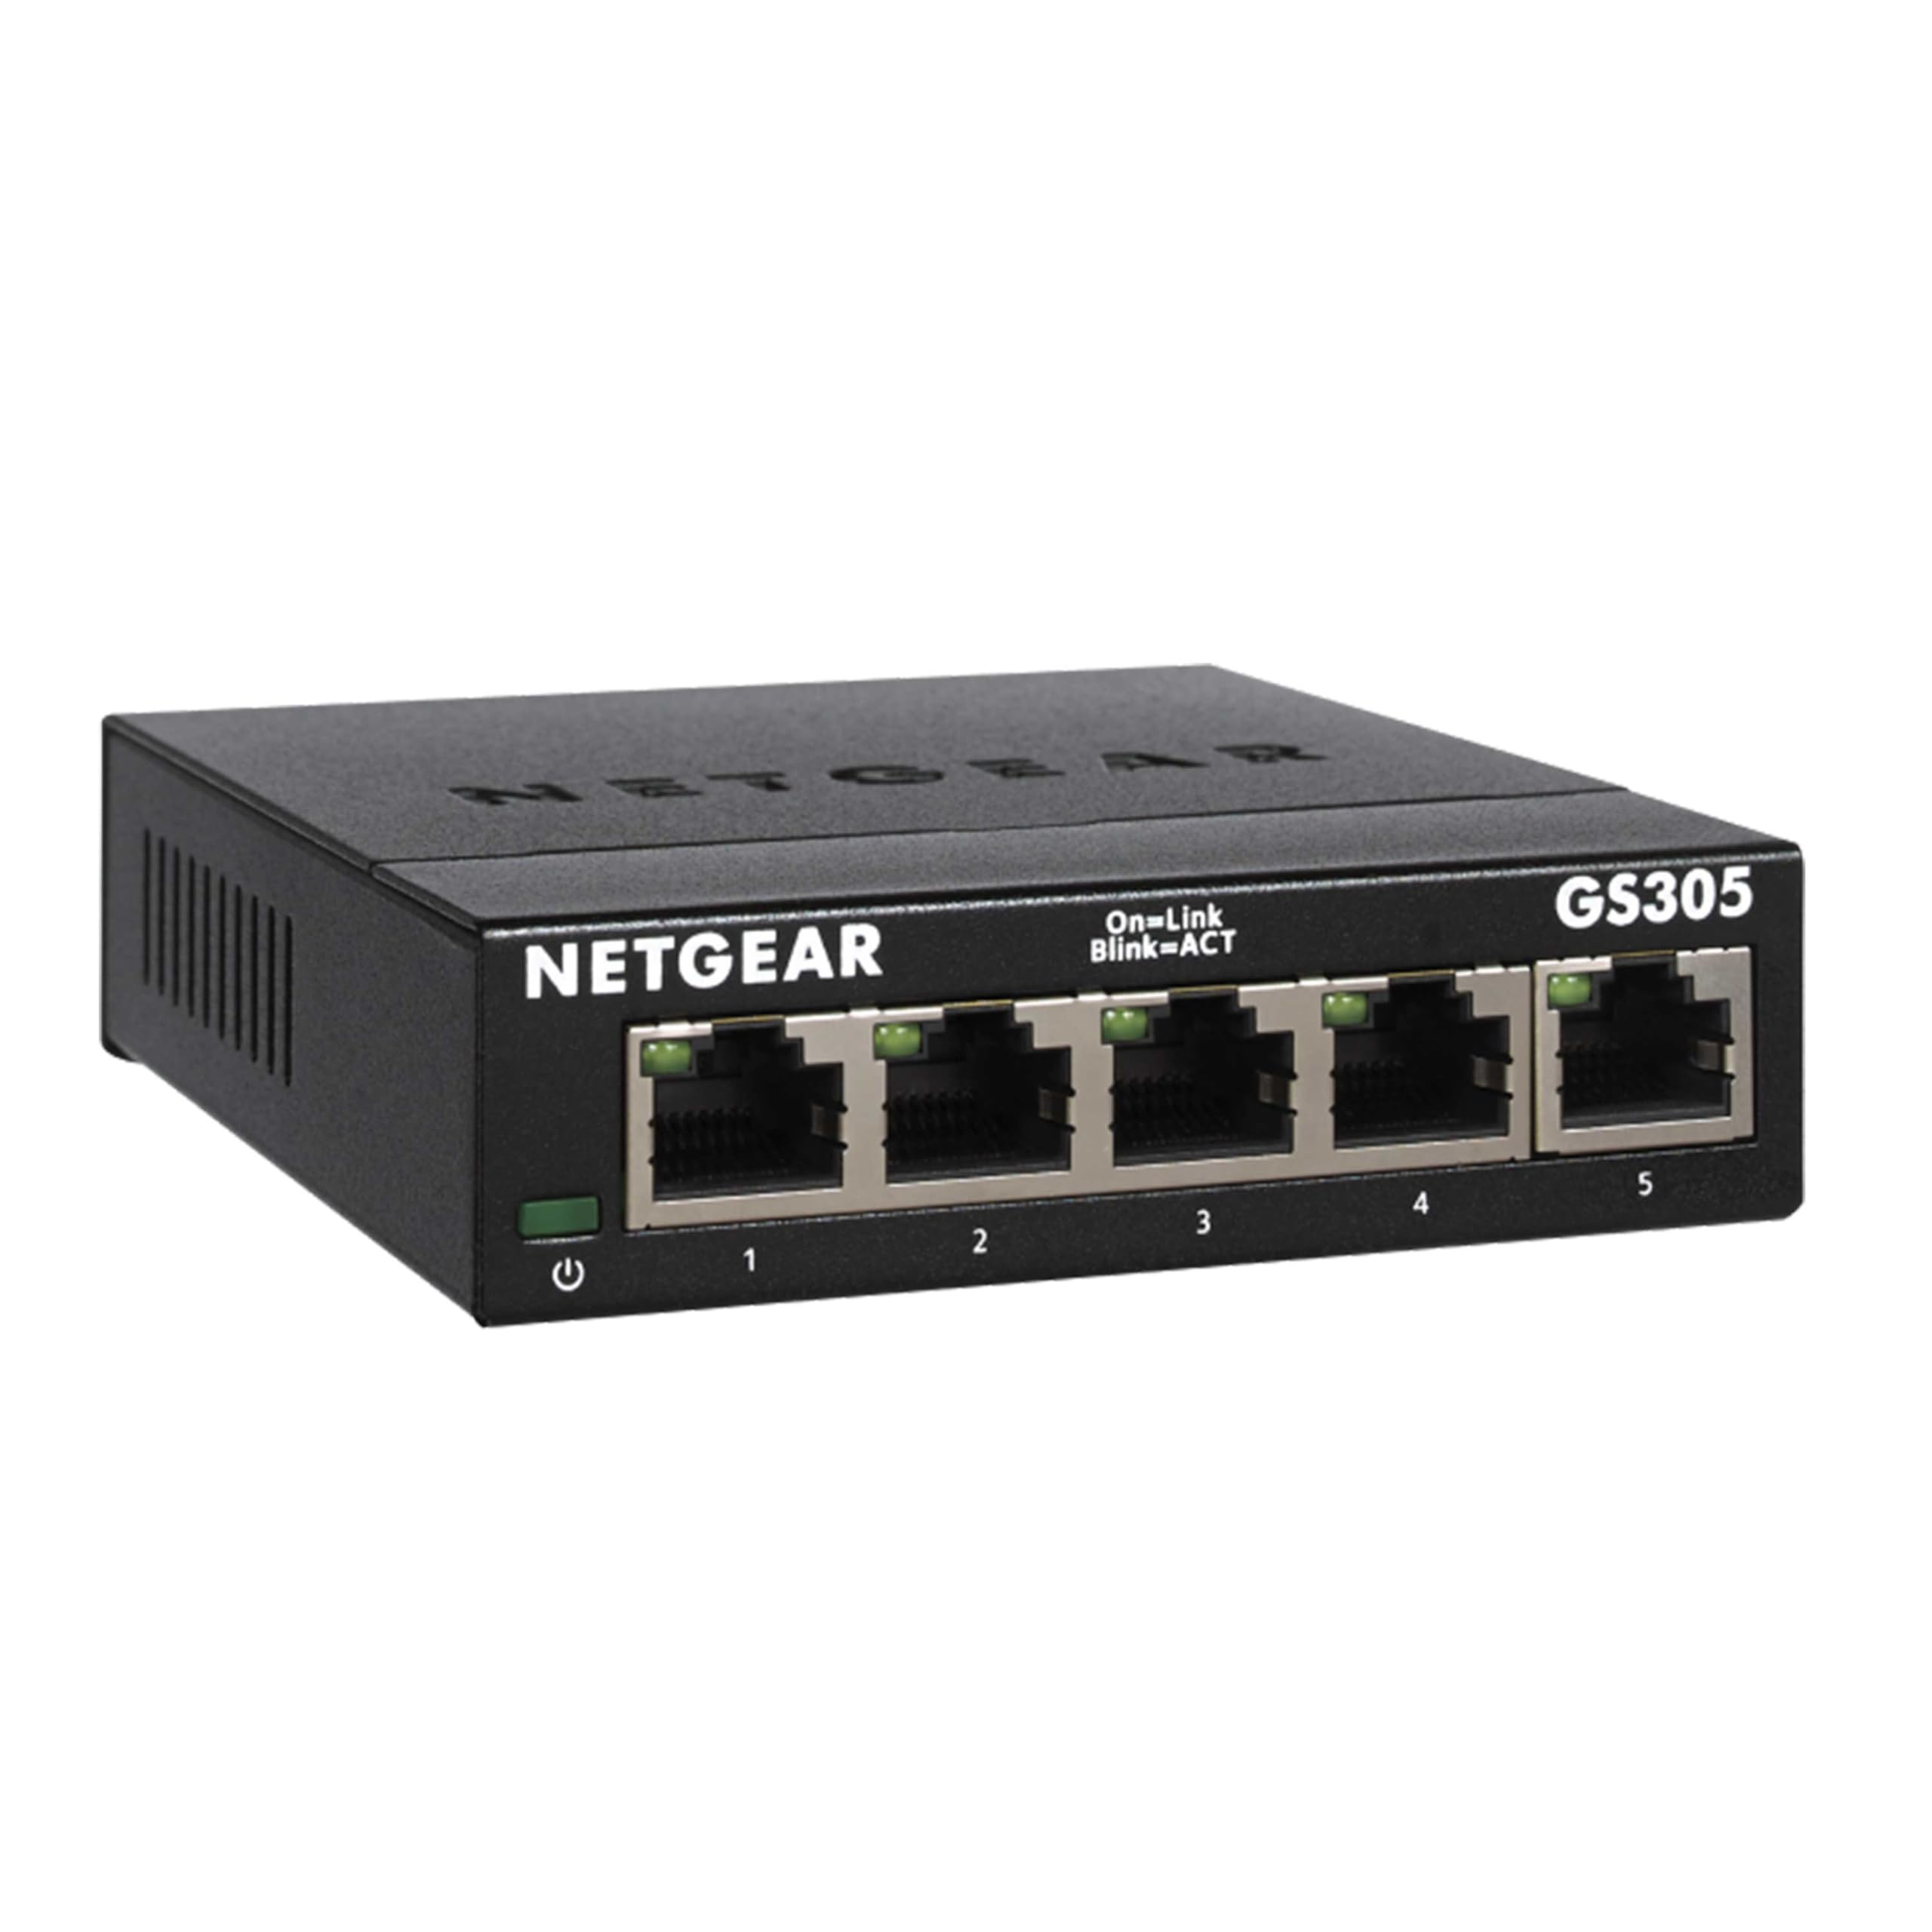
Network components
Routers:
Connect different networks, enabling communication between them. They choose the optimal path for data to travel.
Switches:
Connect devices on a local area network (LAN), forwarding data packets to the intended recipient.

Slide 14
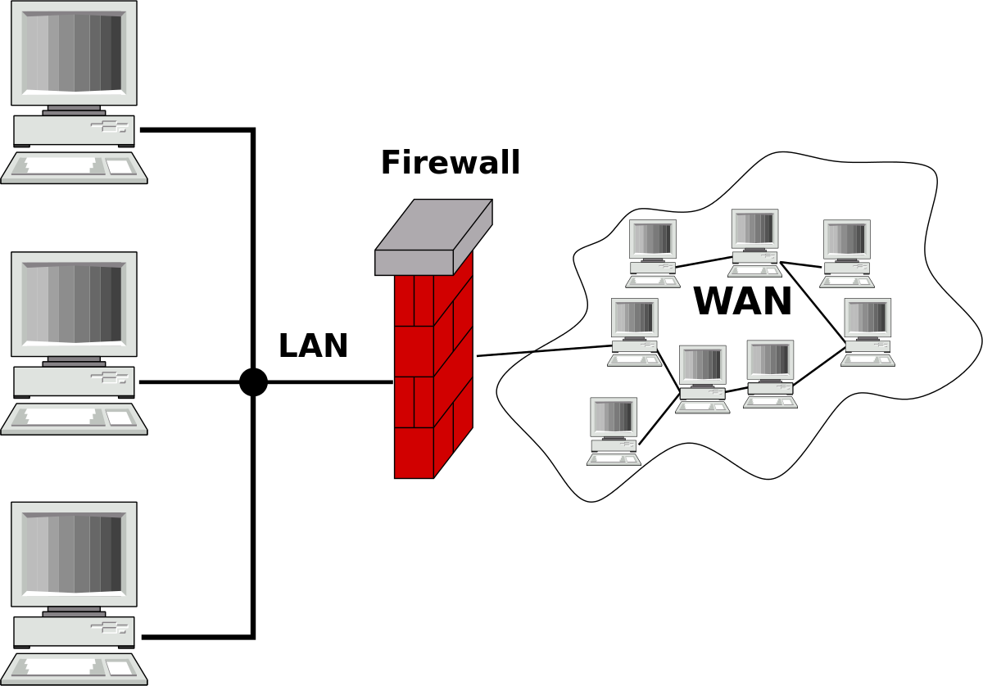
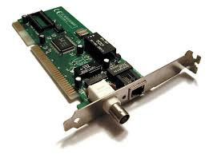
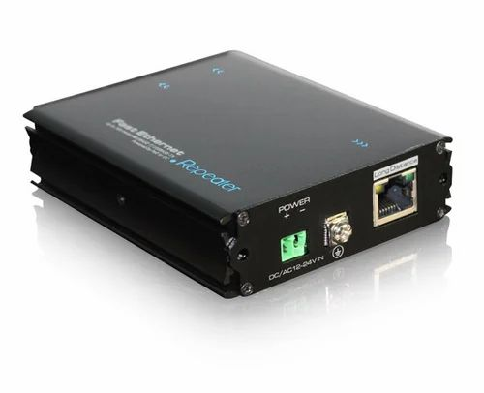
Network components…
Firewalls:
Protect networks from unauthorized access and malicious attacks
Network Interface Card(NIC):
It allows devices to connect to a network and to send and receive data over network using Ip address.
Repeaters:
Amplify and retransmit network signals to extend the range of a network.

Slide 15
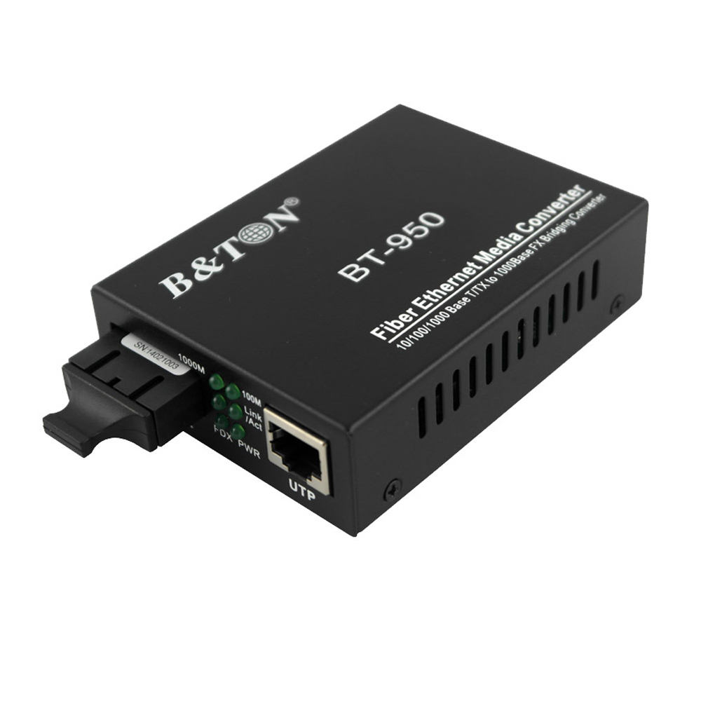
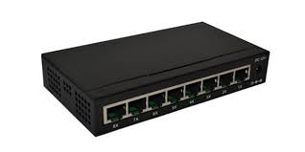
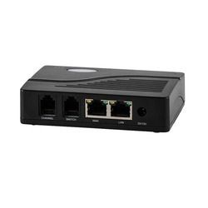
Network components
Hubs:
Connect multiple devices on a network, broadcasting data to all connected devices (less efficient than switches).
Bridges:
Connect different networks, filtering traffic based on network addresses.
Gateways:
Facilitate communication between networks, especially between a local network and the internet.

Slide 16

Wireless routers
Wireless routers are hardware devices that Internet service providers use to connect you to their cable or xDSL Internet network. A wireless router, also called a Wi-Fi router, combines the networking functions of a wireless access point and a router.
xDSL, or "any Digital Subscriber Line," is a family of high-speed internet technologies that transmit data over existing copper telephone lines

Slide 17
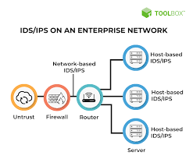
IDS/IPS
Intrusion Detection Systems (IDS) and Intrusion Prevention Systems (IPS) are tools used to monitor and protect networks from malicious activity. While both analyze network traffic, IDS primarily alerts about suspicious activity, while IPS proactively blocks or prevents identified threats. IPS are essentially an advanced version of IDS, with the added capability of taking action to mitigate detected threats.

Slide 18
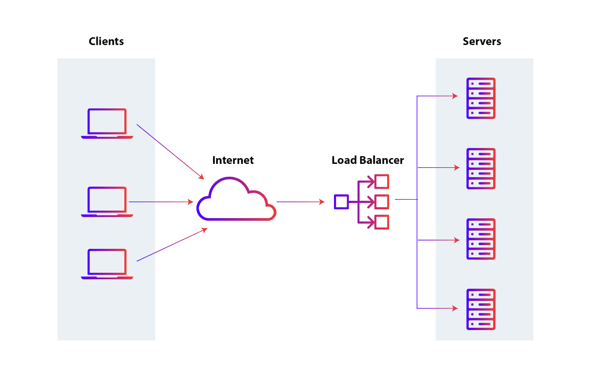
Load balancer
A load balancer or software component that distributes network traffic across multiple servers. It acts as a traffic director, routing client requests to the appropriate backend servers to ensure optimal performance, reliability, and scalability.

Slide 19
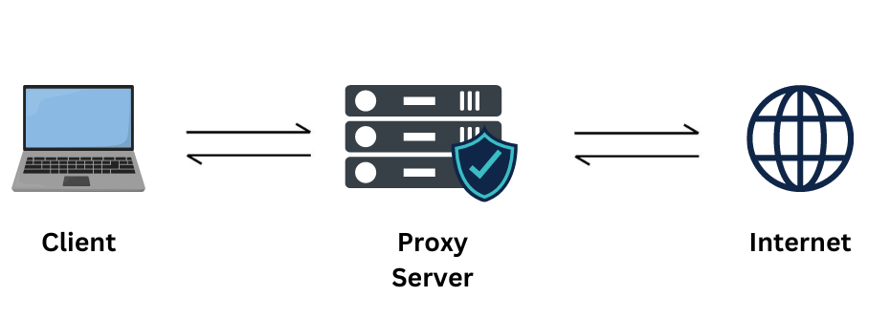
Proxy
Proxy is a server that acts as an intermediary between a client and another server. This can provide benefits like:
privacy,
enhanced security,
improved performance.

Slide 20
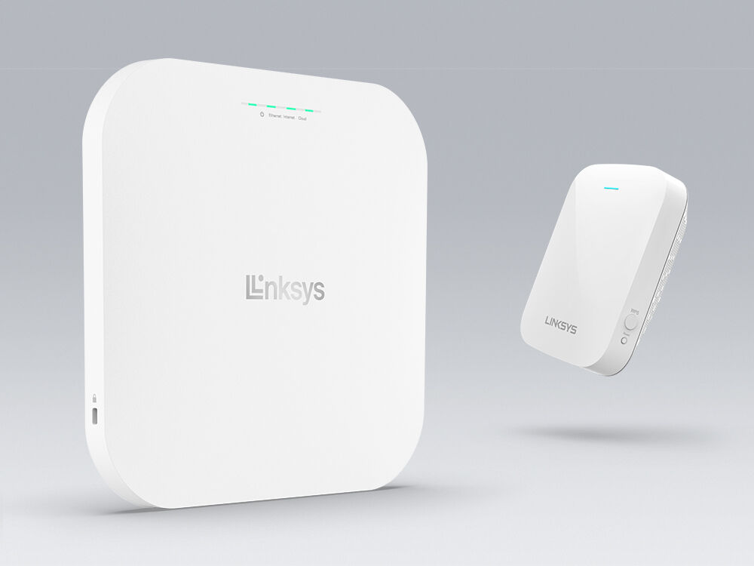
Wireless AP
Wireless Access Point (WAP) is a networking device that allows connecting the devices with the wired network. A Wireless Access Point (WAP) is used to create the WLAN (Wireless Local Area Network. which increases productivity and reduces the infrastructure cost.

Slide 21
Networking standards…
OSI Model: theory
Another framework for understanding network communication,
with seven layers that define different aspects of network communication.
TCP/IP Model: working
A widely used model for understanding network communication,
defining layers of protocols and standards

Slide 22
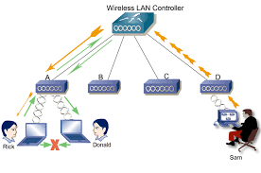
Wireless LAN controller
A wireless LAN controller, or WLAN controller, monitors and manages wireless access points in bulk and allows wireless devices to connect to WLAN, a wireless network architecture. As a centralized device in the network, the wireless LAN controller is usually located at the data center, to which all the wireless APs on the network are directly or indirectly connected.

Slide 23
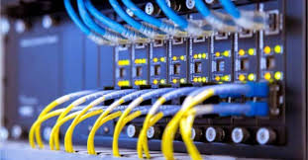
What is the job of a switch
Switches are devices that connect devices within a network. Switching uses switches to forward data from one device to another.

Slide 24
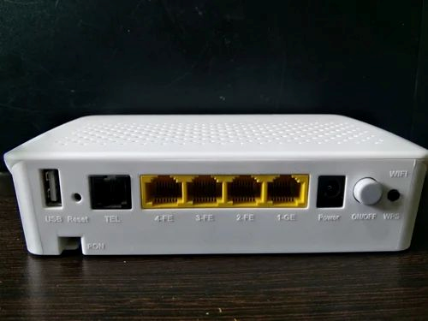
What are routers
Routers are devices that connect networks together. Routing uses routing protocols, which are specialized algorithms that help routers determine the best path to take data from one network to another.

Slide 25
Switching and routing
When the data is sent like a text message, that data is broken down into tiny pieces called packets and sent over the network with the source and destination IP addresses attached. The destination is a host, which is a computer or mobile device on a network. These devices reside in a Local Area Network (LAN).
The process of sending packets from one host to another within a LAN is called switching. The process of doing that between two or more LANs is called routing.
A switch is a Layer 2 device (Data-Link Layer), while a router is a Layer 3 device (Network Layer).

Slide 26
Switching and forwarding…
There are many types of switching: packet, circuit, multilayer, virtual circuit, wide area network (WAN), and local area network (LAN). Circuiting and virtual circuit switching almost always refer to WAN or telephone technologies. Packet switching usually concerns a router or a WAN switch.
It is highly probable that a network will be a mixture of Ethernet and 802.11 nodes. These nodes will run the Internet Protocol at Layer 3 of the Transmission Control Protocol/Internet Protocol (TCP/IP) networking model. The applications will be designed for TCP or the User Datagram Protocol (UDP).

Slide 27
Networking Models

Slide 28
OSI
The OSI Model breaks down network communication into seven layers. These layers are useful for identifying network issues.
The open systems interconnection (OSI) model is a conceptual model created by the International Organization for Standardization which enables diverse communication systems to communicate using standard protocols. In plain English, the OSI provides a standard for different computer systems to be able to communicate with each other.

Slide 29
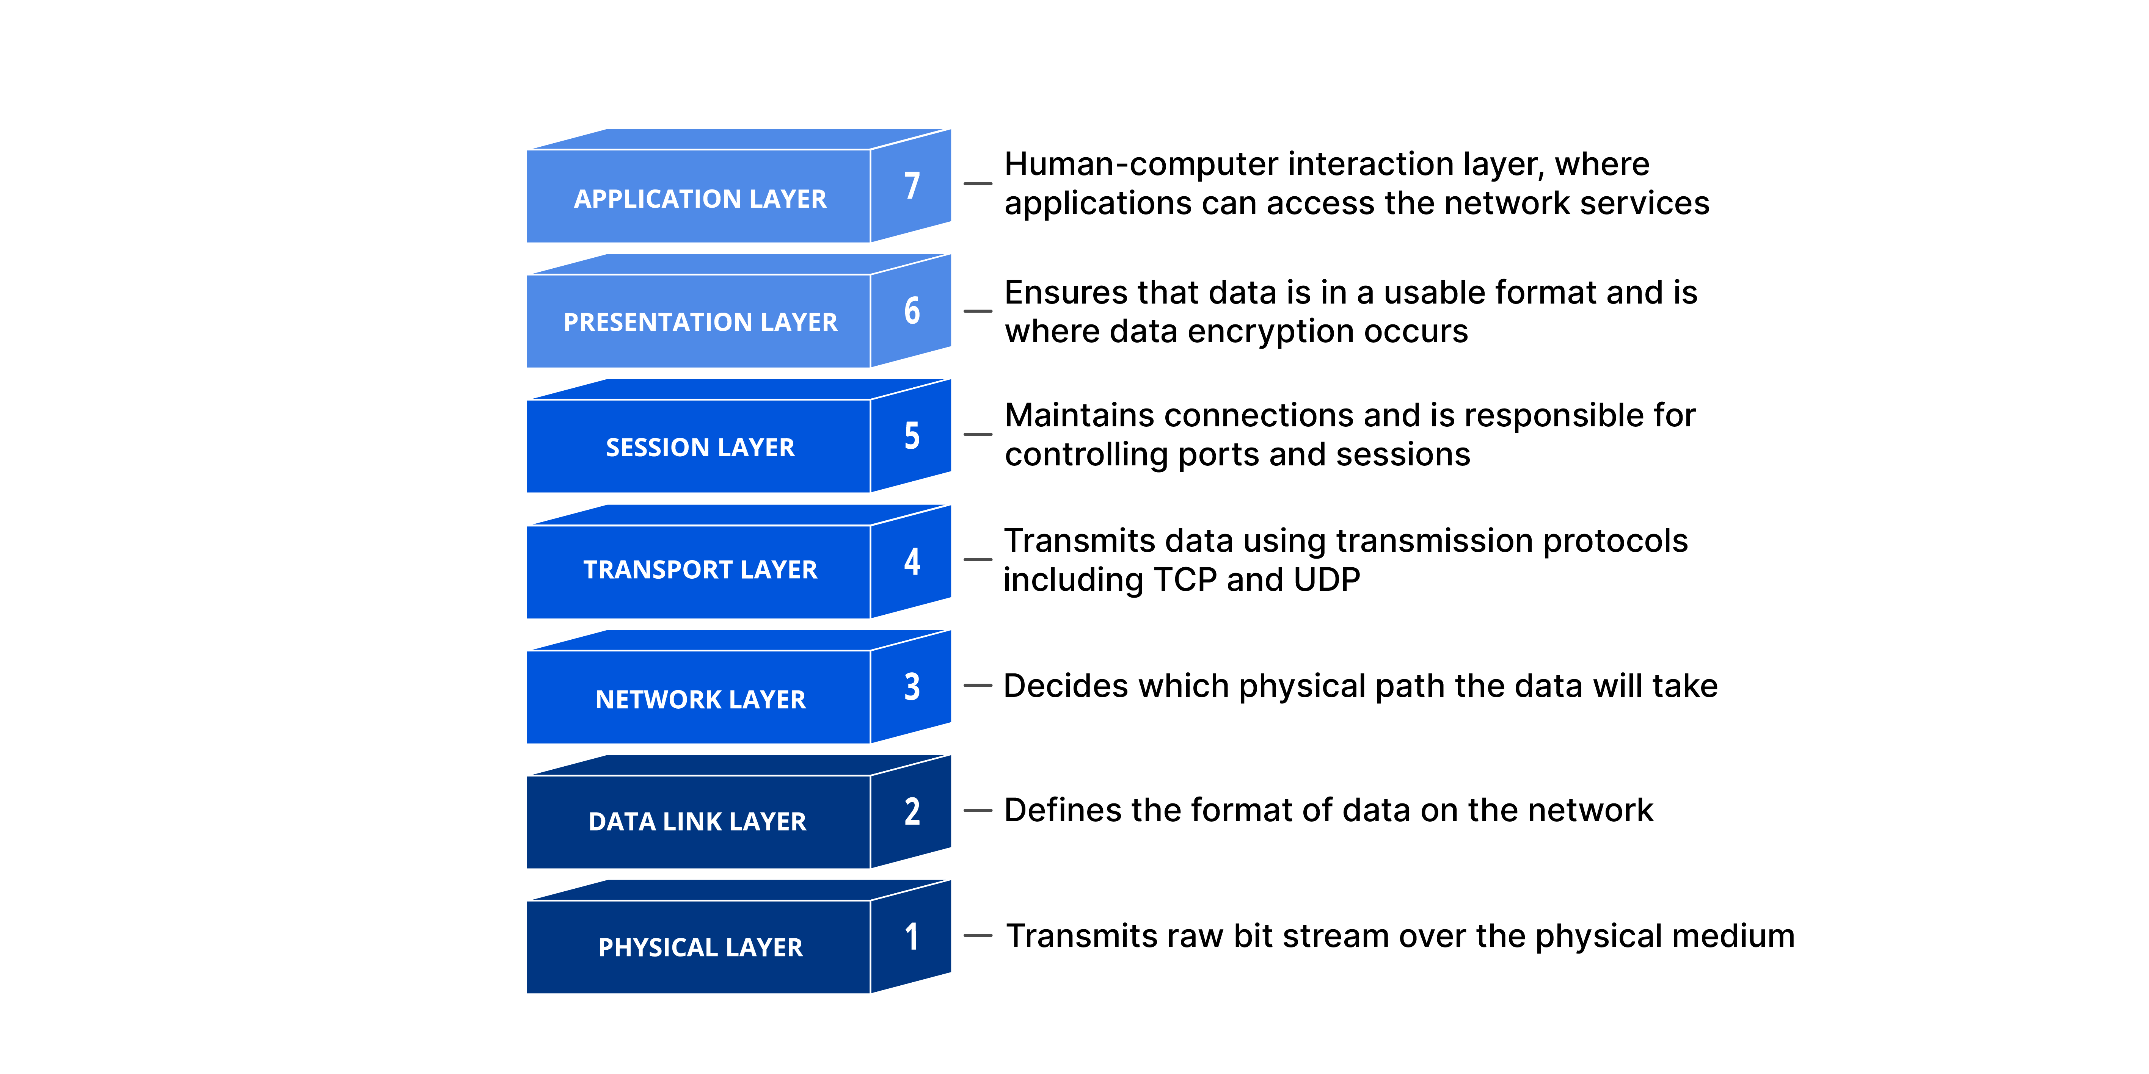
OSI Model

Slide 30
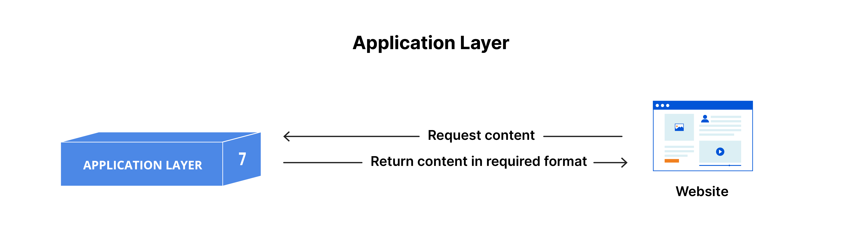
The layers of OSI model
The seven abstraction layers of the OSI model can be defined as follows, from top to bottom:
7. The application layer

Slide 31
Application layer
This is the only layer that directly interacts with data from the user. Software applications like web browsers and email clients rely on the application layer to initiate communications. But it should be made clear that client software applications are not part of the application layer; rather the application layer is responsible for the protocols and data manipulation that the software relies on to present meaningful data to the user.

Slide 32
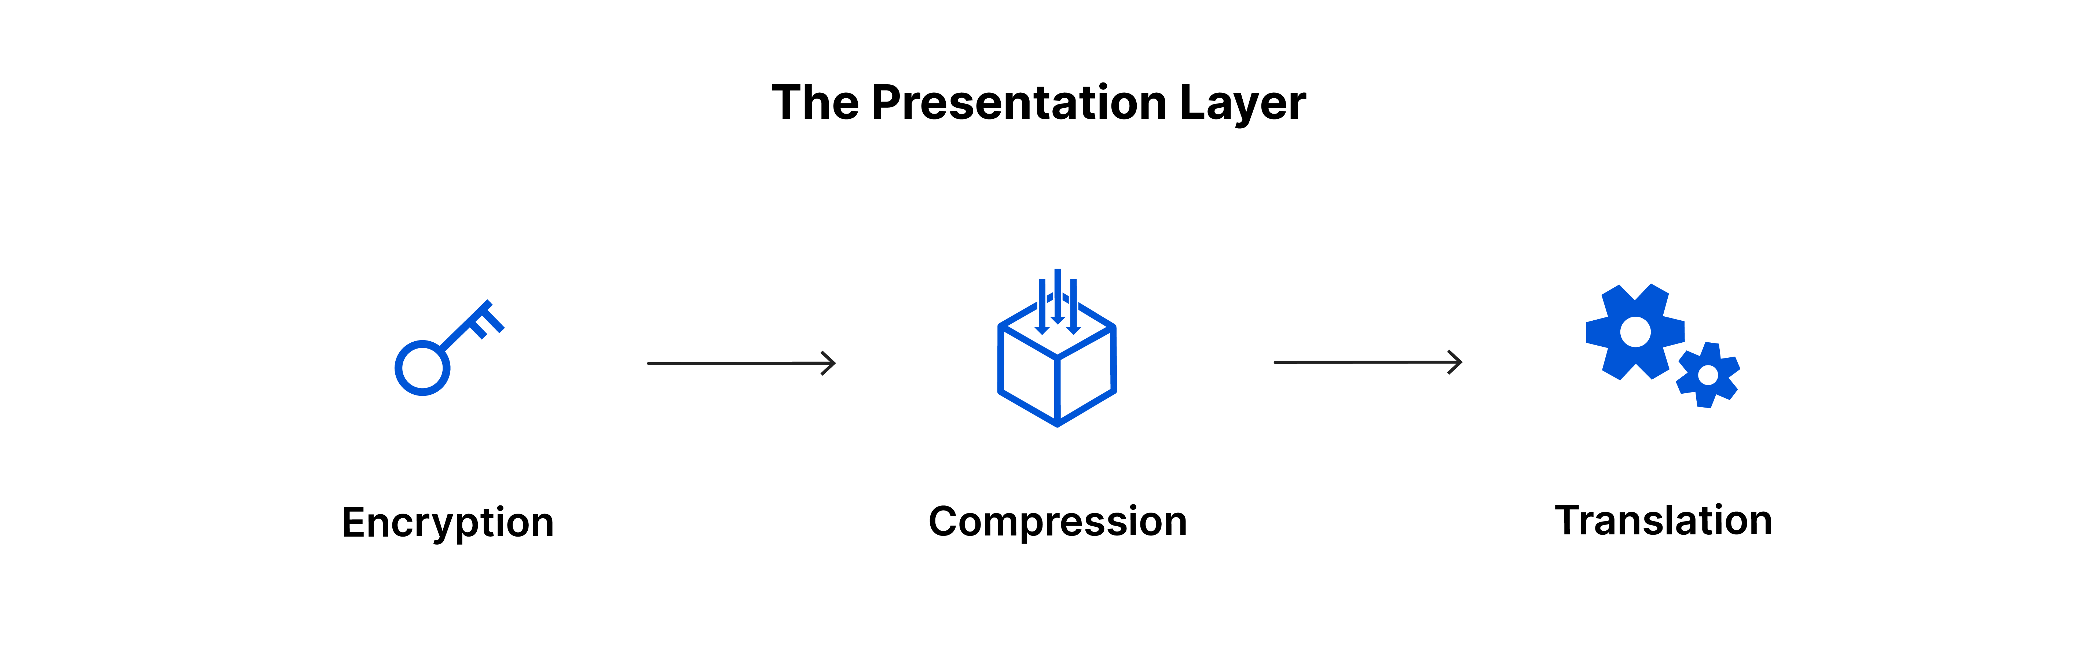
Presentation Layer
This layer is primarily responsible for preparing data so that it can be used by the application layer; in other words, layer 6 makes the data presentable for applications to consume. The presentation layer is responsible for translation, encryption, and compression of data.

Slide 33

Session Layer
This is the layer responsible for opening and closing communication between the two devices. The time between when the communication is opened and closed is known as the session. The session layer ensures that the session stays open long enough to transfer all the data being exchanged, and then promptly closes the session in order to avoid wasting resources.

Slide 34

Transport Layer
Layer 4 is responsible for end-to-end communication between the two devices. This includes taking data from the session layer and breaking it up into chunks called segments before sending it to layer 3. The transport layer on the receiving device is responsible for reassembling the segments into data the session layer can consume.

Slide 35
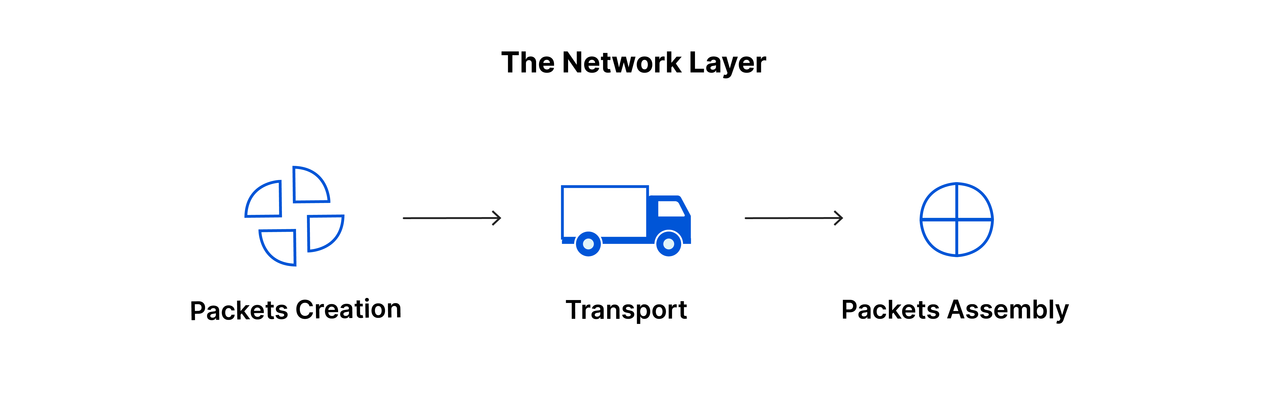
Network layer
The network layer is responsible for facilitating data transfer between two different networks. If the two devices communicating are on the same network, then the network layer is unnecessary. The network layer breaks up segments from the transport layer into smaller units, called packets, on the sender’s device, and reassembling these packets on the receiving device. The network layer also finds the best physical path for the data to reach its destination; this is known as routing.

Slide 36
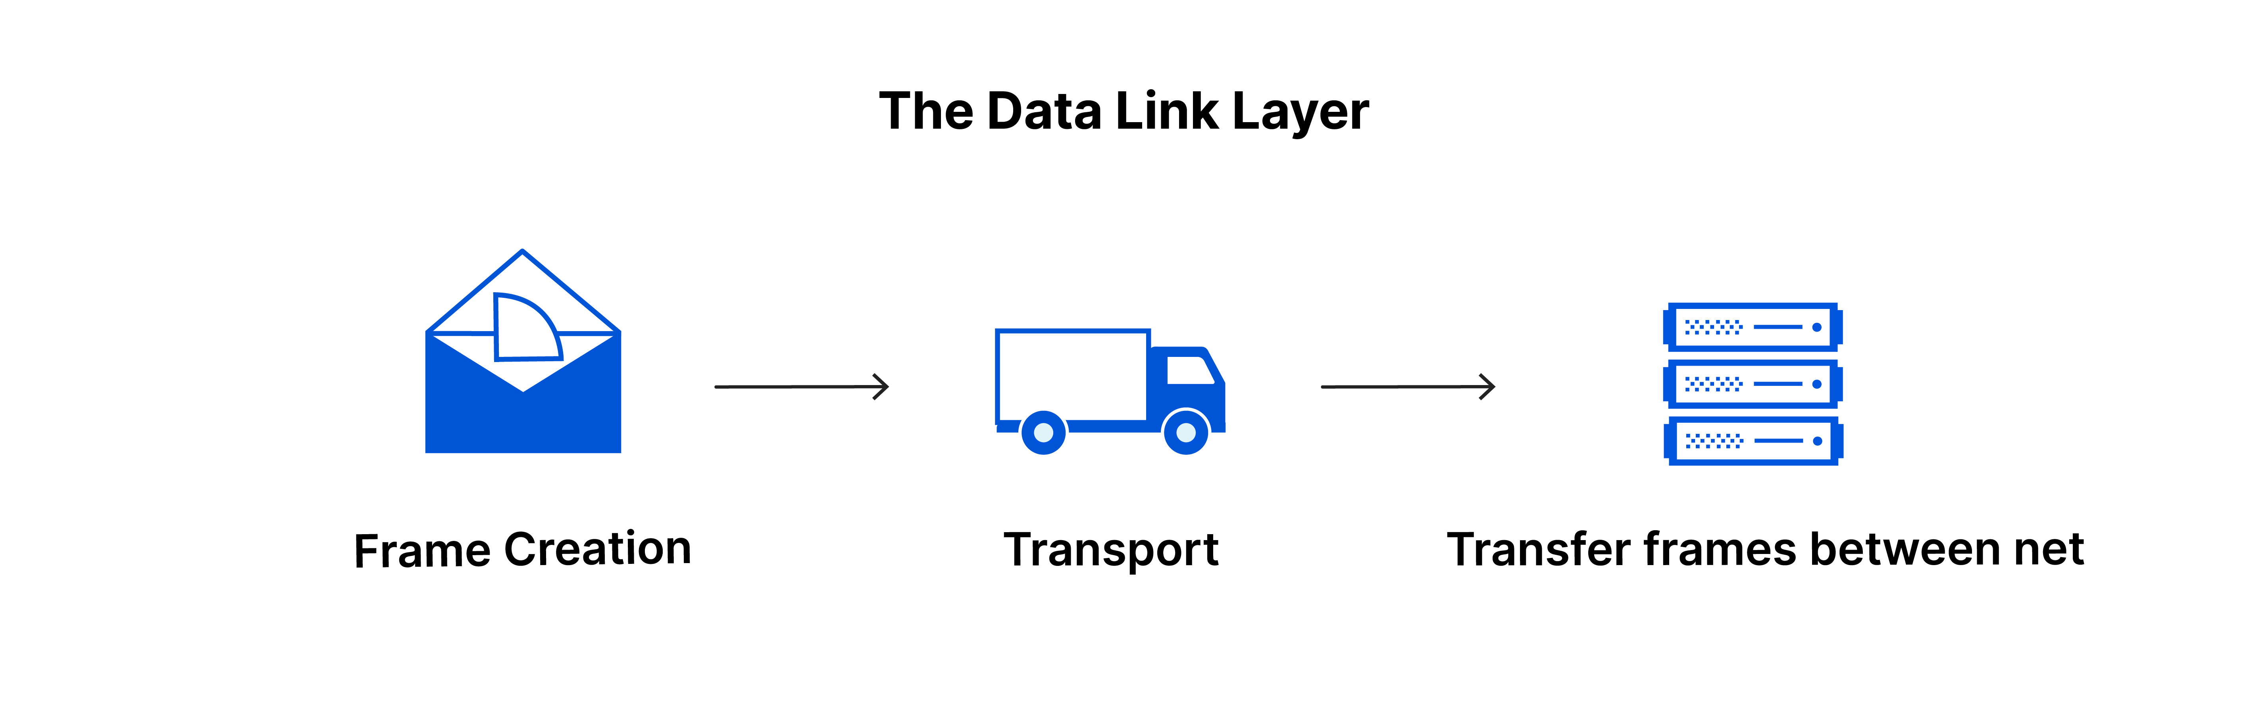
Data Link layer
data link layer facilitates data transfer between two devices on the same network. The data link layer takes packets from the network layer and breaks them into smaller pieces called frames. Like the network layer, the data link layer is also responsible for flow control and error control in intra-network communication (The transport layer only does flow control and error control for inter-network communications).

Slide 37
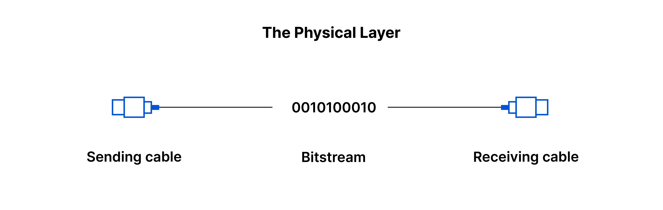
Physical Layer
The physical equipment involved in the data transfer, such as the cables and switches. This is also the layer where the data gets converted into a bit stream, which is a string of 1s and 0s. The physical layer of both devices must also agree on a signal convention so that the 1s can be distinguished from the 0s on both devices.

Slide 38

How the data flows in OSI
To transfer the human-readable information over a network from one device to another, the data must travel down the seven layers of the OSI Model on the sending device and then travel up the seven layers on the receiving end.
The email application will pass this email message over to the application layer, which will pick a protocol (SMTP) and pass the data along to the presentation layer. The presentation layer will then compress the data and then it will hit the session layer, which will initialize the communication session.

Slide 39

How the data flows in OSI
The data will then hit the sender’s transportation layer where it will be segmented, then those segments will be broken up into packets at the network layer, which will be broken down even further into frames at the data link layer. The data link layer will then deliver those frames to the physical layer, which will convert the data into a bitstream of 1s and 0s and send it through a physical medium, such as a cable.

Slide 40
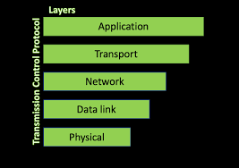
TCP/IP Model

Slide 41
The TCP/IP model
The TCP/IP model is structured into layers, each responsible for specific functions within the communication process. At its core, TCP/IP encompasses two fundamental protocols: the Transmission Control Protocol (TCP) and the Internet Protocol (IP). While IP operates at the network layer, TCP functions at the transport layer, as per the OSI model.

Slide 42
Transport Layer
Sitting above the network layer, the Transport layer caters to session services (TCP) and datagram services (UDP) for the application layer. It ensures reliable data transfer and establishes connections between the data stream and the application.

Slide 43
Internet Layer
The Internet layer takes charge of addressing, packaging, and routing of hosts. It enables end-to-end connectivity, handling the intricacies of network addressing and routing packets across different networks.

Slide 44
Link Layer
The Link layer plays a crucial role in transmitting TCP/IP packets over the network medium and receiving corresponding packets from it. Irrespective of the network access method or frame format, the Link layer ensures seamless communication between devices.

Slide 45
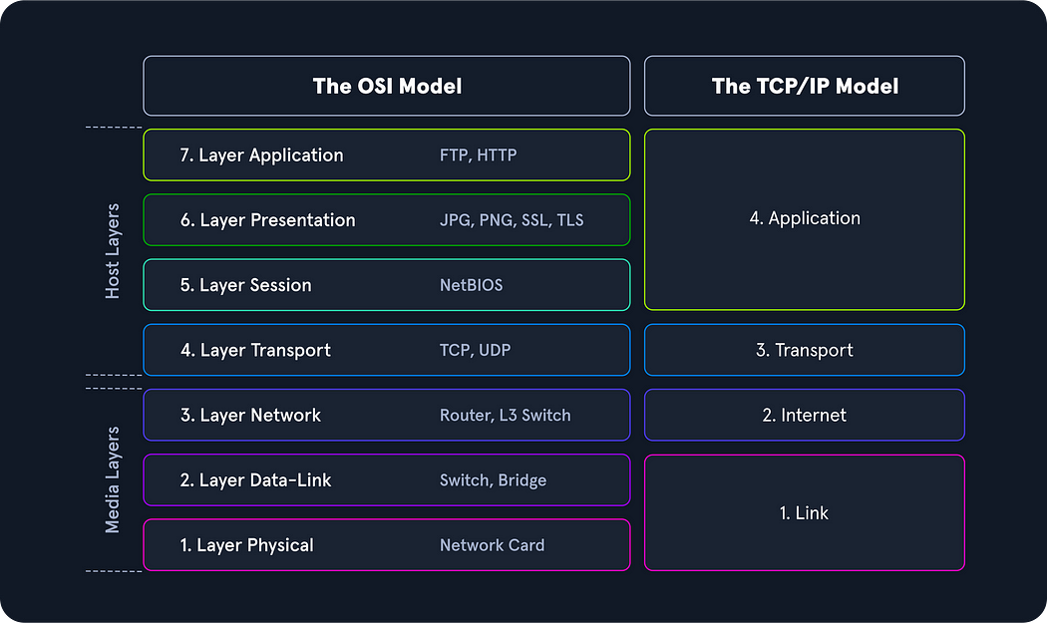

Slide 46
The Action
TCP/IP’s significance lies in its ability to facilitate data transfer and communication across various networks, regardless of the receiver’s location. IP ensures the successful delivery of data packets to their intended destinations, while TCP manages data transfer, ensuring reliable connections between data streams and applications.

Slide 47
Key functions
Logical Addressing with IP:
To accommodate the vast number of hosts on diverse networks, TCP/IP introduces logical addressing. IP takes charge of this addressing mechanism, ensuring that data packets reach the appropriate networks and nodes. It employs techniques such as network classes, subnets, and CIDR to efficiently manage network addressing.

Slide 48
Key functions…
Routing with IP:
IP handles the critical task of routing data packets from the source to the destination. By determining the next node at each step along the transmission path, IP ensures that data packets reach their intended destinations, even if the specific location is unknown to the sender.

Slide 49
Key functions…
Error and Flow Control with TCP:
TCP establishes a virtual connection between senders and receivers, maintaining continuous communication. It incorporates error and flow control mechanisms, enabling reliable data transfer and ensuring that connections remain intact throughout the process.

Slide 50
Key functions…
Application Support with TCP:
TCP offers support to applications through the concept of ports. By assigning unique TCP and UDP ports, it allows for the seamless differentiation of specific applications and their corresponding communication links. This abstraction layer simplifies the communication process and enhances the overall functionality of applications.

Slide 51
Key functions…
Name Resolution with DNS:
TCP/IP relies on the Domain Name System (DNS) to provide name resolution services. DNS translates Fully Qualified Domain Names (FQDNs) into IP addresses, allowing users to access desired hosts on the internet by using their specified names.

Slide 52
IP Addressing and subnetting

Slide 53
IP addressing
IP addressing and subnetting are fundamental concepts in networking that ensure efficient communication between devices on a network. IP addressing assigns unique identifiers (IP addresses) to each device, while subnetting divides larger networks into smaller, more manageable segments called subnets. This allows for better IP address management, security, and network organization.

Slide 54
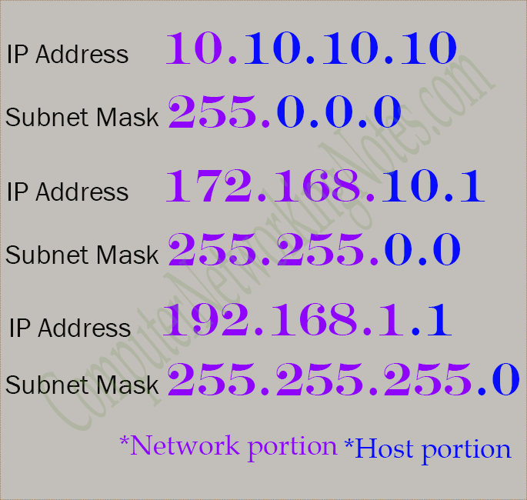
IP Addressing

Slide 55
IP Addressing
Computers work with IPv4 addresses as 32-bit binary strings. Humans usually convert binary to a dotted decimal address, which is easier to write and understand. For example, the binary string 11000000.00000000.00000010.00000010 converts to the IP address 192.0.2.2. Its associated subnet mask converts from 11111111.11111111.11111111.11111100 to 255.255.255.252.

Slide 56
Subnet
Subnet masks clarify which part of the address is the network ID and which is the host ID. Routers, computers and network troubleshooters use IP addresses and subnet masks to manage network traffic, which ensures information sent from one system arrives at its destination.

Slide 58
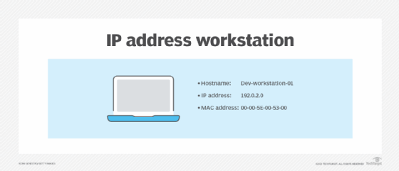
IP addressing fundamentals
Physical address
Logical address
Hostname

Slide 59
Types
IPv4 addresses are divided into five classes (A, B, C, D, and E), determined by the first octet of the address, to accommodate different network sizes and uses. Classes A, B, and C are for general networking with varying numbers of hosts, Class D is reserved for multicasting, and Class E is set aside for experimental purposes

Slide 60
Types of IPV4
Class A The first octet Ranges from 0 to 126
Purpose: used in very large networks with very large number of devices. N.H.H.H
Class B First octet range 128 - 191
Purpose: Designated for medium to large industry and networks like schools or colleges or a medium sized industry
N.N.H.H

Slide 61
Types of IPV4
Class C First octet 192-223
Purpose: implemented by small scale industries or residential environments N.N.N.H
Class D First octet 224-239
Purpose multicasting, to send single data to multiple users
Class E first octet 240-255
Purpose reserved for research and development.

Slide 62
Network Topologies

Slide 63
What is topology
A Network Topology is the arrangement with which computer systems or network devices are connected to each other. Topologies may define both physical and logical aspect of the network. Both logical and physical topologies could be same or different in a same network.

Slide 64
Types of topologies
Point-to-Point Topology
Bus Topology
Star Topology
Ring Topology
Mesh Topology
Tree Topology
Daisy Chain Topology
Hybrid Topology

Slide 65

Point to Point
Point-to-point networks contains exactly two hosts such as computer, switches or routers, servers connected back-to-back using a single piece of cable. Often, the receiving end of one host is connected to sending end of the other and vice-versa.

Slide 66
Bus
Bus topology, all devices share single communication line or cable. Bus topology may have problem while multiple hosts sending data at the same time. Therefore, Bus topology either uses CSMA/CD technology or recognizes one host as Bus Master to solve the issue. It is one of the simple forms of networking where a failure of a device does not affect the other devices. But failure of the shared communication line can make all other devices stop functioning.

Slide 67
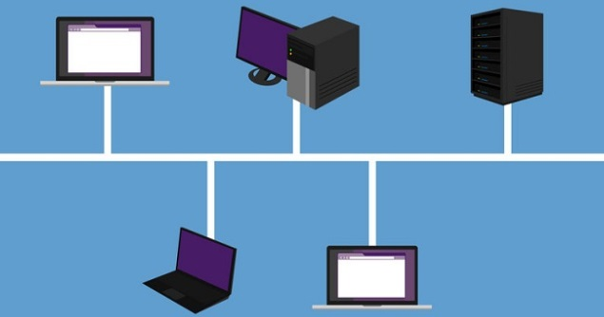
Bus topology

Slide 68
Star
All hosts in Star topology are connected to a central device, known as hub device, using a point-to-point connection. That is, there exists a point to point connection between hosts and hub. The hub device can be any of the following:
Layer-1 device such as hub or repeater
Layer-2 device such as switch or bridge
Layer-3 device such as router or gateway

Slide 69
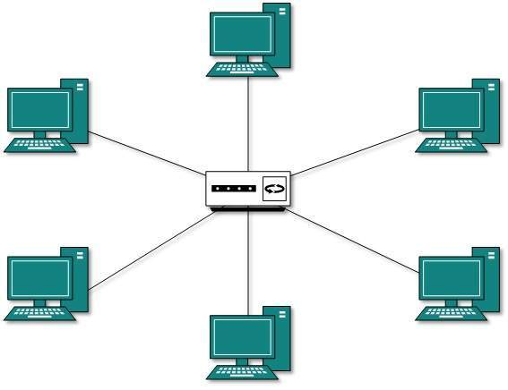
Star

Slide 70
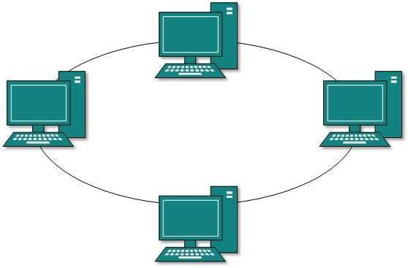
Ring
Ring topology, each host machine connects to exactly two other machines, creating a circular network structure. When one host tries to communicate or send message to a host which is not adjacent to it, the data travels through all intermediate hosts. To connect one more host in the existing structure, the administrator may need only one more extra cable.

Slide 71
Mesh
Mesh topology, a host is connected to one or multiple hosts. This topology has hosts in point-to-point connection with every other host or may also have hosts which are in point-to-point connection to few hosts only.
Hosts in Mesh topology also work as relay for other hosts which do not have direct point-to-point links. Mesh technology comes into two types:
Full Mesh: All hosts have a point-to-point connection to every other host in the network. Thus for every new host n(n-1)/2 connections are required. It provides the most reliable network structure among all network topologies.
Partially Mesh: Not all hosts have point-to-point connection to every other host. Hosts connect to each other in some arbitrarily fashion. This topology exists where we need to provide reliability to some hosts out of all.

Slide 72
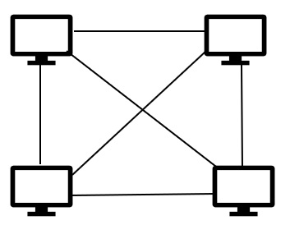

Slide 73
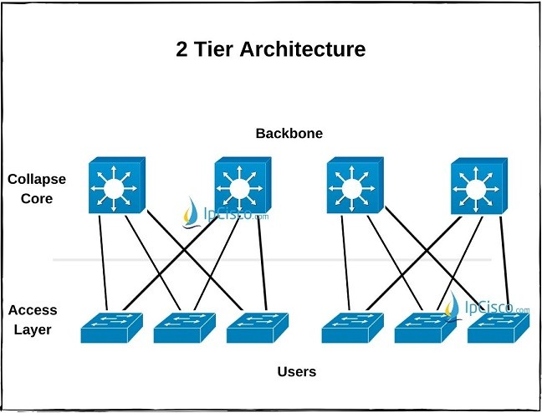
Two tier
A two-tier network topology, also known as a collapsed core or two-tier architecture, simplifies network design by combining the core and distribution layers into a single layer. This results in a simpler, more cost-effective, and manageable network, typically used in smaller campus networks or data centers. It consists of two main layers: the access layer and the collapsed core layer.

Slide 74
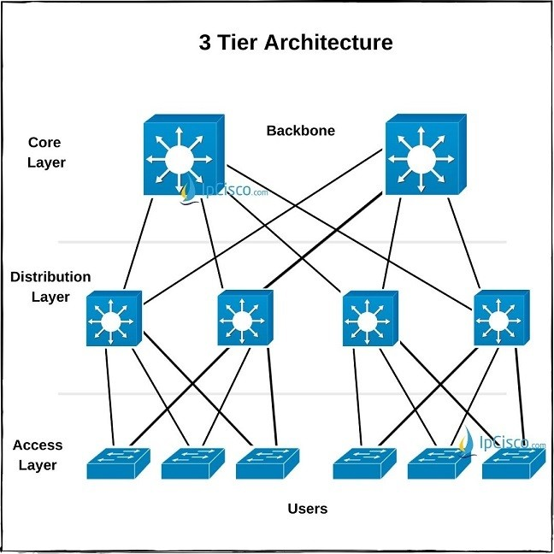
3-Tier
three-tier architecture, is a network or software design that divides a system into three distinct layers: the access layer, the distribution layer, and the core layer. This layered approach improves network management, scalability, and reliability.

Slide 75
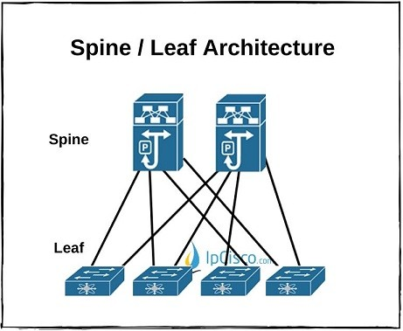
Spine Leaf :
Spine Leaf Architecture is the network architecture with which all the devices are the same segments away. It is the two layered architecture consist of Spine Layer and Leaf Layer.
The Leaf Layer is the layer, consist of Access devices, swithces, servers, edge routers etc. The Spine Layer is the core layer of Spine Leaf Architecture. Routing is the first duty of Spine layer. In Spine Leaf Architecture Design, every Leaf switch is connected to all the Spine Switches.

Slide 76
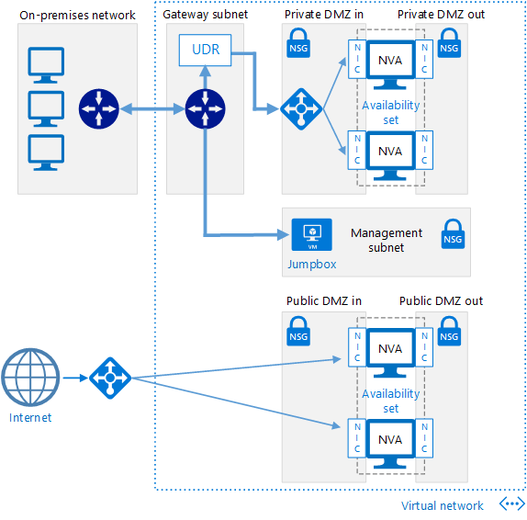
Hub and spoke
A hub and spoke network topology is a design where a central hub connects to multiple individual networks, called spokes, resembling a wheel with a central hub and radiating spokes. This topology is often used to isolate workloads while sharing common services like identity and security.

Slide 77
IPV6

Slide 78
IPv6 Addressing
An IPv6 address consists of 8 sets of 16-bit hexadecimal values separated by colons (:), totalling 128 bits in length.
For example: 2001:0db8:1234:5678:9abc:def0:1234:5678
We can omit leading zeros. For consecutive zeros in contiguous blocks, you can use a double colon (::). Double colons can appear only once in the address.
For example, here is the complete address: 2001:0db8:0000:130F:0000:0000:087C:140B

Slide 79
Abbreviating it
2001:0db8:0:130F::87C:140B
As with IPv4 addresses, we can represent an IPv6 address network prefix the same way:
2001:db8:12::/64

Slide 80
IPv6 unicast addresses generally use 64 bits for the network ID and 64 bits for the host ID.
The network ID is administratively assigned. The host ID is configured manually or auto-configured by any of the following methods:
• Using a randomly generated number.
• Using DHCPv6.
• Using the Extended Unique Identifier (EUI-64) format. We commonly use the EUI-64 host ID format for devices

Slide 81
Switching

Slide 82
Switching
Switching, in the context of computer networks, is the process of forwarding data packets between devices connected to a network. It involves using a network switch, which is a hardware device that directs traffic based on addressing information (like MAC addresses). This allows for efficient communication within a network, unlike older technologies like hubs that broadcast data to all connected devices.

Slide 83
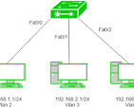
VLAN
VLAN (Virtual Local Area Network) switching allows a physical network to be logically segmented into multiple broadcast domains. This is achieved by assigning a VLAN ID to each switch port, which then determines which VLAN the connected device belongs to. VLANs enhance network security and improve management by isolating traffic between different groups of devices.

Slide 84
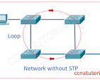
STP
Spanning Tree Protocol (STP) is a network protocol that prevents loops in Ethernet networks with redundant paths, ensuring a loop-free topology. It achieves this by electing a root bridge and blocking redundant paths, effectively creating a tree-like structure. This prevents broadcast storms and network instability caused by endless loops.

Slide 85
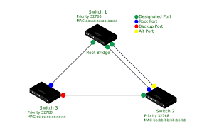
RSTP
Rapid Spanning Tree Protocol (RSTP) is a network protocol that provides faster convergence times than the original Spanning Tree Protocol (STP) in Ethernet networks. RSTP automatically determines the best way to route data on the network without redundancy, detecting link failures and reconfiguring the topology quickly. It achieves this by using a handshake mechanism between switches and defining specific port roles like root, designated, alternate, backup, and edge ports

Slide 86
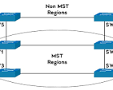
MSTP
Multiple Spanning Tree Protocol, is a network protocol used in switches to prevent loops in Layer 2 networks while also allowing for load balancing and faster convergence. It achieves this by creating multiple spanning trees (instances) for different VLANs within a region, enabling traffic to be distributed across multiple paths.

Slide 87
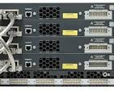
Stacking
switch stacking, is a technique that allows multiple physical network switches to be connected and managed as a single logical switch. This simplifies network management, increases scalability, and improves redundancy.

Slide 88
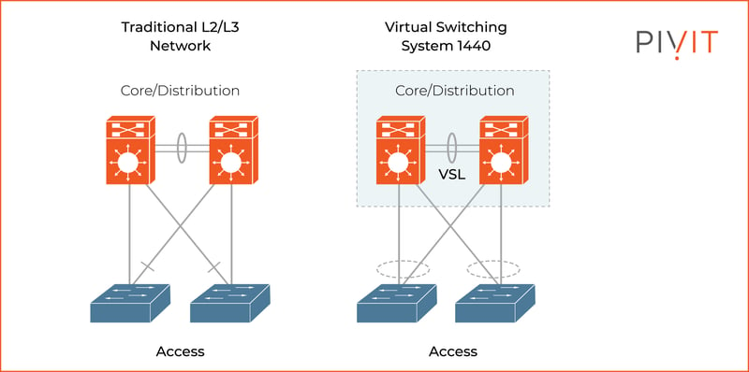
VSS
VSS, or Virtual Switching System, is a Cisco technology that combines two physical switches into a single logical switch. This simplifies network management and enhances redundancy by creating a unified control and management plane. Essentially, devices on the network see the VSS as a single switch, even though it's composed of two physical devices.

Slide 89
Routing

Slide 90
What is routing
Routing, in the context of computer networks, is the process of selecting paths for data packets to travel from a source to a destination within or between networks. It's a crucial function for ensuring that information reaches its intended recipient efficiently. Routers, acting as network intermediaries, analyze data packets, determine the optimal path, and forward the packets accordingly.

Slide 91
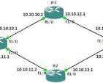
Static routing
Static routing is a technique where network routes are manually configured by an administrator and remain unchanged unless manually modified. It's a simple method for smaller networks with infrequent changes, offering security and reduced resource consumption compared to dynamic routing

Slide 92
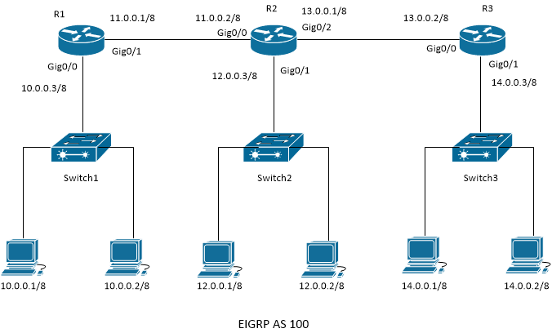
EIGRP
EIGRP, or Enhanced Interior Gateway Routing Protocol, is a Cisco-developed routing protocol used in large enterprise networks to efficiently exchange routing information between routers. It's a hybrid protocol, blending aspects of both distance-vector and link-state routing, and utilizes the Diffusing Update Algorithm (DUAL) for fast and loop-free convergence. EIGRP is known for its rapid convergence times, low network resource usage, and support for various features like VLSM and route summarization.

Slide 93
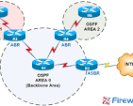
OSPF
Open Shortest Path First is a link-state routing protocol used to determine the most efficient path for data transmission within a single autonomous system (AS). It uses the Shortest Path First (SPF) algorithm (also known as Dijkstra's algorithm) to calculate the best routes based on link costs. OSPF is widely used in IP networks due to its efficiency, scalability, and ability to handle complex network topologies.

Slide 94
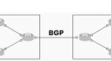
BGP
Border Gateway Protocol routing is the system that enables the internet to function by allowing different networks, called Autonomous Systems (AS), to exchange routing information and determine the best paths for data packets to travel across the internet. It's essentially the "postal service" of the internet, figuring out how to get data from one point to another efficiently

Slide 95
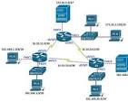
Security access list
Security Access List (ACL) is a set of rules used to filter network traffic, controlling which packets are allowed or denied access to a network or specific resources. ACLs act as a first line of defense, enhancing security by preventing unauthorized access and limiting potential threats. They are essentially like a guest list for a network, determining who or what can enter and exit.

Slide 96
Access List
Filtering:
ACLs filter network traffic based on criteria like source and destination IP addresses, protocols, and port numbers.
Implicit Denial:
If a packet doesn't match any rule in the ACL, it's typically dropped (denied).
Types of ACLs:
  Standard ACLs: Focus on filtering based on source IP addresses.
  Extended ACLs: Provide more granular filtering options, including source/destination addresses, protocols, and port numbers.

Slide 97
How ACL works
Packet Arrival: When a network packet arrives at a device (like a router), it's examined by the ACL.
Rule Matching: The packet is compared against each rule in the ACL, one by one.
Action: If a rule matches, the corresponding action (permit or deny) is taken on the packet.
Implicit Denial: If no rule matches, the packet is typically dropped.

Slide 98
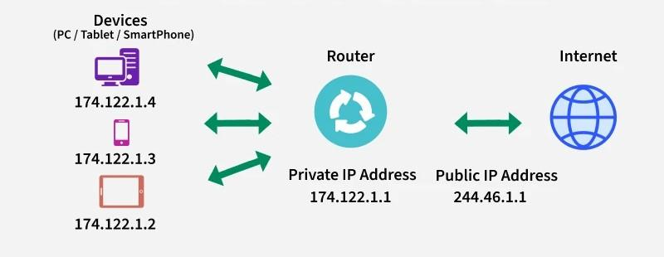
NAT
Network Address Translation is a networking process that modifies network address information in the IP header of packets as they pass through a router or firewall. It allows multiple devices on a private network to share a single public IP address when communicating with the internet, enhancing security and conserving IP addresses.

Slide 99
Private vs. Public IP Addresses:
Devices on a private network (like your home or office network) use private IP addresses, which are not routable on the public internet. NAT translates these private IP addresses to a public IP address when those devices need to access the internet.

Slide 100
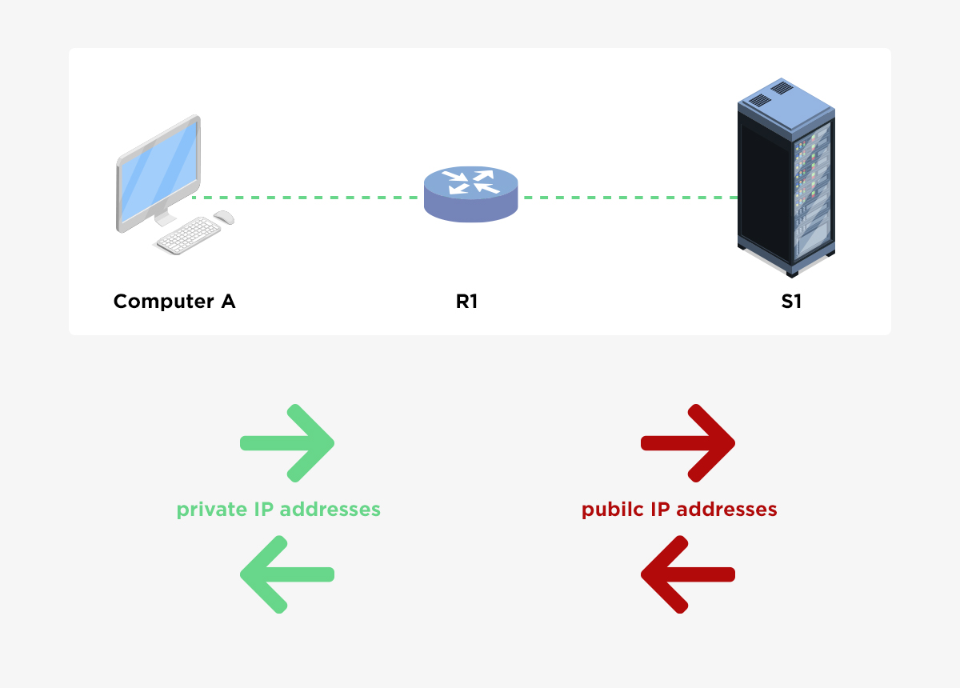
How NAT works
When a device on the private network sends a packet to the internet, the router's NAT function modifies the source IP address in the packet header to its own public IP address. It also creates a translation entry in its NAT table, mapping the private IP address to the public IP address and port number. When the response comes back, the router uses this table to translate the public IP address back to the correct private IP address, delivering the data to the intended device.

Slide 101
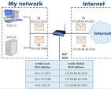
PAT
Port Address Translation, is a technique used to allow multiple devices on a private network to share a single public IP address when connecting to the internet. It's a type of Network Address Translation (NAT) where each internal device is assigned a unique port number in addition to the public IP address. This allows the router to distinguish between different devices' traffic when sending and receiving data from the internet.

Slide 102
How PAT works
When a device on a private network initiates a connection to the internet, the router intercepts the packet, replaces the private IP address with its public IP address, and assigns a unique port number to the connection. This mapping is stored in a NAT table. When the response comes back, the router uses the NAT table to forward the traffic to the correct device on the private network.

Slide 103
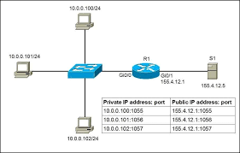

Slide 104
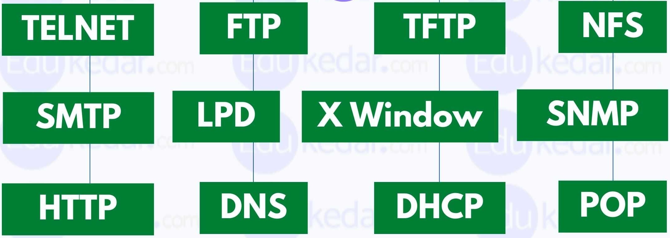
Network services
Applications that allow users or other applications to access resources and functionality over the network. They are hosted on servers and provide various capabilities, such as file sharing, printing, email, and web access. These services are crucial for enabling communication, data sharing, and resource management within a network.

Slide 105
DHCP
Dynamic Host Configuration Protocol network service is a system that automatically assigns IP addresses and other network configuration parameters to devices on a network. It eliminates the need for manual configuration of each device, simplifying network management and improving scalability.
67, 68

Slide 106
How DHCP works
1. Discovery:
When a device connects to the network, it sends out a DHCP discover message to find a DHCP server.
2. Offer:
The DHCP server, upon receiving the discover message, offers an IP address and configuration parameters to the client.
3. Request:
The client selects an offered IP address and sends a DHCP request to the server.
4. Acknowledgement:
The server acknowledges the request and assigns the IP address and configuration to the client.

Slide 107
DNS
Domain Name System is a fundamental network service that translates human-readable domain names (like www.google.com) into machine-readable IP addresses (like 172.217.160.142). This translation allows browsers and other applications to locate and connect to websites and other online resources. Essentially, DNS acts as the internet's phonebook, enabling users to access websites using easy-to-remember names instead of complex IP addresses.

Slide 108
How DNS works
User Request: When a user enters a website address (domain name) into a browser, the request is sent to a DNS resolver.
DNS Resolver Query: The DNS resolver (also called a DNS recursor) is typically provided by your internet service provider (ISP) or a public DNS service like Cloudflare. It then queries other DNS servers to find the corresponding IP address.
Recursive Query: The DNS resolver starts with the root servers and iteratively queries other DNS servers (TLD servers, authoritative servers) until it finds the correct IP address.
Authoritative Server: The authoritative server holds the definitive record for the domain name, providing the correct IP address.

Slide 109
How DNS works...
Response to Resolver: The authoritative server sends the IP address back to the DNS resolver.
Response to Browser: The resolver then forwards the IP address to the user's browser.
Connection: The browser uses the IP address to connect to the website's server and retrieve the requested content.
53

Slide 110
TFTP service
TFTP (Trivial File Transfer Protocol) is a simple network protocol for transferring files, particularly in situations where a full-fledged FTP (File Transfer Protocol) is unnecessary or impractical due to its complexity and resource requirements. It's often used for tasks like network booting, firmware updates, and transferring configuration files, especially in environments with limited resources or where security is not a primary concern
TFTP uses UDP 69

Slide 111
SSH
Secure Shell is a network protocol that provides a secure, encrypted connection between two computers, typically for remote access and management. It's widely used for tasks like remotely managing servers, transferring files, and accessing services in the cloud. SSH replaces older, insecure protocols like Telnet and FTP, offering strong authentication and encryption to protect data transmitted over networks, especially public ones.
22

Slide 112
HTTP
Hypertext Transfer Protocol, is a fundamental application layer protocol that enables communication between web browsers (clients) and web servers. It acts as a set of rules that govern how web browsers request information (like a webpage) from a server and how the server responds with the requested data or an error message. Essentially, it's the language that allows the internet to function by facilitating the exchange of information between users and websites.
Port 80

Slide 113
Telnet
Telnet is a network protocol that enables a user to remotely access and control a computer or network device via a command-line interface. It's a client-server application where the client initiates a connection to a server, allowing the user to interact with the remote system as if they were physically present. Telnet primarily uses TCP/IP and the standard port 23 for communication

Slide 114
SNMP
Simple Network Management Protocol service, is a network protocol used for managing and monitoring network devices. It allows administrators to collect information, configure devices, and respond to network events remotely. The service is implemented on devices like routers, switches, servers, and other network-connected equipment.
161, 162

Slide 115
TACACS+
Terminal Access Controller Access Control System Plus is a security protocol used for AAA (Authentication, Authorization, and Accounting) in network devices. It provides centralized management of user access to network resources. TACACS+ encrypts all AAA packets and allows for fine-grained control over user commands, making it a more secure and flexible option than its predecessor, TACACS.
TCP 49

Slide 116
RADIUS
RADIUS in networking stands for Remote Authentication Dial-In User Service. It's a protocol that provides a centralized authentication, authorization, and accounting (AAA) framework for users accessing network resources. Essentially, it helps manage who can access your network and what they can do once they're connected.
Radius combines AAA
1813

Slide 117
Syslog
Syslog is a standard protocol used for computer logging, particularly in Unix-like systems, and is crucial for monitoring and managing system events. It allows devices and applications to send log messages to a central server, enabling administrators to track system behavior, diagnose issues, and ensure security.
514

Slide 118
SNMP
Simple Network Management Protocol, is a widely used internet standard protocol for monitoring and managing network devices. It allows network administrators to collect information from and configure devices like routers, switches, servers, and printers. SNMP uses a manager-agent model where a central manager (NMS) communicates with agents on managed devices to gather data or make changes.
162

Slide 119
NTP
Network Time Protocol service is a protocol that synchronizes the clocks of computer systems over a network. It's crucial for maintaining accurate and consistent time across devices, which is important for various applications and services. NTP clients, typically on individual computers, communicate with NTP servers to synchronize their clocks.
UDP 123

Slide 120
RF basics

Slide 121
RF
Radio Frequency is a range of electromagnetic wave frequencies used in wireless communication. Specifically, RF refers to the oscillation rate of electromagnetic radiation, spanning from approximately 3 kHz to 300 GHz. These frequencies are used to transmit and receive signals for various applications, including radio, television, and wireless internet.

Slide 122
802.11 standard
IEEE 802.11 protocol, commonly known as Wi-Fi, is a set of standards for implementing Wireless Local Area Networks (WLANs). It defines the architecture, media access control (MAC), and physical layer (PHY) specifications for how devices communicate wirelessly.
MAC and PHY layers:
The protocol defines both the Media Access Control (MAC) layer, which handles how devices share the wireless medium, and the Physical (PHY) layer, which deals with the radio signals and modulation techniques.

Slide 123
Wi-Fi Alliance:
The Wi-Fi Alliance is a trade association that certifies devices to ensure interoperability between different manufacturers' products using the 802.11 standard.
Frequency Bands:
802.11 devices operate in different frequency bands, including 2.4 GHz and 5 GHz, and newer versions like Wi-Fi 6E also utilize the 6 GHz band.

Slide 124
802.11 standards
802.11a: Operates in the 5 GHz band, offering higher data rates than 802.11b.
802.11b: Operates in the 2.4 GHz band, offering speeds up to 11 Mbps.
802.11g: Operates in the 2.4 GHz band, offering speeds up to 54 Mbps.
802.11n: Supports both 2.4 GHz and 5 GHz bands, with data rates up to 600 Mbps, and introduces MIMO technology.

Slide 125
802.11 standards...
802.11ac (Wi-Fi 5): Operates primarily in the 5 GHz band, offering significantly higher speeds (up to 3.5 Gbps) and wider channels.
802.11ax (Wi-Fi 6): Designed for improved performance in crowded environments, with features like OFDMA and MU-MIMO.

Slide 126
Wireless authentication
Wireless authentication is the process of verifying the identity of a device or user attempting to connect to a wireless network. It ensures that only authorized individuals or devices can access the network and its resources, preventing unauthorized access and protecting data.
802.1X Authentication:
A more robust method using the Extensible Authentication Protocol (EAP), often used in enterprise environments. It involves a RADIUS server for centralized authentication.

Slide 127
Encryption
Wireless encryption, also known as Wi-Fi security, protects the wireless network by encrypting data transmitted between devices, making it difficult for unauthorized users to access or eavesdrop on the network. This encryption, along with authentication protocols, ensures only authorized users can connect and share data. Common encryption types include WEP, WPA, WPA2, and WPA3, with WPA3 being the latest and most secure standard.

Slide 128
WPA
WPA, or Wi-Fi Protected Access, is a security protocol designed to protect wireless network communications. It was introduced to replace the flawed WEP (Wired Equivalent Privacy) protocol, offering stronger encryption and authentication. WPA uses TKIP (Temporal Key Integrity Protocol) for encryption and EAP (Extensible Authentication Protocol) for authentication, enhancing security against unauthorized access and eavesdropping.

Slide 129
WPA2
Wi-Fi Protected Access 2 is a security protocol that protects wireless networks. It uses the Advanced Encryption Standard (AES) for strong encryption and the Counter Mode with Cipher Block Chaining Message Authentication Code Protocol (CCMP) for authentication and data integrity. WPA2 is widely adopted and considered the industry standard for securing Wi-Fi networks, particularly in home and small office environments.

Slide 130
WPA3
WPA3 is the latest Wi-Fi security protocol, introduced to enhance the security of wireless networks. It replaces the older WPA2 standard, offering stronger encryption and protection against various attacks like brute-force and offline dictionary attacks. WPA3 improves password security and provides better protection for individual connections, even on public Wi-Fi hotspots.

Slide 131
Connection types

Slide 132
DCI
Data Center Interconnect, refers to the technologies and services that link multiple data centers together, enabling them to share data and resources. This interconnection is crucial for various purposes, including disaster recovery, data replication, load balancing, and overall improved network performance. DCI can span from short distances within a campus to long distances across regions or even continents.

Slide 133

WAN interconnect
Wide Area Network interconnect is the process of connecting multiple Local Area Networks (LANs) or other networks across a wide geographical area, enabling communication and resource sharing between different locations. This could involve connecting multiple offices, data centers, or cloud resources.

Slide 134
P2P
P2P interconnect, or peer-to-peer interconnect, refers to a network architecture where devices connect directly to each other without relying on a central server. In this setup, each device acts as both a client and a server, allowing them to share resources and data directly with others. This contrasts with the traditional client-server model where a central server manages communication.

Slide 135

MPLS
MPLS Interconnect refers to the process of connecting different MPLS (Multiprotocol Label Switching) networks, often belonging to different providers or organizations, to enable communication and data exchange between them. This interconnection can be achieved through various methods, each with its own advantages and considerations.

Slide 136

PPPOE
Point-to-Point Protocol over Ethernet, is a network protocol that encapsulates PPP (Point-to-Point Protocol) frames within Ethernet frames. It's primarily used by internet service providers (ISPs) to deliver broadband internet services, like DSL and fiber, to users. Essentially, it allows multiple users to connect to an ISP's network over an Ethernet connection using PPP for authentication and session management.

Slide 137

xDSL
Digital Subscriber Line, is a family of technologies that enable high-speed data transmission over existing copper telephone lines. It is a broad term encompassing various DSL technologies like ADSL, HDSL, SDSL, and VDSL. These technologies differ in their data rates, operating distances, and whether they offer symmetric or asymmetric connections (equal or unequal upstream and downstream speeds).

Slide 138
What is xDSL
Broadband over Copper:
xDSL technologies leverage the existing copper infrastructure of telephone lines to deliver broadband internet access.
Digital Data Transmission:
They transmit digital data, including audio, video, and internet traffic, over these lines.
Local Loop Technology:
xDSL connections typically extend from a central office (where the telephone company's equipment is located) to a subscriber's premises

Slide 139
Dark fiber
Dark fiber refers to unused, unlit optical fiber cables that have been installed but are not currently carrying any data traffic. It's essentially a pre-installed, high-capacity network infrastructure that can be leased or purchased for customized network solutions.

Slide 140
What is dark fiber
Unused Fiber:
Dark fiber is fiber optic cable that has been laid, but no light signals (data) are being transmitted through it.
Potential Capacity:
It represents the potential bandwidth available in a telecommunications network.
Lease or Purchase:
Organizations can lease or purchase dark fiber from network providers to build their own private, dedicated networks.

Slide 141
Cables
cables are the physical pathways that transmit data and information within a network. They connect devices like computers, routers, and switches, enabling communication and data transfer. The three main types are coaxial, twisted pair, and fiber optic cables.

Slide 142
Cables
Coaxial Cables:
These cables have a central conductor surrounded by an insulating layer, a braided shield, and an outer jacket. They were commonly used in older Ethernet networks and for cable TV.
Twisted Pair Cables:
These cables consist of pairs of insulated copper wires twisted together. They are widely used in local area networks (LANs) and come in shielded (STP) and unshielded (UTP) varieties.

Slide 143
Twisted pair cables
Unshielded Twisted Pair (UTP): The most common type, UTP cables are used in both telephone and computer networks. Different categories (CAT3, CAT5, CAT5e, CAT6, CAT6a, CAT7, CAT8) specify different performance characteristics like speed and bandwidth.
Shielded Twisted Pair (STP): STP cables have an additional layer of shielding to protect against interference, making them suitable for environments with high electrical noise.

Slide 144
Cables
Fiber Optic Cables:
These cables use light signals transmitted through thin strands of glass or plastic to transfer data. They offer high bandwidth and are ideal for long distances and high-speed networks.

Slide 145
Cables
Ethernet Cables:
Many networking cables are Ethernet cables, which are used to connect devices within a local area network (LAN), such as computers, routers, and switches.
Crossover Cables:
These cables are used to connect two similar devices directly, like two computers or two switches, without a hub or switch in between.
Console Cables:
A special type of cable used for connecting a computer to a device's console port for configuration and management.

Slide 146
Cloud connectivity
Public Internet Connection with VPN:
This is the most common method, where users connect to cloud services over the public internet using a VPN (Virtual Private Network) for encryption and security.
Direct Cloud Connections:
Also known as Direct Connect, Cloud Interconnect, or ExpressRoute, these methods provide a dedicated, private connection between an organization's network and a specific cloud provider, bypassing the public internet.

Slide 147
Cloud connectivity...
Cloud Interconnect (Cross-Cloud Interconnect):
This enables secure and private connections between different cloud providers, facilitating multi-cloud and hybrid cloud deployments.
Virtual Private Cloud (VPC) Peering:
This allows you to connect VPCs within the same cloud provider or across different providers, creating a private network between them for seamless communication.

Slide 148
Cloud connectivity...
Software-Defined Cloud Interconnection (SDCI):
This approach uses software-defined networking (SDN) to dynamically route traffic and optimize cloud connectivity, often offered by specialized providers.
Network as a Service (NaaS):
NaaS providers offer on-demand network connectivity, allowing businesses to quickly provision and scale connections to various cloud providers and other network resources.
Private Cloud Hubs:
These hubs, often offered by colocation providers, provide one-to-many private connectivity to multiple cloud providers and other network services.

Slide 149
EXPRESSROUTE
Azure ExpressRoute provides a private connection between your on-premises network and the Microsoft cloud, bypassing the public internet. This offers enhanced reliability, faster speeds, lower latency, and increased security compared to standard internet connections. It enables you to extend your network into the Microsoft cloud, accessing services like Azure and Microsoft 365.

Slide 150

Direct Connect
Direct Connect, is a service that provides a dedicated, private network connection between an organization's on-premises infrastructure and a cloud provider's environment, bypassing the public internet. This offers several advantages, including increased bandwidth, reduced latency, and enhanced security.

Slide 151
Cloud interconnect
Cloud Interconnect provides a direct, private, and high-bandwidth connection between your on-premises network and Google Cloud, enhancing performance, security, and reliability for cloud networking solutions. It allows you to extend your network to Google's network, enabling efficient data transfer and hybrid cloud operations.

Slide 152

Physical interconnect
Category 5 cable (Cat 5) is a twisted pair cable for computer networks. Since 2001, the variant commonly in use is the Category 5e specification (Cat 5e). The cable standard provides performance of up to 100 MHz and is suitable for most varieties of Ethernet over twisted pair up to 2.5Gb but more commonly runs at 1000(Gigabit Ethernet) speeds. Cat 5 is also used to carry other signals such as telephone and video.

Slide 153

CAT6
Category 6 cable (Cat 6) is a standardized twisted pair cable for Ethernet and other network physical layers that is backward compatible with the Category 5/5e and Category 3 cable standards.
Cat 6 must meet more stringent specifications for crosstalk and system noise than Cat 5 and Cat 5e. The cable standard specifies performance of up to 250 MHz, compared to 100 MHz for Cat 5 and Cat 5e.^{[1]}

Slide 154

CAT7
Category 7 cable (Cat 7 cable) is a shielded twisted pair cable that is used in high-speed Ethernet-based computer networks of 1 Gbps or higher between directly connected servers, switches, and computer networks. The ISO/IEC 11801:2002 Class F specification defines and specifies it. Cat7 cable ethernet cable types and speeds are backward compatible with Cat 6, Cat 5/e cabling standards, and Cat5/e equipment.

Slide 155

RJ45
The eight-pin RJ45 connector is a standardised interface which often connects a computer to a Local Area Network (LAN). This type of connector was originally developed for telephone communications but is now used in a range of applications. The abbreviation, RJ45, stands for Registered Jack-45.

Slide 156
RJ11
RJ11, RJ14, and RJ25 are the most commonly used interfaces for telephone connections for one-, two-, and three-line service, respectively. Although these standards are legal definitions in the United States, some interfaces are used worldwide.

Slide 157

Fiber SMF
Single-Mode Fiber, is a type of optical fiber designed to carry only a single mode of light, enabling long-distance, high-bandwidth data transmission with minimal signal loss. This is achieved by using a very narrow core (typically 8 to 10.5 μm) that restricts light to a single path.

Slide 158

MMF
Multimode fiber (MMF) is a type of optical fiber, characterized by its larger core diameter that allows multiple light modes to propagate, making it suitable for short-distance data transmission. It's commonly used in local area networks (LANs), data centers, and other applications where distances are relatively short.

Slide 159

SPF
Small Form-factor Pluggable (SFP) is a compact, hot-pluggable network interface module format used for both telecommunication and data communications applications. An SFP interface on networking hardware is a modular slot for a media-specific transceiver, such as for a fiber-optic cable or a copper cable.

Slide 160
SPF+
The SFP+ transceivers (10 gigabits enhanced small form-factor pluggable) are interchangeable compact fiber connectors. CWDM SFP+ transceivers provide the right tools for a single network device to connect to various types of fiber optic cables and distances.

Slide 161

LC connector
LC connectors are small form factor fiber optic connectors designed for making fast connections in high-density applications. They are a miniaturized version of the earlier SC fiber connector (50% smaller) and feature a square plastic housing with a 1.25 mm ceramic ferrule.

Slide 162

SC connector
SC connectors (AKA: Subscriber, Square, or Standard connectors) use a push-pull design but utilize a locking tab to secure the cable. SC is the most common fiber optic connector in use today and is typical for datacom and telecom applications.

Slide 163

ST connector
(Straight Tip connector) A fiber-optic cable connector that uses a bayonet plug and socket. It was the first de facto standard connector for most commercial wiring.

Slide 164

Interface issue
Network card issues, also known as Network Interface Card (NIC) issues, typically manifest as a computer's inability to connect to a network or the internet. These problems can stem from various sources, including physical connection problems, incorrect network settings, faulty network cards, or driver issues. Troubleshooting steps include checking physical connections, verifying network settings, updating or reinstalling drivers, and potentially resetting the network stack.

Slide 165

Cable issue
Common network cable issues include physical damage, loose or faulty connections, interference, and maximum cable length being exceeded, leading to slow speeds, intermittent connections, or complete failure. Troubleshooting steps include visually inspecting the cable for damage, testing with another cable, restarting devices, and verifying proper connections.

Slide 166

Network collision
Network collisions occur when two or more devices on a shared network segment try to transmit data simultaneously, causing the data packets to interfere with each other. This leads to data corruption, performance degradation, and increased latency as devices need to retransmit the collided packets. Collisions are more prevalent in networks using older technologies like hubs or in environments with high traffic and large network sizes.

Slide 167
Duplex mismatch
A duplex mismatch in networking occurs when two connected devices use different duplex settings, such as one being set to full duplex and the other to half duplex. This mismatch can lead to significant performance issues like slow speeds, high packet loss, and communication errors.

Slide 168
Cause of duplex mismatch
Manual Configuration:
If one device is manually set to full duplex and the other is set to autonegotiate (which might default to half duplex), a mismatch can occur.
Autonegotiation Failure:
When one device is set to autonegotiate and the other is not, or if autonegotiation fails, the devices may end up with mismatched settings.

Slide 169
Fixing duplex mismatch
Consistent Configuration:
Ensure both devices on a link are either both manually configured for the same duplex setting or both using autonegotiation.
Disable Autonegotiation Sparingly:
While autonegotiation is generally recommended, it should be disabled only when necessary and with careful consideration of the potential for mismatches.
Verify Settings:
Regularly check the duplex settings on network devices to identify and correct any mismatches.

Slide 170


Slide 171

Next Gen Networking
Next-generation networking (NGN) generally refers to the evolution of telecommunications networks towards a packet-based, all-IP architecture, offering greater flexibility, scalability, and convergence of services. It aims to replace traditional circuit-switched networks with a unified, IP-based infrastructure that can handle diverse traffic types (voice, data, video) and support a wider range of applications and services.

Slide 172
Abberviations
MPLS (Multi-Protocol Label Switching) is a high-performance networking technique that speeds up and optimizes data traffic by replacing traditional IP routing with labels
BRAS (Broadband Remote Access Server) is a crucial device located at an Internet Service Provider's (ISP) network that acts as a gateway between broadband subscriber networks and the provider's core network
PSTN (Public Switched Telephone Network) is the global network of traditional, circuit-switched phone systems that connects users through physical lines and exchanges to transmit voice calls.

Slide 173
Abbreviations…
HGW (Home Gateway) It is a device that interconnects a home's local area network (LAN) with the broader, external internet or wide-area network (WAN). A modern HGW is typically a single, multi-functional piece of hardware that combines the capabilities of a router, a modem, and a firewall.
xDSL (Digital Subscriber Line) is a generic term for a family of technologies that provide high-speed internet access over traditional copper telephone lines.

Slide 174

Abbreviations
FTTx (Fiber to the X) is a broadband network architecture that uses fiber-optic cables to deliver telecommunications services, including high-speed internet, to various endpoints like homes, buildings, or curbs, with the "X" representing the specific location where the fiber terminates.
HFC (Hybrid Fiber Coax) network, is a broadband telecommunications network that combines fiber optic cables for high-capacity, long-distance data transmission with coaxial cables for the final connection to homes and businesses.

Slide 175

Abbreviations…
VoIP (Voice over Internet Protocol) is a technology that converts voice into digital data packets to be transmitted over an IP network, such as the internet or a local network, instead of traditional analog phone lines.

