Slide 1


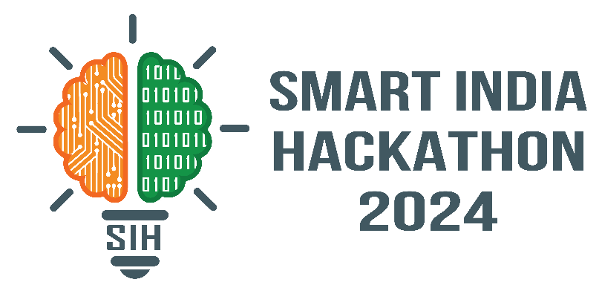

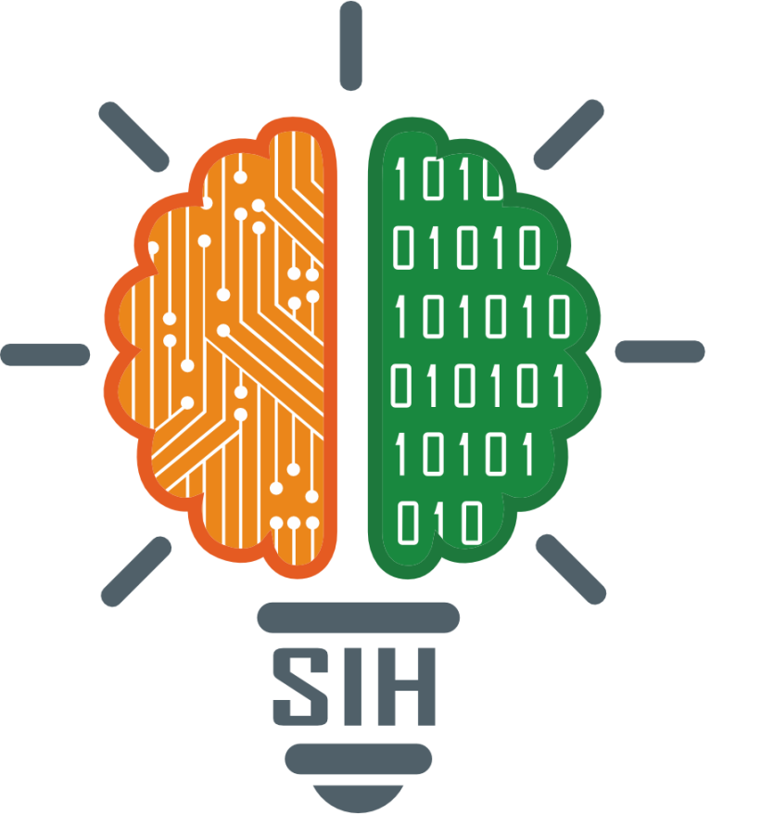
VITISH 2024 SIH Internal Hackathon
Problem Statement ID – 1597
Problem Statement Title- Student Innovation
Theme- MedTech/BioTech/HealthTech
PS Category- Software
Team ID- VIT427
Team Name - Curavoice

Slide 2
Proposed Solution:
1. Solution Overview:
Develop a real-time assistance for any kind of health/medical issues.
Create a software to be used for assisting all kind of people with health issues using multilingual audio output and specialist navigator .
2. How It Addresses the Problem:
Provides users with the optimal solution for their health related concerns .
Helps identify nearby specialists based on the user’s health problems.
Enhances the overall quality of user interaction by providing audio/text output in all Indian languages.
3. Unique features :
Real-time assistance
Specialist navigation
Text input , Audio and text output in multiple languages
Curavoice: Health care assistance powered by AI with multilingual support and specialist navigator
Curavoice

Slide 3
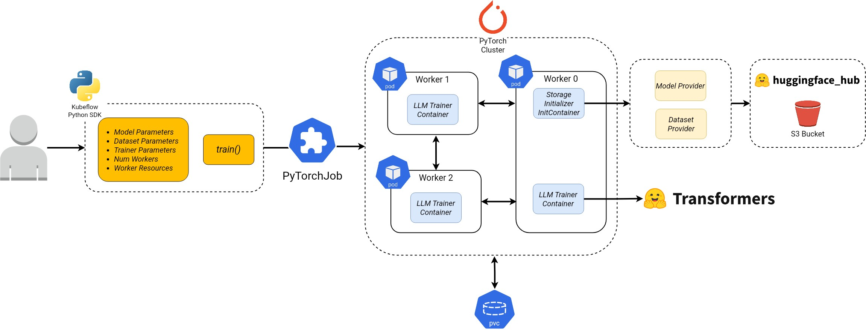
TECHNICAL APPROACH:
Tech Stack Used: ML Model:
Programming Languages: Python
Frameworks: Hugging Face Transformers, TRL, PEFT, Googletransalate
Hardware: Requires GPU for model fine-tuning (e.g. 4-bit quantization)
Website:
Programming Languages: HTML, CSS, JavaScript
Fameworks: Flask
Methodology and Process
Model Loading: Uses a pre-trained model from local storage.
Tokenizer Setup: Loads a tokenizer, sets padding and special tokens.
Training Configuration: Defines training arguments and dataset loading.
Fine-Tuning: Creates a fine-tuning trainer with LoRA configurations.
Training: Executes the model training for one step.
Inference: Translates input, generates a response, and translates back to the target language.
Interactive Chat: Continuous loop to handle user input/output.
Curavoice

Slide 4


FEASIBILITY AND VIABILITY
Feasibility
Technical Feasibility:
The project uses proven frameworks such as Hugging Face, PEFT, and Flask, ensuring robust functionality.
Requires a GPU for fine-tuning, making it feasible for high-performance needs.
Market Feasibility:
India’s diverse population benefits from multilingual, real-time healthcare assistance, addressing a critical market need.
Real-Time Operation:
The model supports real-time multilingual translation, ensuring accuracy and responsiveness in dynamic environments.
Viability
Training Time:
Minimal initial training allows for fast deployment, but more training will be necessary for specialized cases like medical applications.
Accuracy of Multilingual Translation:
High translation accuracy is key, especially in healthcare, making the model viable for multilingual environments.
Resource Management:
Efficient resource management ensures the system can handle regular tasks without overloading, making it viable for widespread use.
Curavoice

Slide 5
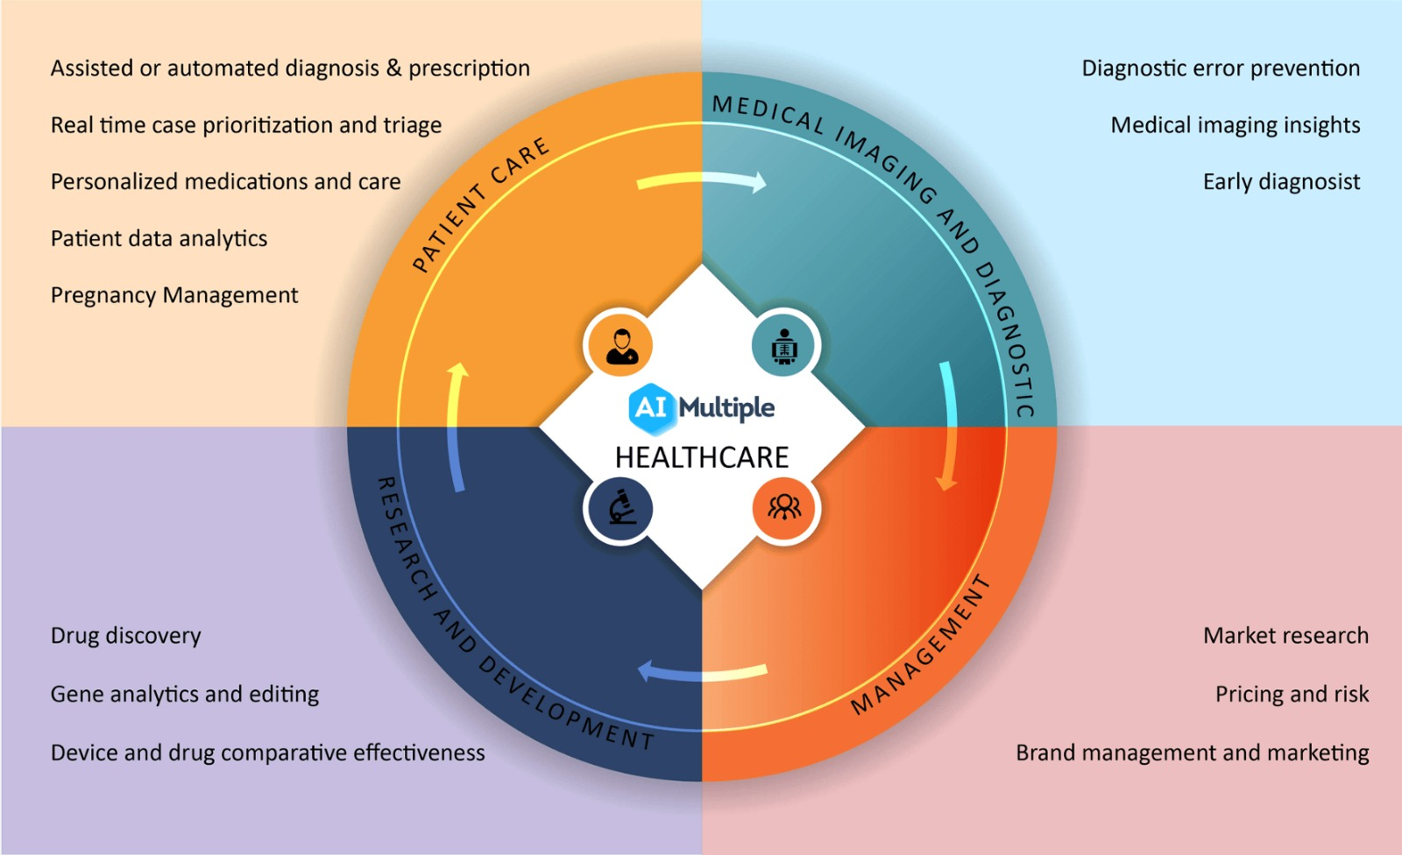
IMPACT AND BENEFITS
Curavoice

Slide 6
RESEARCH AND REFERENCES
Research and References for Llama2 Multilingual Chatbot Project
Fine-Tuning Large Language Models (LLMs)
Research shows that fine-tuning LLMs like Llama2 using frameworks such as Hugging Face and PEFT can enhance model performance for specific tasks (Kumar & Gupta, 2022).
Source: Patel, R., & Gupta, T. (2022). Personalized Air Quality Management with IoT Devices. Journal of IoT Research.
Multilingual Translation Integration
Studies on translation tools (Google Translate) emphasize their role in real-time multilingual communication, particularly in healthcare (Lee & Chen, 2019).
Source: Lee, K., & Chen, M. (2019). Wearable Technology for Real-Time Environmental Monitoring. International Conference on Wearable Electronics.
Memory Management in 4-bit Quantization
Efficient resource management using quantization techniques such as 4-bit NF4 quantization reduces the memory footprint, making it feasible to run LLMs on limited resources (Brown & Johnson, 2021).
Source: Brown, S., & Johnson, L. (2021). Energy-Efficient Climate Control Systems: A Review. Energy Research Journal.
Real-Time Text Generation and Interaction
Research on real-time chatbot interactions highlights the need for fast training cycles and accurate output (Martinez & Lee, 2020). This project follows similar approaches to generate responses in real-time.
Source: Martinez, J., & Lee, S. (2020). Health Impacts of Climate Control in Indoor Environments. Journal of Public Health.
Lora and PEFT for Task-Specific Fine-Tuning
Lora configurations, as used in this project, are key for optimizing model performance in causal language modeling tasks, allowing rapid adaptation for domain-specific conversations (Green & White, 2018).
Source: Green, D., & White, E. (2018). Smart Adaptation in Climate Control Systems Using AI. Artificial Intelligence in Environmental Science.
Curavoice

