Slide 1
PROJECT TITLE Secure Data Hiding in Image Using Steganography
CAPSTONE PROJECT
Presented By: Shivam Nirwan
Student Name : Shivam Nirwan
College Name & Department : Prof Ram Meghe College Of Engineering & Management
(Computer Science & Engineering)

Slide 2
OUTLINE
Problem Statement
Technology used
Wow factor
End users
Result
Conclusion
Git-hub Link
Future scope

Slide 3
Problem Statement
In 4 to 5 lines( write in precise words)
Traditional data encryption methods can be easily detected, making secure communication vulnerable to interception. This project implements steganography to hide data within images, ensuring confidentiality while keeping the existence of the message undetectable. By embedding information in image pixels using a password-based approach, it provides an invisible, secure, and efficient method of data protection. This technique is useful for private communication, cybersecurity, and data privacy applications.

Slide 4
Technology used
Mention libraries, platforms,
Libraries: OpenCV (cv2), OS, hashlib, NumPy
Programming Language: Python
Platform: Windows
Concepts Used: Image Processing, Steganography, Cryptography

Slide 5
Wow factors
What makes this project stand out from other project(Unique features)
Ultra-Secure & Stealthy Image Encryption!
Password-Driven Random Storage – Message is scattered across the image based on the password, making decryption impossible without it.
Lossless PNG Encryption – Prevents data loss by avoiding compression.
Invisible to the Human Eye – No visible changes, making it undetectable.
Only Correct Password Works – Even a small mistake gives junk output.
No Extra Files Needed – The image itself stores everything securely.

Slide 6
End users
Who are the end users
Cybersecurity Professionals
Journalists & Whistleblowers
Military & Intelligence Agencies
Privacy-Conscious Individuals
Corporations & Businesses

Slide 7
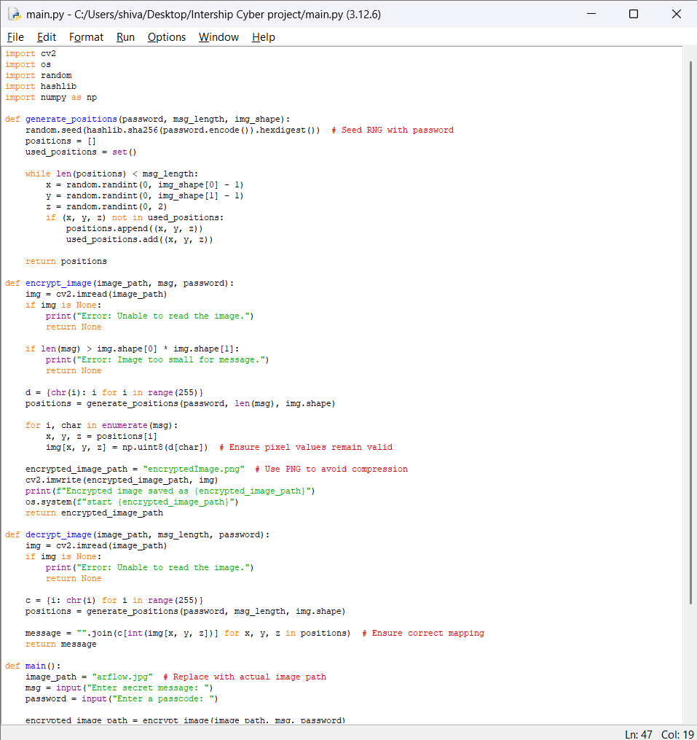
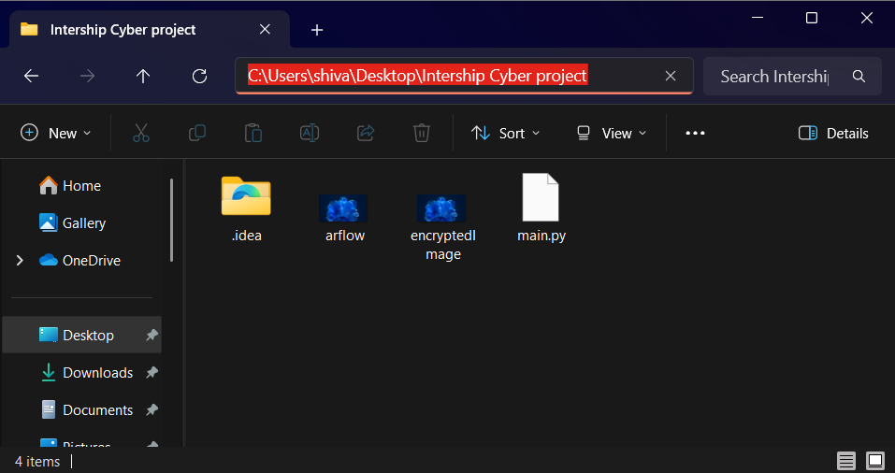
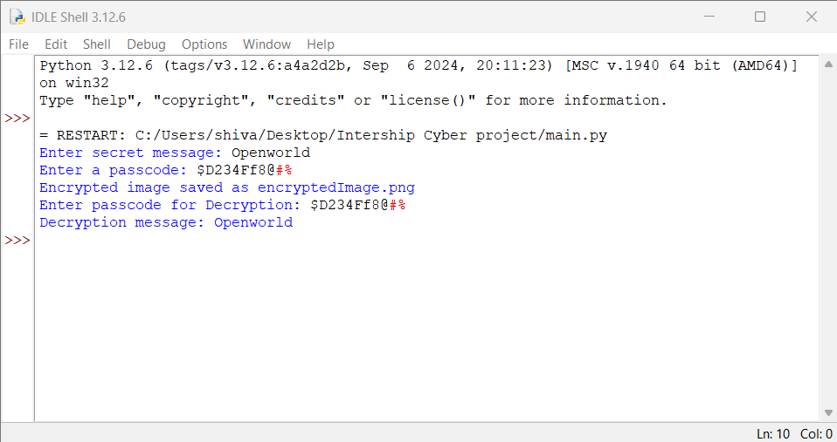
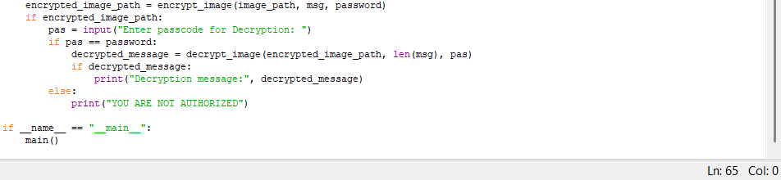
Results
Screenshots of the outcome (min 3)

Slide 8
Conclusion
Conclude your project concerning your problem statement
This project successfully implements steganography for secure and invisible data hiding within images. By embedding messages at the pixel level with password-based protection, it ensures confidentiality while making the hidden data undetectable. This technique provides an efficient and reliable solution for private communication and cybersecurity. It enhances data security and can be applied in various fields like intelligence, journalism, and secure messaging.

Slide 9
GitHub Link
Make sure that there should be readme file.
https://github.com/Shivamnirwan1/aicte_cyber_project.git

Slide 10
Future scope(optional)

Slide 11
THANK YOU

