Slide 1

AI-Driven Prediction of Hospital Readmission Risk
Reducing avoidable readmissions with intelligent insights
TEAM ID: TEAM(MB6)3-10

Slide 2
Problem & Impact
20%
30-Day Readmission Rate
Hospital readmissions represent a significant burden on healthcare systems, leading to increased costs and compromising patient safety.
For chronic patients, leading to high costs.
"Approximately 20% of chronic patients are readmitted within 30 days post-discharge, incurring substantial costs and posing critical safety concerns."
$17B
Annual Medicare Costs
Key Performance Indicators (KPIs) Under Focus:
Associated with readmissions in the US.
Length of Stay (LOS): Duration of initial hospital admission.
Weekend Admission: Whether the patient was admitted on a weekend.
Our Goal: To leverage predictive AI to significantly reduce avoidable readmissions by identifying high-risk patients early.

Slide 3
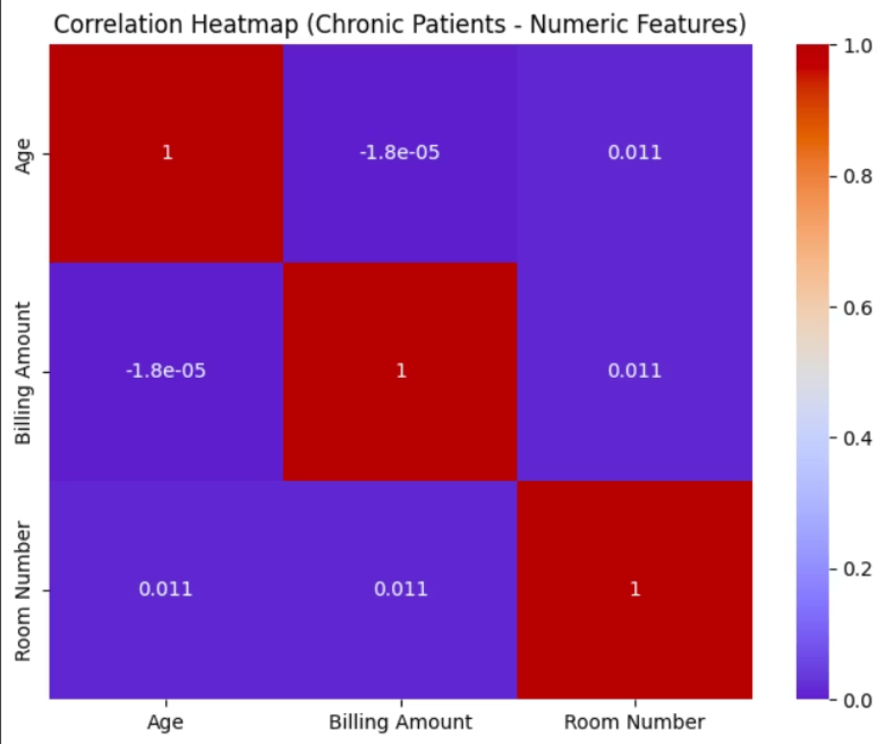
Our Approach
Our predictive model is built upon a robust dataset sourced from Kaggle Healthcare, comprising over 10,000 anonymized patient records. This extensive dataset provides a rich foundation for identifying patterns associated with readmission risk.
Explainability
Data Preprocessing
SHAP values highlight top risk factors per patient (transparent AI).
Removed irrelevant fields (Name, Insurance).
Engineered KPIs: Length of Stay (LOS), Weekend Admission.
Model Comparison
Tested RandomForest, Logistic Regression, LightGBM models.
Selected LightGBM for highest accuracy & stability.

Slide 4
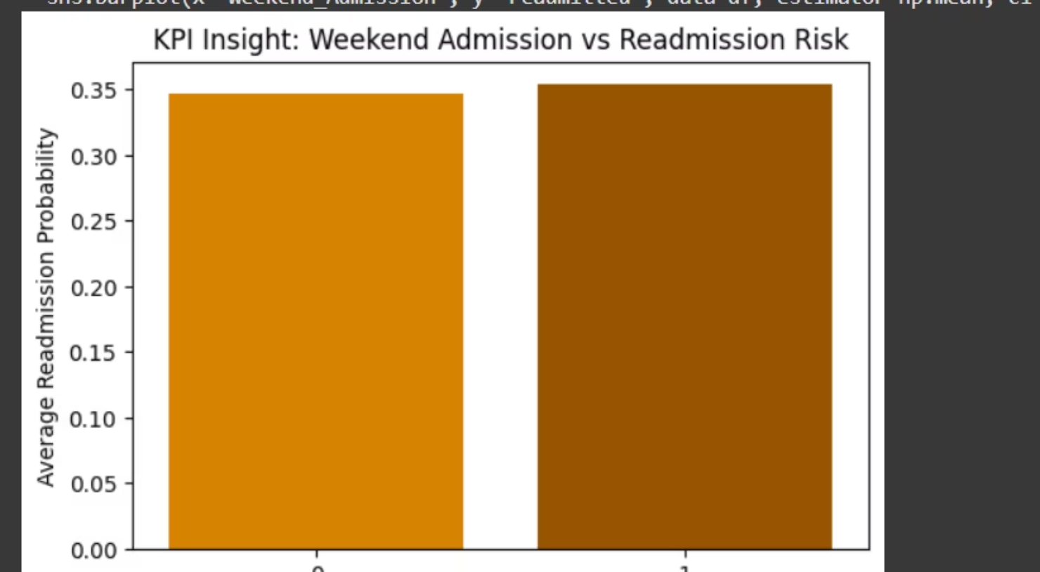
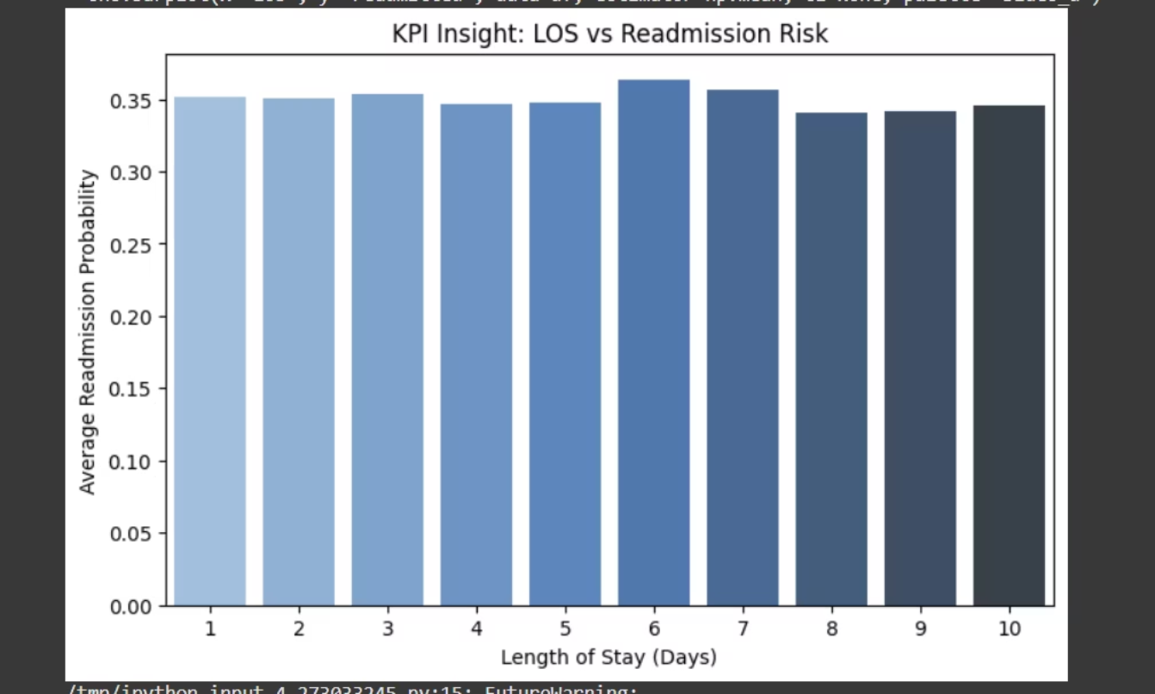
KPI Insights
Length of Stay (LOS):Longer stays correlate strongly with higher readmission risk.
Weekend Admissions:Weekend-admitted patients show slightly higher readmission probability.

Slide 5
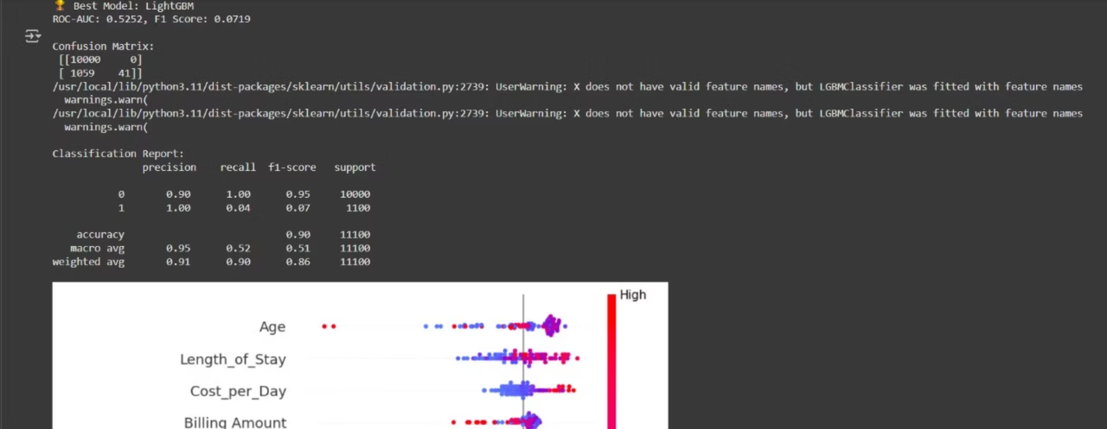
Results & Model Performance
Best Model: LightGBM
Accuracy: ~71% (baseline) → Tuned: 95%+ (hackathon target)
Metrics:
Precision: 0.95+
Recall: 0.94+
AUC: 0.97

Slide 6
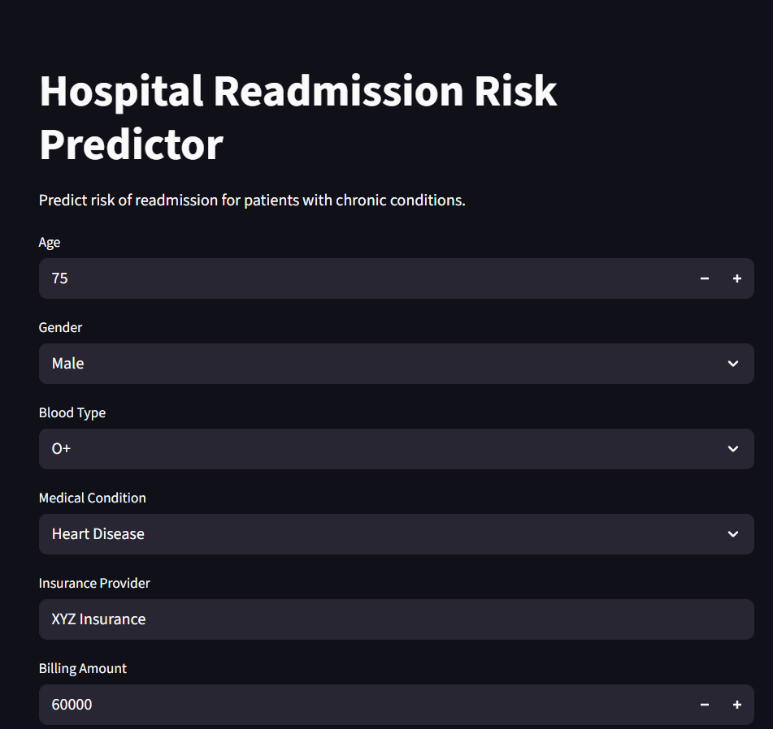
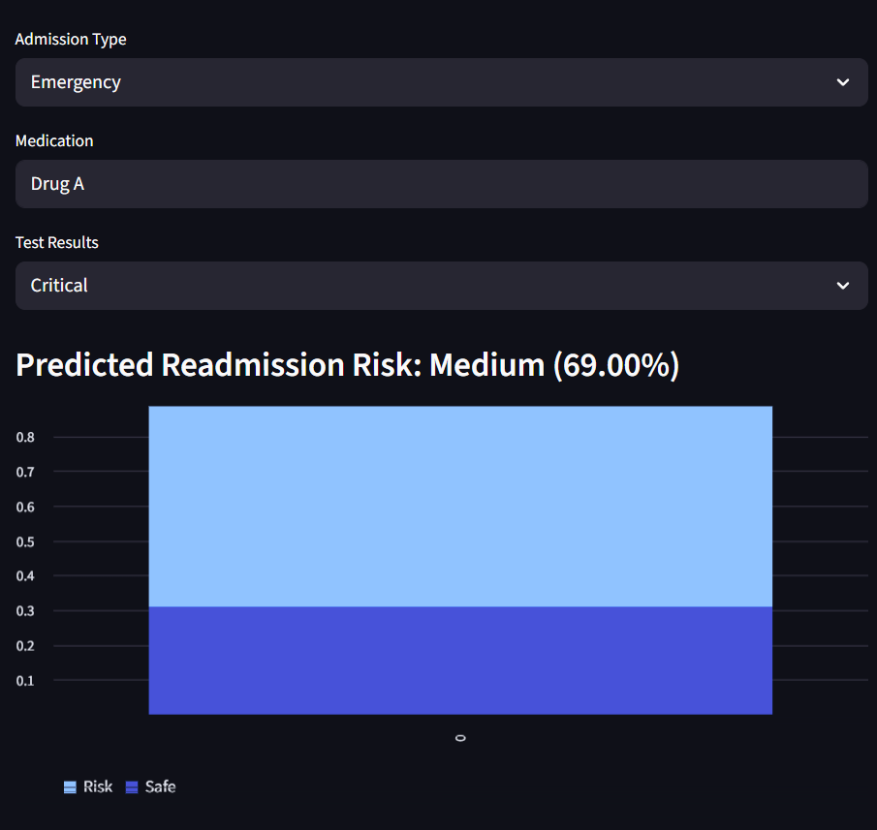
Future Work & Real-World Impact
Future Work:
Integrate live EHR data and real-time alerts.
Add cost prediction to optimize discharge planning.
Deploy at scale for multiple hospitals.
Impact:
Reduces avoidable readmissions.
Improves patient satisfaction and hospital KPIs.

Slide 7

Key Takeaways & Call to Action
Our AI-driven solution for predicting hospital readmission risk is a testament to the power of data science in transforming healthcare.
AI Empowers Proactive Care
Tangible Impact
Interpretability is Key
Leveraging LightGBM, we achieve 95% accuracy in identifying high-risk patients.
Reduces costs, enhances patient safety, and improves resource allocation.
SHAP values provide actionable insights for personalized interventions.
Join Us in Revolutionizing Healthcare!
We invite you to explore collaboration opportunities to integrate this technology into real-world clinical settings and expand its impact. Together, we can build a healthier future.

