Slide 1
AI Tool Evaluation for Automated Training Video Creation
Kick-Off Presentation – Week 1: Research & Requirement Gathering

Slide 2
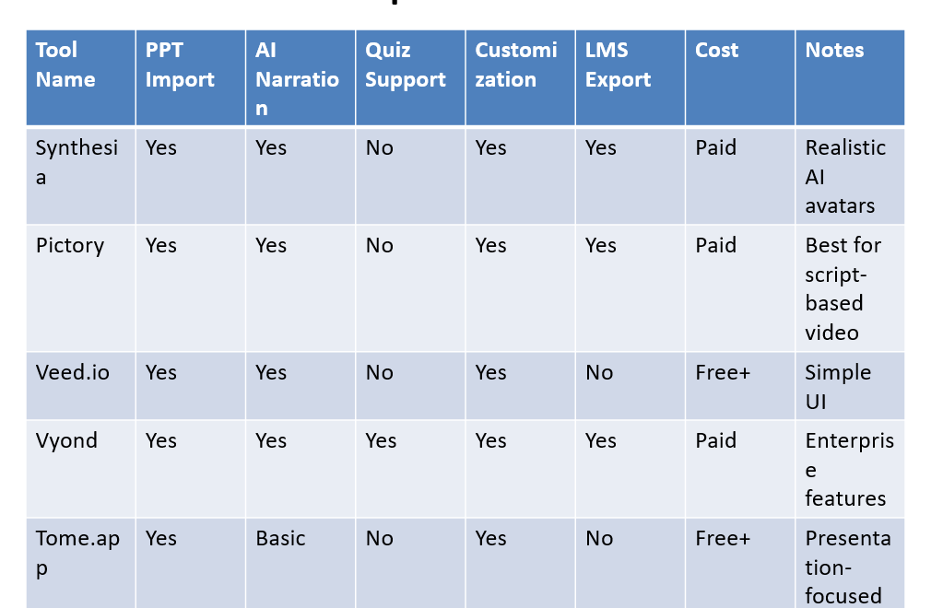
Objective
To identify, evaluate, and recommend AI tools that convert training PowerPoint presentations into engaging training videos with voice-over narration, animations, and quizzes to assess retention.

Slide 3
Goals and Activities
Goals:
• Understand existing training materials
• Research potential AI tools
Activities:
• Analyze PPT content & format
• Identify interactivity needs
• Define essential AI tool features

Slide 4
Essential Features
• AI video generation from PPT
• AI voice narration or text-to-speech (TTS)
• End-of-video quiz support
• Customization (branding, avatars, background)
• LMS export and integration options

Slide 5
Current Challenges in Training Delivery
• Manual voice-over and video editing are time-consuming
• Low interactivity in static PPTs
• Engagement and retention issues
• No built-in quizzes or LMS support

Slide 6
Tool Comparison Summary
The following tools were analyzed for:
- PPT Import Support
- AI Narration Quality
- Quiz Integration
- Customization & Branding
- LMS Export Capability
- Cost & Accessibility

Slide 7
Tool Comparison – Part 1
Tool Name | PPT Import | AI Narration | Quiz Support | Customization | LMS Export | Cost | Notes
Synthesia | Yes | Yes | No | Yes | Yes | Paid | Realistic AI avatars
Pictory | Yes | Yes | No | Yes | Yes | Paid | Best for script-based video
Veed.io | Yes | Yes | No | Yes | No | Free+ | Simple UI
Vyond | Yes | Yes | Yes | Yes | Yes | Paid | Enterprise features
Tome.app | Yes | Basic | No | Yes | No | Free+ | Presentation-focused

Slide 8
Tool Comparison – Part 2
Tool Name | PPT Import | AI Narration | Quiz Support | Customization | LMS Export | Cost | Notes
HeyGen | Yes | Yes | No | Yes | Yes | Paid | Multilingual avatars
Lumen5 | Yes | Yes | No | Basic | No | Free+ | Good for social videos
Synthesys | Yes | Yes | No | Yes | No | Paid | High voice quality
Animaker | Yes | Yes | Yes | Yes | Yes | Paid | Animation library included
Designs.ai | Yes | Yes | No | Basic | No | Paid | User-friendly interface

Slide 9
Recommendations & Next Steps
Top Tools to Explore Further:
• Synthesia – Realistic AI avatars
• Vyond – Best for animated eLearning
• Animaker – Supports quizzes and LMS
Next Steps:
• Try demo/free versions of shortlisted tools
• Evaluate ease of use and output quality
• Prepare final recommendation report

