Slide 1

Artery – Digital human girl

Slide 2
Artery – Digital Human girl
Tagline:
"More than an Assistant – A Digital Version of human"
About Artery:
Artery is an AI-powered OS designed to understand your emotions, voice, and behavior, while assisting in tasks across system, security, automation, and cloud integration. Just like arteries are vital in the human body, Artery becomes the lifeline of My digital world.
Birthday / Launch: TBD

Slide 3
Features (Summary)
Human-like Chatbot + Voice Assistant.
Emotion detection via face, voice, text.
Vision: face + object recognition.
2D/3D avatar interface.
Security monitoring for PC + phone.
Personal assistant (calls, SMS, calendar).
Self-learning AI.

Slide 4
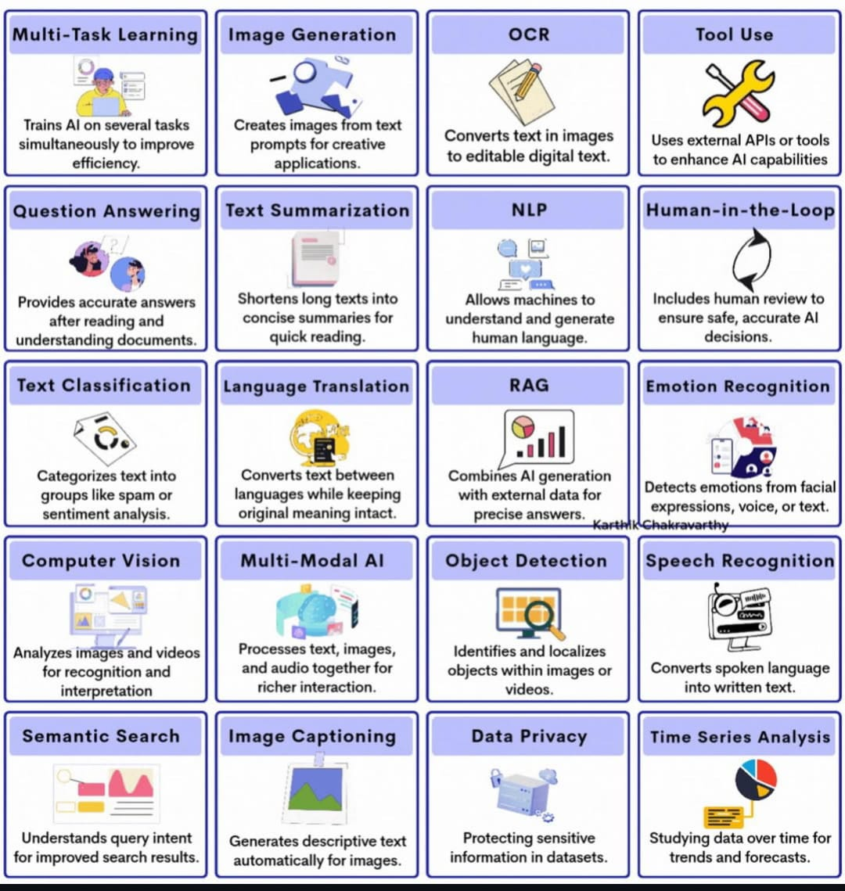
Core Features of Artery
Artery comes with multi-layered features that make Unbeatable Ai powered OS :
Chatbot Intelligence – Responds like a human (text + voice)
Voice Assistant – Execute tasks, calls, messages via speech commands
2D/3D Avatar – Visual representation, future upgrade → hologram
Emotion Detection – Understands feelings via voice, face & tone
Vision Module – Recognizes user & environment via camera (OpenCV)
Task Scheduling – Manage calendar, reminders, alarms, automation
Security & Device Manager – Detects malware, system threats & phone risks
Self-Learning – Adapts over time (like human behavior learning)

Slide 5
Languages & Technologies (Summary Table)
Module | Language | TEchnology/Library/API | Purpose
Response | Python | Transformers, OpenAI API | Text Conversation
Voice Assistant | Python | SpeechRecognition, Pyttsx3 | Voice Input/Output
Emotion Detection | Python | OpenCV, librosa, transformers | Detect Emotions
Vision System | Python | OpenCV, YOLO, PyTorch | Face/Object Recognition
2D/3D Avatar | Python / C#/C++ | Tkinter/Pygame, Unity, Blender | Avatar & Hologram
Personal Assistant | Python | Twilio, Google API | Calls, SMS, Scheduling
Security Monitoring | Python | psutil, antivirus APIs | System & Security
Self-Learning | Python | Scikit-learn, TensorFlow | Adaptive AI
Cloud Integration | Python + Cloud | AWS, Azure, HuggingFace | Heavy Model Support

Slide 6
Modules & Their Technologies
Response (like ChatGPT)
Emotion Detection (via Face, Voice, Text)
Language/Tech: Python
Libraries: Transformers (HuggingFace), NLTK, Spacy
API: OpenAI API / LLaMA / HuggingFace
Role: Natural text conversation (Q&A, tasks, general chat).
Voice Assistant (STT + TTS)
Language/Tech: Python
Libraries/APIs: SpeechRecognition, Pyttsx3, Vosk / Google Speech-to-Text, ElevenLabs TTS
Role: Convert speech ↔ text, respond in voice like a human.
Language/Tech: Python
Libraries: OpenCV (face emotion), librosa (voice emotion), transformers (text sentiment)
Models: FER2013 for face emotions, Speech Emotion Recognition models.
Role: Capture user’s emotions and respond empathetically.
Vision System (Face + Object Recognition)
Language/Tech: Python + Deep Learning
Libraries: OpenCV, TensorFlow/PyTorch, YOLOv8
Role: Recognize users, objects, and environment through camera.

Slide 7
Modules & Their Technologies
Security & System Monitoring
2D/3D Avatar & Hologram
Language/Tech:
2D: Python (Tkinter/Pygame)
3D/Hologram: Unity + Blender (C#) or Unreal Engine (C++)
Role: Show a digital face/avatar of Artery that reacts in real-time.
Personal Assistant (Calls, SMS, Scheduling)
Language/Tech: Python
Libraries/APIs: Twilio (SMS/Calls), Google Calendar API, WhatsApp API
Role: Send/receive messages, reply to calls, schedule tasks.
Language/Tech: Python
Libraries: psutil (system stats), yara / antivirus APIs (virus scan)
Role: Monitor PC + phone health, detect viruses, warn user.
Self-Learning & Adaptation
Language/Tech: Python
Libraries: Scikit-Learn, TensorFlow, PyTorch
Techniques: Reinforcement Learning, Preference Learning
Role: Learn from your usage patterns and improve automatically.
Cloud Integration
Platform: AWS, Google Cloud, Azure, HuggingFace Hub
Role: Heavy AI models (GPT, Vision) run on cloud → results return to your system.

Slide 8
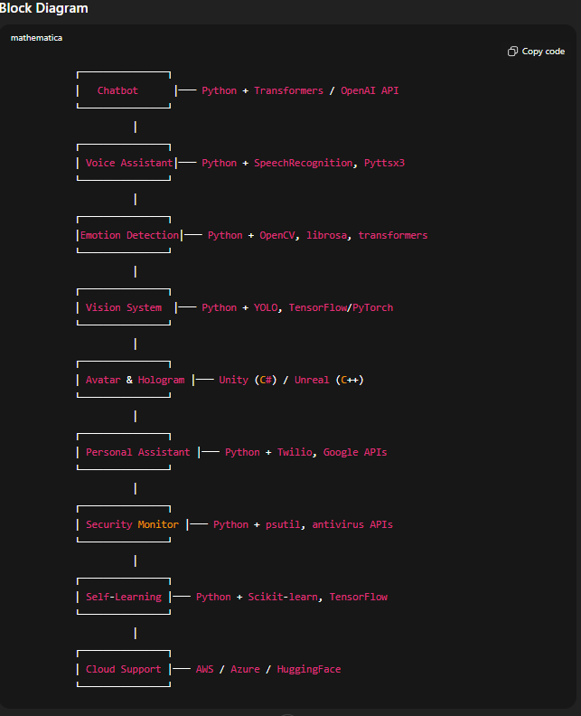
Modules & Technologies Used in Artery Block Diagram

Slide 9
Define Working
Artery is an AI-powered OS that can:
Interact like humans (via text & speech)
Recognize and respond to emotions (voice, face, tone)
Manage personal devices (phone + computer)
Detect security issues (viruses, suspicious activity)
Schedule & automate tasks (calendar, reminders, calls, messages)
Represent itself with a 2D/3D avatar, future upgrade → hologram
🔄 Flowchart (PPT SmartArt):
User gives Input (Voice/Text/Face)
AI processes → NLP + Emotion + Vision
Core Brain (Decision-making + Scheduling + Security)
Output → Reply (Text/Voice/Avatar) + Action (call, alert, schedule, control device)

Slide 10
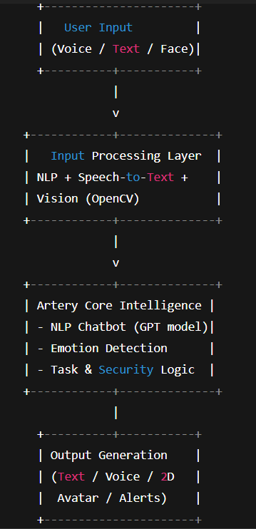
🖼️ Block DiagraM:
🎥 Tutorial URLs (for basics covered in intro)
Response (NLP + GPT): YouTube – Build Chatbot in Python
Speech Recognition + Voice AI: YouTube – Jarvis AI with Python
OpenCV Face Recognition (Vision): YouTube – Face Detection with OpenCV

Slide 11
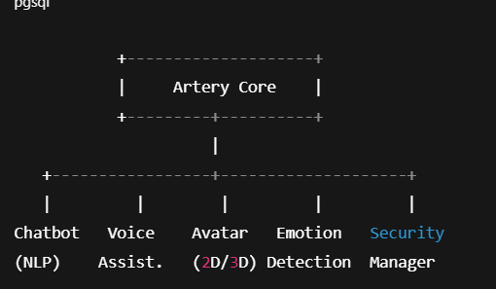
🔄 Flow Idea
⚙️ Define Working:
Response+ NLP: Uses Transformer models (like GPT) for natural responses.
Voice Module: SpeechRecognition + TTS for real-time communication.
Vision Module: OpenCV + Deep Learning for recognition.
Emotion Detection: ML models analyzing tone & facial expressions.
Security Module: Scans files/processes for threats + sends phone alerts.
Scheduler: Uses Python libraries (schedule, calendar) to manage tasks.

Slide 12

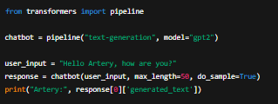
💻 Example Code Snippet (Feature – Chatbot with NLP):
from transformers import pipeline
chatbot = pipeline("text-generation", model="gpt2")
user_input = "Hello Artery, how are you?"
response = chatbot(user_input, max_length=50, do_sample=True)
print("Artery:", response[0]['generated_text’])
from transformers import pipeline
chatbo
response = chatbot(user_input, max_leng
print("Artery:", response[0]['generated_text’])
🎥 Tutorial URLs:
Response + NLP: Udemy – NLP AI Assistant
Voice Assistant: YouTube – Jarvis AI
OpenCV Vision: YouTube – Face Recognition
Task Scheduler: Python Schedule Docs

Slide 13
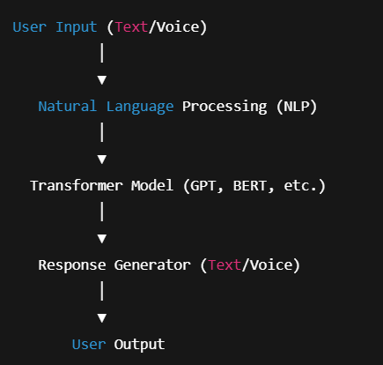
Response Module (Like ChatGPT)
The Chatbot Module enables Artery to:
Converse naturally like humans.
Understand context, emotions, and intent.
Reply via text & voice.
Integrate with calls, SMS, and apps (future upgrade).
🔄 Block Diagram (for PPT):

Slide 14
⚙️ Define Working:
Input Layer: User gives text/voice.
Preprocessing: Voice → Text (SpeechRecognition).
NLP Model: Processes intent using GPT/BERT.
Response Generator: Creates human-like response.
Output: Converted to voice (Text-to-Speech).
🎥 Tutorial URLs:
Text + Voice Chatbot: YouTube – Python Jarvis
Transformers NLP: HuggingFace Docs
Speech Recognition: Python SpeechRecognition Docs

Slide 15
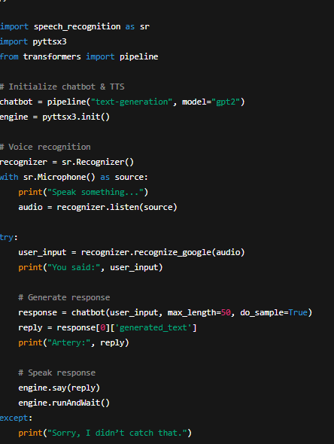
💻 Example Code Snippet:
import speech_recognition as sr
import pyttsx3
from transformers import pipeline
# Initialize chatbot & TTS
chatbot = pipeline("text-generation", model="gpt2")
engine = pyttsx3.init()
# Voice recognition
recognizer = sr.Recognizer()
with sr.Microphone() as source:
print("Speak something...")
audio = recognizer.listen(source)
Try
user_input = recognizer.recognize_google(audio)
print("You said:", user_input)
# Generate response
response = chatbot(user_input, max_length=50, do_sample=True)
reply = response[0]['generated_text']
print("Artery:", reply)
# Speak response
engine.say(reply)
engine.runAndWait()
except:
print("Sorry, I didn’t catch that.")

Slide 16
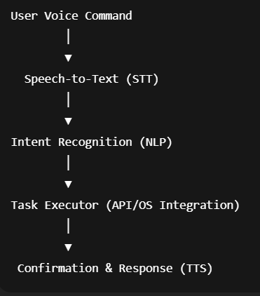
Voice Assistant Module
The Voice Assistant Module extends Artery’s ability to:
Reply to calls & SMS.
Perform task automation (open apps, set reminders, send emails).
Control devices using voice commands.
Integrate with IoT devices (future upgrade).
🔄 Block Diagram

Slide 17
⚙️ Define Working:
Speech-to-Text (STT): Converts user speech → text.
NLP Engine: Detects intent (call, message, open app, reminder).
Task Executor: Uses APIs & system libraries to perform the action.
Text-to-Speech (TTS): Confirms action back to user.
🎥 Tutorial URLs:
Basic Jarvis Assistant: YouTube
WhatsApp Automation: PyWhatKit Docs
Voice Assistant with Python: YouTube

Slide 18
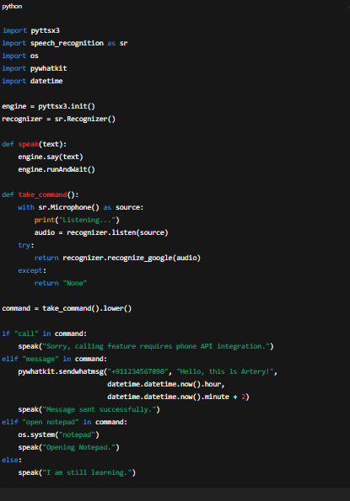
💻 Example Code Snippet:

Slide 19
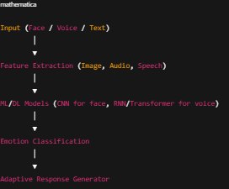
Emotion Recognition Module
The Emotion Recognition Module gives Artery the ability to understand human emotions through:
Facial expressions (smile, anger, sadness).
Voice tone analysis (happy, stressed, calm).
Speech patterns / way of talking (fast, slow, hesitation).
Adapts responses accordingly → makes Artery human-like.
🔄 Block Diagram:

Slide 20
⚙️ Define Working:
Face Emotion Detection – Uses OpenCV + Deep Learning to classify expressions.
Voice Emotion Detection – Analyzes pitch, tone, intensity.
Talking Style – Detects hesitation, stress, confidence via speech analysis.
Response Adjustment – Artery changes tone/response depending on detected emotion.
🎥 Tutorial URLs:
Facial Emotion Recognition with DeepFace: YouTube
Voice Emotion Recognition with Python: YouTube
Speech Emotion Recognition Dataset (RAVDESS): Kaggle

Slide 21
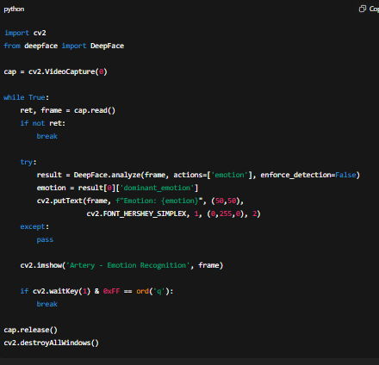
💻 Example Code Snippet (Face Emotion Recognition):

Slide 22
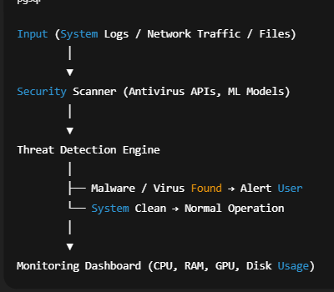
Security & System Monitoring Module
The Security & Monitoring Module ensures real-time protection of both system and user data.
Detects viruses, malware, ransomware.
Monitors CPU, RAM, GPU usage.
Alerts user in case of suspicious activity.
Acts as a guardian assistant for system health & security.
🔄 Block Diagram:

Slide 23
⚙️ Define Working:
File & Process Scanning – Uses ML models or VirusTotal API to detect suspicious files.
Network Monitoring – Tracks unusual traffic or data exfiltration.
System Resource Tracking – Displays live CPU, RAM, GPU stats.
Real-Time Alerts – Notifies user with warning & possible fix.
🎥 Tutorial URLs:
1.System Monitoring with Python (psutil): YouTube
2.VirusTotal API Tutorial: YouTube
3.Python Security Projects: YouTube

Slide 24
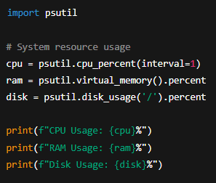
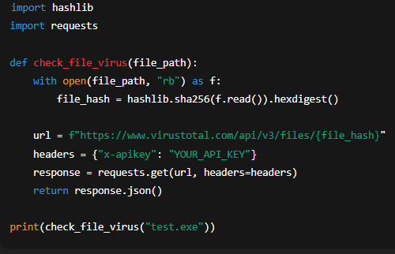
Code Summary
💻 Example Code Snippet (System Monitoring):
💻 Example Code Snippet (Virus Scan via Hash Check):

Slide 25
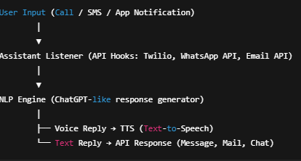
Personal Assistant Module
The Personal Assistant Module makes Artery act like a real human helper.
Handles calls, SMS, WhatsApp, and emails.
Can reply to messages automatically in a human-like way.
Reads out notifications and responds via voice or text.
Works across PC + Mobile integration.
🔄 Block Diagram:

Slide 26
⚙️ Define Working:
Notification Capture – Hooks into phone/desktop APIs.
Understanding Message – NLP engine analyzes tone & intent.
Generate Reply – Uses trained model (like GPT).
Send Reply Automatically – Through Twilio, WhatsApp Business API, Gmail API etc.
🎥 Tutorial URLs:
Twilio SMS API Setup: YouTube
WhatsApp Bot with Python: YouTube
Gmail API with Python: YouTube

Slide 27
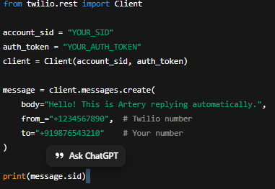
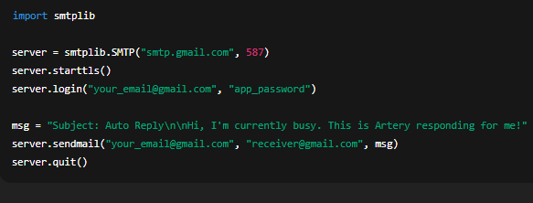
Code Summary
💻 Example Code Snippet (Email Reply with Gmail API):
💻 Example Code Snippet (SMS with Twilio):

Slide 28
Vision System (Face + Object Recognition)
Define Working:
Uses camera input + OpenCV + Deep Learning (CNN models like ResNet, YOLO).
Detects face, objects, gestures.
Helps Artery recognize you and environment.
Block Diagram: Camera → Preprocessing → CNN Model → Recognition → Output (Name/Object/Action).
Flowchart: Start → Capture Frame → Detect Face/Object → Match with Database → Take Action → End.
Tutorial URL: OpenCV Face Recognition Tutorial

Slide 29
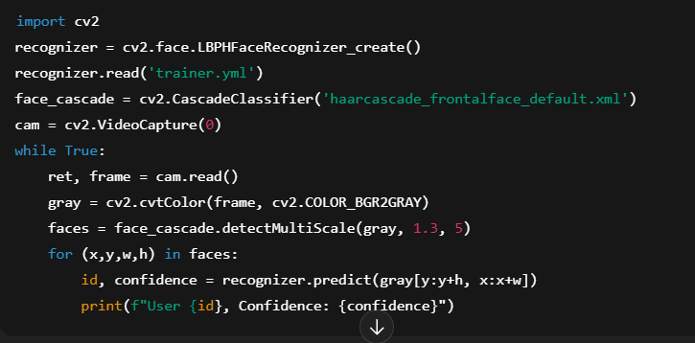
Code Snippet (Face Recognition):

Slide 30
2D/3D Avatar & Hologram
Define Working:
2D avatar with animation (using Python + Pygame/Tkinter + AI voice sync).
3D hologram (Unity/Blender + AR/VR support).
Shows Artery as “human-like” interface.
Block Diagram: Text/Voice Input → Avatar Engine → Lip Sync/Emotion → Display (2D/3D).
Flowchart: Input → Avatar Generate → Sync with Voice/Emotion → Output Display.
Tutorial URL: 3D Avatar AI Tutorial

Slide 31
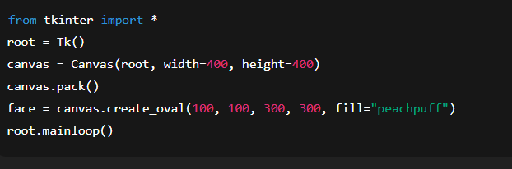
Code Snippet (2D Avatar basic):

Slide 32
Personal Assistant (Calls, Messages, Scheduling)
Define Working:
Uses APIs like Twilio (calls, SMS), Google Calendar API (scheduling).
Voice + text commands trigger actions.
Block Diagram: Command → NLP → API Call → Action (Call/SMS/Event).
Flowchart: Start → Listen → Understand Intent → Connect API → Send/Receive → End.
Tutorial URL: Twilio Python SMS Tutorial

Slide 33
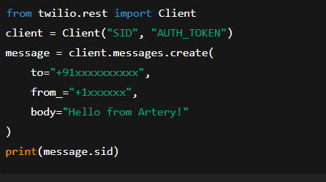
Code Snippet (SMS):

Slide 34
Security & System Monitoring
Define Working:
Scans system (antivirus APIs, malware detection).
Monitors CPU/GPU/Memory usage.
Warns of threats in PC/phone.
Block Diagram: System Stats + Security Scan → Analyzer → AI Alert → User Notification.
Flowchart: Start → Scan → Detect Threat/Overload → Alert User → Take Action.
Tutorial URL: Python Security Scan

Slide 35
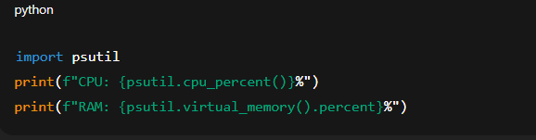
Code Snippet (System Usage):

Slide 36
Self-Learning & Adaptation(SALM)
Define Working:
Machine Learning models update knowledge with interaction.
Stores user preferences, improves responses.
Block Diagram: User Input → Model Training → Update Knowledge → Improved Output.
Flowchart: Input → Train Model → Update Database → Respond → Feedback → Loop.
Tutorial URL: Reinforcement Learning Basics

Slide 37
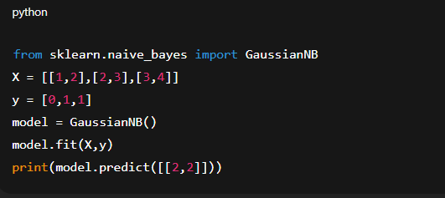
Code Snippet

Slide 38
Minimum System Requirements
My System:
ASUS TUF Gaming A15
Ryzen 7, 16GB RAM, RTX 3050 (4GB), 512GB SSD, Windows 11.
Cloud Requirements:
For heavy AI models (GPT, Vision), integrate with Google Colab, AWS, Azure, HuggingFace.
Model Requirements:
Python 3.10+
TensorFlow/PyTorch, OpenCV, NLTK/Spacy, Twilio, psutil.
System Requirements:
Processor=intel (i5,i7,i9 )/Ryzen 5,7,9 And Above
Ram/Rom=8/256,16/512,24/1Tb And Above
GPU= RTX 3050 (4GB), RTX 4050 (6GB), RTX 8050 (16GB) AND Above
Os= Window(10,11), Linux, Mac

Slide 39
Problems & Drawbacks
Heavy GPU usage (3D, deep learning).
Latency in voice + vision processing.
Cloud dependency (Requires High internet).
Privacy risks (face, voice, data storage).

Slide 40
Future Advancements
Full holographic 3D projection.
AR glasses integration.
Offline large language models.
Emotional intelligence like human-level.

Slide 41
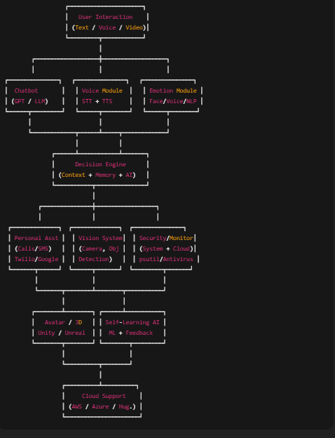
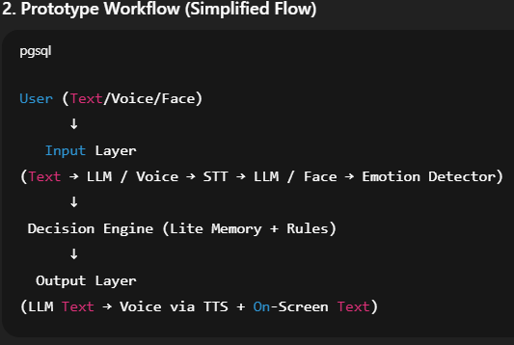
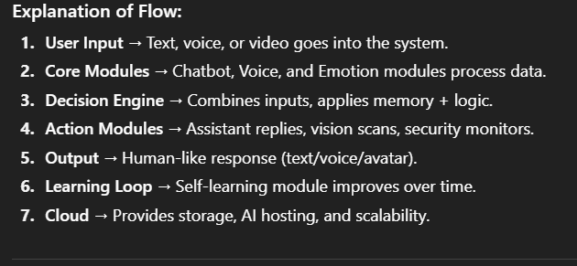
Final Working Block Diagram And Prototype

Slide 42
Creator (Short Intro)
Creator: Shivam Tyagi
CSE Student, R.D. Engineering College (2027 Batch)
Passion: AI, Data Science, Python and Java .
Member of GDG And Azure Microsoft.
Goal: To build Artery as a complete digital human clone

