Slide 1

Employee Attrition Analysis

Slide 2
Problem Statement
As a Data Analyst in our HR firm, we aim to analyze and understand the factors influencing employee attrition within our organization. The dataset provided contains various features related to employees, their demographics, job roles, and satisfaction levels.
The objective is to identify patterns and insights that can help us predict and mitigate attrition rates effectively.

Slide 3
Analysis Objective
Identify key factors contributing to employee attrition within the organization.
Explore relationships between various features and attrition rates.
Build predictive models to forecast the likelihood of employee attrition.
Provide actionable insights and recommendations to HR and management to reduce attrition and enhance employee retention strategies.

Slide 4
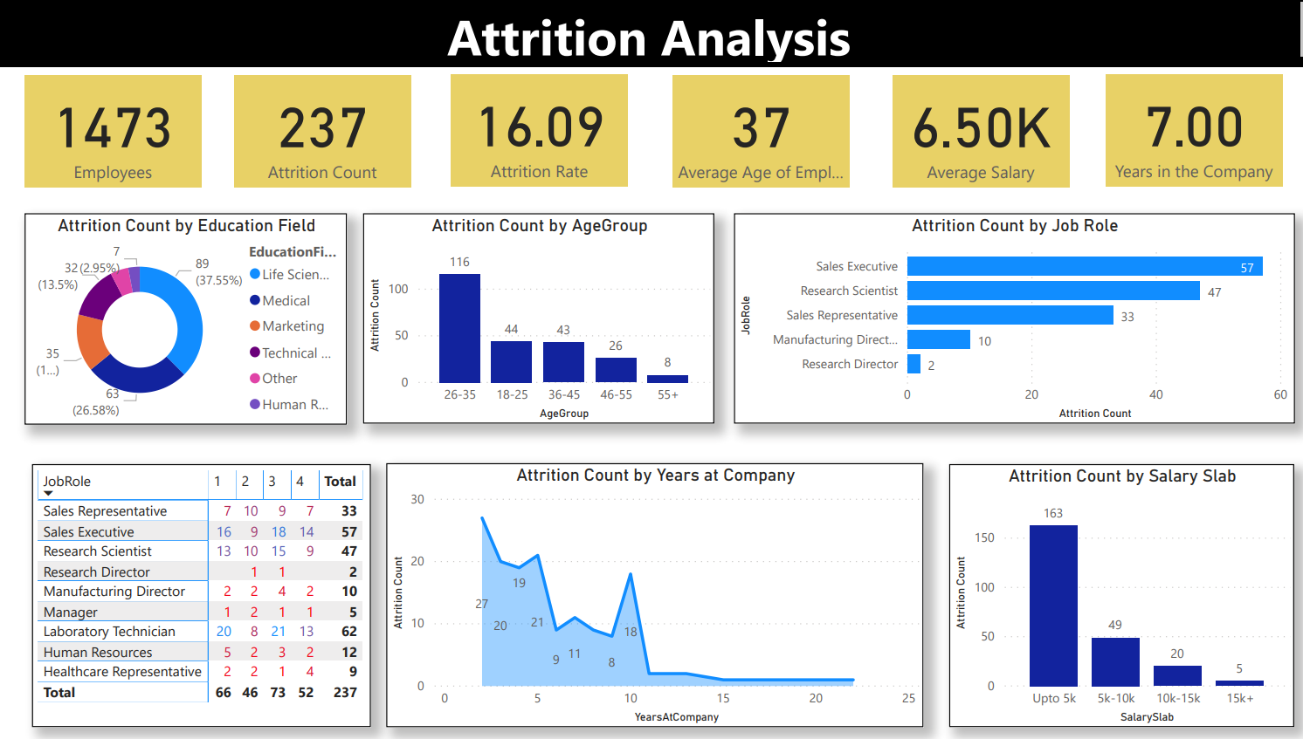

Slide 5
Complete Insights
Start by presenting the overall attrition rate for the organization is 16.09%.
The attrition rate by age group. the highest attrition rate is among the 26-35 age group (26.58%).
Show the attrition rate for different job roles. Sales Representatives and Research Scientists have the highest attrition rates (33 and 47 respectively).
For example, for Sales Representatives, it could be high pressure, challenging targets, or lack of commission structure.
The attrition rate seems to be increasing with salary, with the highest rate in the 15k+ salary bracket.
Note: It is important to remember that correlation does not imply causation. There could be other factors influencing attrition in higher salary brackets, such as more opportunities available to these employees.

Slide 6
Need to Include some more Insights

Slide 7
Thank you!

