Slide 1
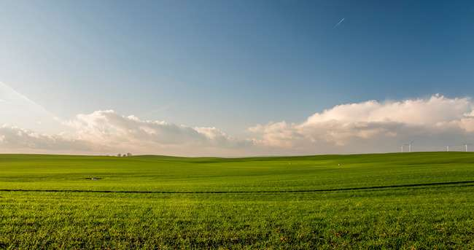


01
AGROMITRA
Smart Farming with Market Demand Insight
Team Name:- Techified

Slide 2
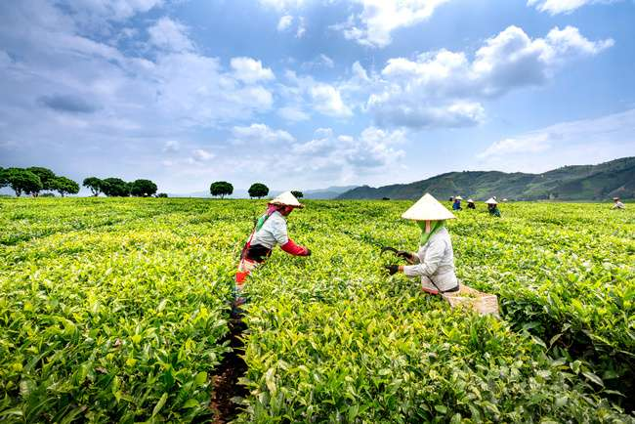
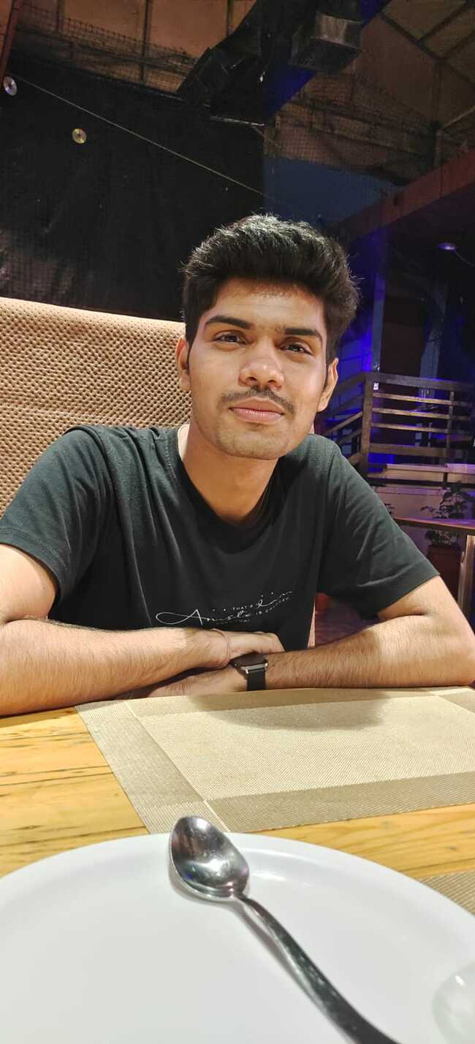
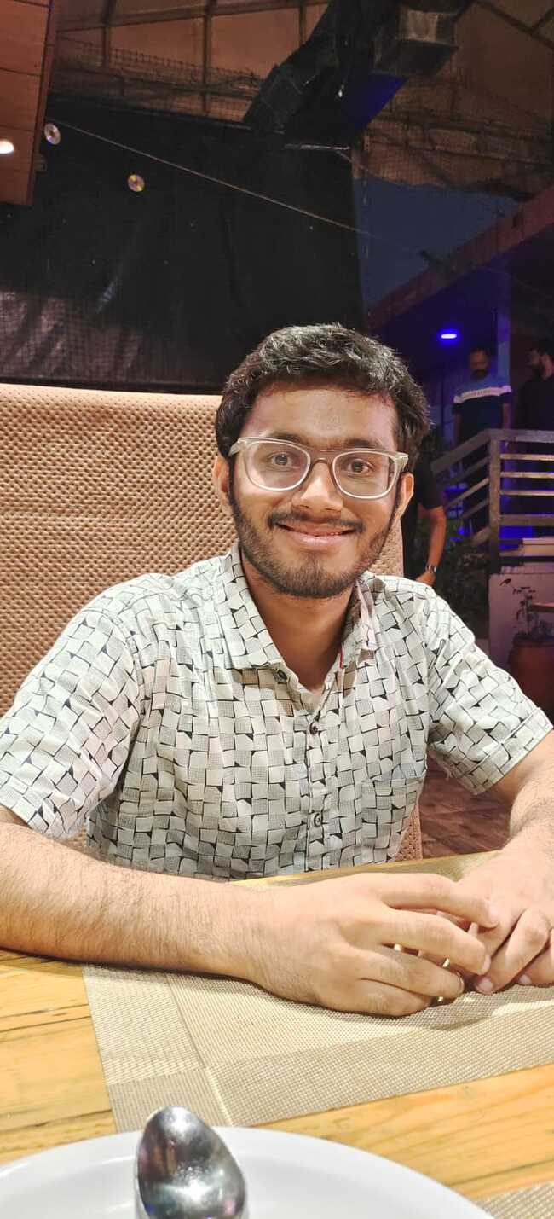

Team
Techified
02
Shivansh Shukla
Vansh Verma
Shivansh Mahajan

Slide 3
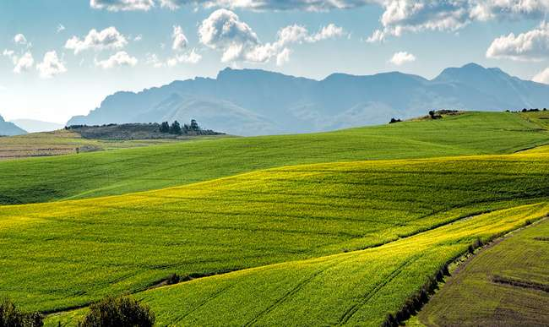
03
Theme:-Agriculture
Problem :-Sustainable Farming through AI: Optimizing
Crop Choices and Market Success
Harness AI to empower farmers with data-driven decisions, ensuring better crop yields and market alignment. Transform traditional farming into a modern, efficient practice, promoting environmental sustainability and economic growth. Enable farmers to thrive by providing insights from planting to market, fostering a resilient agricultural ecosystem.

Slide 4
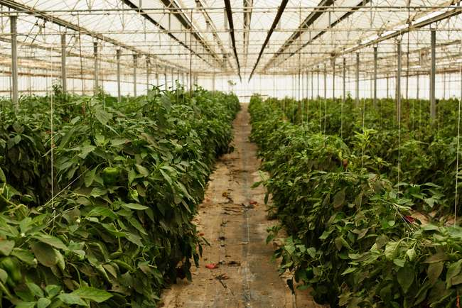

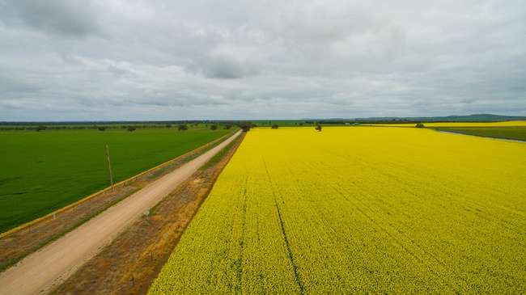
04
Our Idea
Empowers farmers with market-based intelligence and optimized farming practices.
Analyzes market demand to offer tailored crop recommendations with demand scores.
Farmers input crop preferences, location, land size, previous crops, and soil details.
Implements crop rotation models and assesses soil health.
Provides actionable insights for maximum yield and sustainability.
A one-stop solution guiding farmers from planting to selling, aligning efforts with market trends.

Slide 5
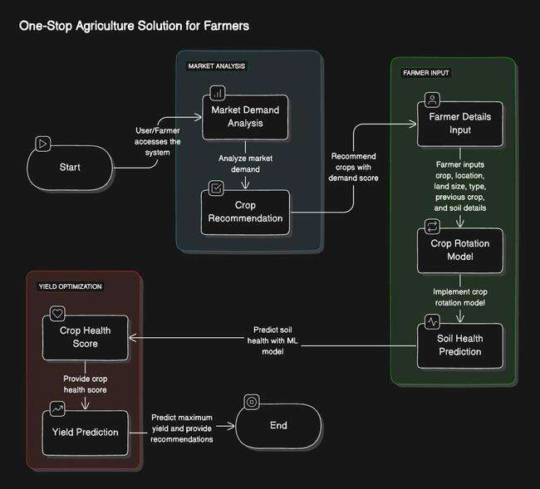
05
How it will Work?

Slide 6
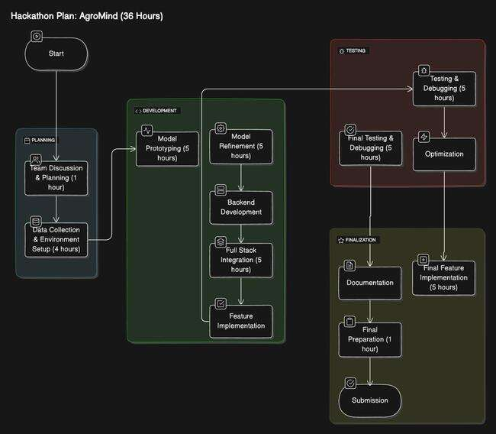
06
The Action Plan

Slide 7
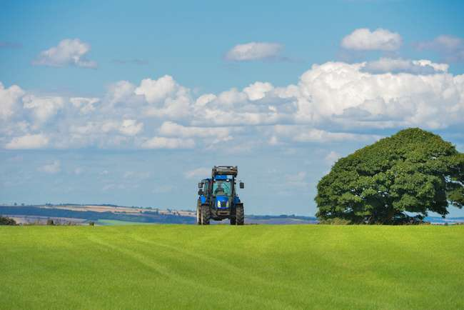
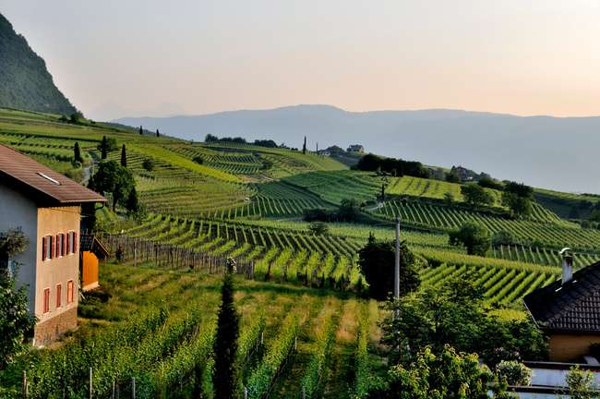
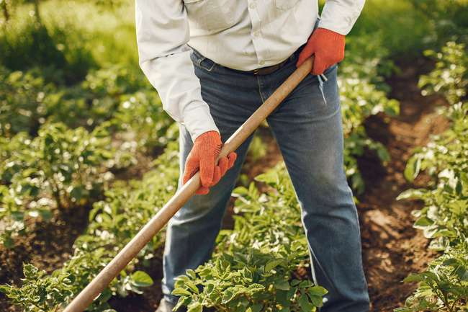
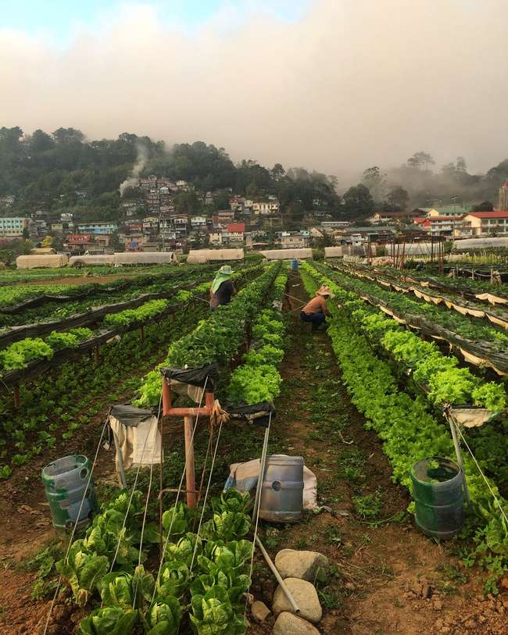
Key Features
07
Tailored Crop Planning :- Location & Land-Based Insights: Suggests optimal crops based on the farmer's location, land size, and crop rotation history.
Yield Prediction & Optimization :- Yield Forecasting: Estimates potential yield and provides strategies to maximize productivity based on soil and environmental factors.
Market Demand Analysis :- Crop Recommendations: Identifies high-demand crops and vegetables based on market trends and seasonal patterns.
Soil & Crop Health Evaluation :- Soil Analysis & Health Score: Analyzes soil type, nutrients, pH, and moisture to assess crop health and recommend improvements.

Slide 8
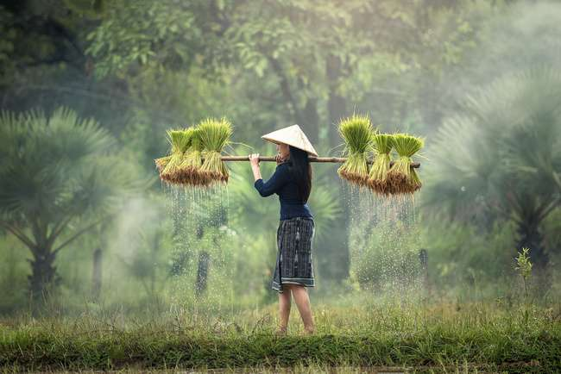
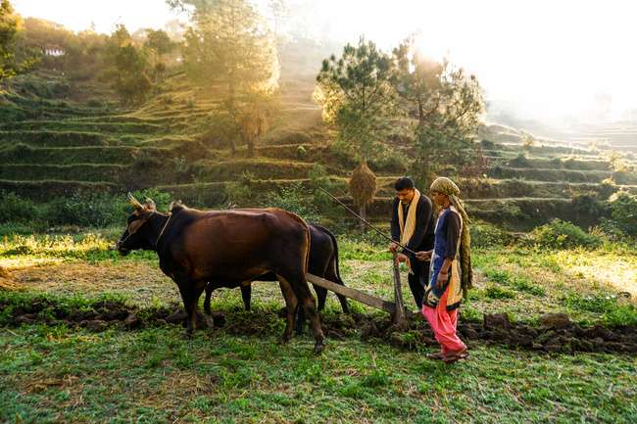
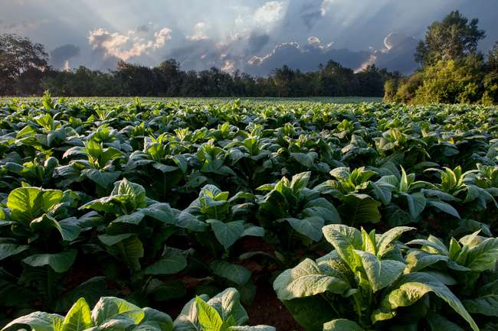

09
08
Tech Stack
Frontend :- Nextjs , Shadcn ,Tailwind , Framer motion
Backend :- Express.js , Postgresql, Prisma ORM,
ML Tech Stack :- Numpy, Pandas , Scikit-learn , Tensorflow, oblib, FastAPI

Slide 9
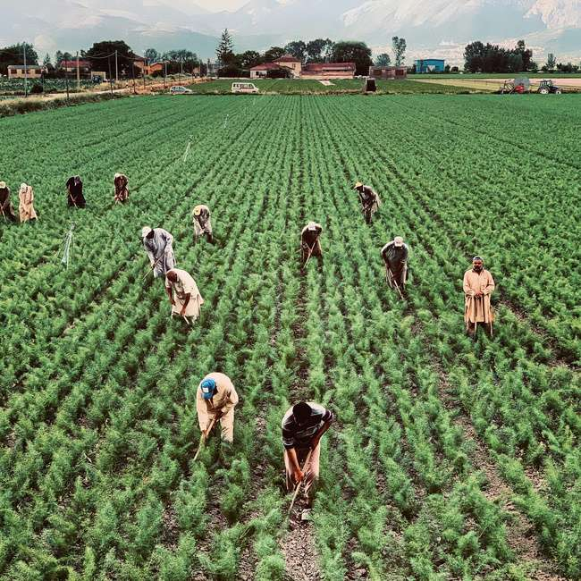
09
Thynk Unlimited
Future Growth
Precision Agriculture: Integrate IoT for real-time soil, weather, and crop health data.
E-Commerce Integration: Enable direct market access and increase farmer profitability.
Global Insights: Expand to provide international market demand and export opportunities
Sustainability: Incorporate climate models for eco-friendly farming and climate adaptation.
Linguistic Barriers:- Disabling any kind of language, region or culture barriers

Slide 10
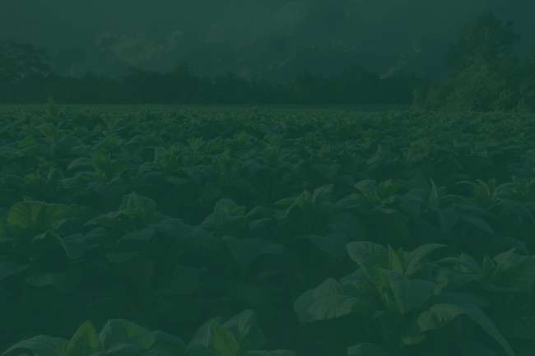
Thank You!

