Slide 1
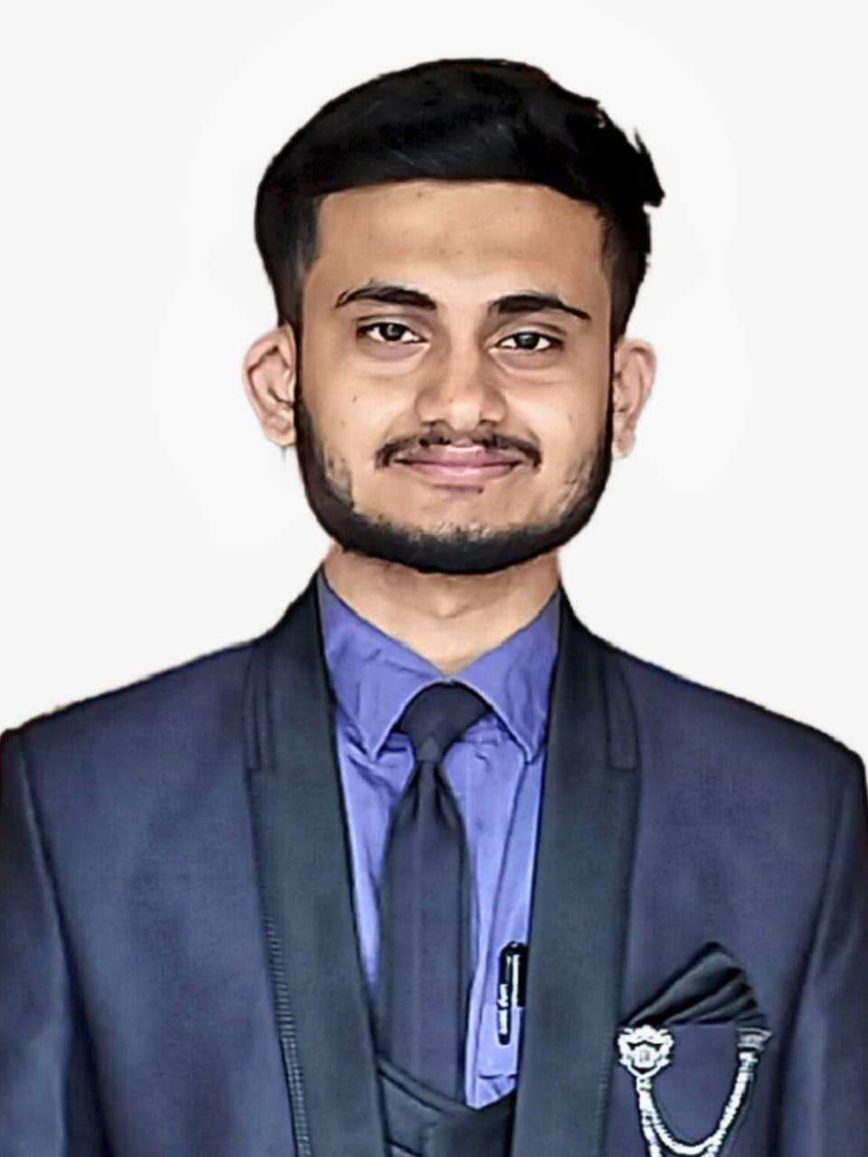
Shivanagouda Patil
Consultant
Machine Learning Professional with 2 years of experience in Machine Learning and Generative AI, specializing in NLP. Proficient in developing and deploying AI and ML solutions across diverse industries. Skilled in Python, AWS, and MLOps tools with a strong foundation in statistical analysis. Adept at translating business needs into impactful data-driven solutions. Passionate about leveraging cutting-edge technologies to drive innovation and optimize business processes
Industries and Domain
Healthcare
Cybersecurity
Governance Risk and Compliance
Experience Summary
CirrusLabs : Machine Learning Engineer
Developed a cybersecurity chatbot that fetched documents from S3, processed them using AWS Bedrock Titan embeddings, and stored the embeddings in OpenSearch. Applied kNN search to retrieve the top 3 relevant text chunks and leveraged the AWS Bedrock LLaMA 3.2 model to generate precise, contextually accurate responses to user queries.
Designed and implemented two FastAPI services for policy and control generation: one for handling prompts and returning JSON responses using LLaMA 3.2, and another for embedding generation.
Built a proof of concept (POC) for extracting referral reasons using AWS Comprehend, focusing on the identification and categorization of medical entities
Brane Group: Associate Process Leader
Orchestrated classification models (Random Forest, Decision Tree, AdaBoost, and KNN algorithms) to predict patient eligibility for operations in the Brazilian healthcare industry, achieving 5% improvement in Accuracy.
Constructed a Generative AI application using the LLaMA 3 model to automate support ticket classification, prioritization, and resolution time prediction. Enhanced customer feedback processing by implementing a structured approach to categorize tickets and store actionable insights in a DataFrame.
Self-Projects :
Engineered an autonomous content generation pipeline using CrewAI, with role-specific agents handling research, writing, and publishing tasks. Integrated GPT-4 and Tavily Search to produce real-time, high-quality blog posts and social media content, significantly enhancing the pipeline’s impact
Created a Wine Quality Prediction API using FastAPI for real-time inference and utilized MLflow to track experiments and log model parameters. The pipeline includes stages like data ingestion, validation, transformation, model training, and evaluation, ensuring efficient model management.
Built an NLP-based chatbot to identify safety risks from accident reports across 12 plants in 3 countries. Performed data cleaning, NLP preprocessing, and built ML, neural network, and LSTM classifiers to predict accident severity. Deployed the best model using FastAPI for real-time analysis.
Technical Skills
Language : Python (NumPy, Pandas, Matplotlib, Seaborn, OpenCV, NLTK, Gensim), SQL, HTML
Frameworks: Scikit-Learn, TensorFlow, LangChain, LangSmith, Crew ai, Fast API
MLOps Tools: MLflow, DVC
DevOps: CI/CD, Docker
Generative AI: RAG (all steps from chunking to retrieval), Prompt Engineering, Model configuration, Fine-tuning (LoRA, PEFT), Agentic AI (CrewAI, LangGrapgh), AWS Bedrock
Cloud Platforms: AWS (S3, EC2, Lambda, API Gateway, SageMaker AI, ECR, ECS, CloudWatch)
Education
PGP in AIML from UT Austin, Texas
M. Tech : Ramaiah Institute of Technology
Location : Bengaluru
Notes:
Profile 3

