Slide 1
Android:
Android is a Linux-based operating system for mobile devices such as smartphones and tablet computers. It is developed by the Open Handset Alliance led by Google.
Android is a software stack for mobile devices that includes an operating system, middleware and key applications.
Android contains its own Java Virtual machine called (Dalvik Virtual Machine - DVM).
Android supports 2-D and 3-D graphics using the OpenGL libraries and supports data storage in a SQLite database.
Dalvik Virtual Machine is a virtual machine it contain some uses special byte code. Therefore we cannot run standard Java byte code on Android. Android provides a tool "dx" which allows converting Java Class files into "dex" (Dalvik Executable) files.

Slide 2
Hardware & Software Requirement:
Hardware | Minimum Requirement
Processor | Dual Core And Above
Main Memory(RAM) | 1 GB (Recommended)
Secondary Memory(Hard Disk) | At least 5 GB of Free space
Display | Any Color Monitor
Input devices | Standard Keyboard and Mouse
Minimum Software Requirement
Java Development Kit 1.6
Android SDK(Standard Development Kit)
Eclipse Galileo
Android 2.1

Slide 3
Android Features:
Application framework: It is used to enabling reuse and replacement of components.
Dalvik virtual machine: Dalvik virtual machine (DVM) is a process virtual machine which is part of an open source the Android mobile phone platform based on the Linux operating system and is developed by the (Open Handset Alliance).
Optimized graphics: It contains both 2D and 3D. 2D is based on graphics library and 3D is based on OpenGL.
SQLite: It is used to data storage in database.
Media support: It contains audio, video, and still image formats (MPEG4, JPG, PNG and GIF).
Bluetooth, EDGE, 3G, and Wi-Fi (hardware dependent)
Camera, GPS, Compass and Accelerometer (hardware dependent).

Slide 4
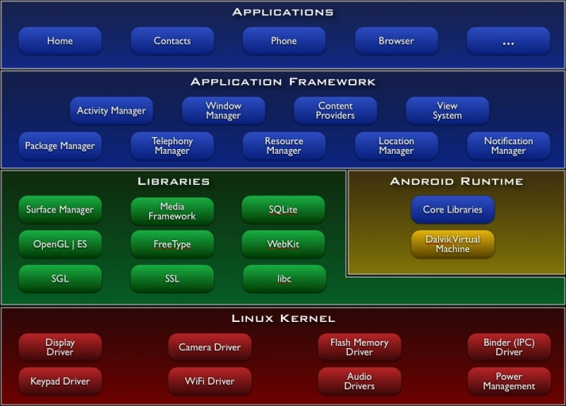
Android Architecture:

Slide 5
Applications: These are applications written in Java. Some of basic applications include a calendar, email client, SMS program, maps, making phone calls, accessing the Web browser, accessing your contacts list and others. If you are an average user, this is the layer you will us most, rest all layers are used by Google programmers, developers and hardware manufacturers.
Application Framework: This is the skeleton or framework which all android developers has to follow. The developers can access all framework APIs an manage phone’s basic functions like resource allocation, switching between processes or programs, telephone applications, and keeping track of the phone’s physical location. The architecture is well designed to simplify the reuse of components. Think of the application framework as a set of basic tools with which a developer can build much more complex tools.
Libraries: This layer consists of Android libraries written in C, C++, and used by various systems. These libraries tell the device how to handle different kinds of data and are exposed to Android developers via Android Application framework.
Runtime Android: This layer includes set of base libraries that are required for java libraries. Every Android application gets its own instance of Dalvik virtual machine. Dalvik has been written so that a device can run multiple Virtual Machines efficiently and it executes files in executable (Dex) optimized for minimum memory.

Slide 6
Kernel: This layer includes Android’s memory management programs, security settings, power management software and several drivers for hardware file system access, networking and interprocess - communication. The kernel also acts as an abstraction layer between hardware and the rest of the software stack.

Slide 7
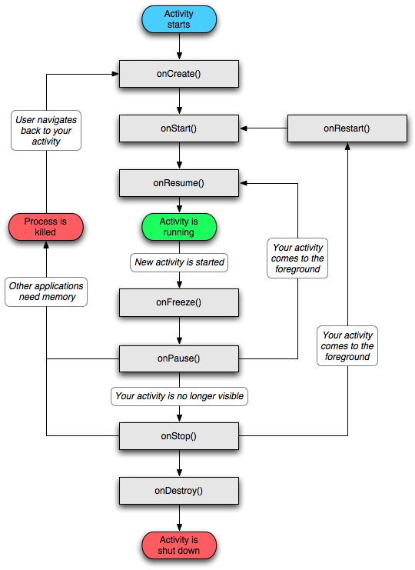
Activity Lifecycle:

Slide 8
Limitations:
This application works only on Android Operating System in it.
This application works only if there is internet facility available in the host mobile.
The application can only be used in India.
This application does not have a feature for History maintenance.

Slide 9
Future Enhancements:
The very first enhancement would be to make the application to work all the countries.
This application does not store any history of previous usage, so in future i will add history details also.

Slide 10
Thank You
For Being a Good Audience

