Slide 1
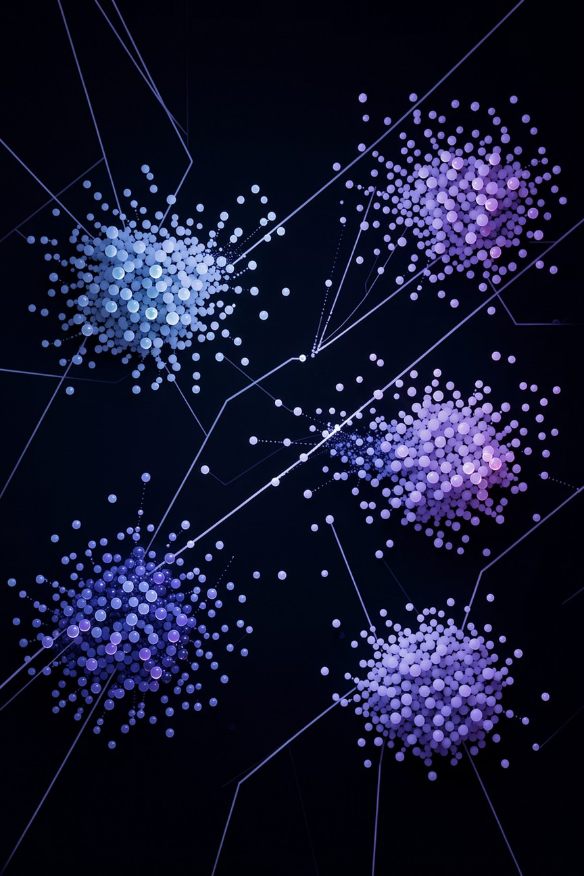

DBSCAN vs. K-Means: Choosing the Right Clustering Algorithm
A comprehensive guide to selecting the optimal clustering method for your data analysis needs
Submitted to :- Dr. Anirudha Gaikwad Assistant professor(Dept of CSE)

Slide 2



The Challenge: Finding Patterns in Unlabeled Data
Uncover Hidden Structures
Clustering reveals meaningful patterns and relationships in data without predefined labels
Algorithm Selection
Not all algorithms perform equally— choosing the right one is critical for accurate results
Impact on Analysis
The wrong choice can lead to misleading insights and poor decision-making

Slide 3

Meet the Contenders: K-Means
What It Is
A popular, simple, and fast algorithm that partitions data into a predefined number of clusters (K). Known for its efficiency and ease of implementation.
How It Works
Assigns data points to the nearest cluster centroid and iteratively updates centroids until convergence. Uses distance-based optimization.
Best For
Well-separated, spherical clusters Large datasets where speed is crucial Situations where cluster count is known

Slide 4

K-Means in Action: The "Round Pegs, Round Holes" Scenario
Imagine sorting marbles by color. K-Means excels when clusters are distinct and roughly spherical, creating clear boundaries.
Use Case
Customer segmentation for personalized marketing when you know you want, say, 5 distinct customer groups
Limitation
Struggles with irregular shapes and is sensitive to outliers, potentially misclassifying points

Slide 5

Meet the Contenders: DBSCAN
01 02
What It Is
Density-Based Spatial Clustering of Applications with Noise. Finds clusters of varying shapes and densities while identifying outliers.
How It Works
Groups together points that are closely packed based on density, marking points in low-density regions as noise or outliers.
03
Best For
Datasets with arbitrary cluster shapes, noise present, and when the number of clusters isn't known beforehand.

Slide 6

DBSCAN in Action: The "Finding Constellations" Scenario
Think of finding star patterns in the night sky. DBSCAN can identify complex, arbitrary shapes and effectively ignore stray stars (noise).
Use Case
Anomaly detection in financial transactions Identifying geographical clusters of specific events Spatial data analysis with irregular patterns
Strength
Handles arbitrary shapes and noise effectively, unlike K-Means, making it robust for real- world data

Slide 7
Key Differences at a Glance
1
Cluster Shape
K-Means: Spherical only
DBSCAN: Arbitrary shapes
2
Number of Clusters
K-Means: Predefined 'K'
DBSCAN: Auto-detected
3
Handling Noise
K-Means: Poor handling
DBSCAN: Excellent detection
4
Scalability
K-Means: Scales well
DBSCAN: Less scalable for sparse, massive datasets

Slide 8

When to Use Which? The Decision Tree
Do you know the number of clusters and expect them to be roughly spherical?
→ K-Means
Do you expect clusters of irregular shapes, or is noise a significant factor?
→ DBSCAN
Is speed paramount for a massive dataset with clear, round clusters?
→ K-Means
Do you need to identify outliers or have varying cluster densities?
→ DBSCAN

Slide 9
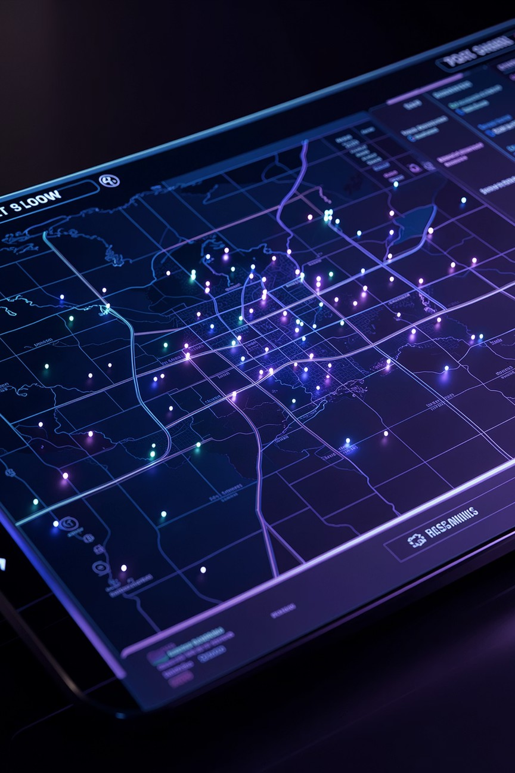
Real-World Performance: Geospatial Data Example
Performance Metrics
A study on geospatial data demonstrated DBSCAN's superior performance in identifying clusters with irregular shapes and handling noise effectively.
0.8646
DBSCAN Score
Silhouette coefficient achieved
0.8160
K-Means Score
Silhouette coefficient achieved
This highlights DBSCAN's robustness in identifying clusters with irregular shapes and handling noise, outperforming K-Means by 6% in silhouette score.

Slide 10




Conclusion: The Right Tool for the Right Job
Both Are Powerful
K-Means and DBSCAN serve
different purposes and excel in specific scenarios
Understand Mechanics
Knowing core mechanics and limitations is crucial for effective data analysis
Choose Wisely
Select the algorithm that matches your data characteristics to unlock true patterns

Slide 11
THANK YOU

