Slide 1

House Price Prediction
Presented By
Shivanchal Asthana

Slide 2

Table of Content
Introduction
Benefits of House Price Prediction
Problem statement
Objectives
Research Methodology
Data Analysis/ Visualizations/ Observations
Conclusions

Slide 3

Introduction
Houses are one of the necessary need of each and every person around the globe and therefore housing and real estate market is one of the markets which is one of the major contributors in the world’s economy. It is a very large market and there are various companies working in the domain.
In this project, We use machine Learning algorithm to predict the right value of any house with the available independent variables.

Slide 4

Benefits
Predicting house prices can help to determine the selling price of a house of a particular region and can help people to find the right time to buy a home.
Higher prices may lead to an expansion of new house-building as construction companies have the incentive of making more profit. This adds directly to GDP and may stimulate a multiplier effect in local areas / regions.
An increase in prices may lead to an improvement in the consumer confidence of home-owners which might then cause a rise in consumer spending

Slide 5
About Problem Statement
A US-based housing company named Surprise Housing has decided to enter the Australian market. The company uses data analytics to purchase houses at a price below their actual values and flip them at a higher price. For the same purpose, the company has collected a data set from the sale of houses in Australia.
Our Task is to solve problems in the domain to help the companies increase their overall revenue, profits, improving their marketing strategies and focusing on changing trends in house sales and purchases.

Slide 6

Objectives
Create an analytical framework to understand
- Key factors impacting house price
Develop a modelling framework
- To estimate the price of a house that is up for sale

Slide 7
Research Methodology
The research methodology adopted for this is given as follows:
Research design: The research design adopted for this study is descriptive research design. The descriptive research design focuses on the accurate description of the variables present in the problem.
Sampling: Sampling allows concentrating upon a relatively smaller number of people and hence, to devote more energy that the information collected from them is accurate.
Sampling Size: The total size of the sample is 269 respondents.

Slide 8
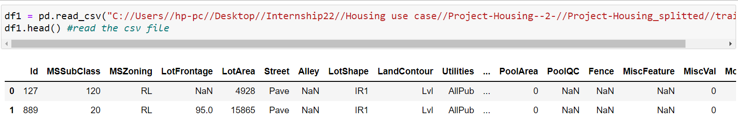
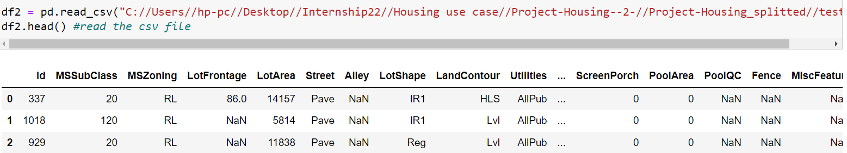
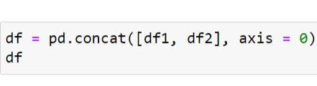
Data Analysis and Interpretation
Train Dataset
Test Dataset
Concatenate both Dataset
We have two datasets – first one is Train dataset and second one is Test dataset.
Size of Train dataset is – (1168 x 81)
Size of Test dataset is – (292 x 80)

Slide 9
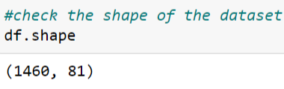
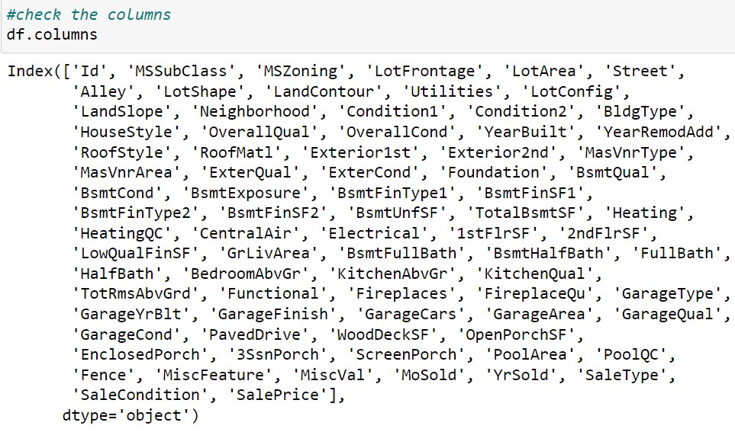
Data Understanding

Slide 10
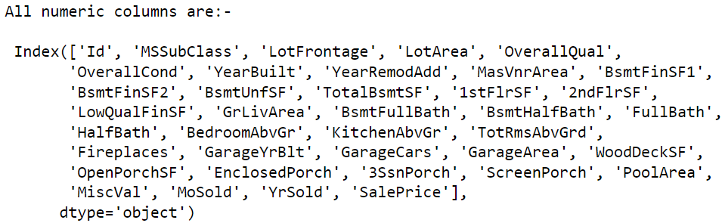
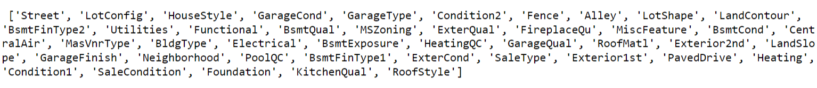

Data Understanding
There some columns who have numerical values
Some columns have categorical values.

Slide 11
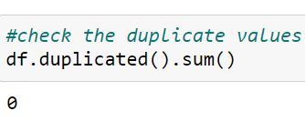
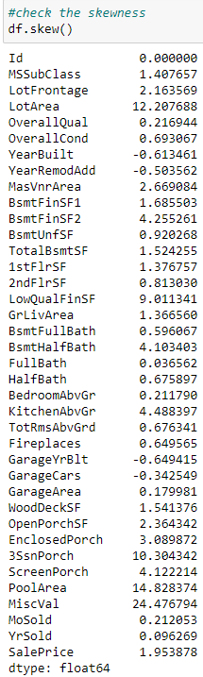
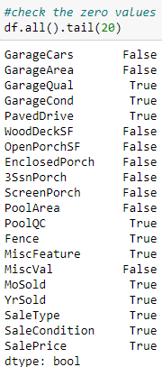
Data Understanding
There are no duplicate values
Some columns has zero values
Some columns also have some skewness

Slide 12
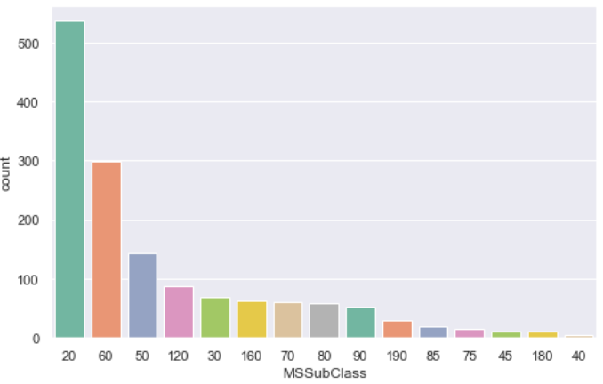
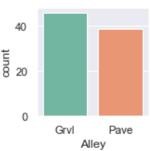
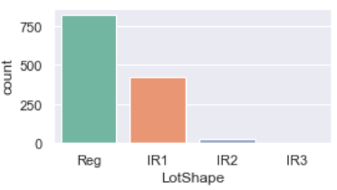
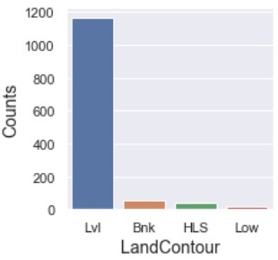
Data Analysis
1-STORY 1946 & NEWER ALL STYLES has more than others and it contains almost 36%.
2. Grvt and Pave are almost equal to each other.
3. Slope of properties are generally regular
4. And flatness of the preperties are Flat/level.

Slide 13
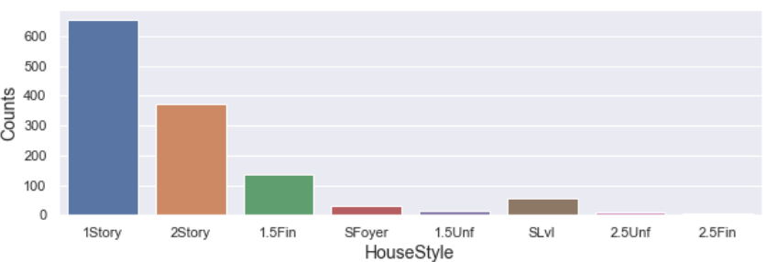
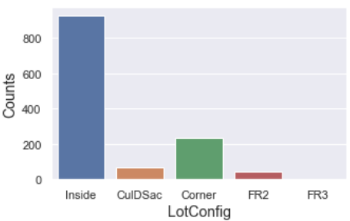
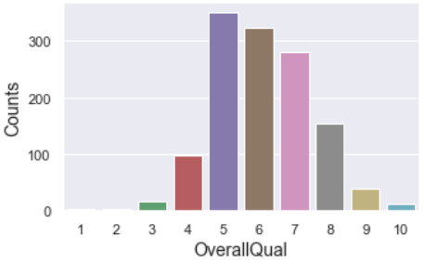
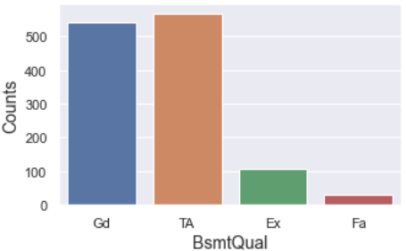
Data Analysis
House style of maximum peoples are 1Story
Mainly Lot configuration is inside lot
Overall quality is 5
The count of the Height of basement is Gd and TA is almost equal.

Slide 14
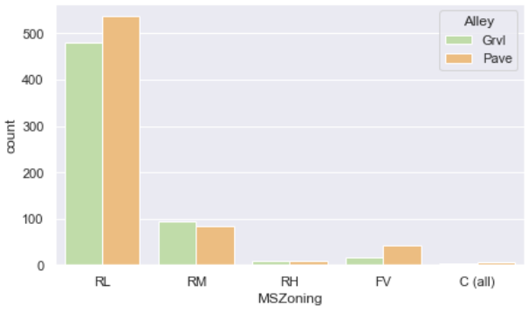
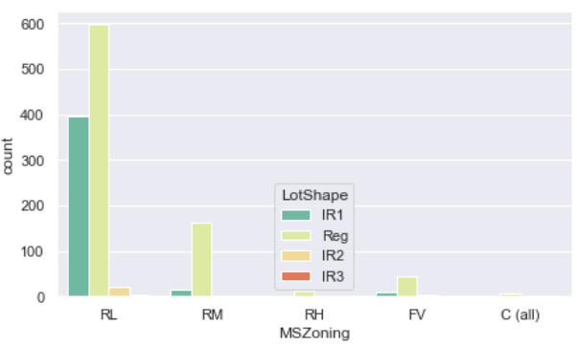
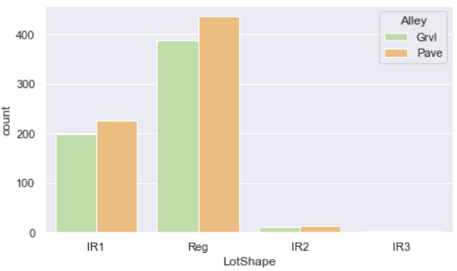
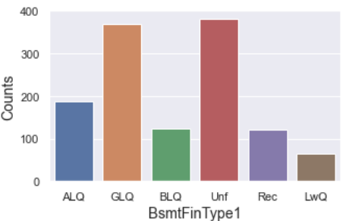
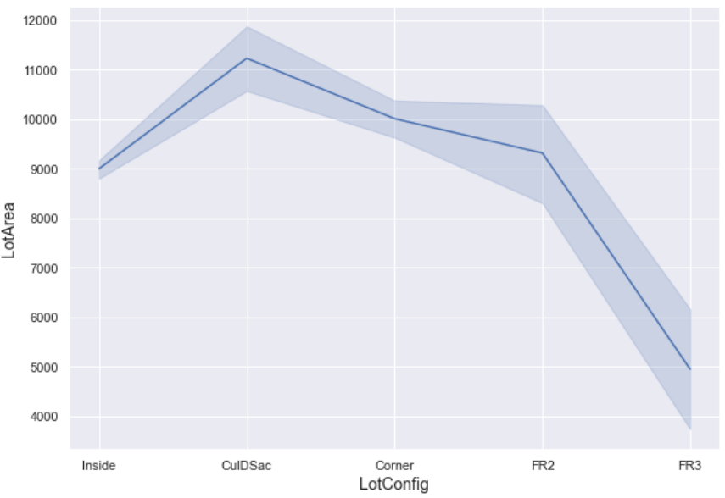
Data Analysis
At first count plot, Pave is highly related to RL than Grvl
Residential Low density has flat level property.
Count of Unf and GLQ is higher than others.
While observing lineplot, we see, Lotarea of FR3 is very low and CulDSac is high than others

Slide 15
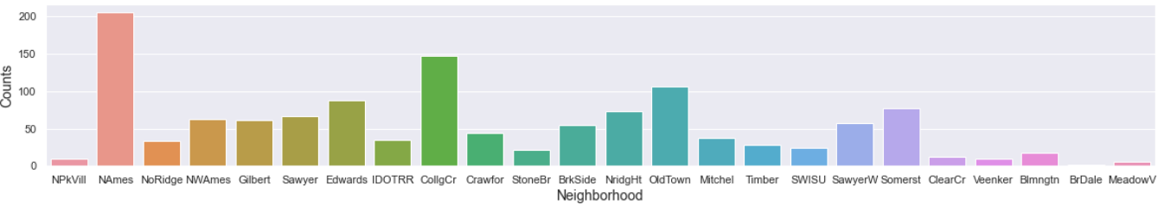
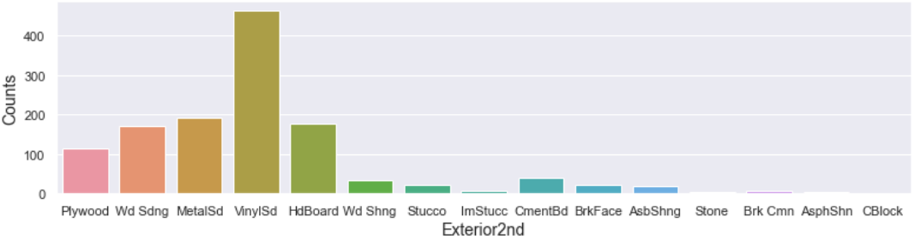
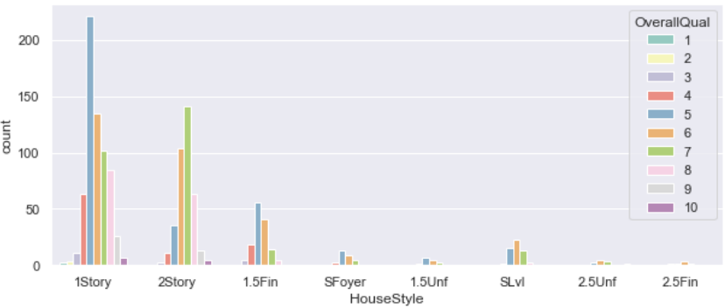
Data Analysis
1Story building got 5 ratings more than others.
NAmes has more count than others in neighborhood.
vinylSd has more counts than others.

Slide 16
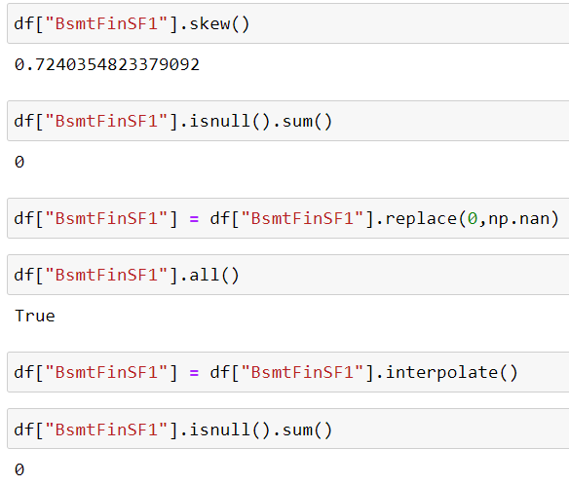
Treating Null and zero values
We see, there are lot of null values and zero values in the column.
So, we replace all zero values into null values.
Then use interpolate and bfill method to fill the null values.

Slide 17
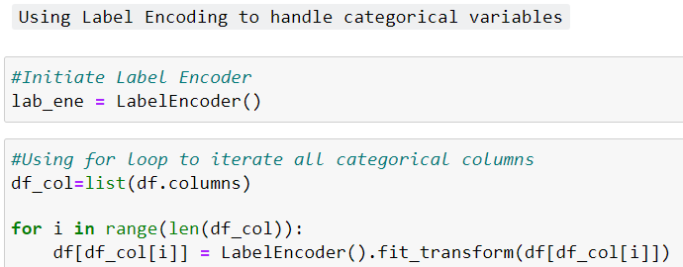

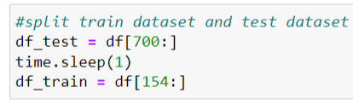
Encoding Shuffling Splitting
We use LabelEncoding to convert all categorical columns into Numerical form.
We Shuffle all rows in our dataset.
Split the dataset into two parts df_train and df_test.

Slide 18
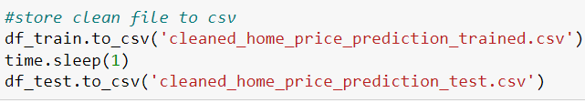
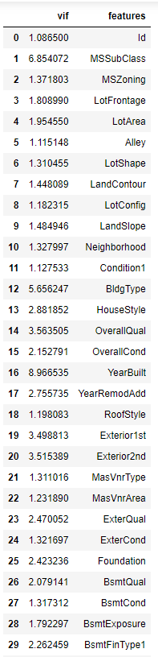
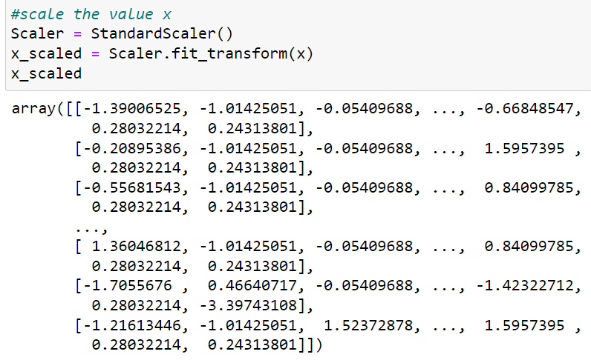
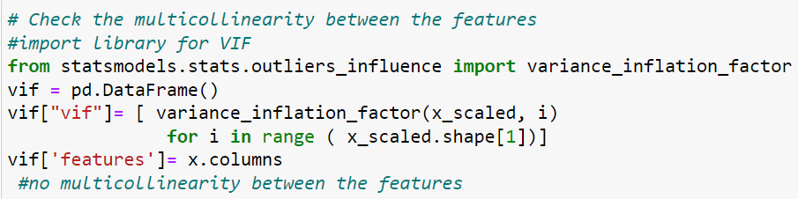
Scalling & Multicollinearity
We first save our both clean dataset (train and test)
Now, we scaled the data by using StandardScaler.
We check the multicollinearity and try to remove it by using heatmap and VIF

Slide 19
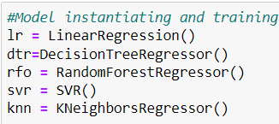
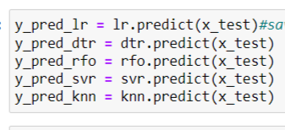
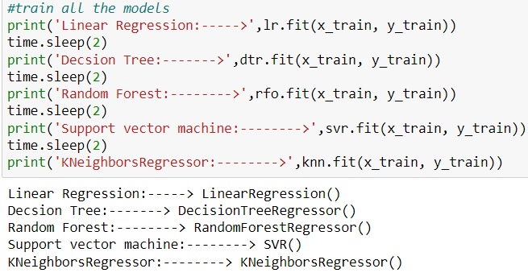
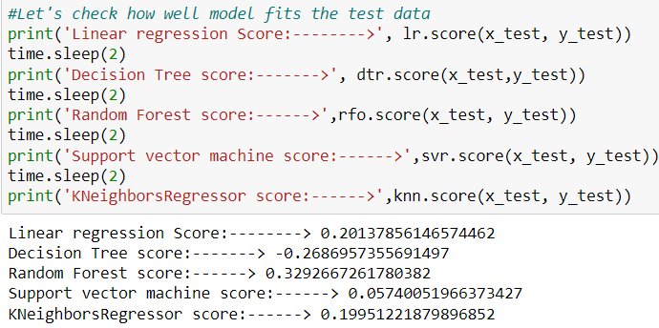
Models
We use 5 modals here- Linear Regression, decision Tree Regressor, Random Forest Regressor, SVR and KNNRegressor.
Random Forest Regressor is giving us more accuracy than others.

Slide 20
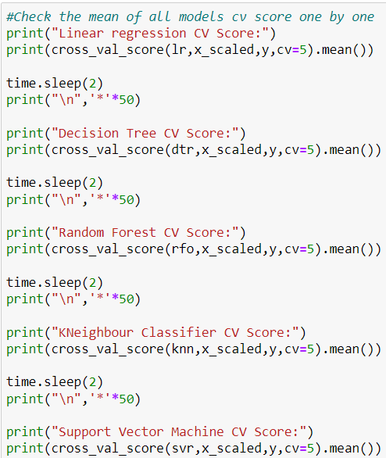
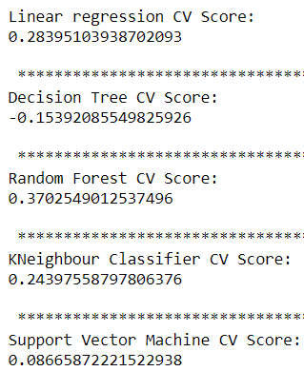
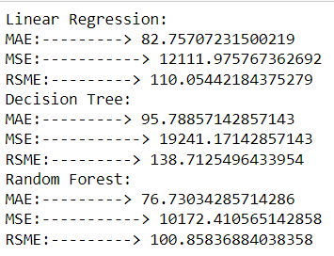
CV Score
By using Cross validation, Random forest is giving us better accuracy than others.
So, we can neglect SVR, Decision tree because they gives us worst accuracy.
MAE, MSE, RSME are better in Random forest than other model.

Slide 21
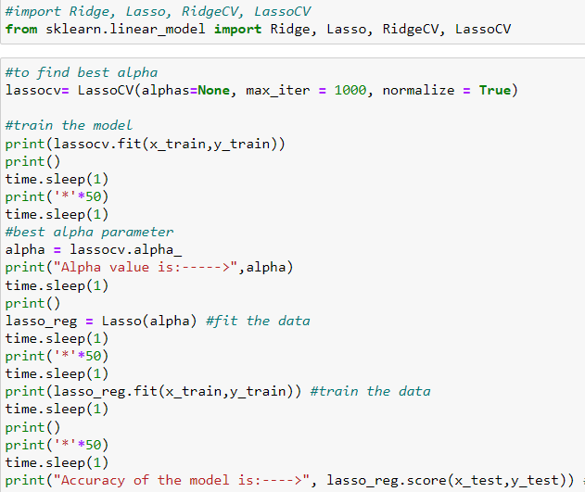
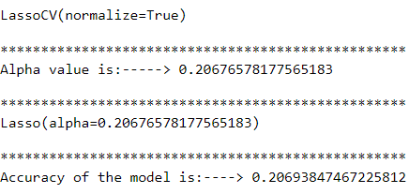
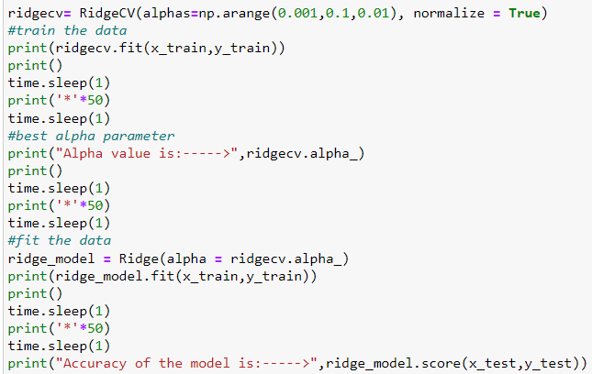
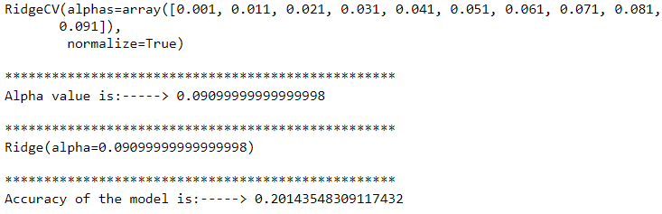
Lasso & Ridge Regression
1. Lasso and Ridge regression both are giving us worst accuracy.

Slide 22
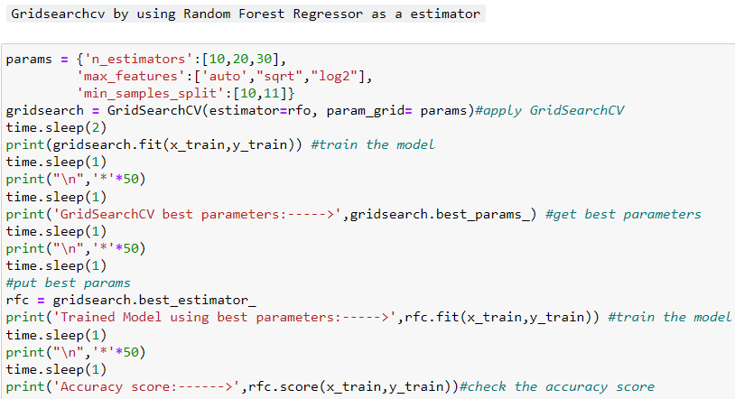
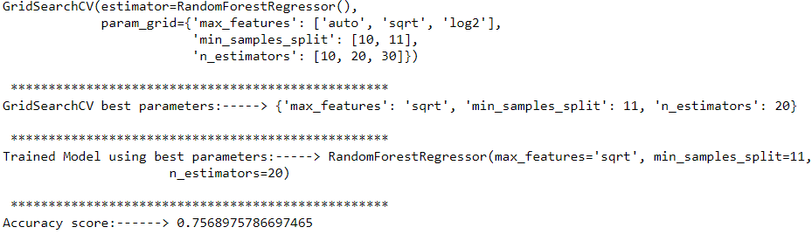
GridSearchCV using RandomForest Regressor
1. GridSearchCV by using RandomForestRegressor as a estimator is giving us approx. 75% Accuracy.

Slide 23
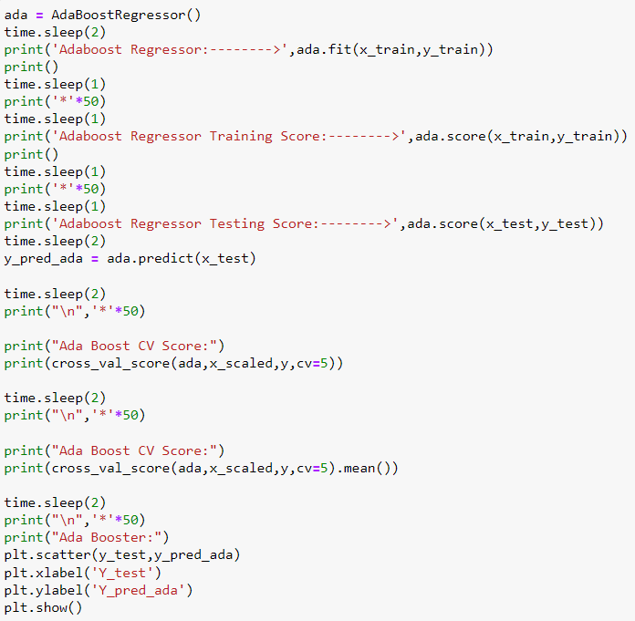
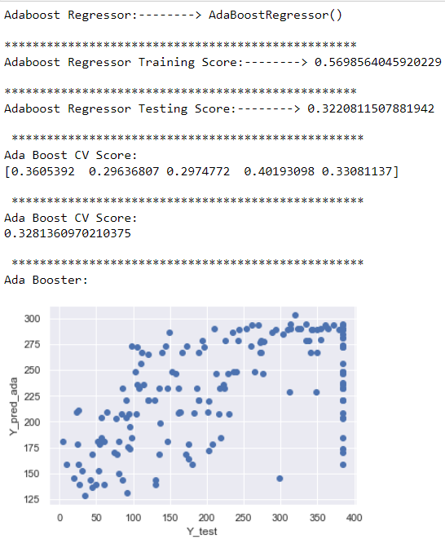
AdaBoost Regressor
AdaBoost Regressor is giving us 32% Accuracy.

Slide 24
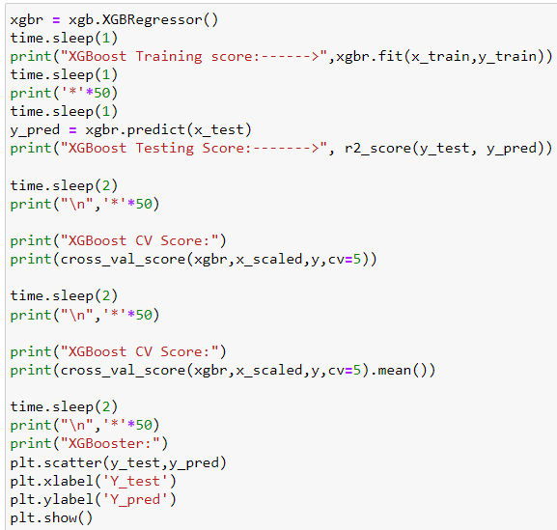
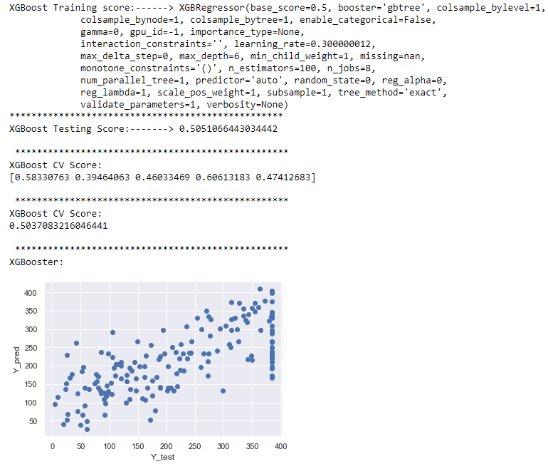
XGBoost Regressor
XGBoostRegressor is giving 50% accuracy

Slide 25


Gradient Boosting Regressor
GradientBoostingRegressor is giving us 43% accuracy.

Slide 26



Saving best model & Conclusion
1. We find, RandomForestRegressor by using GridsearchCV is giving us best accuracy out of them which 75%. So, We save it as a best estimator.

Slide 27

ThankYou

