Slide 1

Customer Retention Case Study
Presented By:
Shivanchal Asthana

Slide 2

Table of Content
Introduction
Benefits of Customer Retention
Problem statement
Objectives
Research Methodology
Data Analysis/ Visualizations/ Observations
Conclusions

Slide 3
Introduction
Customer retention refers to a company’s ability to turn customers into repeat buyers and prevent them from switching to a competitor. It indicates whether your product and the quality of your service please your existing customers. It’s also the lifeblood of most subscription-based companies and service providers.
It is a measure of how products and services supplied by a company meet or surpass customer expectation. "the number of customers, or percentage of total customers, whose reported experience with a firm, its products, or its services (ratings) exceeds specified satisfaction goals." Customers play an important role and are essential in keeping a product or service relevant; it is, therefore, in the best interest of the business to ensure customer satisfaction and build customer loyalty.
The ultimate goal of retention marketing is to increase customer value. Customer value is the final piece of the puzzle because it helps you understand how much each customer is actually worth.

Slide 4
What are the benefits of Customer Retention?
Retained customer tend to buy other services from same company
Retained customer are known to be less price/cost sensitive
Positive Word of Mouth – Free Marketing 24/7
The probability of selling to an existing customer is 60/70%
The probability of selling to a new product is 5-20%
Declined migration rates
Remember it’s more expensive to aquire a new customer than to plan an old one

Slide 5
About Problem Statement
Customer satisfaction has emerged as one of the most important factors that guarantee the success of online store; it has been posited as a key stimulant of purchase, repurchase intentions and customer loyalty. A comprehensive review of the literature, theories and models have been carried out to propose the models for customer activation and customer retention. Five major factors that contributed to the success of an e-commerce store have been identified as: service quality, system quality, information quality, trust and net benefit. The research furthermore investigated the factors that influence the online customers repeat purchase intention. The combination of both utilitarian value and hedonistic values are needed to affect the repeat purchase intention (loyalty) positively. The data is collected from the Indian online shoppers. Results indicate the e-retail success factors, which are very much critical for customer satisfaction.

Slide 6

Objectives
Knowing customer behavior
Track customers
Gather and store data
Do data mining
Know trends current events
Create Useful Information:
Cycle---Action---Reaction---Feedback---Repeat
Customer expectation of future use
Keeping customers active with tools
Sophisticated searches
Spam (News Alerts)
Online payment
Online support

Slide 7
Research Methodology
The research methodology adopted for this is given as follows:
Research design: The research design adopted for this study is descriptive research design. The descriptive research design focuses on the accurate description of the variables present in the problem.
Sampling: Sampling allows concentrating upon a relatively smaller number of people and hence, to devote more energy that the information collected from them is accurate.
Sampling Size: The total size of the sample is 269 respondents.

Slide 8
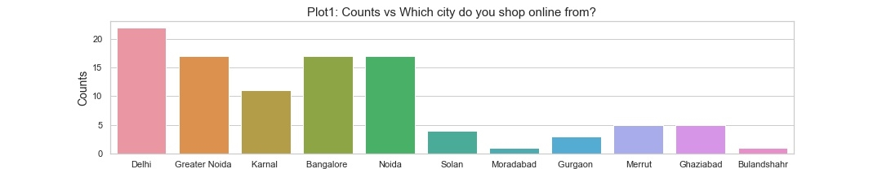
Data Analysis and Interpretation
Observations:
Females are more than Males
Mostly people’s do online shopping from Delhi

Slide 9
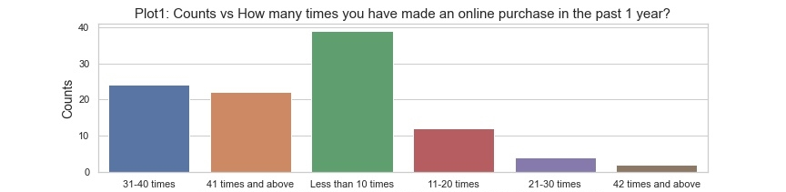
Observations:
People’s are more in their age group 21-30 years.
In any Age Group, Females are more than Males.
Maximum Females are from the Age Group 21-30 years in terms of percentage.
Mostly, Less than 10 times people’s made an online purchase in the past 1 year

Slide 10
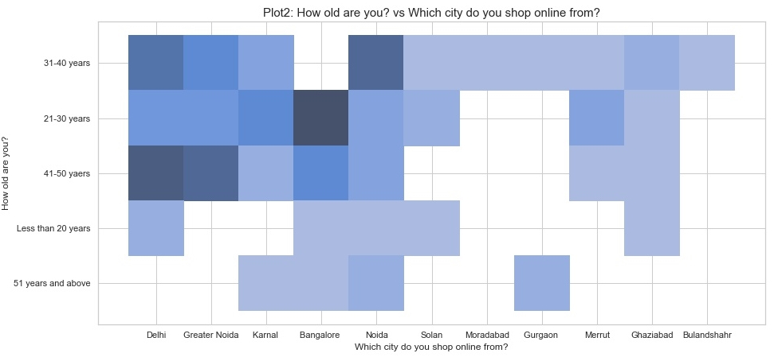
Observations:
Mostly people’s are from Bangalore who have age group 21-30 years.
Only two cities Bulandshr and muradabad, there are only one age group who are doing online shopping that is 31-40 years.
We find, 43% males are from delhi and 24% females are from greater noida and bangalore.
And there is no male from solan

Slide 11
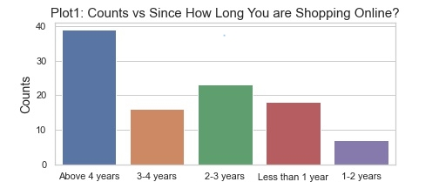
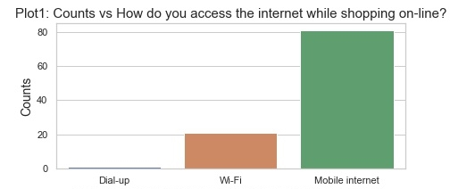
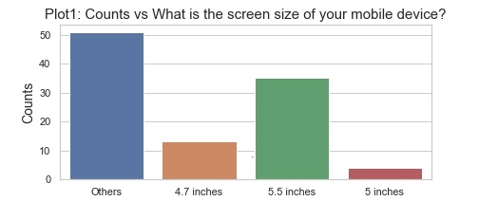
Observations
Visualizations:
We find, people's are more who are doing online shopping more than 4 years in percentage wise also. that is 37.86%
Peoples who are doing shopping more than 4 years, their age groups are 31-50 years old
Peoples who are doing shopping more than 4 years, mostly are females in this category
Peoples who are doing shopping more than 4 years, Mostly peoples are from Greater Noida
We find, there are more people's who are using mobile internet than others.
there is only one person who use dial up service.
Males are using more mobile internet than females in terms of percentage
generally smartphone users has screensize 5.5 inches and laptops users has others screensize.

Slide 12
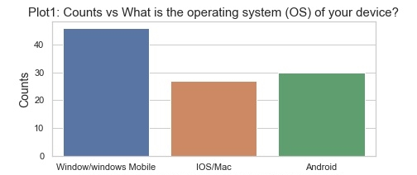
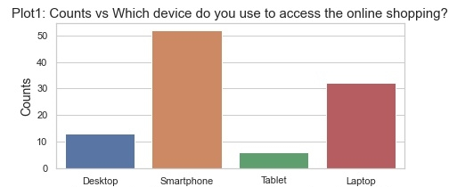
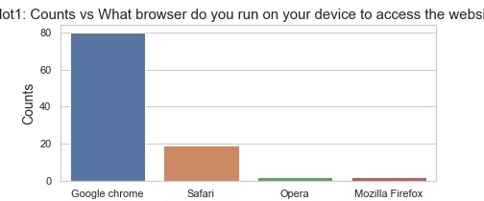
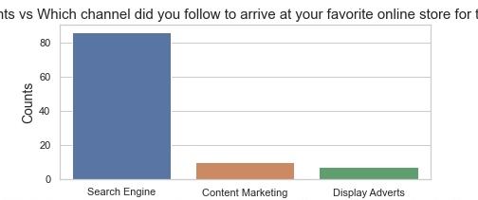
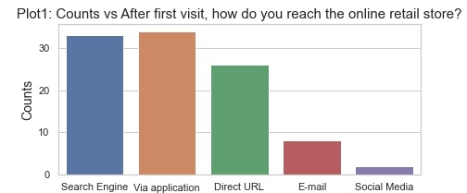
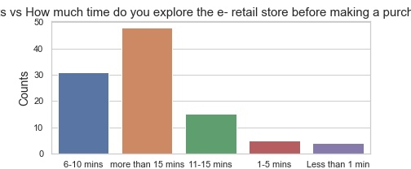
Visualizations

Slide 13
Observations:
smartphone users are more than others.
females are using more smartphone than males, and only males are using Tablets
in every age group, smartphone users are more than others.
mostly smartphone users are from Bangalore
mostly smartphone users are using mobile internet
mostly peoples are using window/windows mobile than others
both female and male are using window mobile more than other category
mostly laptop users are using windows mobile
people using google chrome more than other browser
smartphone users use google chrome more than other category users
peoples are using search engine more than others
mostly people uses google chrome as a search engine
mostly people uses search engine and Via application to reach the online retail store
People’s are more who spent more than 15 min for making decisions
mostly 21-30 years old females are spent time more than 15 mins to take decisions

Slide 14
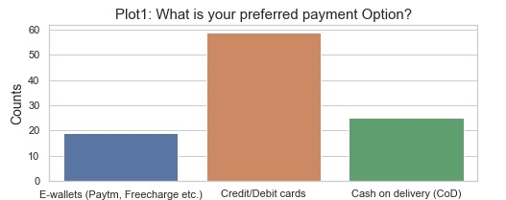
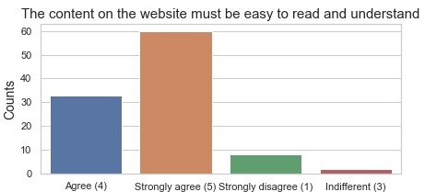
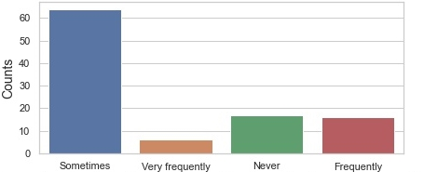
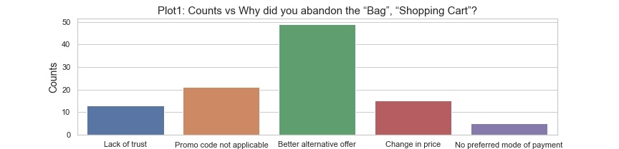
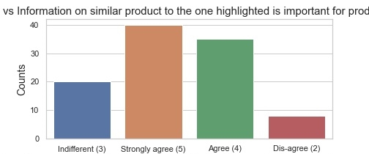
Visualizations:
selecting an items and leaving without making payment

Slide 15
Observations:
1. Most preferred payment option is credit/debit card
2. Mostly females are using credit/debit card
3. Age group 21-30 years old are using credit/debit card most
4. Mostly in Delhi peoples are using credit/debit card
5. People sometimes abandon (selecting an items and leaving without making payment) your shopping cart.
6. People abandon the “Bag”, “Shopping Cart” beacuse they see better alternatives
7. People's are strongly agree that Information on similar product to the one highlighted is important for product comparison
8. Those people's are strongly agree who are doing shopping more than 4 years

Slide 16
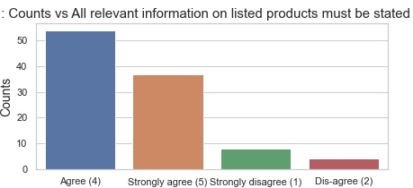
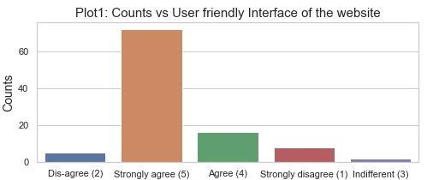
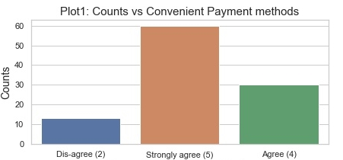
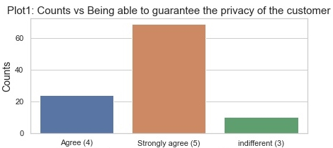
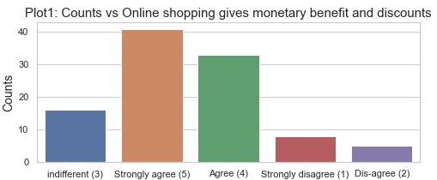
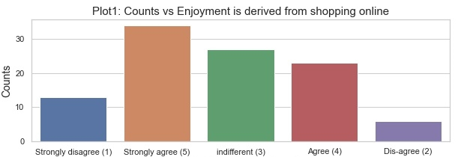
Visualizations:

Slide 17
Observations:
1. Mostly people's are agree with this that all relevant information on listed products must be stated clearly.
2. People's are strongly agree with user friendly interface of the website
3. 21-30 years old people's are strongly agree with this
4. People's are strongly agree with Convenient Payment methods
5. People's who are using credit/debit cards, those people's are agree with this.
6. People's are strongly agree with that companies are being able to guarantee the privacy of the customer
7. People's are strongly agreed with Responsiveness, availability of several communication channels (email, online rep, twitter, phone etc.)
8. People's are strongly agree with Online shopping gives monetary benefit and discounts
9. People's are strongly agree with the enjoyment is derived from shopping online
10. People's who do shopping more than 4 years, they strongly agree about Enjoyment is derived from shopping online

Slide 18
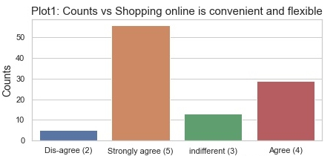
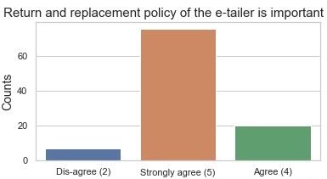
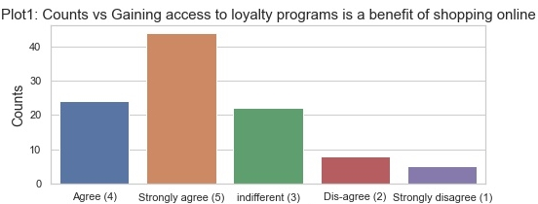
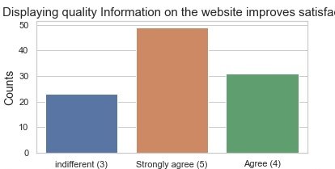
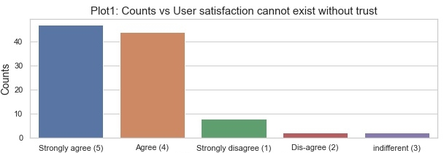
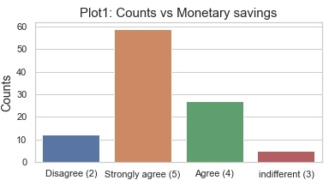
Visualizations:

Slide 19
Observations:
1. People's are strongly agree with shopping online is convenient and flexible
2. People's who do shopping more than 4 years, they strongly agree about Shopping online is convenient and flexible.
3. People's are strongly agree with return and replacement policy of the e-tailor is important for purchase decision.
4. People's are strongly agree with gaining access to loyalty programs is a benefit of shopping online.
5. People's are strongly agree with displaying quality information on the website improves satisfaction of customers.
6. People's are strongly agree with user satisfaction cannot exist without trust
7. People's are strongly agree with Monetary savings

Slide 20
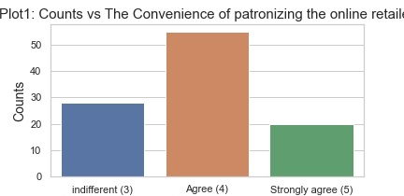
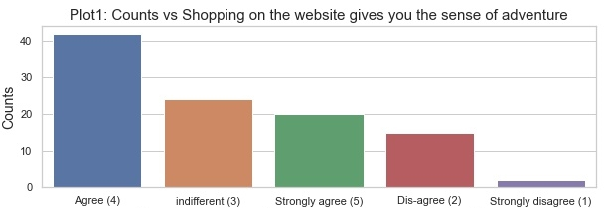
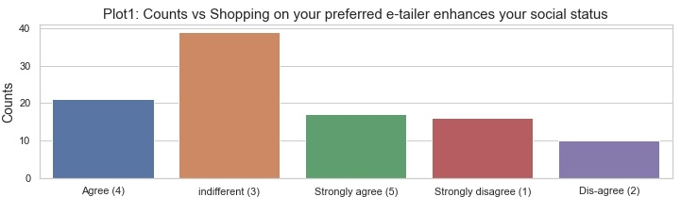
Visualizations:
Observations:
People’s are agree with the convenience of patronizing the online retailer.
People's are agree with the shopping on the website gives us the sense of adventure
The maximum opinion on 'Shopping on your preferred e-tailer enhances your social status’ is indifferent

Slide 21
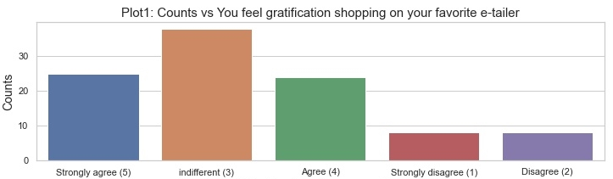
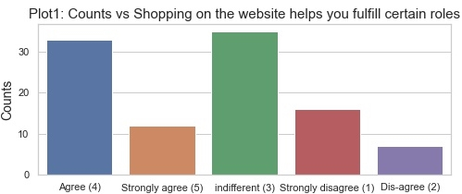
Visualizations:
Observations:
People feels indifferent that they feel gratification shopping on their favourite e-tailor
People’s opinions are indifferent that Shopping on the website helps you fulfill certain roles

Slide 22
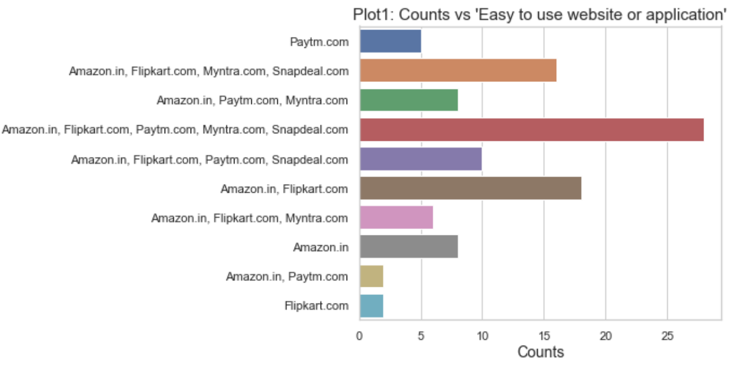
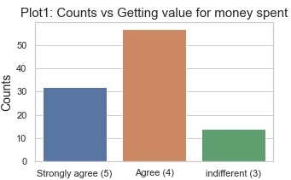
Visualizations:
Observations:
1. People's are agree with Getting value for money spent
2. People thinks all the companies website and their applications are easy to use.

Slide 23
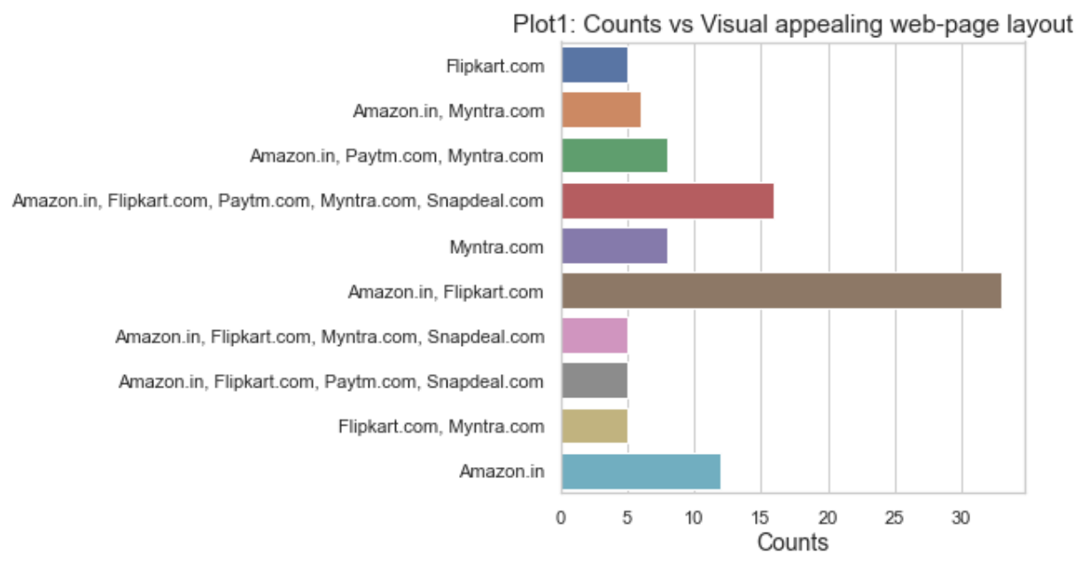
Visualizations:
Observations:
People's likes Amazon and Flipkart the most appealing web-page layouts
People also likes the variety of products on Amazon and Flipkart.
They thinks the variety of products on offer are better than other companies like Myntra, Paytm etc

Slide 24
Observations:
People feels that complete and relevant description information of products are necessary and better on Amazon and FlipKart websites and their application.
More peoples are 'indifferent' opinion when compare it with Complete information on listed seller and product being offered is important for purchase decision.

Slide 25
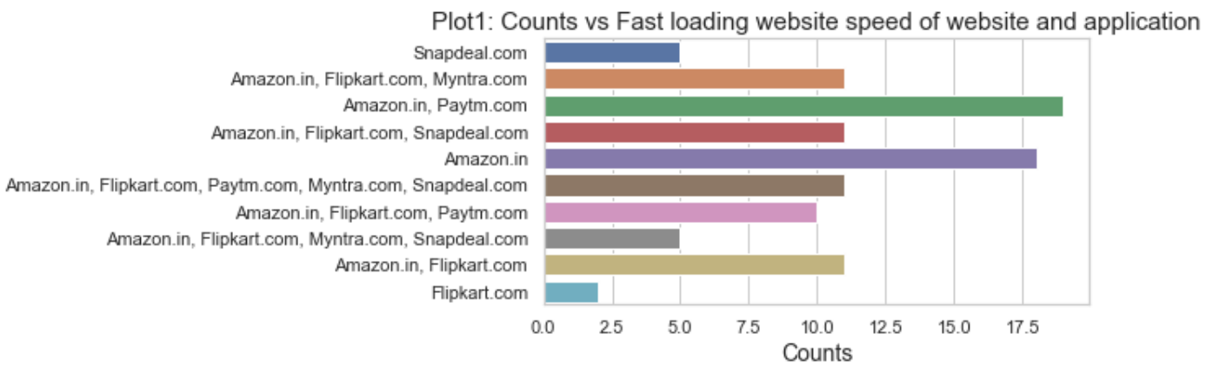
Visualizations:
Observations:
1. People thinks that Amazon and Paytm Fast loading website speed of website and application
2. Only Amazon website speed is faster than other company
3. Flipkart has lowest speed of loading website and application

Slide 26
Observations:
1. People thinks that Amazon has better reliability of the website or application
2. Flipkart has worst reliability of the website and application.
3. People thinks that Amazon has better quickness to complete purchase
4. Flipkart has worst quickness to complete purchase
5. People thinks that both (Amazon and Flipkart) has better Availability of several payment options
6. Flipkart has worst Availability of several payment options
7. Individually Amazon has best Availability of several payment options
8. Amazon have best speedy order delivery and FlipKart has worst.
9. Amazon have best privacy of customers information and FlipKart has worst
10. Amazon have best Security of customer financial information and Myntra has worst
11. Amazon is more trustworthy than Flipkart and Myntra
12. Amazon is more Presence of online assistance through multi-channel than Flipkart and paytm.com
13. Amazon has more Longer time to get logged in (promotion, sales period) than other companies

Slide 27
Observations:
1. Amazon and Flipkart has more Longer time in displaying graphics and photos (promotion, sales period) than other companies
2. Myntra and Paytm is good at Late declaration of price (promotion, sales period)
3. Myntra and Paytm is good at Longer page loading time (promotion, sales period)
4. Paytm has longer delivery period than others
5. Amazon is better at Change in website/Application design
6. Amazon and Myntra has high Frequent disruption when moving from one page to another while Filpkart has low
7. Amazon website is more efficient than other
8. Amazon is most recommendable website than others

Slide 28
Conclusion:
At last, We conclude that mostly females whose age group is around 21-30 years takes part in online shopping. Most of the people’s belongs to big cities like Delhi, Noida, Bangalore etc. They are experienced people, they do shopping more than 4 years and using smartphones, Laptops with mobile internet, their operating system is windows, screen size is bigger. They generally use applications, google chrome as a search engine to reach the online store.
People likes Amazon the most because its website and application is easy to use, wide variety of products on offer, Complete, relevant description information of products, fast loading website speed, more reliable, more quickness to complete the purchase, Availability of several payment options, Speedy order delivery, Privacy of customers’ information, Security of customer financial information,more trustworthy, Longer time to get logged in, Longer time in displaying graphics and photos, quick declaration of price, Lesser page loading time, many mode of payment on most products, Lesser delivery period, better at Change in website/Application design

Slide 29
References:
Farris, Paul W.; Neil T. Bendle; Phillip E. Pfeifer; David J. Reibstein (2010). Marketing Metrics: The Definitive Guide to Measuring Marketing Performance. Upper Saddle River, New Jersey: Pearson Education, Inc. ISBN 0-13-705829-2.
^ http://www.commonlanguage.wikispaces.net/ Material used from this publication in this article has been licensed under Creative Commons Share Alike and Gnu Free Documentation License. See talk.
^ Gitman, Lawrence J.; Carl D. McDaniel (2005). The Future of Business: The Essentials. Mason, Ohio: South-Western. ISBN 978-0-324-32028-2.
^ Coelho, Pedro S.; Esteves, Susana P. (May 2007). "The Choice between a Fivepoint and a Ten-point Scale in the Framework of Customer Satisfaction Measurement". International Journal of Market Research. 49 (3): 313–339. doi:10.1177/147078530704900305. ISSN 1470-7853. S2CID 166325179.
^ Dawes, John; Stocchi, Lara; Dall’Olmo-Riley, Francesca (May 2020). "Over-time variation in individual's customer satisfaction scores" (PDF). International Journal of Market Research. 62 (3): 262–271. doi:10.1177/1470785320907538. ISSN 1470-7853. S2CID 213159177.
^ Jump up to:ª ^{b} ^{c} ^{d} Kucukosmanoglu, Ahmet Nuri; Sensoy Ertan (2010). "Customer Satisfaction: A Central Phenomenon in Marketing". [1]
^ Westbrook, Robert A., and Richard L. Oliver. "The dimensionality of consumption emotion patterns and consumer satisfaction." Journal of consumer research (1991): 84-91.
^ Homburg, Christian, Nicole Koschate, and Wayne D. Hoyer. "The role of cognition and affect in the formation of customer satisfaction: a dynamic perspective." Journal of Marketing 70.3 (2006): 21-31.
^ Johnson, Michael D., Andreas Herrmann, and Frank Huber. "The evolution of loyalty intentions." Journal of marketing 70.2 (2006): 122-132.
^ John, Joby (2003). Fundamentals of Customer-Focused Management: Competing Through Service. Westport, Conn.: Praeger. ISBN 978-1-56720-564-0.

Slide 30
Thankyou

