Slide 1


Malignant Comments Classifier
Presented By
Shivanchal Asthana

Slide 2
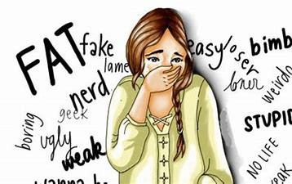
Table of Content
Introduction
Benefits of Malignant Comments Classifier
Problem statement
Objectives
Research Methodology
Data Analysis/ Visualizations/ Observations
Conclusions

Slide 3
Introduction
Over a decade, social media have been growing, and people are able to express their opinions and also discuss among others via these platforms. o These debates may arise due to differences in opinion and may often result in fights over the social media during which offensive language termed as malignant comments may be used from one side.
This clearly pose the threat of abuse and harassment online. As such, some people stop giving their opinions or give up seeking different opinions which result in unhealthy and biased discussion.
Therefore it results in different platforms and communities finding it very difficult to facilitate fair conversation and are often forced to either limit user comments or get dissolved by shutting down user comments completely.

Slide 4
Benefits
The main benefit of this classifier is that we can easily know about which comment is malignant or not and based on that we can easily remove it.
By using this project, we can reduce online hate which is increasing now a days.
Everyone do some hard work and give some precious time to make content and publish on social media, and peoples are just do malignant comment on that for spreading hate and by seeing hate comments, anybody can loose their confidence. So, This is useful for social media activist or influencers to get good quality of feedback and it may bolster their confidence also.

Slide 5
About Problem Statement
The proliferation of social media enables people to express their opinions widely online. However, at the same time, this has resulted in the emergence of conflict and hate, making online environments uninviting for users. Although researchers have found that hate is a problem across multiple platforms, there is a lack of models for online hate detection.
Online hate, described as abusive language, aggression, cyberbullying, hatefulness and many others has been identified as a major threat on online social media platforms. Social media platforms are the most prominent grounds for such toxic behaviour.
There has been a remarkable increase in the cases of cyberbullying and trolls on various social media platforms. Many celebrities and influences are facing backlashes from people and have to come across hateful and offensive comments. This can take a toll on anyone and affect them mentally leading to depression, mental illness, self-hatred and suicidal thoughts.
Internet comments are bastions of hatred and vitriol. While online anonymity has provided a new outlet for aggression and hate speech, machine learning can be used to fight it. The problem we sought to solve was the tagging of internet comments that are aggressive towards other users. This means that insults to third parties such as celebrities will be tagged as unoffensive, but “u are an idiot” is clearly offensive.

Slide 6

Objectives
Create an analytical framework to understand
- Key factors impacting how much comment is malignant or not
Develop a modelling framework
- To check the comment is malignant or not.

Slide 7
Research Methodology
The research methodology adopted for this is given as follows:
Research design: The research design adopted for this study is descriptive research design. The descriptive research design focuses on the accurate description of the variables present in the problem.
Sampling: Sampling allows concentrating upon a relatively smaller number of people and hence, to devote more energy that the information collected from them is accurate.
Sampling Size: The total size of the sample is 153164 respondents.

Slide 8
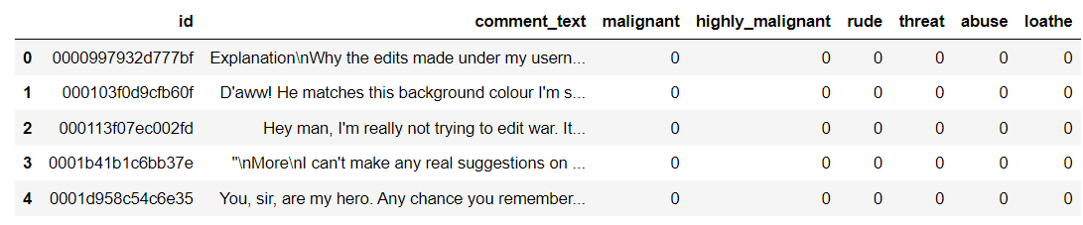
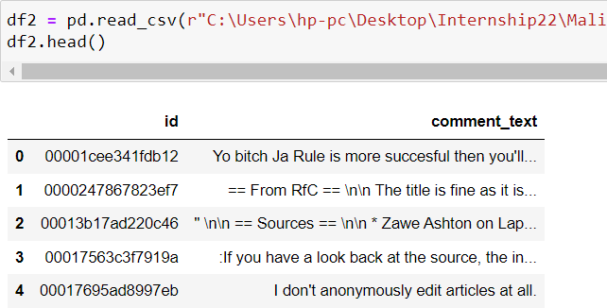
Data Analysis and Interpretation
We have two Dataset- Train and Test
Train Dataset contains 8 columns
Test Dataset contains 2 columns

Slide 9
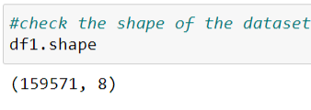
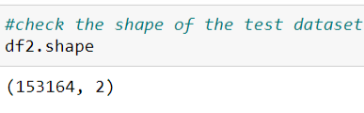
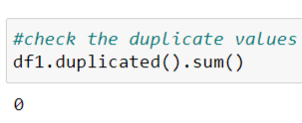
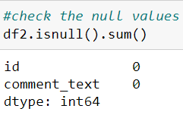
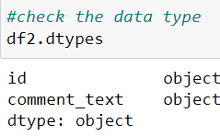
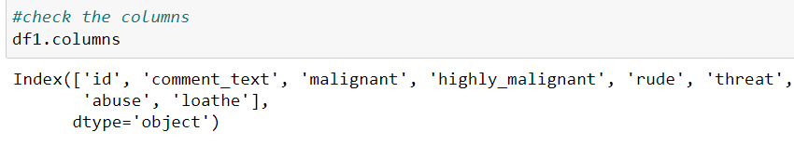
Data Understanding
Shape of Train Dataset is 159571 rows and 8 columns
Shape of test dataset is 153164 rows and 2 columns
No duplicate values found in train dataset
No null values found in test dataset and both the columns are object type in test dataset

Slide 10
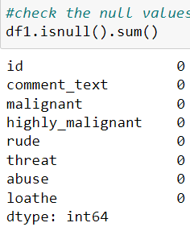
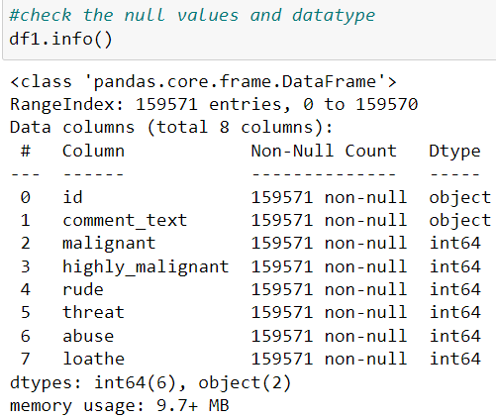
Data Understanding
No Null values are found in Train dataset
Except 2 columns, rest all are integer type

Slide 11
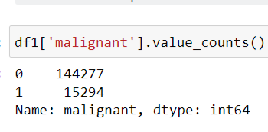
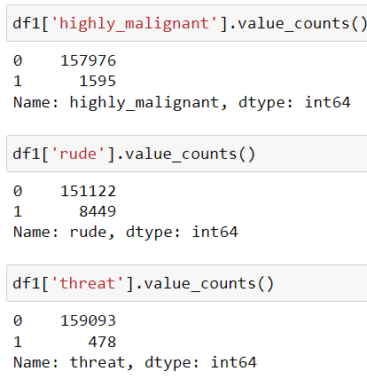
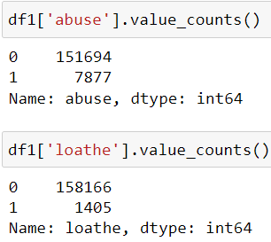
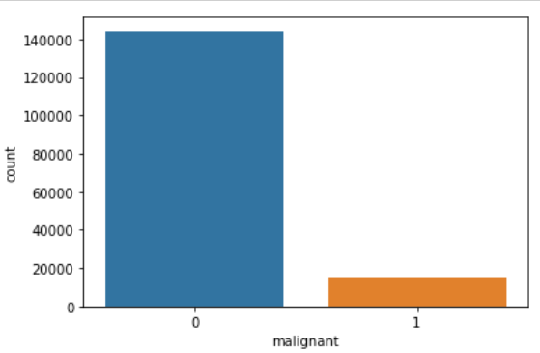
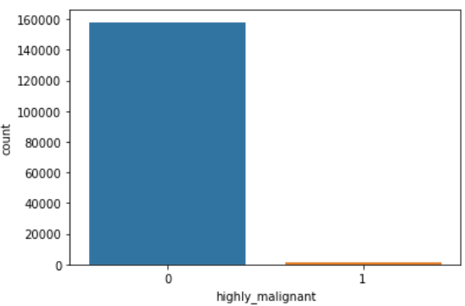
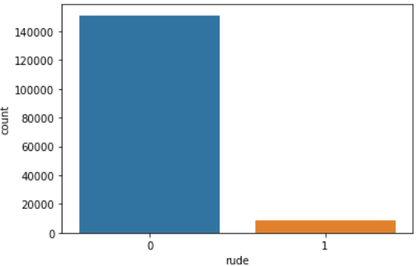
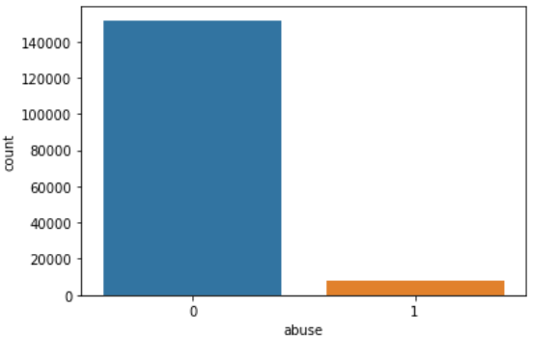
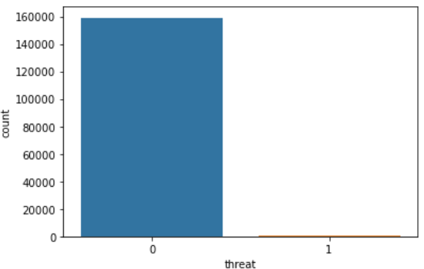
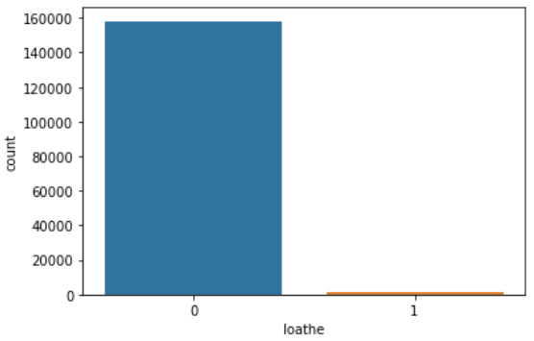
EDA
1. We can see here, our columns are imbalanced.

Slide 12
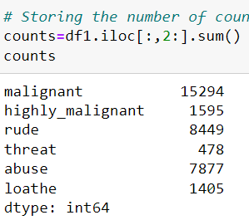
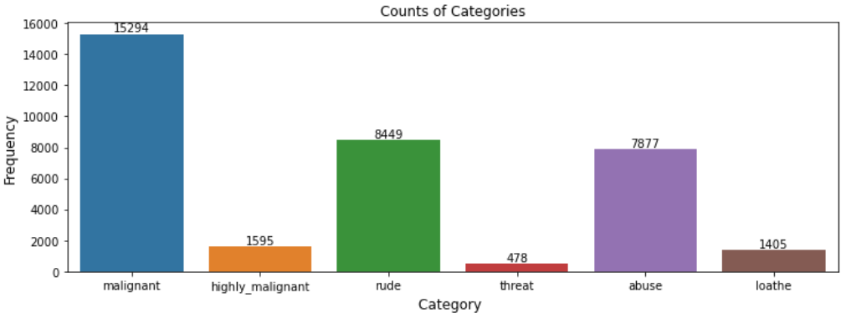
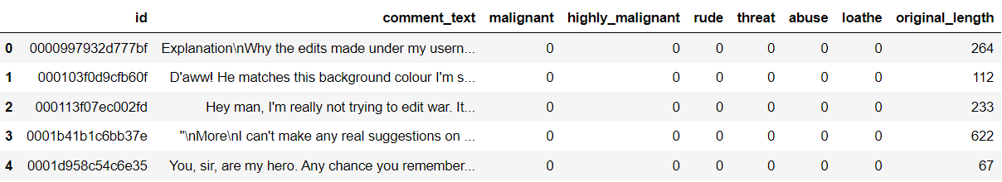
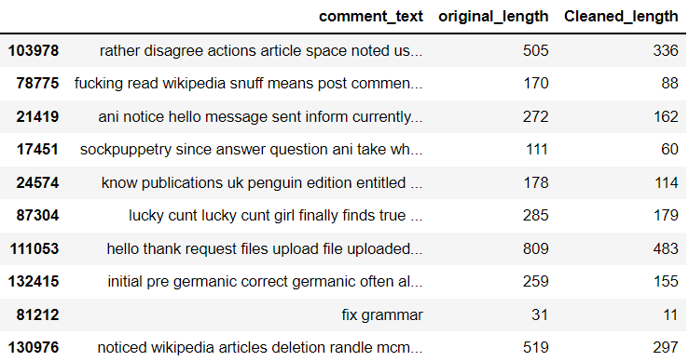
Data Understanding
We see, how much comments are distributed according to their categories, malignant comments are more than others.
And these two datasets are our cleaned dataset.

Slide 13
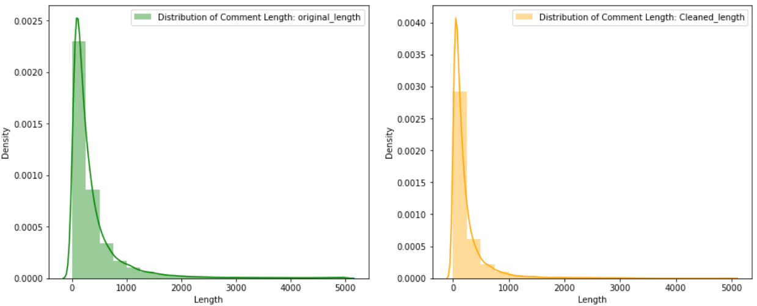
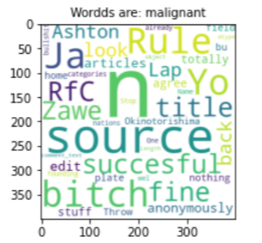
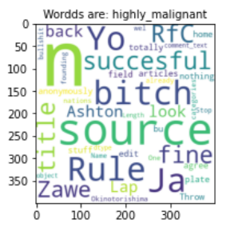
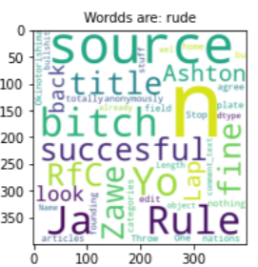
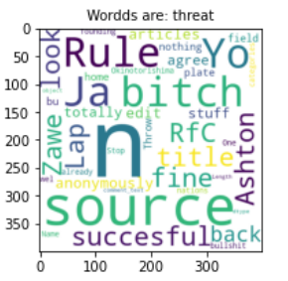
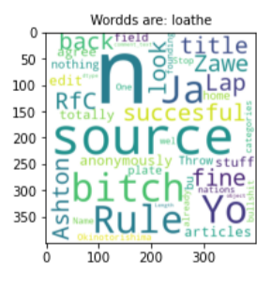
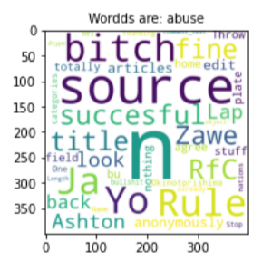
Data Visualization
We can see, original length and cleaned length both are imbalanced.
By using Wordcloud, we see these words are malignant, highly malignant etc.

Slide 14
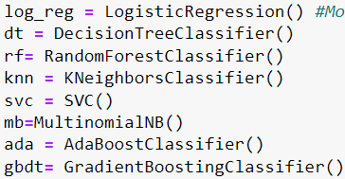
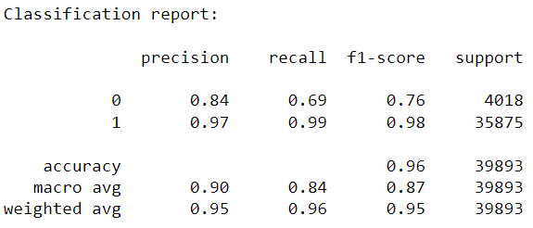
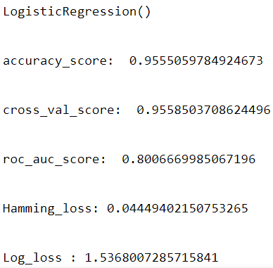
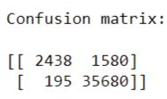
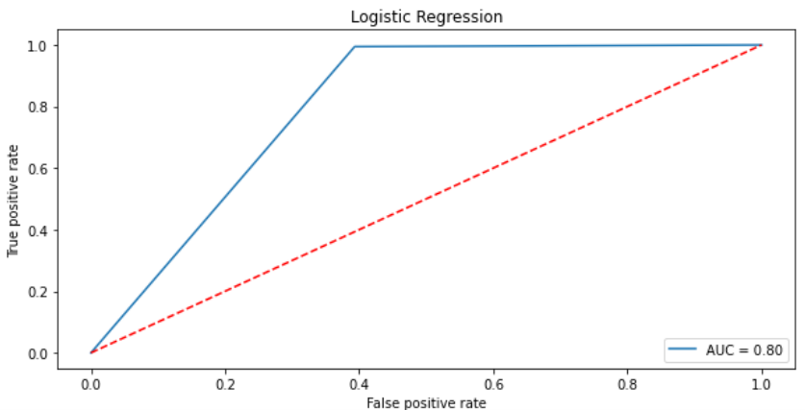
Model Building & Logistic Regression
We check our accuracy by using 6-7 models.
Logistic Regression is giving us 95.5% Accuracy.

Slide 15
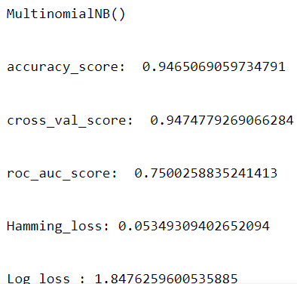
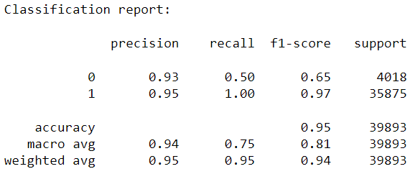
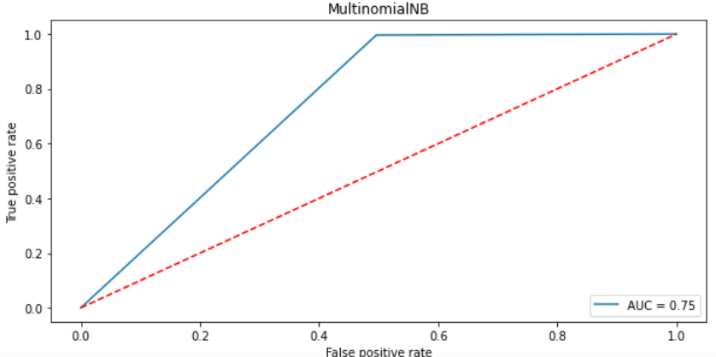
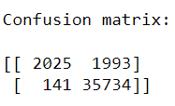
MultinomialNB
1. MultinomialNB is giving us 94.6% Accuracy

Slide 16
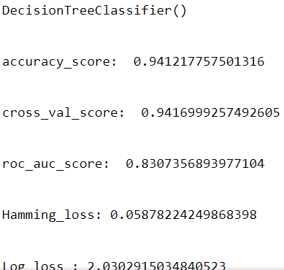
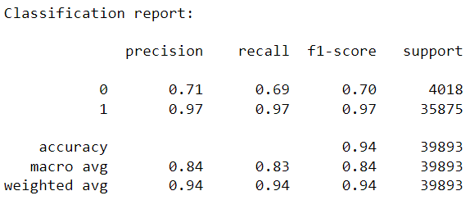
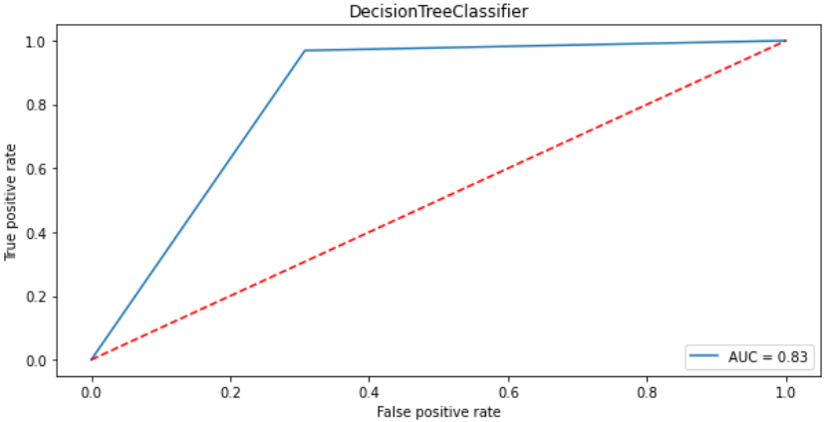
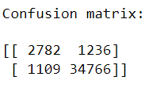
DecisionTree Classifier
1. DecisionTreeClassifer is giving us 94.1% Accuracy

Slide 17
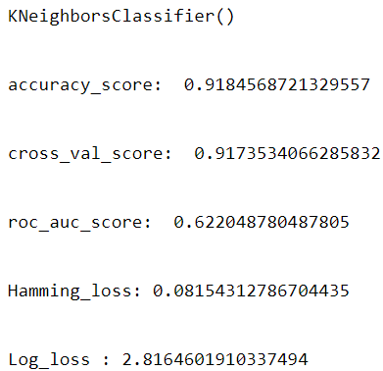
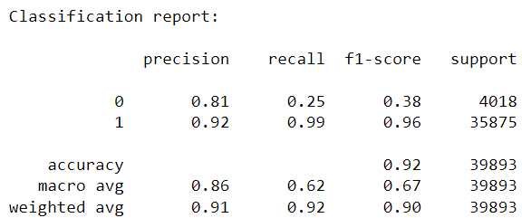
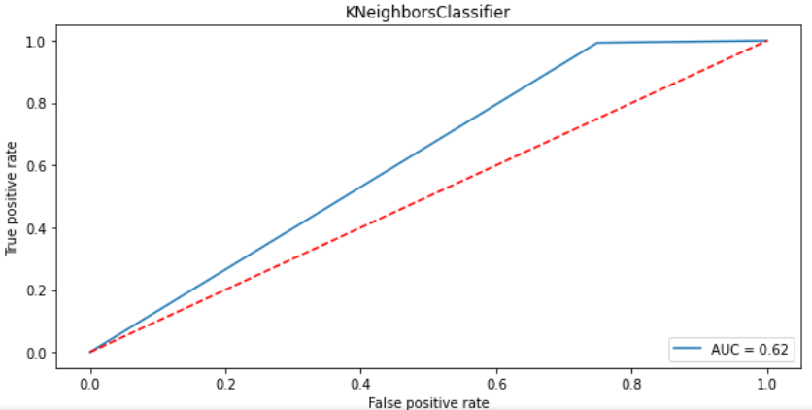
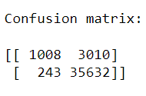
KNN Classifier
1. KNN Classifier is giving us 91.8% Accuracy

Slide 18
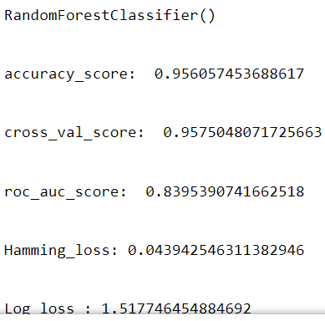
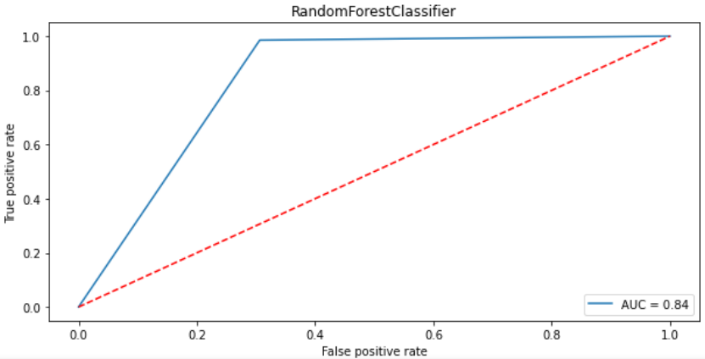

RandomForest Classifier
1. RandomForestClassifier is giving us 96% Accuracy

Slide 19




Ada Boost Classifier
1. AdaBoostClassifier is giving us 94.4% Accuracy

Slide 20




Gradient Boosting Classifier
1. GradientBoostingClassifier is giving us 93.9% Accuracy

Slide 21

GridSearchCV Using RandomForest
1. We see, random Forest is giving us good accuracy, so, we tried to improve accuracy by using GridSearchCV, but we failed to improve it.

Slide 22
Conclusion
We see, RandomForest is giving us better accuracy. So, this is our best model.

