Slide 1


Slide 2
AIM OF THE PROJECT
This project is all about finding the answers of the questions that we are looking for.
In this project, our main focus is to analyze and find favorite movies, favorite directors, Top 250 IMBD movies, directors with highest imbd rating, popular movie genre, critic favorite actor and user favorite actor.

Slide 3
TECHNOLOGY STACK USED
Microsoft Excel – To import the datasets, cleaning of data, filtering of data, analyze the data using various formula and tools and then visualize it using various graphs and charts.
Microsoft Power Point – To create PPT that includes Useful Insights
and Solutions for our Business Problems.

Slide 4
TOP 10 PROFITABLE MOVIES
Movie Title | Director_Name
Avatar | James Cameron
Jurassic World | Colin Trevorrow
Titanic | James Cameron
Star Wars: Episode IV - A New Hope | George Lucas
E.T. the Extra-Terrestrial | Steven Spielberg
The Avengers | Joss Whedon
The Lion King | Roger Allers
Star Wars: Episode I - The Phantom Menace | George Lucas
The Dark Knight | Christopher Nolan
The Hunger Games | Gary Ross

Slide 5
TOP 250 IMBD MOVIES
Drive link for Excel File:- Excel File
Rank | Movie_Title | Num_of_Votes | IMBD_Score | Language
1 | The Shawshank Redemption | 1689764 | 9.3 | English
2 | The Godfather | 1155770 | 9.2 | English
3 | The Dark Knight | 1676169 | 9 | English
4 | The Godfather: Part II | 790926 | 9 | English
5 | The Lord of the Rings: The Return of the King | 1215718 | 8.9 | English
. . . | . . . | . . . | . . . | . . .
246 | The Wrestler | 251349 | 7.9 | English
247 | The Chorus | 44151 | 7.9 | French
248 | Do the Right Thing | 59524 | 7.9 | English
249 | Moon | 260607 | 7.9 | English
250 | Before Midnight | 95362 | 7.9 | English

Slide 6
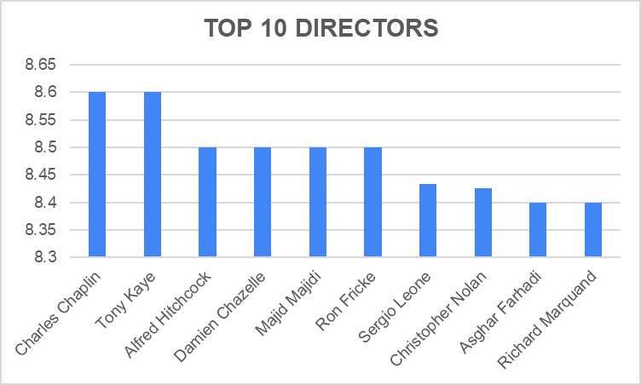
TOP 10 DIRECTORS
Director_Name | Mean_IMBD_Score
Charles Chaplin | 8.6
Tony Kaye | 8.6
Alfred Hitchcock | 8.5
Damien Chazelle | 8.5
Majid Majidi | 8.5
Ron Fricke | 8.5
Sergio Leone | 8.433333333
Christopher Nolan | 8.425
Asghar Farhadi | 8.4
Richard Marquand | 8.4

Slide 7
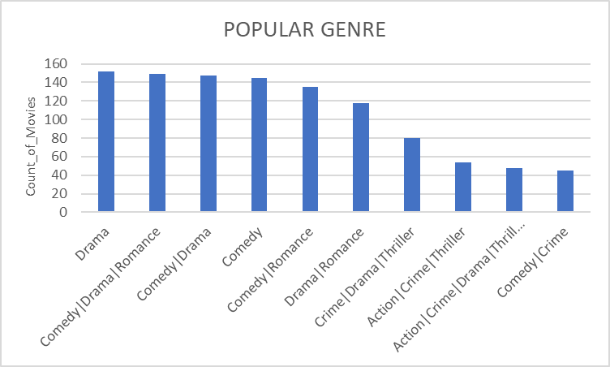
POPULAR GENRE
Drive Link of Excel File:- Drive Link
Genre | Movie Count
Drama | 152
Comedy|Drama|Romance | 149
Comedy|Drama | 147
Comedy | 145
Comedy|Romance | 135
Drama|Romance | 118
Crime|Drama|Thriller | 80
Action|Crime|Thriller | 54
Action|Crime|Drama|Thriller | 48
Comedy|Crime | 45

Slide 8
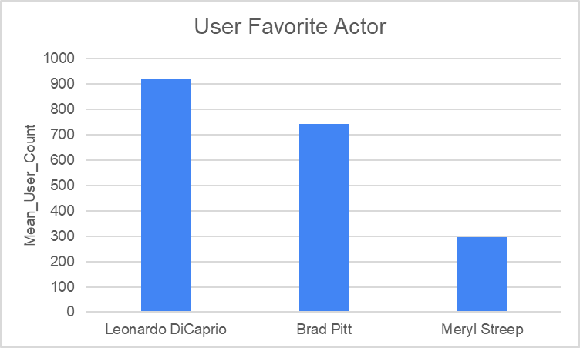
USER FAVORITE ACTOR
Actor_Name | Mean_User_Review
Leonardo DiCaprio | 922.55
Brad Pitt | 742.3529412
Meryl Streep | 297.1818182

Slide 9
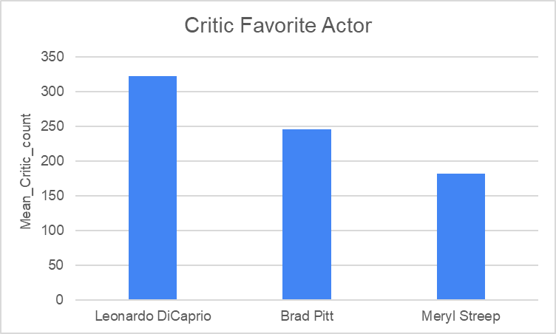
CRITIC FAVORITE ACTOR
Actor_name | Mean_Critic_Review
Leonardo DiCaprio | 322.2
Brad Pitt | 245
Meryl Streep | 181.4545455

Slide 10
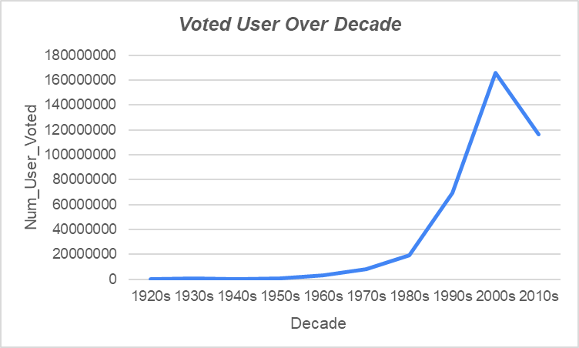
NUMBER OF USERS OVER DECADE
Decade | Num_User_Voted
1920s | 116392
1930s | 804839
1940s | 230838
1950s | 678336
1960s | 2983442
1970s | 8269828
1980s | 19344369
1990s | 69635863
2000s | 165976267
2010s | 116239604

Slide 11
CONCLUSION
I have learnt a lot while working on this project like the concept of 5 why’s and it’s importance, how to ask right questions in order to understand the problem, how to clean the data optimally etc.
This project gives me opportunity to implement my data analytics learning into a real world problem in order to derive useful insights

Slide 12


