Slide 1

QuizUp – A Quiz application
Submitted to :- Submitted By :-
Ms. Tanusha Mittal Shivang mahendra
assistant professor Semester:- 4TH
Geu , Dehradun Univ. Roll No.:-2019103

Slide 2
Introduction
Problem Statement
This project is about Designing a QuizUp – A Quiz Application for users to play, enjoy and learn.
And also to understand the concepts of Java and Android Studio and solve real world problems using Java.

Slide 3
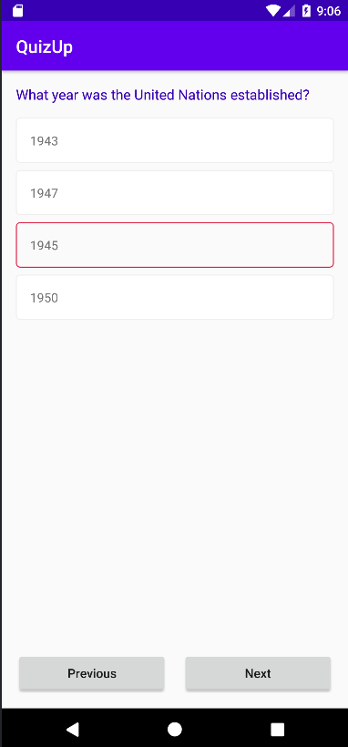
Introduction
QuizUp – A Quiz Application
It a quiz application which consists of many different quizzes on different topics such as sports, general knowledge, history, etc. The users can attempt quizzes anytime and from anywhere using their mail id and passwords from any device. Users get score/credit points for each correct answer and after submitting they can see their result and correct answers for each question. Quizzes are uploaded in the database along with the questions and its options. Every question has 4 options and users can select any one.

Slide 4
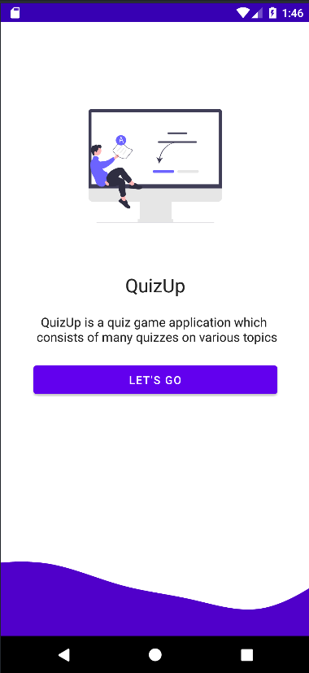
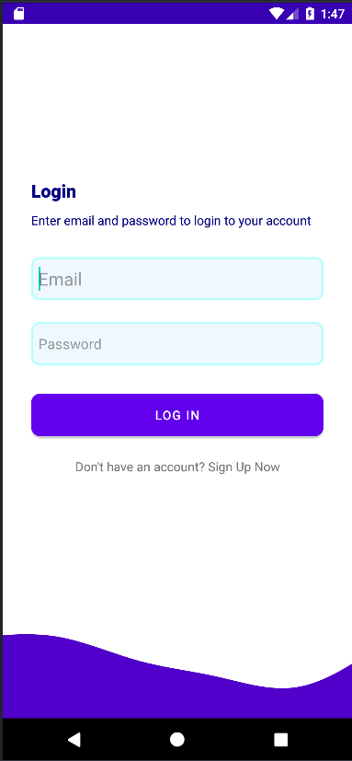
methodology
Designing Introduction, Login and Registration Window
The introduction window tells us about the QuizUp application and has a button that takes us to login window.
Login window asks users for their mail id and password to login in to their account and has a text asking user to sign up if they don’t have an account and takes user to sign up window.
Sign Up Window asks user to enter mail id and create a password to create a user account. It also has text that if user already have an account then it takes them to login window.
Both the login and signup window takes the user to Main window after clicking on login or sign up button.
Introduction Window Login Window

Slide 5
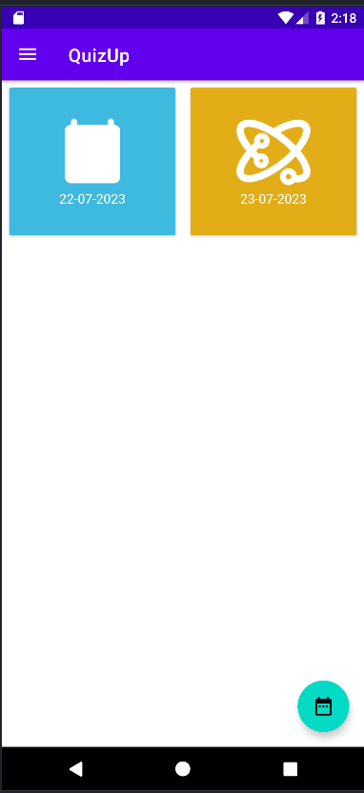
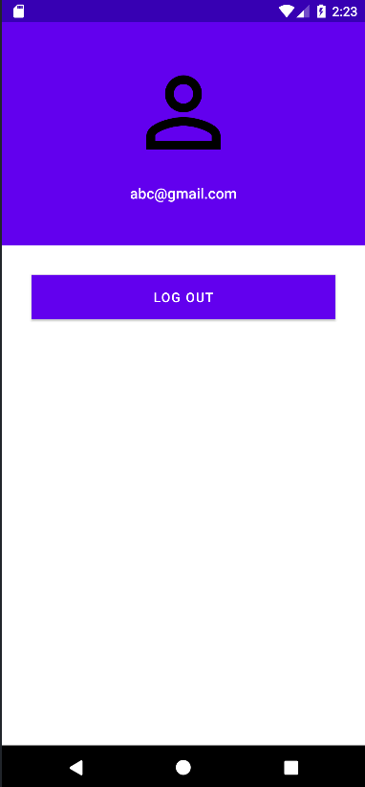
methodology
Designing Main Window and Profile Window
In the main window there are various quizzes, from which users can select they are titled according to date. There is also a calendar from which user can select a date and start attempting a quiz. It has a drawer which has many options such as profile, follow us, etc. and users can view their profile from there.
Profile Window, from here users can see through which id they have logged in and can log out from there.
Main Window Profile Window

Slide 6
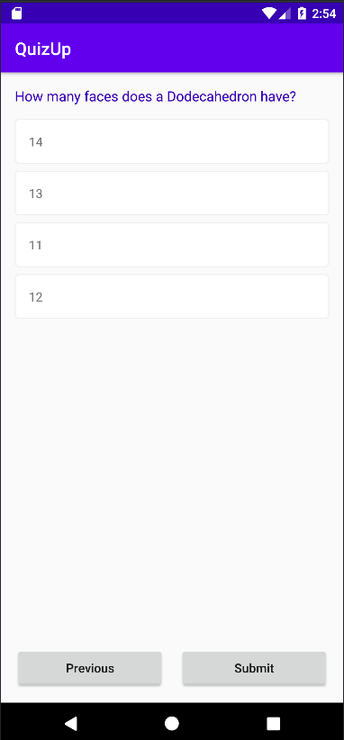
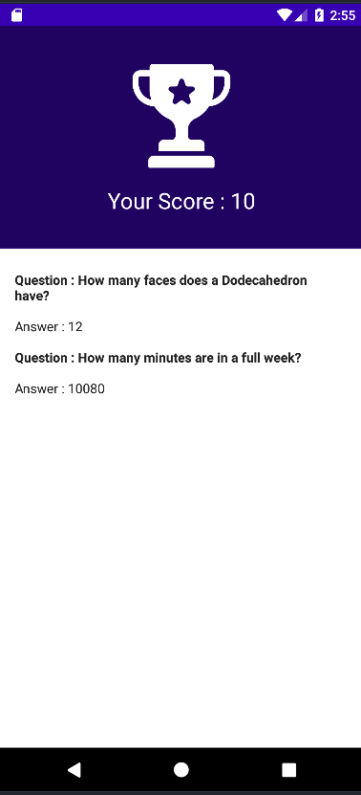
Methodology
Designing Question Window and Result Window
In Question Window, question is displayed with its 4 options and user can select from any of the options. It also has few buttons such as next, previous, and submit to help user to go from one question to another and submit the quiz.
In Result Window, users can see their score in the quiz. And users can also view the correct answers for each and every question in the quiz.
Question Window Result window

Slide 7
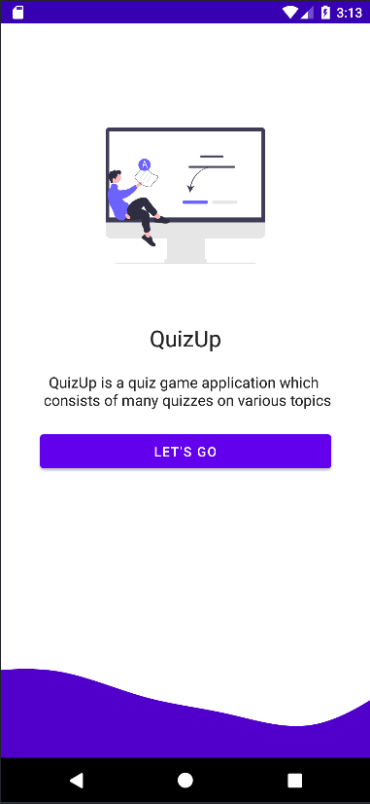
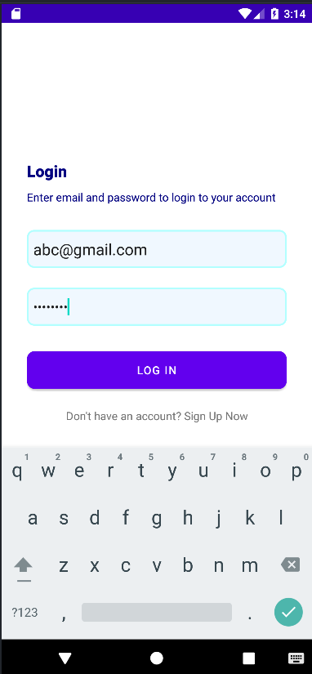
Result
With the help of the above explained methodology the Designing of a QuizUp – A Quiz Application was successfully completed and the designed QuizUp Application does work perfectly.

Slide 8
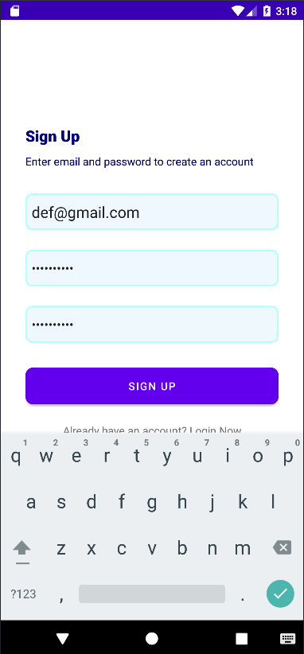
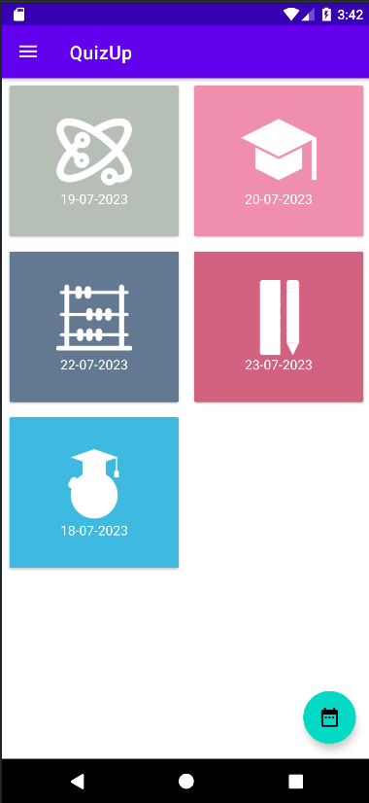
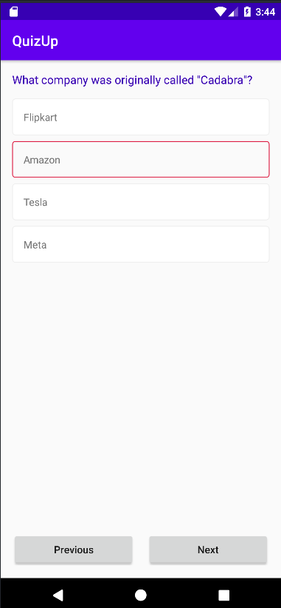

Slide 9
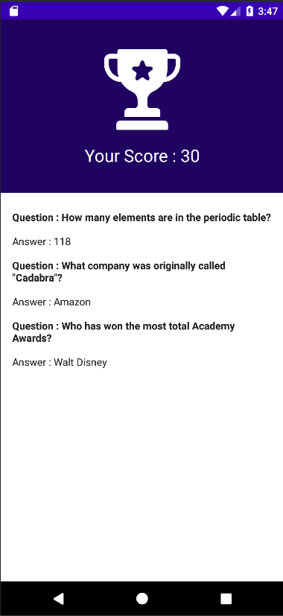
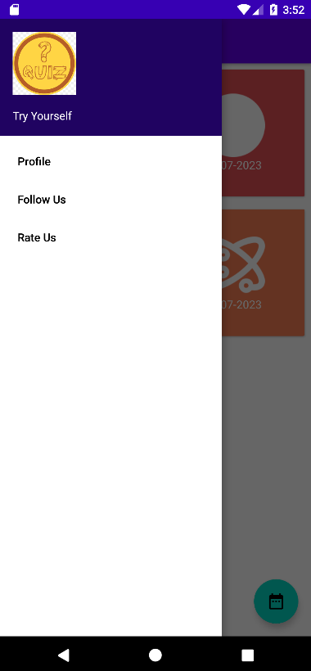
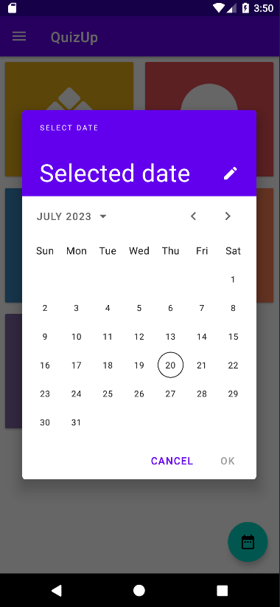

Slide 10

Conclusion and future work
Conclusion
With the help of the above method, the designing of the QuizUp – A Quiz Application has been completed and verified.
Future Work
The game can be improved by adding new things such as:-
To add more ways to log in such as phone number or different social media accounts.
Users can create their own quizzes to play with their family and friends.
Adding different profile options such as viewing past attempted quizzes and their results.
Arranging quizzes according to their difficulty.
Introducing private quizzes which can be accessed only with the help of a pin or a password.

Slide 11
Thank You

