Slide 1


Shivang Kumar
&
Vikas Pandey
Data Analytics Project

Slide 2


OBJECTIVE
Develop Deep Insights About Car types to launch
Project is related to Post purchase data of cars in U.K. and we have performed SQL queries using MS SQL Server to retrieve data and MS Excel to create a dynamic dashboard which will help the brand to determine the categories of cars to be launched, the features to be included and it's target customers.

Slide 3
Category wise Sales Data
Compact cars are being sold the most (10614)

Slide 4
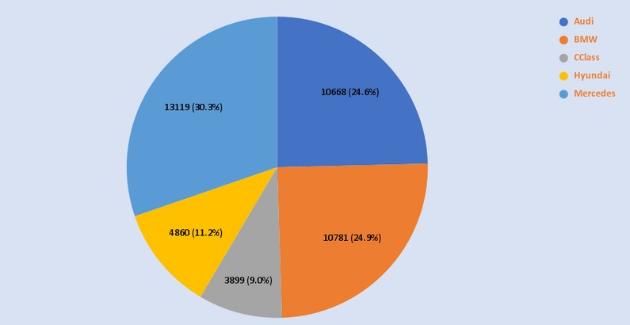
Brand wise Sales figures
Approximately 80% of Customers preferred european brands

Slide 5
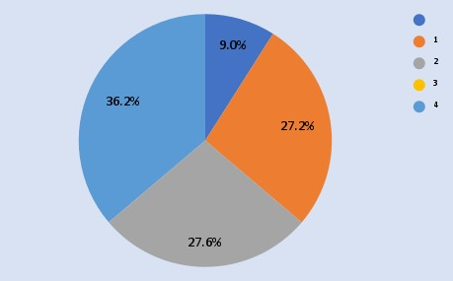
Transmission type preferred by buyers
36.2% of buyers preferred semi automatic and 27.2% preferred automatics transmission

Slide 6
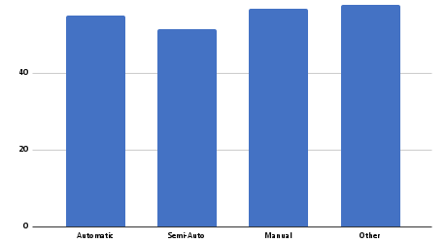
Transmission type offering good fuel efficiency
Automatic transmission offers better fuel efficiency than Semi Automatic

Slide 7
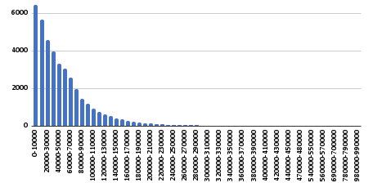
Impact of fuel spending on car sales
There is an inverse relationship between fuel spending and car sales

Slide 8
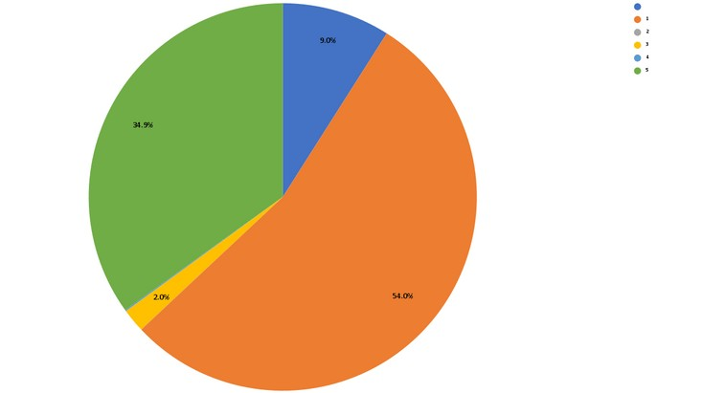
Fuel type preffered by customers
Petrol (54%) is the most preferred fuel type followed by diesel (35% approx)

Slide 9
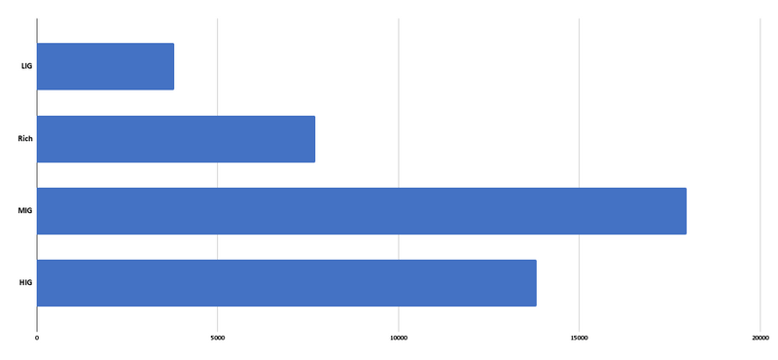
Income groups and sale of cars
Mid income group(MIG) customers are the majority buyers

Slide 10

Conclusion:
Brand can launch compact cars with Semi Automatic and Automatic transmission in Diesel segment
targeting MIG customers
36.2% of buyers preferred semi automatic and 27.2% preferred automatics transmission ..
Automatic transmission offers better fuel efficiency than Semi Automatic.
Petrol (54%) is the most preferred fuel type followed by diesel (35% approx.).
Mid income group(MIG) customers are the
majority buyers

Slide 11
Thank You

