Slide 1
Cricket Player Performance Prediction
End-to-End Machine Learning System with Explainability and Deployment
Shivang Bhardwaj

Slide 2
Problem Statement
Traditional cricket prediction relies on simple averages
Machine learning enables prediction using historical patterns
Models learn nonlinear relationships between performance indicators
Goal: Predict batsman runs using engineered cricket features

Slide 3
Dataset Overview
Total records: 16439
Total features: 10
Dataset derived from IPL ball-by-ball data
Includes career, form, opponent, and experience features

Slide 4
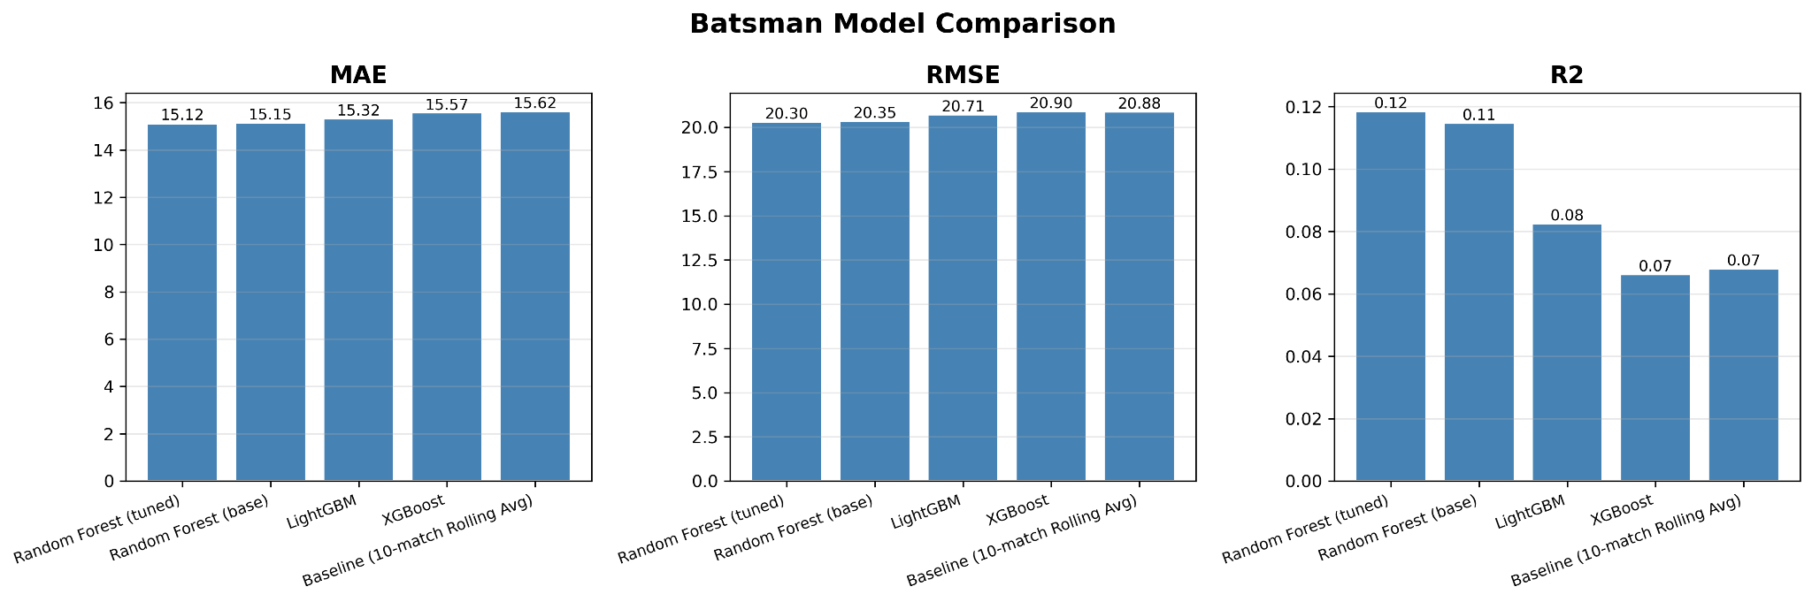
Model Performance Comparison
Random Forest achieved best predictive accuracy

Slide 5
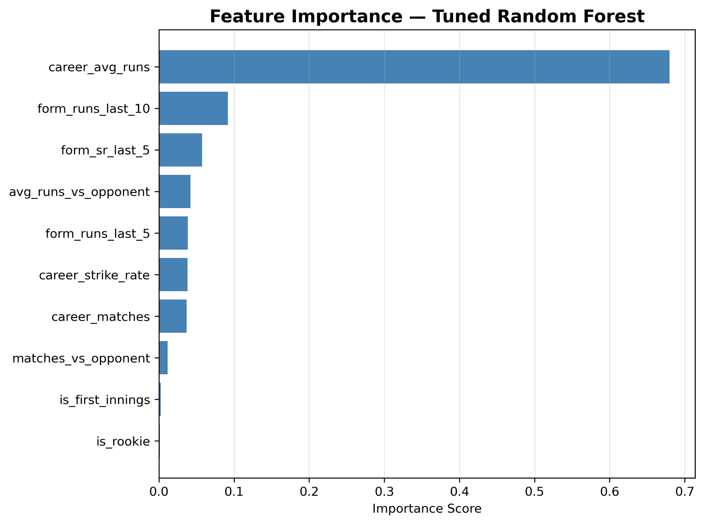
Feature Importance

Slide 6
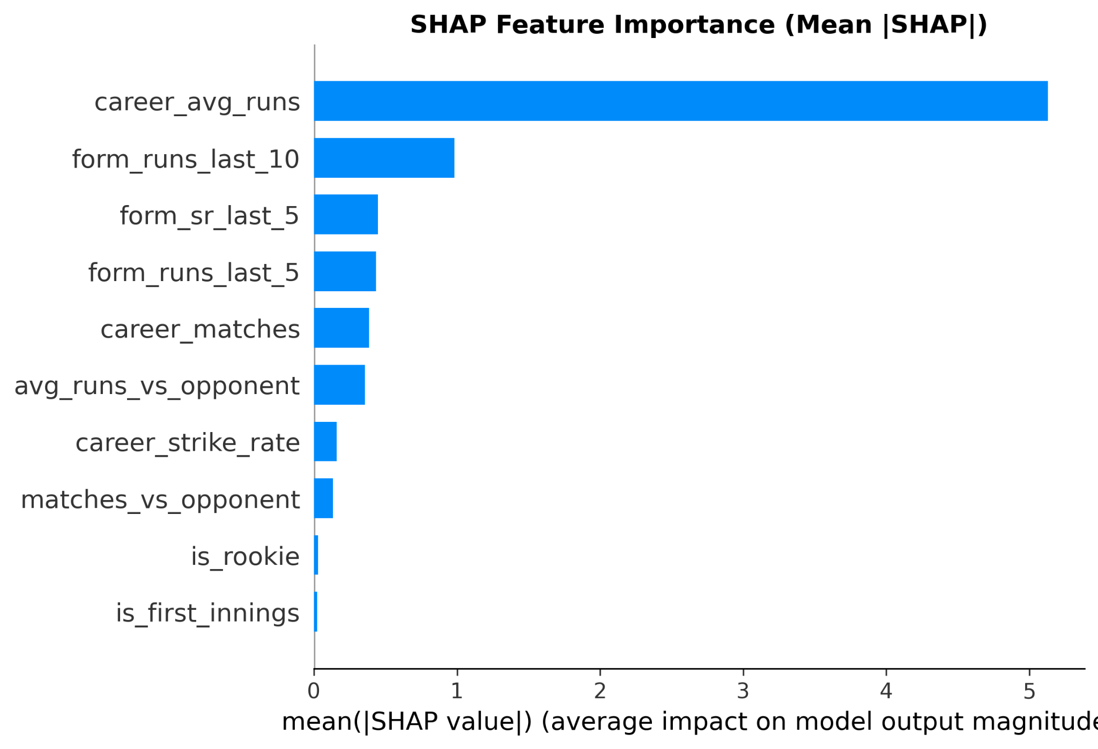
SHAP Feature Importance

Slide 7
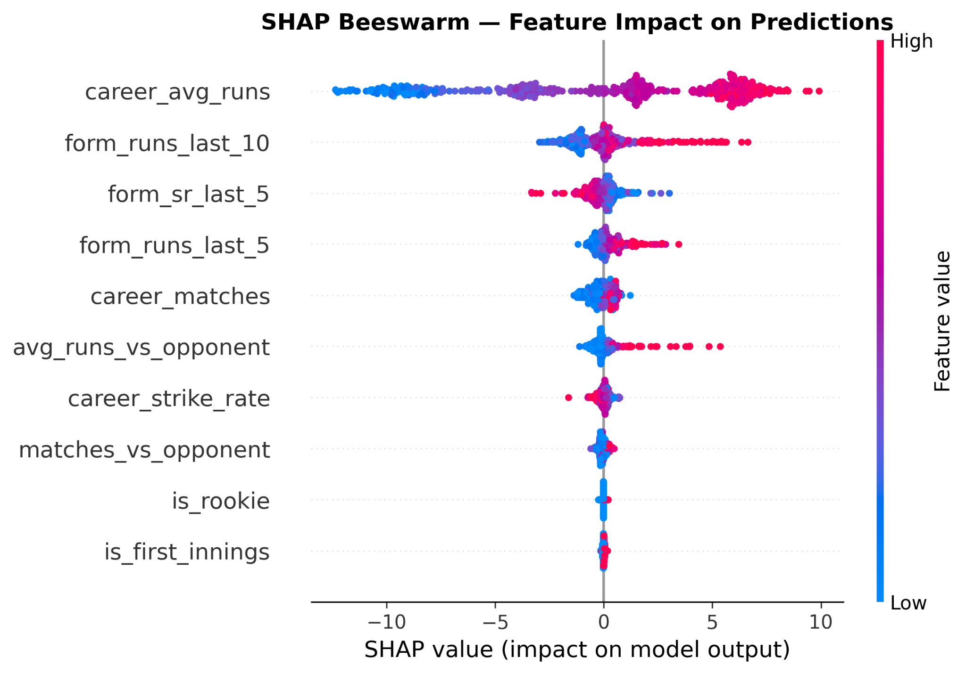
SHAP Beeswarm Analysis

Slide 8
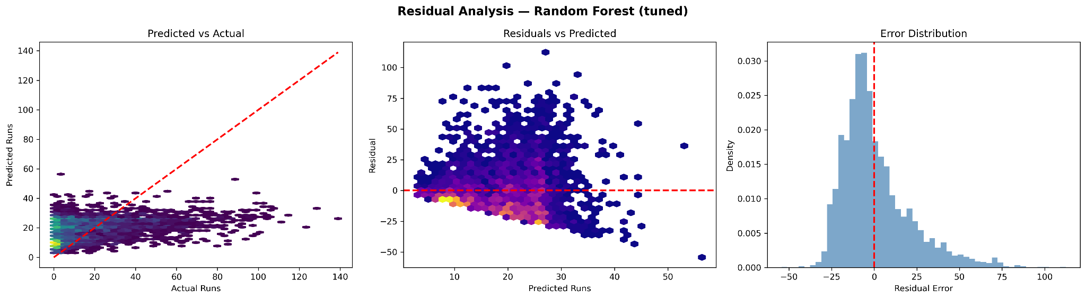
Residual Analysis

Slide 9
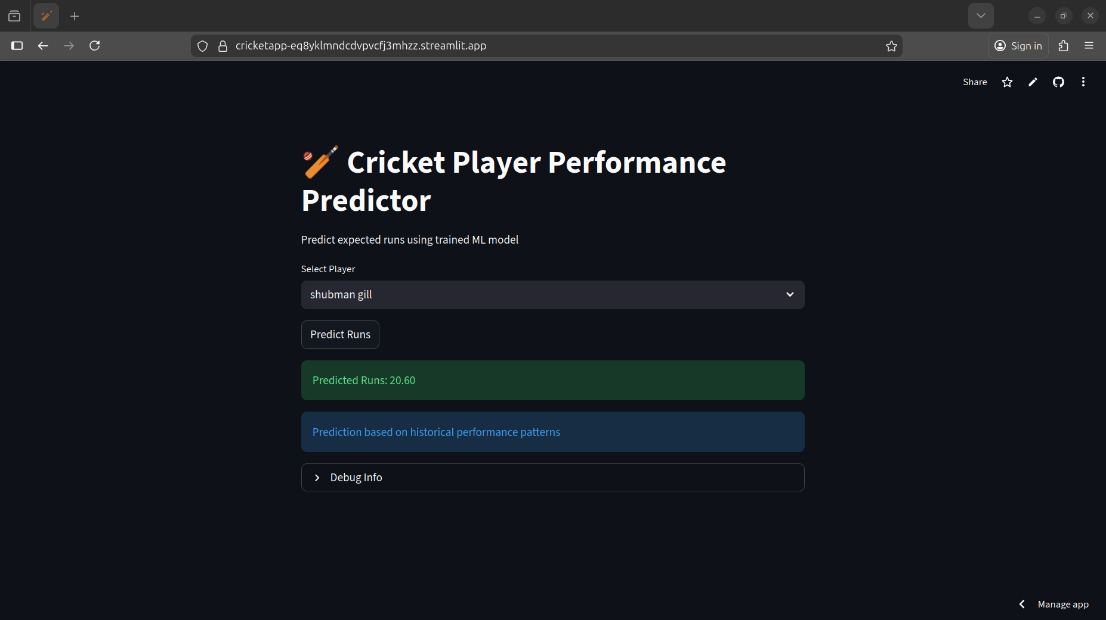
Streamlit Deployment

Slide 10
Conclusion
Built full ML pipeline from data to deployment
Random Forest achieved best performance
SHAP provided model explainability
System deployed successfully using Streamlit

