Slide 1
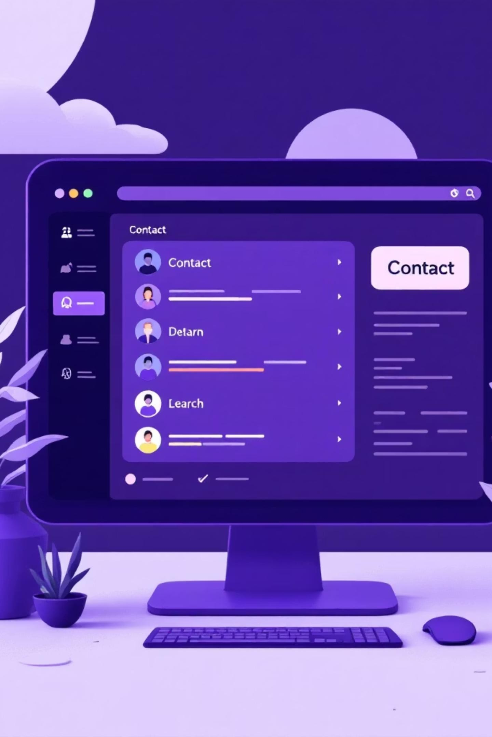

Contact Search App
A Java-based desktop application for efficient contact management
with prefix-based search.
Submitted by: Shivang Chaurasia (12316885)
Submitted To: Dr. Preetjot Kaur
Lovely Professional University

Slide 2

Project Overview
A Java Swing desktop application enabling users to add, update, delete, and search contacts efficiently. Features include prefix-based search using Trie data structure, reverse lookup by phone number, and persistent local storage in contacts.txt. Similar to a mini Truecaller or phonebook system with event-driven GUI interaction.

Slide 3


Slide 4
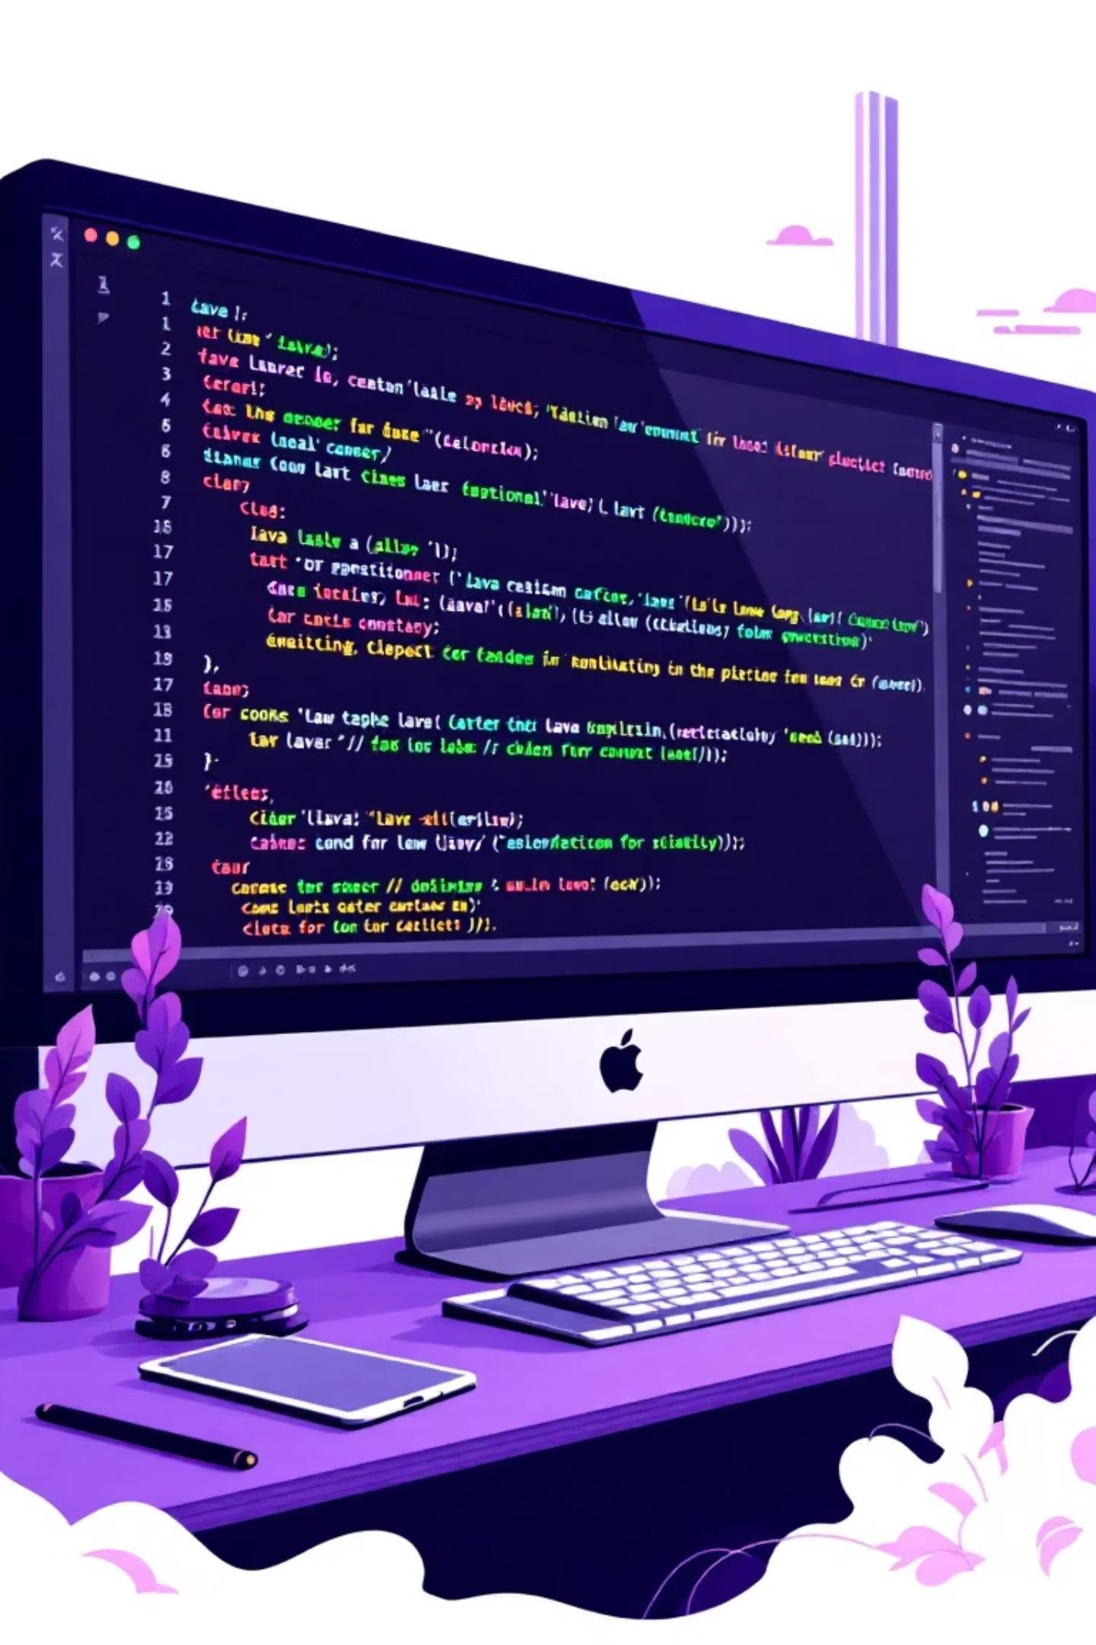
Core Technologies
Java Development
JDK 23 with Swing GUI Framework for desktop interface.
Data Structures
Trie, HashMap, ArrayList for
efficient storage and retrieval.
Programming Paradigm
Object-Oriented Programming with Java Collections.

Slide 5
Five Core Features
1
Add or Update Contacts
Input name and number; stores in Trie, HashMap, and contacts.txt file for persistence.
2
Search by Name Prefix
Fast, real-time search using Trie structure—type "Al" to find "Alice".
3
Delete Contacts
Remove contacts from Trie, HashMap, and contacts.txt file.
4
File Persistence
All contacts auto-saved and auto-loaded on app startup.

Slide 6
Data Structure Implementation
Data Structure | Application
Trie | Fast prefix-based search of contact names
HashMap | Map names to numbers; enable reverse lookup
File I/O | Persistent storage in contacts.txt
Array | TrieNode maintains 26 child nodes for letters

Slide 7
GUI Design & Architecture
Interface Components
Design Principles
Java Swing framework
GridLayout for button arrangement
JTextArea with JScrollPane for output
JOptionPane for user input
Clean, modern interface
Event-driven programming
User-friendly interaction
Responsive button actions

Slide 8
Application Workflow
01
Open GUI
User launches the application window.
03
Search by Prefix
Enter prefix; Trie retrieves matching contacts instantly.
06
Delete Contact
Remove from Trie, HashMap, and contacts.txt file.
02
Add/Update Contact
Enter name and number; stored in Trie, HashMap, and file.
05
Data Persists
All changes saved; data remains after app closes.

Slide 9
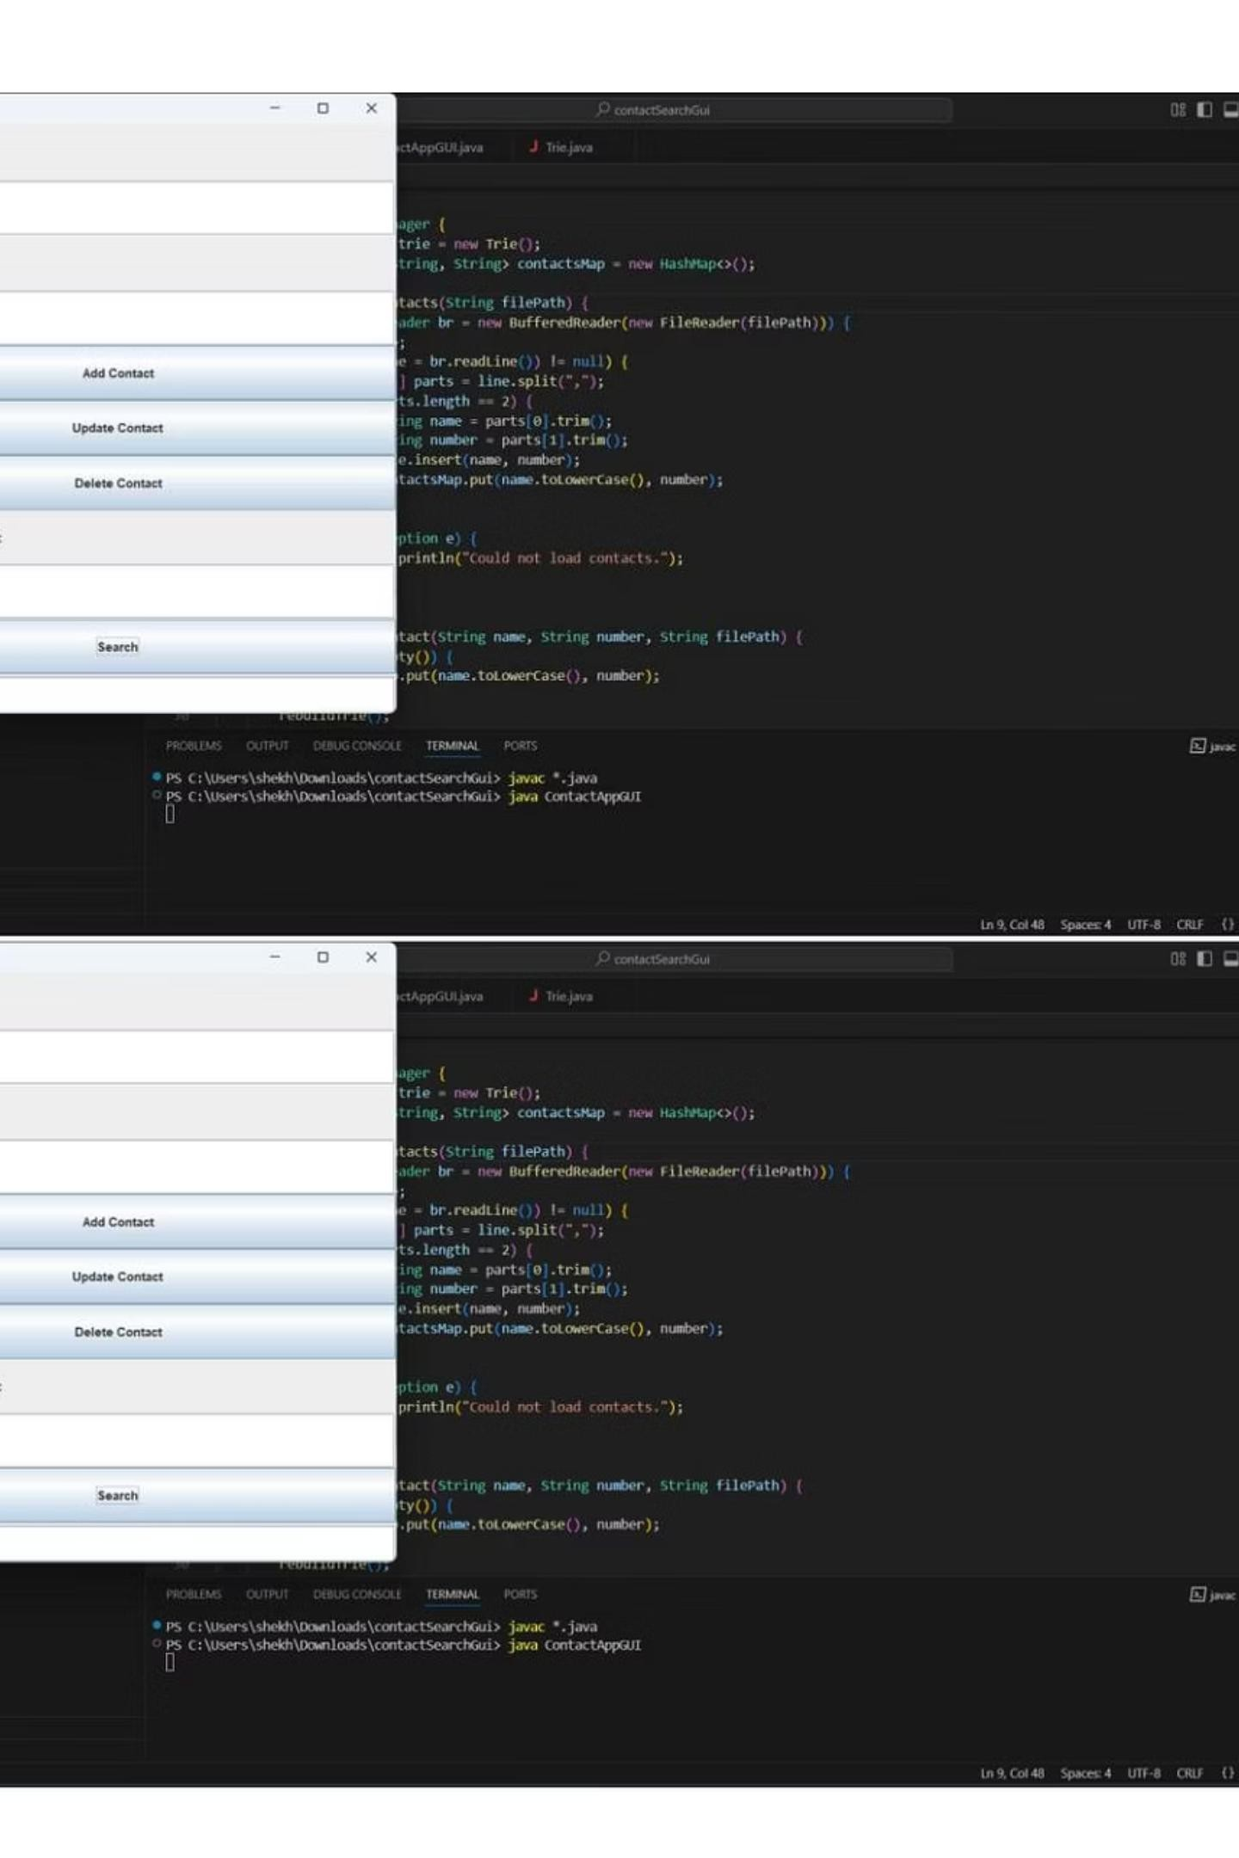
Sample Data & Results
Contact Added
Name: Shivang Phone: 76778664677
Search Result
Shivang - 76778664677 displayed after prefix search.

Slide 10
Learning Outcomes
DSA Mastery
Hands-on experience with Trie for prefix search and HashMap for constant-time operations.
Understood importance of
selecting appropriate data structures for real-world efficiency.
GUI Development
Built complete desktop interface using Swing components. Applied layout managers and event-driven programming to link user actions to logical operations.
OOP Principles
Practiced encapsulation with private fields, applied composition through object collaboration, and strengthened class design and modular architecture skills.

Slide 11

Thank You

