Slide 1

Name: Shivang Chaurasia Registration no: 12316885
Course Code: IXD802

Slide 2


Slide 3
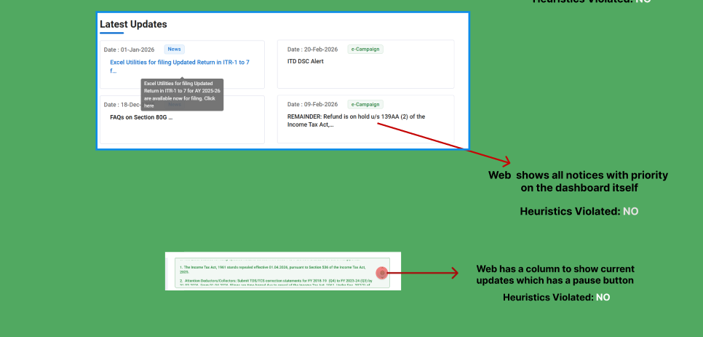

Slide 4
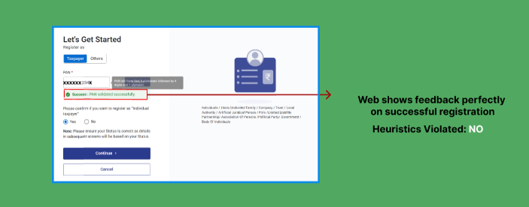

Slide 5
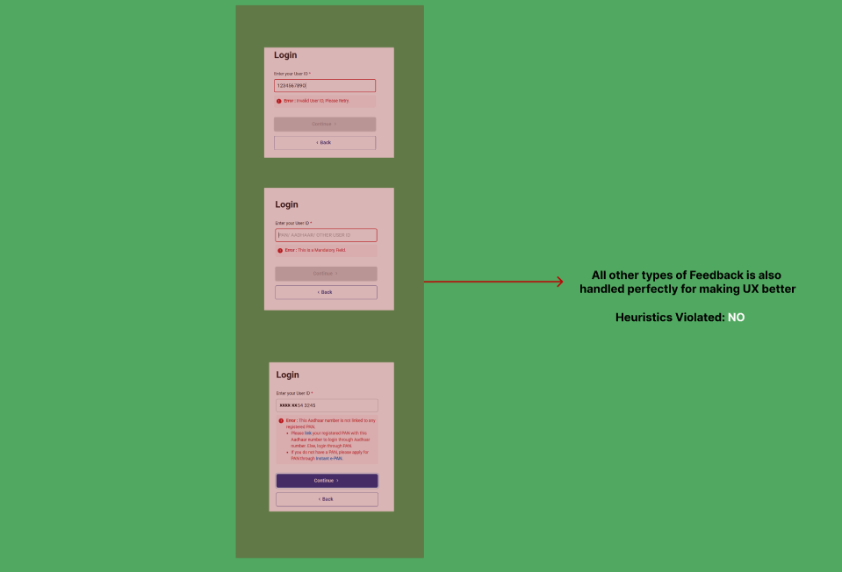

Slide 6
