Slide 1
Clustering of countries
By:- Shivang naik

Slide 2
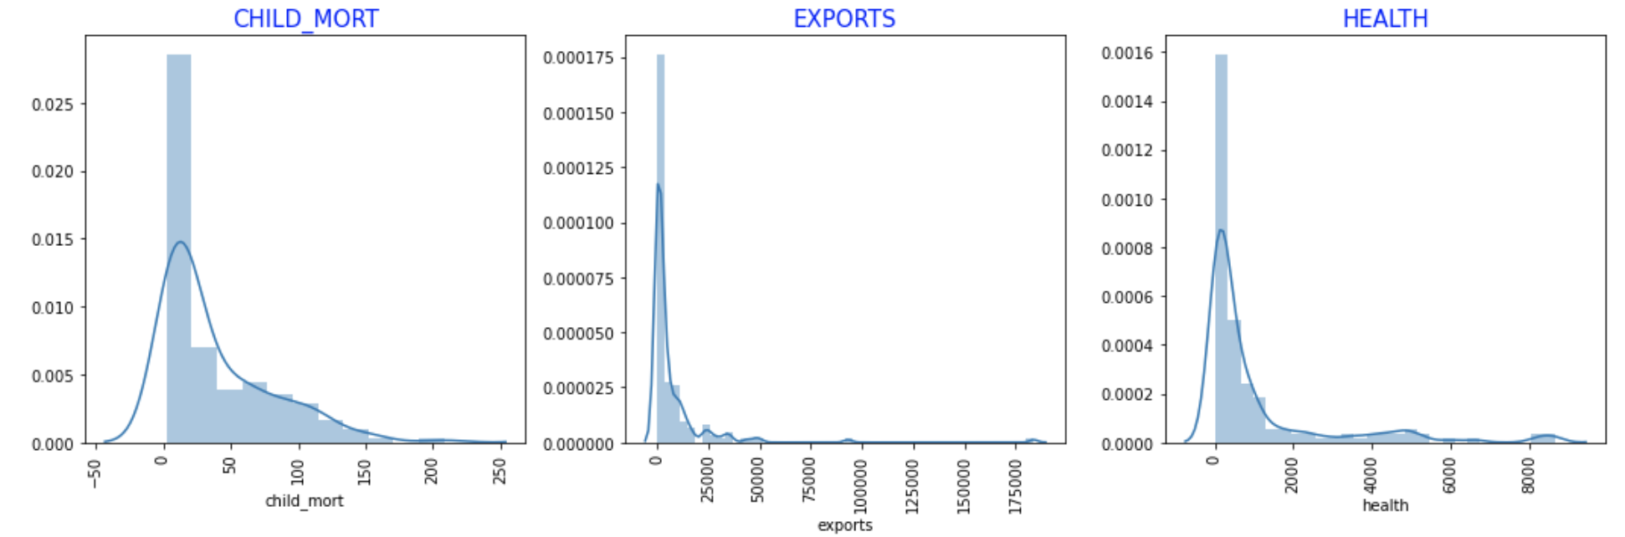
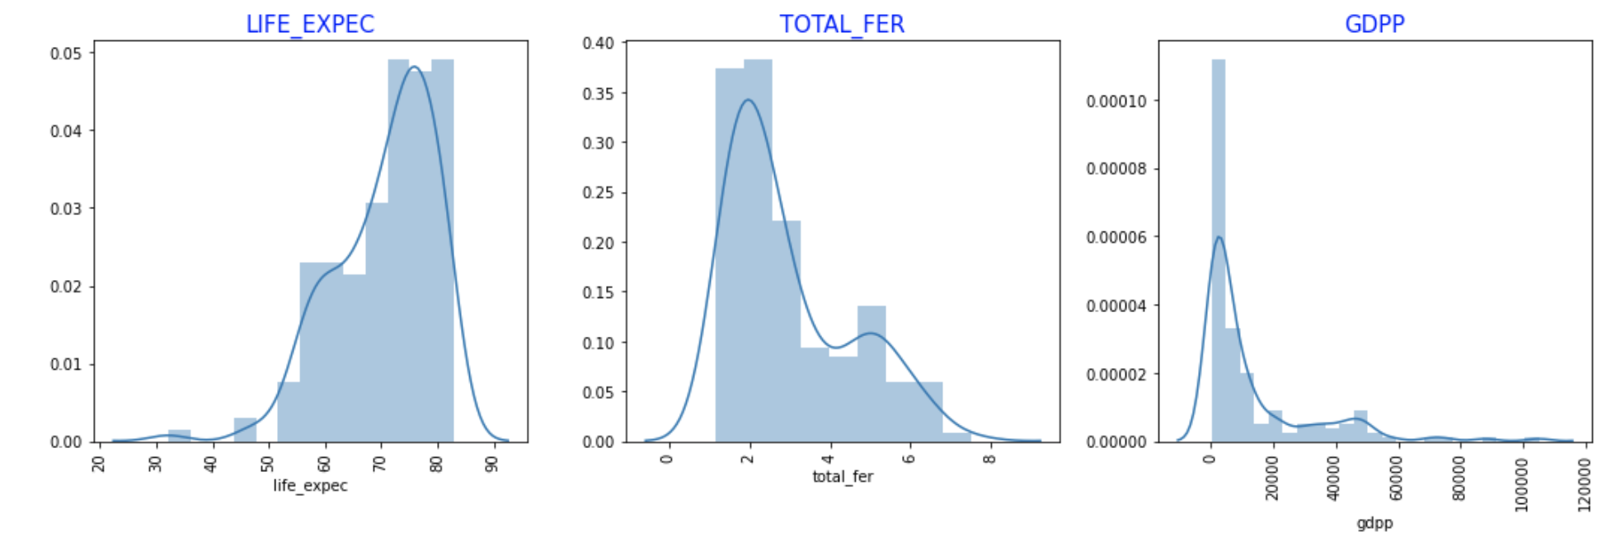
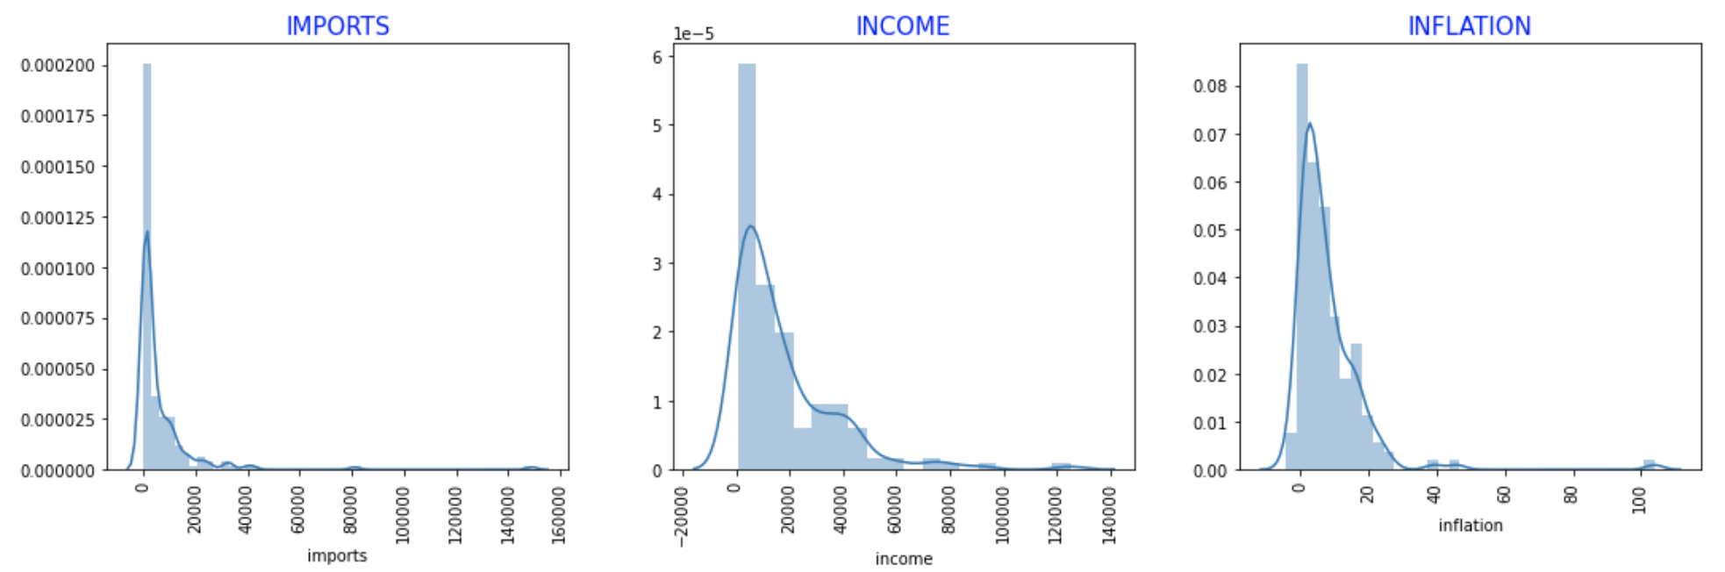
Univariate - Analysis
Most of graphs are Normally Distributed.
We noticed some grouping in LIFE_EXPEC, TOTAL-FER and GDPP.

Slide 3
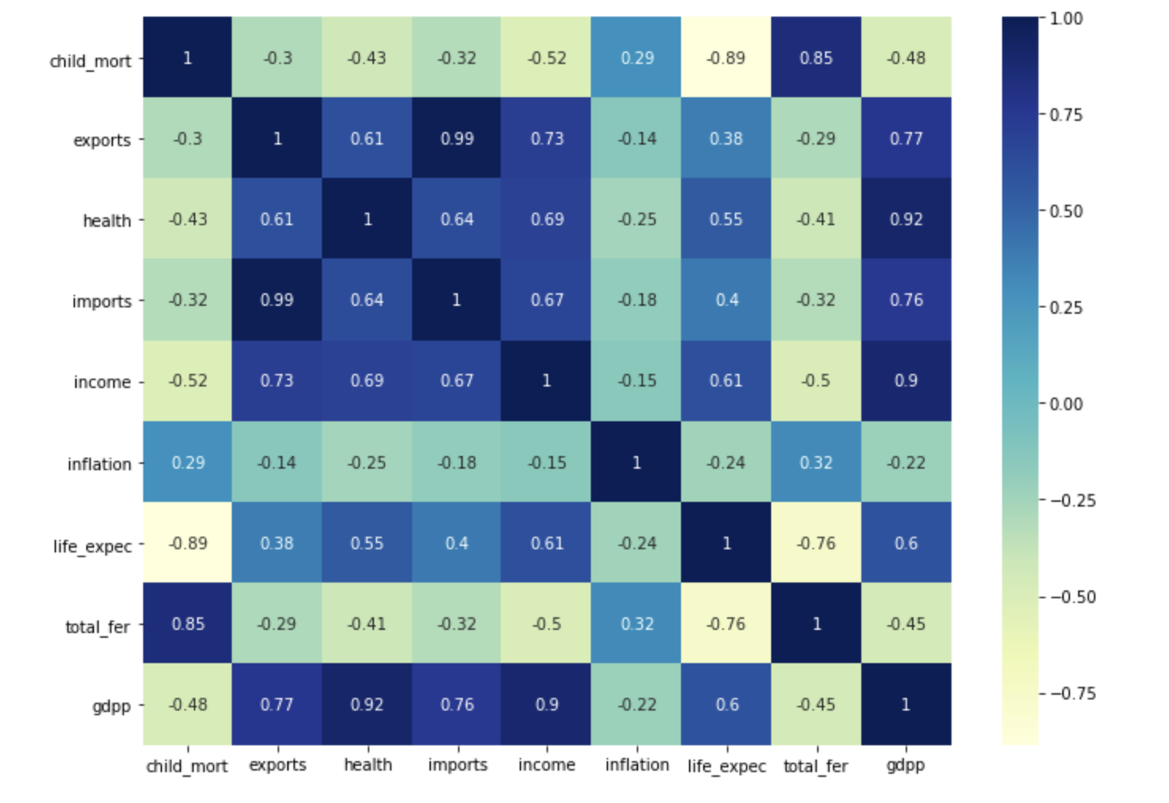
Bivariate - Analysis
We found strong Correction between gdpp-health, gdpp-income, life_expec-child_mort, imports-exports.

Slide 4
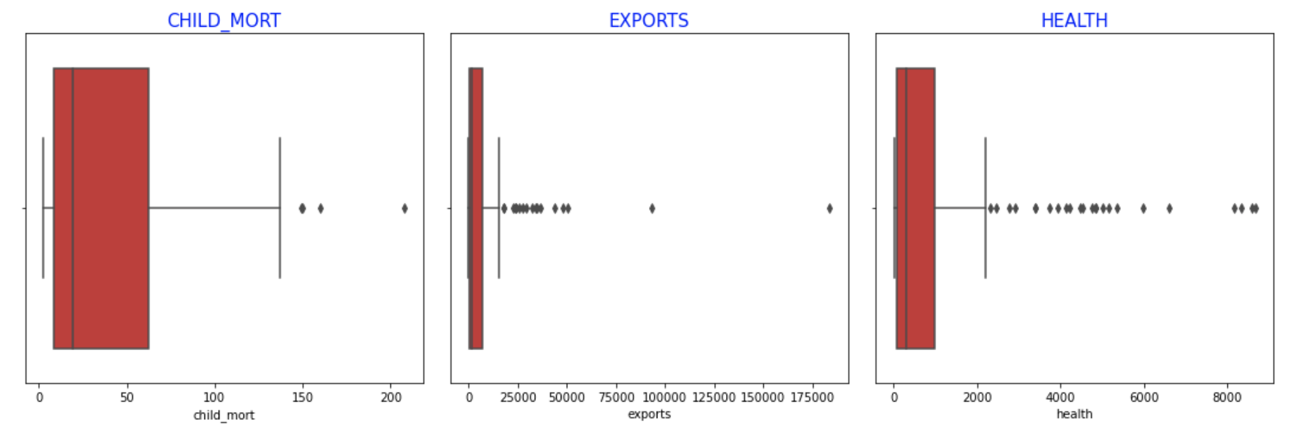
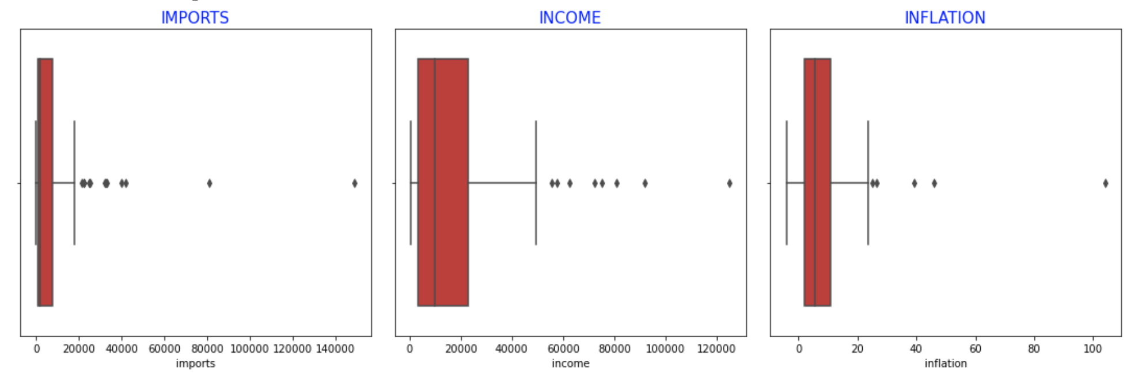
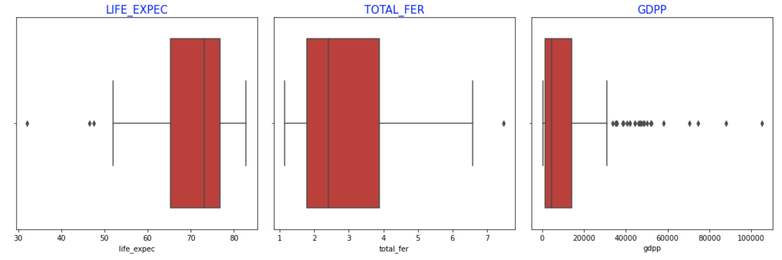
Outlier - Analysis
By looking those graphs we can say that every variables have outliers.
But we can’t drop those data directly, that might be useful for clustering analysis.

Slide 5
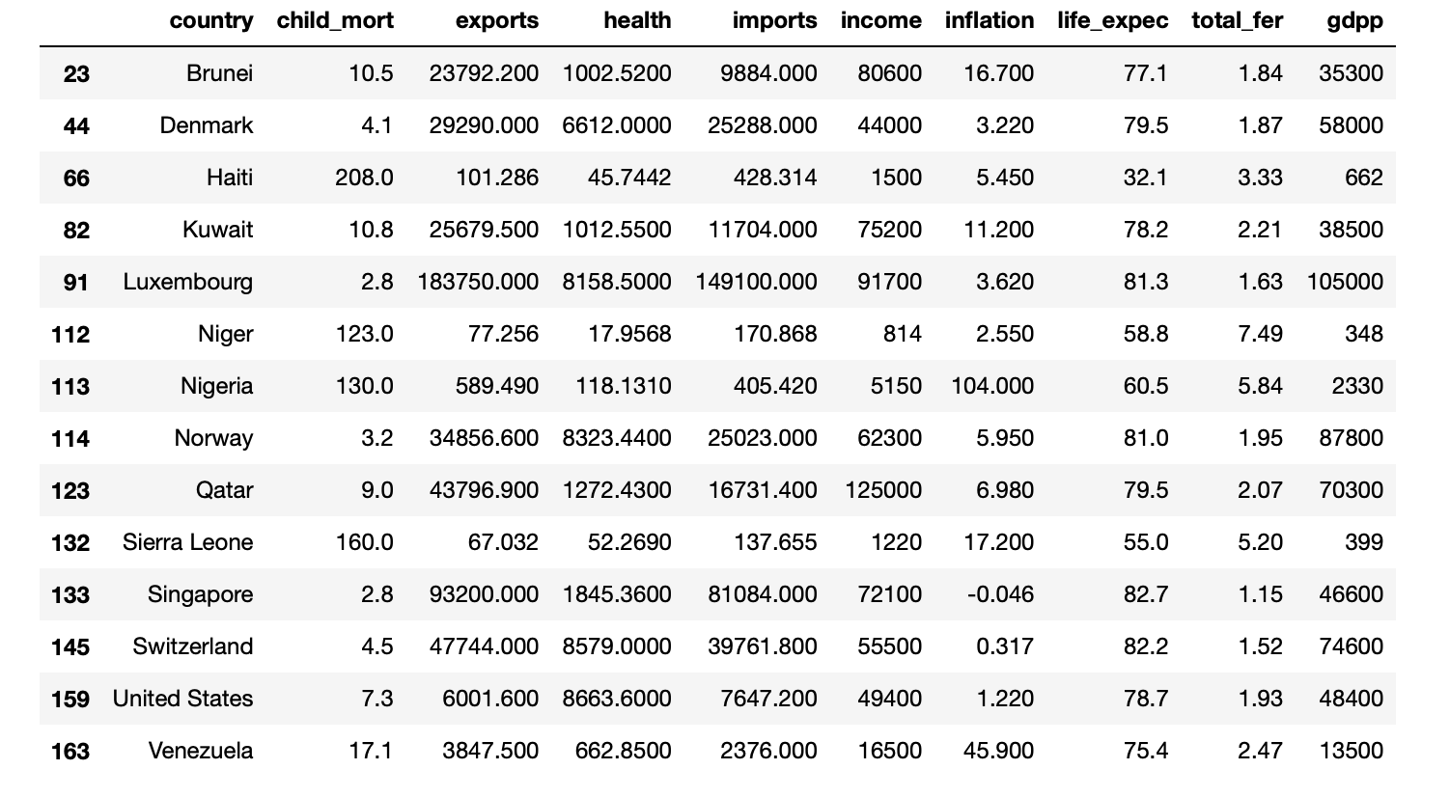
Zscore - Analysis
We used Z-score method for detecting outliers.
By Looking Table
Haiti, Niger, Sierra Leone, Nigeria have low gdp and high child_mort. So, we can't consider them as outliers.
Otherwise Every outliers have Very high income, Very high gdpp and Low child_mort values. So, they don't need an aid. We can drop them for better accuracy.

Slide 6
Rescale & Hopkins statistics
We used Standard Scaler for Scaling data.
After Scaling data mean of data is 0 and std is 1.
Every times we got Hopkins Statistics score grater than 0.90
It is good score for forming clusters because data are dissimilar to each others.
Hence, we can say that there is good cluster tendency.

Slide 7
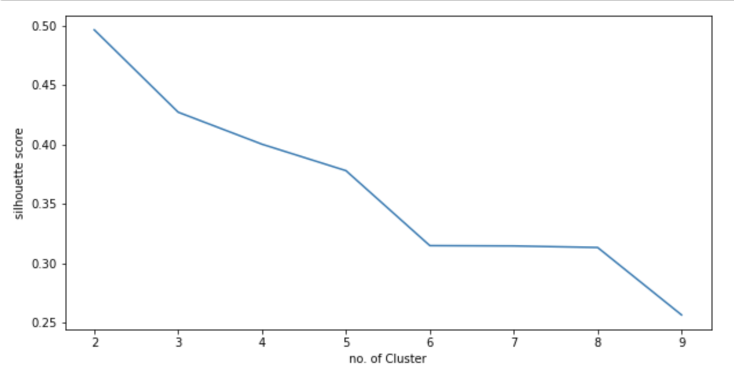
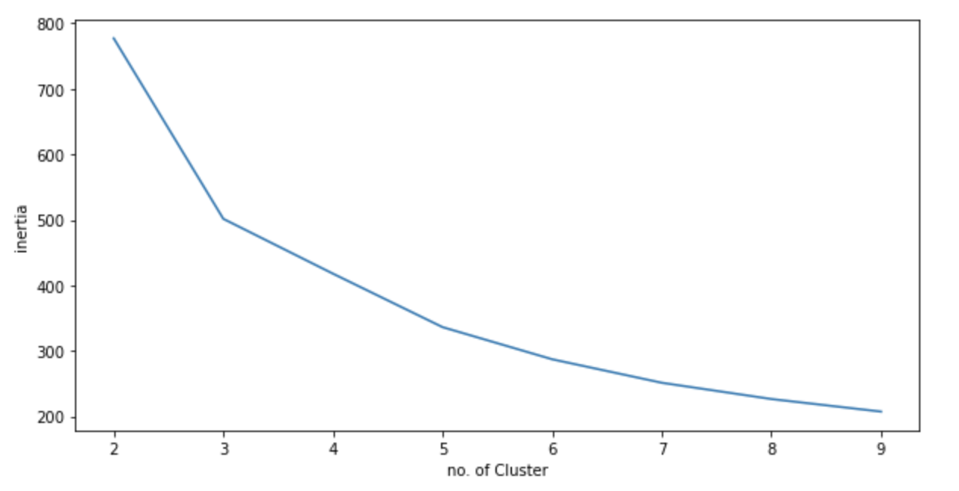
Silhouette Score and Elbow Curve
By observing both curves we chose k (no. of cluster) is equal to 3.

Slide 8
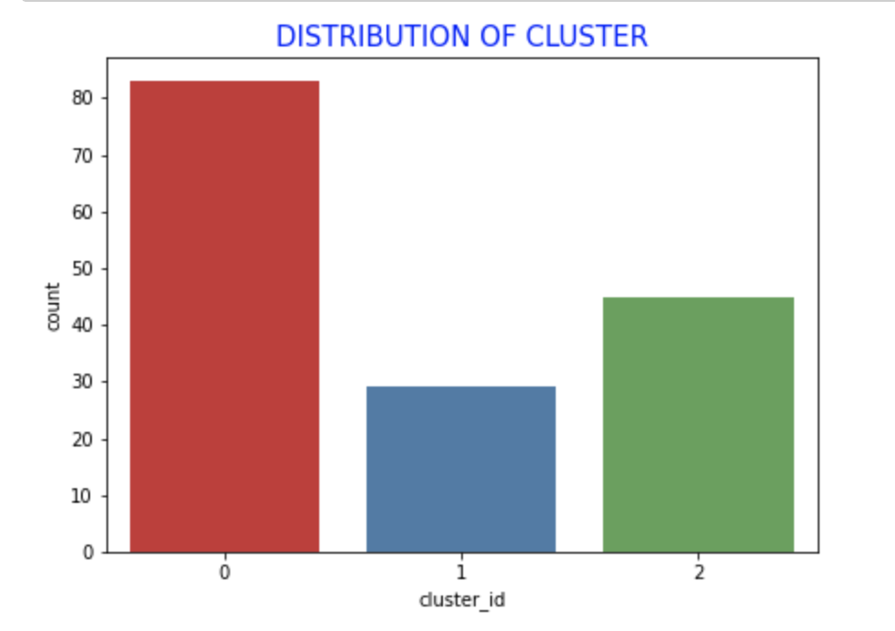
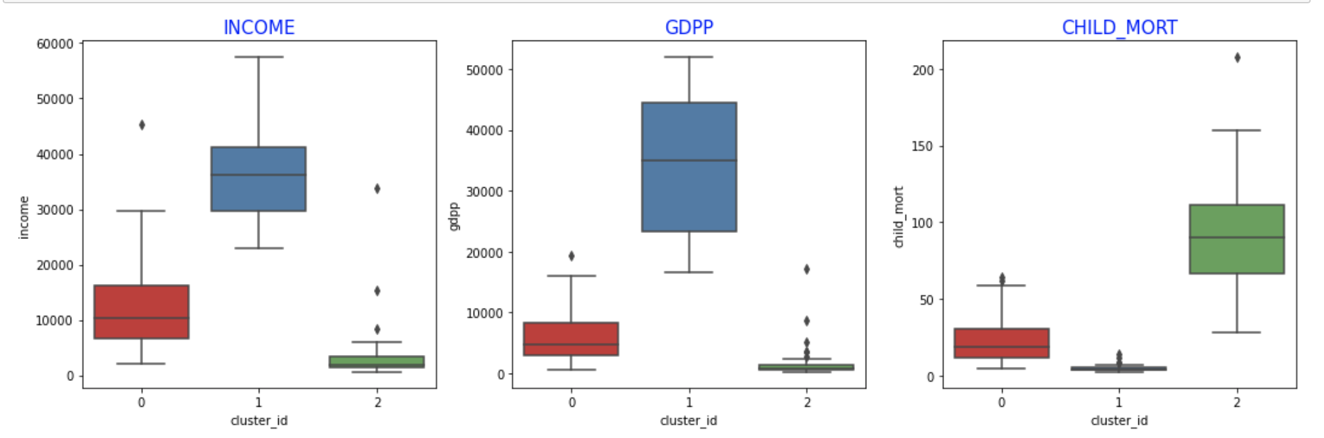
K-Means Cluster distribution and Analysis
Cluster 2 has low income, low gdpp and high child_mort.
Cluster - 2 is a cluster that we should focus for our analysis.
In cluster two there are 40+ country whom require aid.

Slide 9
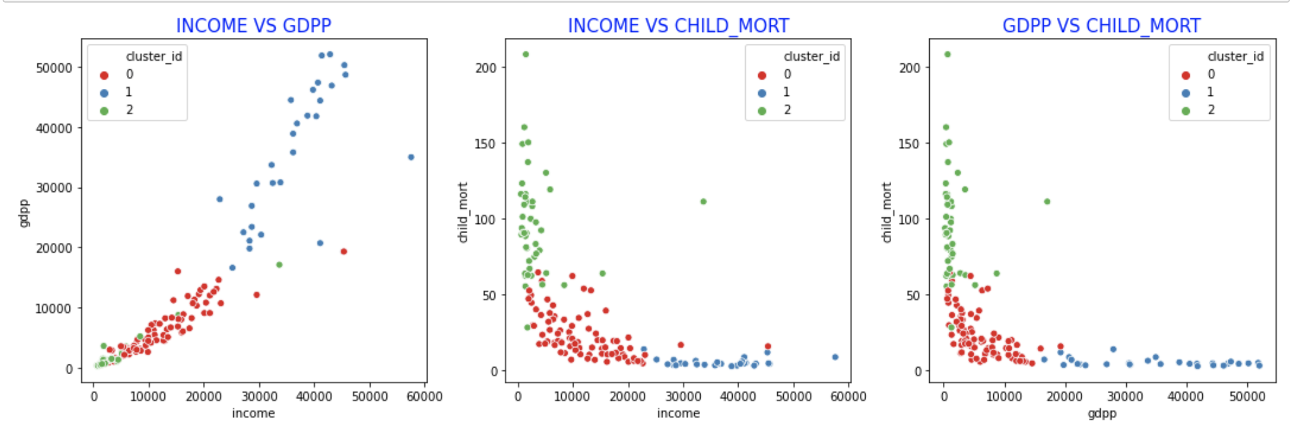
Visualizing important variable

Slide 10
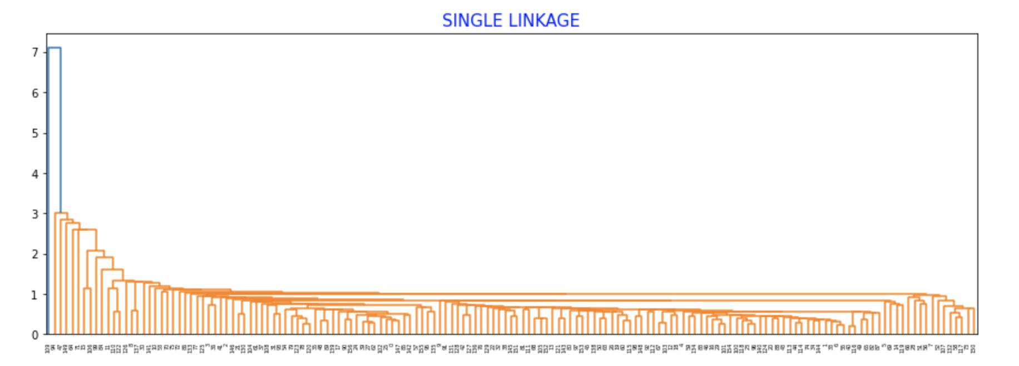
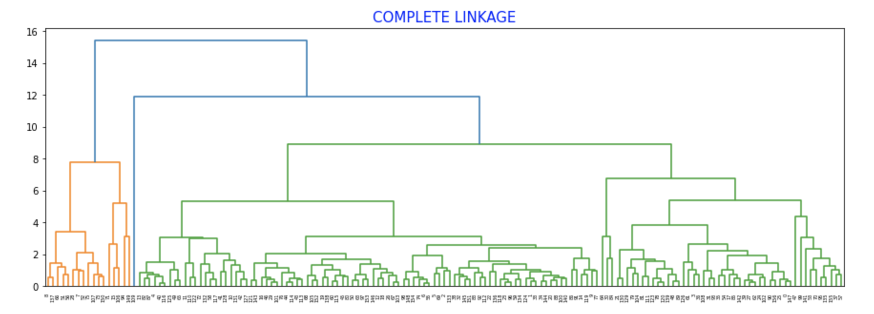
Hierarchical clustering
There are two types of Linkage visualized.
Single Linkage is hard to visualized and difficult to predict no of cluster.
Complete Linkage is easy to visualized and we can predict no of cluster is 2.

Slide 11
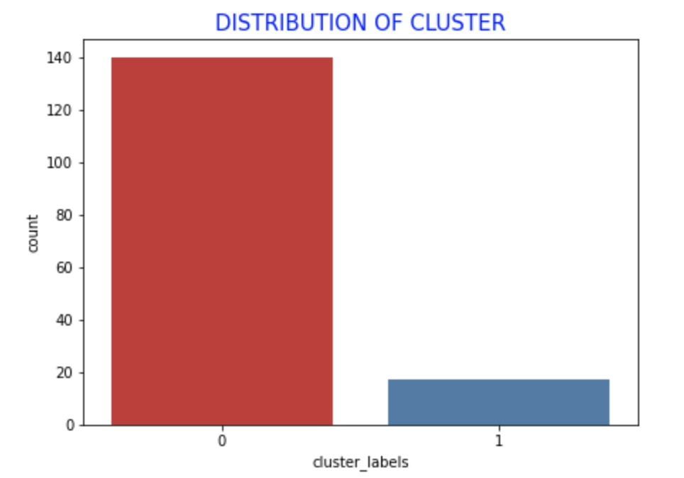
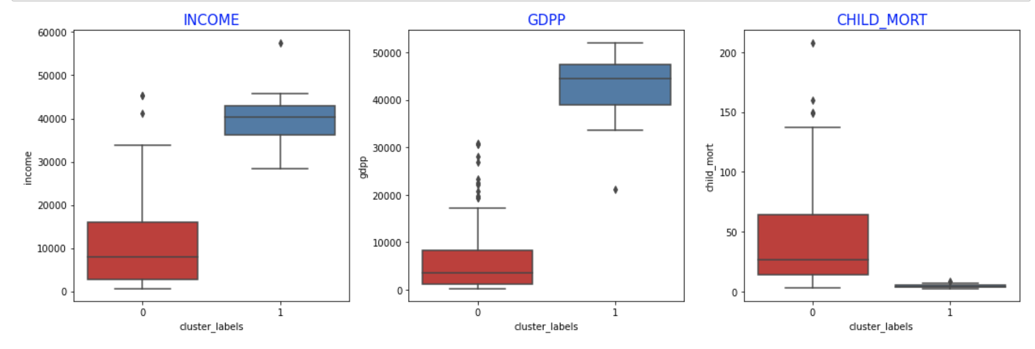
Hierarchical Cluster distribution and Analysis
Cluster 0 has low income, low gdpp and high child_mort.
Cluster - 0 is a cluster that we should focus for our analysis.
In cluster 0 there are 135+ country whom require aid.

Slide 12
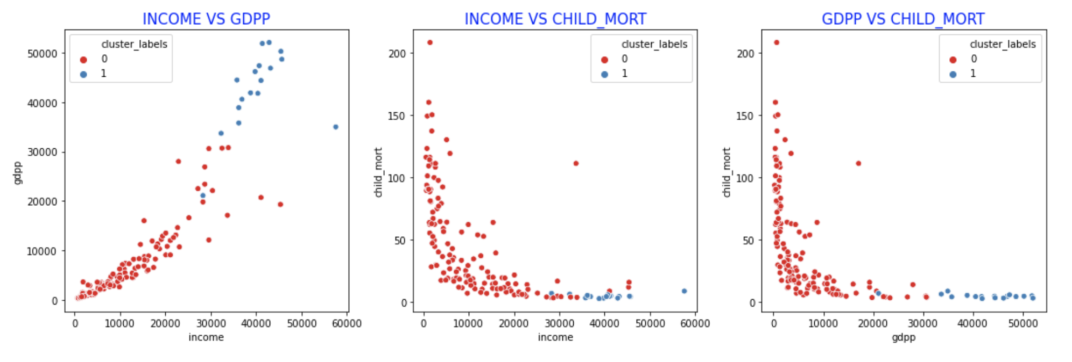
Visualizing important variable

Slide 13
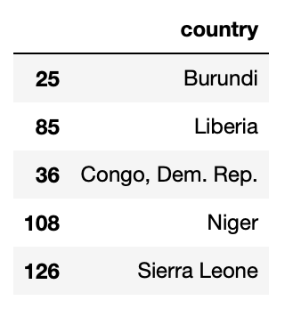
Top 5 Countries whom require aid most
Both clustering method gives same top 10 countries.
We select K-Means clustering algorithm for further analysis.
Burundi, Liberia, Congo – Dem. Rep., Niger, Sierra Leone are those countries whom require aid most.

Slide 14
THANK YOU

