Slide 1
Prediction for Credit Card Approval
Name – Shivang Rustagi
Batch - MIP-ML-14

Slide 2

PROBLEM STATEMENT
The primary objective of this project is to predict the approval or rejection of credit card applications.
The challenge lies in understanding the key factors influencing credit card approval decisions and
building a predictive model to assist in the decision-making process.

Slide 3
TABLE 0F CONTENT
01
04
Exploratory Data Analysis (EDA)
Machine Learning Model Development
02
05
Feature Engineering
Model Evaluation
03
Data Preprocessing
06
Predicting Credit Card Approval

Slide 4

Exploratory Data Analysis (EDA)
01

Slide 5
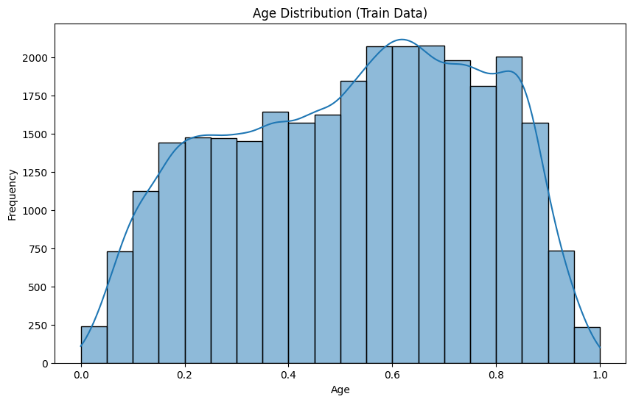

Slide 6
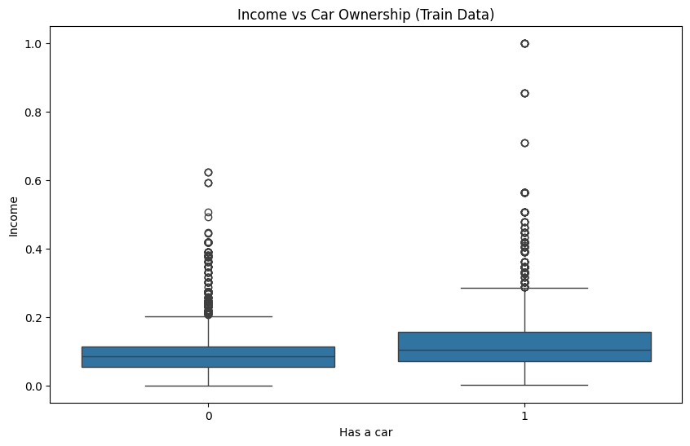

Slide 7
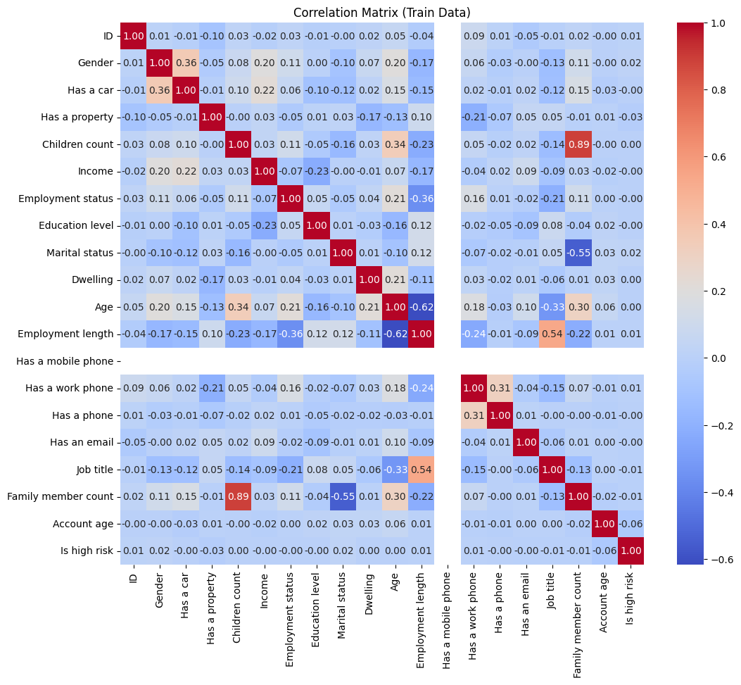

Slide 8

Feature Engineering Feature engineering is a preprocessing step in supervised machine learning and statistical modeling which transforms raw data into a more effective set of inputs.
02

Slide 9
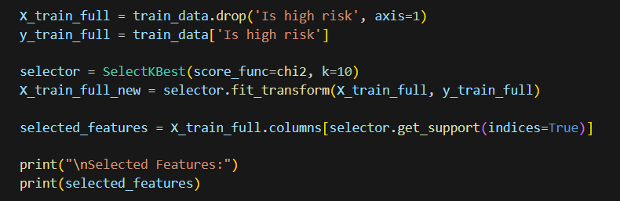
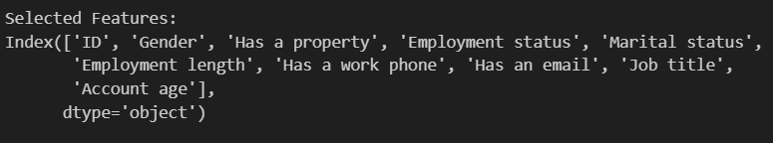

Slide 10

Data Preprocessing
03
Data preprocessing can refer to manipulation, filtration or augmentation of data before it is analyzed, and is often an important step in the data mining process.

Slide 12
Machine Learning Model Development
04

Slide 13
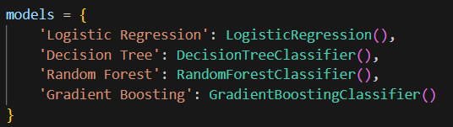

Slide 14
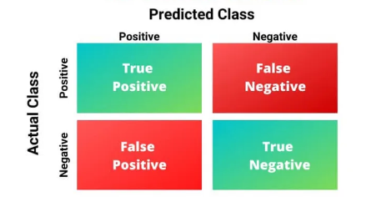
Model Evaluation
05

Slide 15
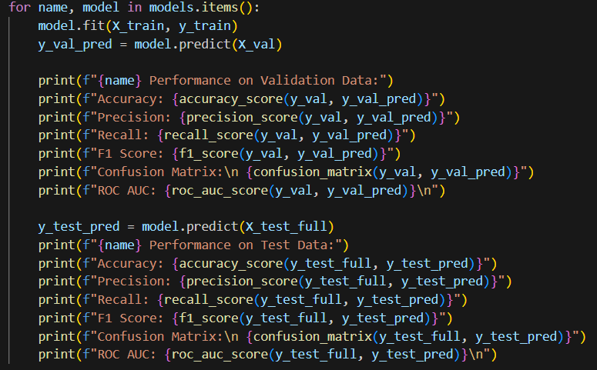

Slide 16
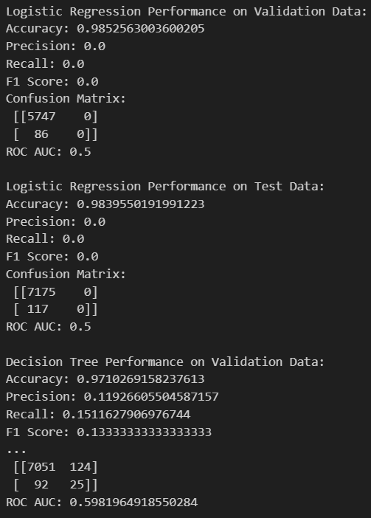
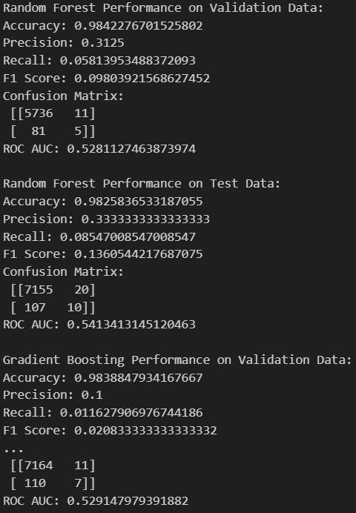

Slide 17
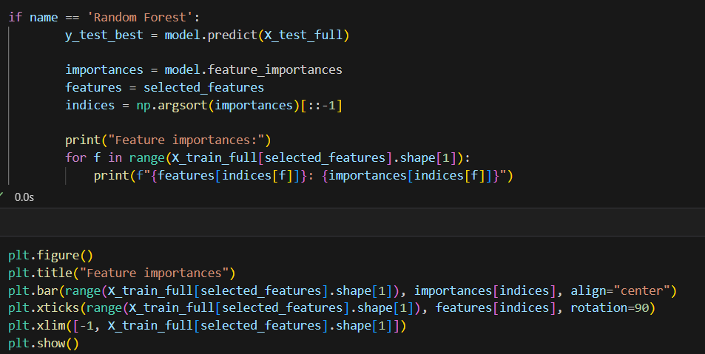

Slide 18
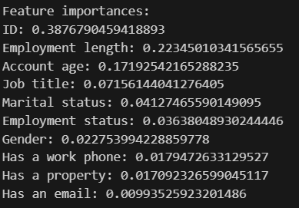
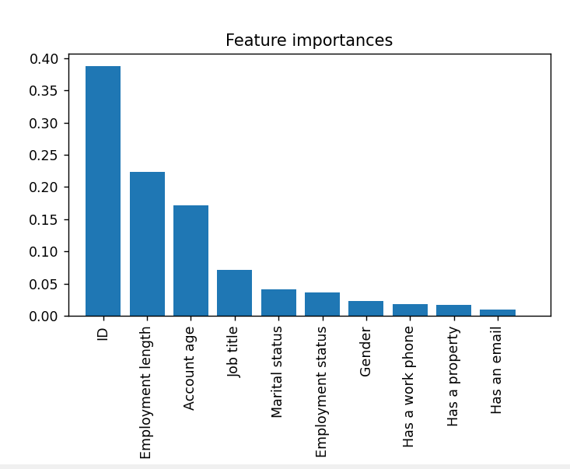

Slide 19

Predicting Credit Card Approval
06

Slide 20
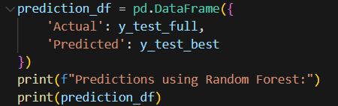
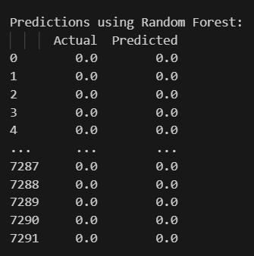

Slide 21
THANK YOU

