Slide 1



PgNest
Name: Gohel Shivangi
Branch: IT
Enrollment: 23002170210034
Batch: C1
1

Slide 2
Overview
• Tracking bookings, payments, and room availability.
• Provides automated booking, rent calculations and payment tracking.
• Uses password hashing and secure database storage for security.
• Manage rooms by admin
• Graphical report provide insights into revenue, occupancy and trends.
2

Slide 3
Tech Stack
Tkinter for GUI
Python
SQLite
Hashlib for Encryption
3

Slide 4
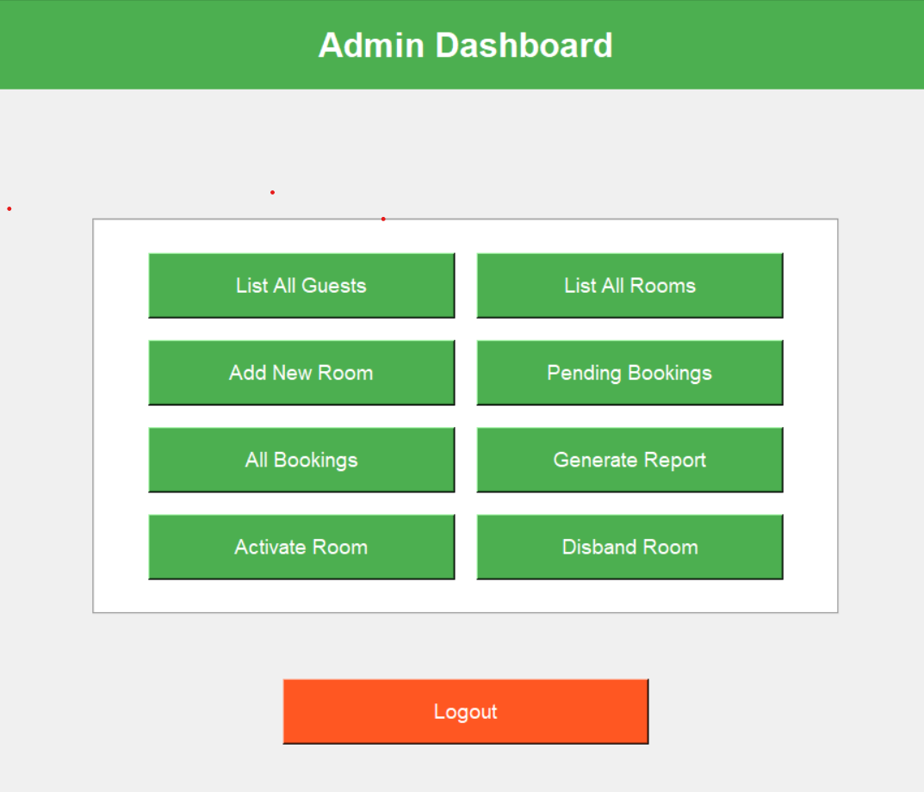
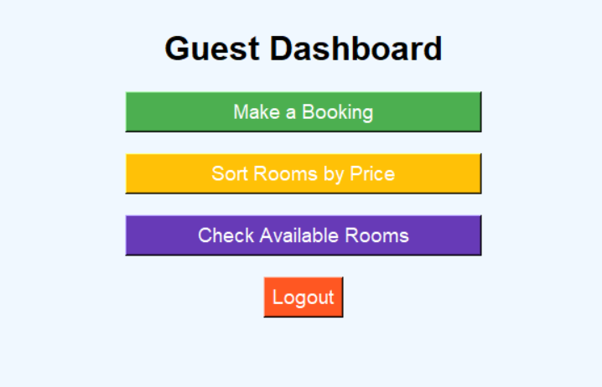
Features
Role-Based Access
Booking Management
Reports & Analytics
Update room status dynamically
Secure Payment & Check-Out
Password Hashing
4

Slide 5
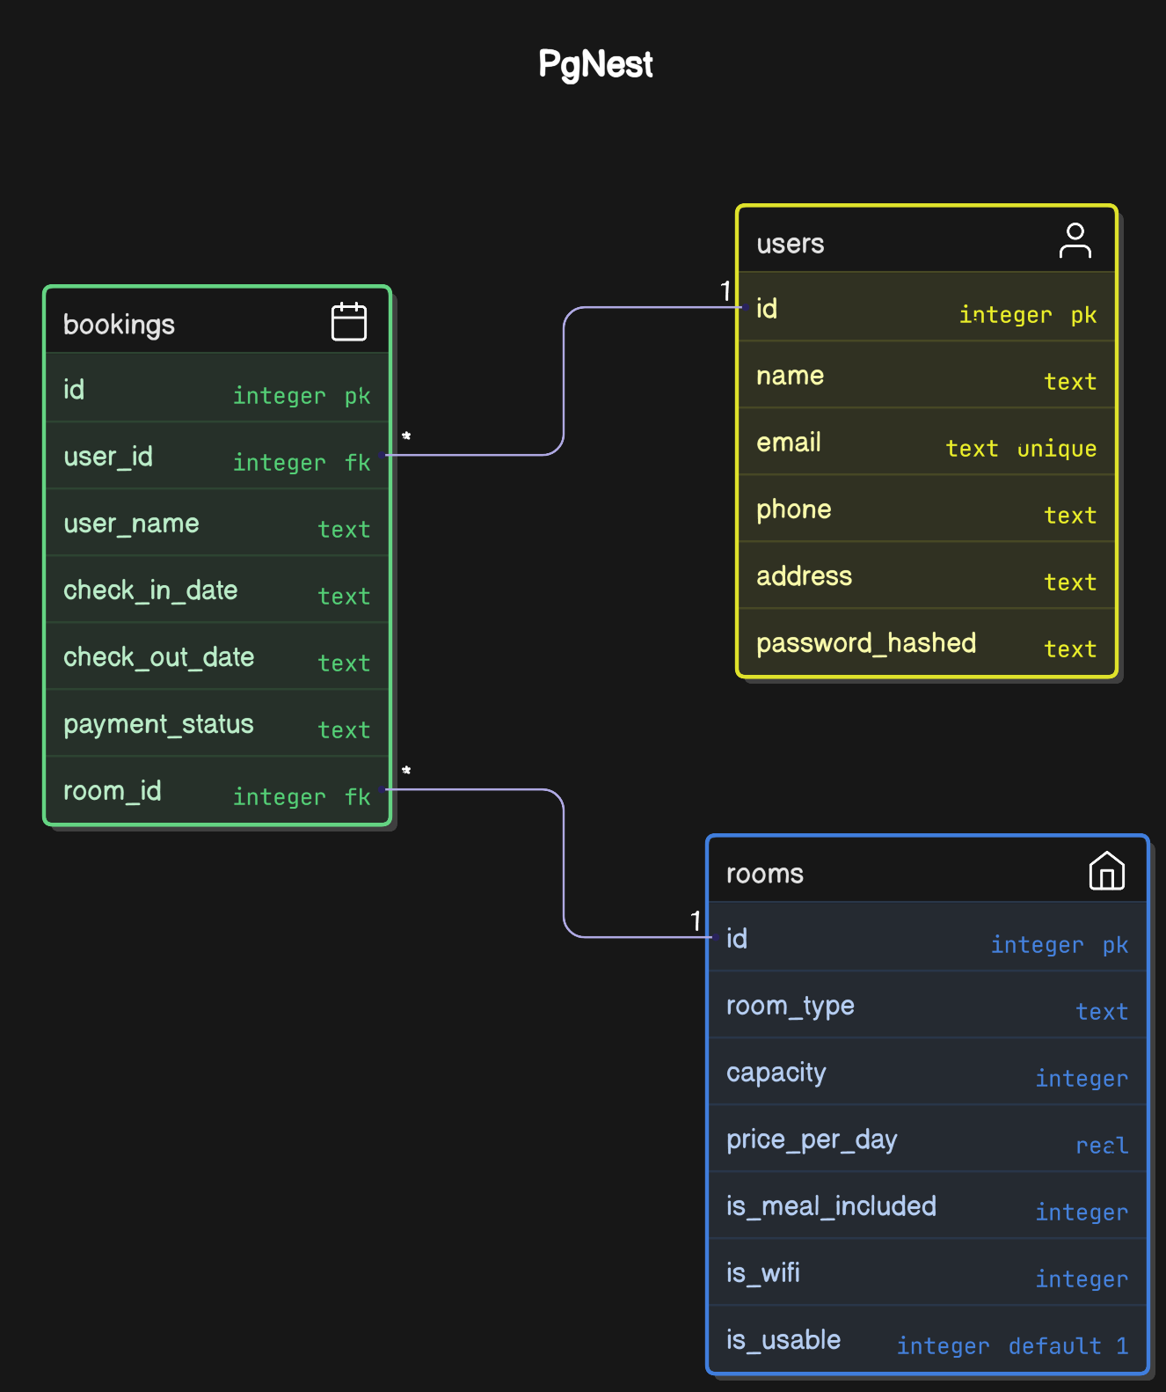
ER-Diagram
5

Slide 6
Future Scope
• AI-based Rent Prediction
• Mobile App Integration
• Automated Rent Payment Reminders
• Face Recognition for Check-in
• IoT-Based Smart Room Management
6

Slide 7
THANK YOU
Presented By : Shivangi Gohel
7

