Slide 1
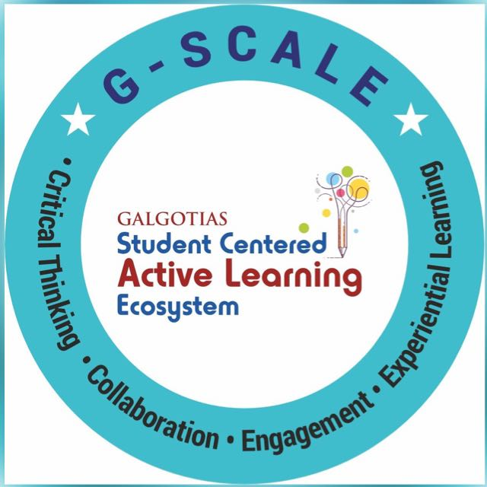
Chatbot and Virtual Assistant in Customer Service Group N0 : 11 Shivanand Gupta | 22SCSE1012610 Submitted To : Dr. Umesh Lilhore Shivang Kakkar | 22SCSE1180121 Shivangi Sehgal | 22SCSE1180097 Shreyash Upadhyay | 22SCSE1012304

Slide 2
Introduction In today’s fast-paced digital world, customer service expectations are evolving rapidly. To meet these demands, many businesses are integrating chatbots and virtual assistants into their support systems. This project explores how intelligent conversational agents can enhance customer service by providing instant responses, reducing human workload, and operating 24/7. This project focuses on building a chatbot and virtual assistant for customer service using Natural Language Processing (NLP).

Slide 3
Problem Statement As customer expectations grow for instant and efficient support, businesses face challenges in maintaining high-quality service at scale. This project addresses the need for an intelligent, automated solution—a chatbot and virtual assistant—that can handle customer queries in real-time, reduce human dependency, and enhance user satisfaction by offering consistent, 24/7 support.

Slide 4
Importance of the Project This project plays a significant role in showcasing how AI-powered chatbots and virtual assistants are revolutionizing the customer service industry. By automating routine queries, these systems enhance response speed, reduce operational costs, and ensure 24/7 availability—something traditional human support often cannot achieve. With the growing demand for personalized and instant support, businesses are rapidly adopting such technologies to improve customer satisfaction and loyalty.

Slide 5
Objectives
To understand the role of chatbots and virtual assistants in enhancing customer service efficiency.
To explore real-world applications, with a focus on industry examples like HDFC Bank’s EVA.
To analyze how AI-driven systems can handle customer queries, reduce response time, and operate 24/7.
To evaluate the impact of virtual assistants on customer satisfaction and business operations.
To highlight the advantages and limitations of using conversational AI in customer service.

Slide 6
Literature Review Studies show that AI-powered chatbots and virtual assistants are transforming customer service by providing fast, consistent, and 24/7 support. Research highlights their role in reducing workload, improving customer satisfaction, and cutting operational costs. Real-world examples like HDFC Bank’s EVA prove their effectiveness in handling high volumes of queries. However, challenges such as complex query handling and data privacy remain key concerns. Overall, literature supports their growing importance in modern customer service systems.

Slide 7
Methodology Approach Used 1.We developed a chatbot system using a combination of Machine Learning and Deep Learning techniques. 2.Text data was collected and converted to a structured CSV format. 3.Deep Learning required specialized preprocessing and training steps, so text cleaning, tokenization, and padding were performed , followed by an Embedding Layer. 4.The model was built using an LSTM-based sequence-to-sequence encoder-decoder architecture.

Slide 8
Deep Learning Model:- LSTM (Long Short-Term Memory): Used for training the chatbot using an encoder-decoder model to understand and generate context-aware responses. NLP Techniques: Lowercasing of text Removal of unwanted characters Skipped Stopword removal, stemming, and lemmatization (not necessary for DL models) Tokenization using Tokenizer Padding sequences to ensure uniform length(eg:- sent 1:”hello how are you” Sent 2: “hi”) Word Embedding to convert tokens into dense vectors (used while training) Eg:”Hello”(its several literal and figurative meaning..)

Slide 9
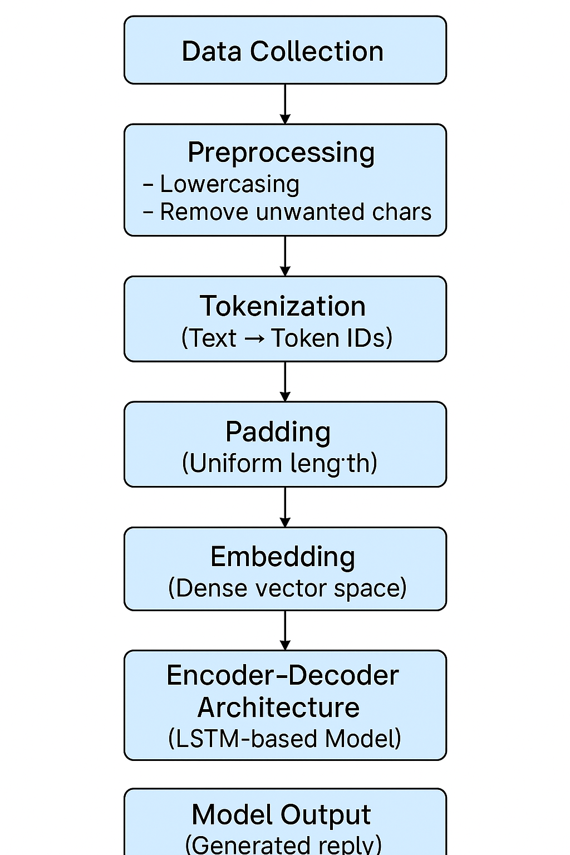
System Architecture

Slide 10
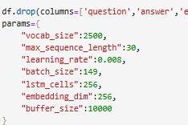
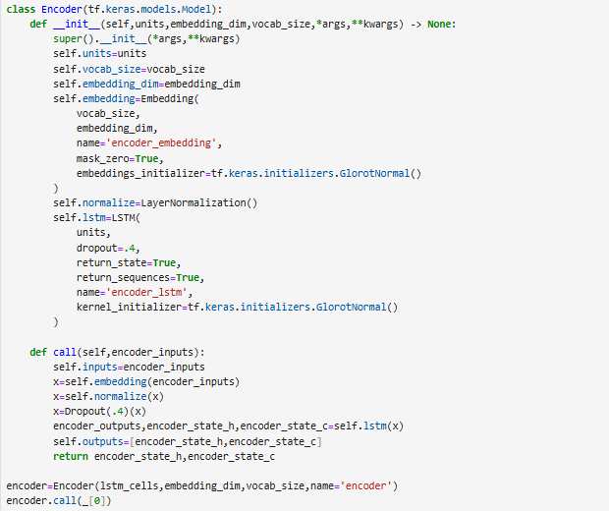
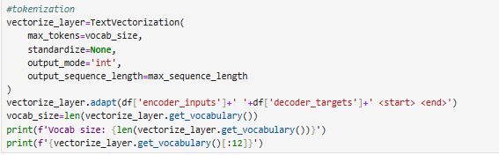
Implementation

Slide 11
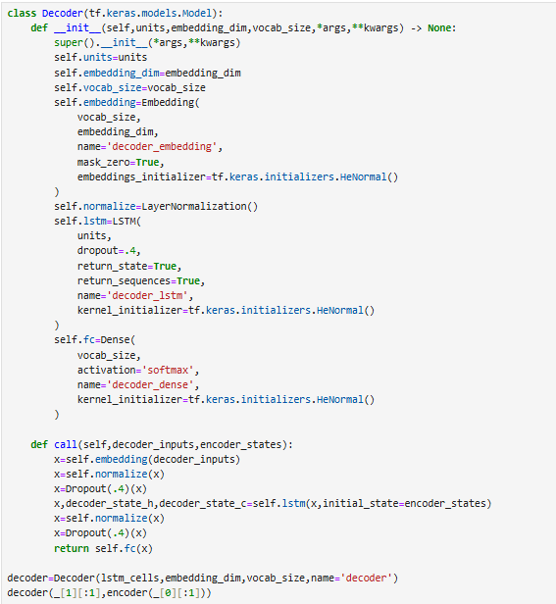
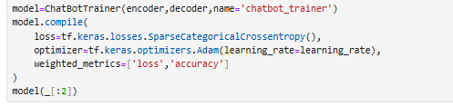
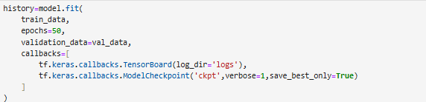
Implementation

Slide 12
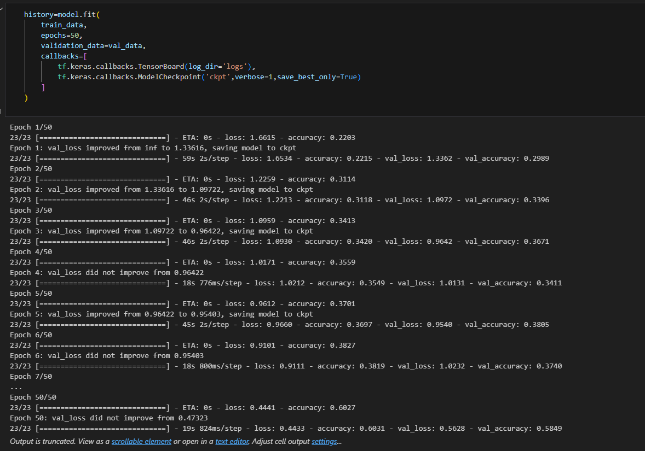
Results

Slide 13
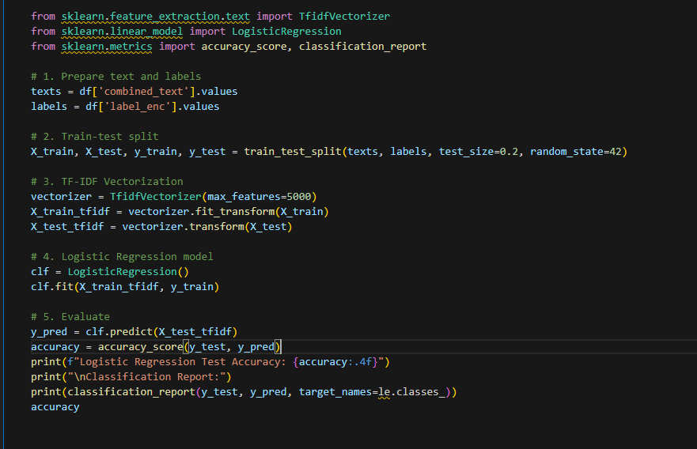
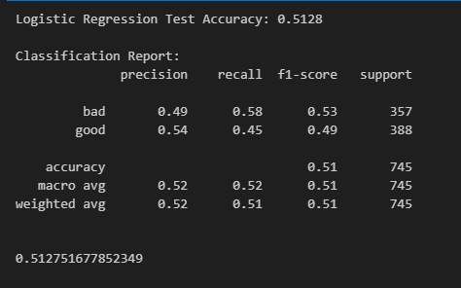
Results

Slide 14
Challenges
1.Slow Performance of Rule-Based Chatbot
The rule-based chatbot initially took a long time to respond due to inefficient iterations over the entire dataset.
2. Low Accuracy (~50%)
The basic rule-based and logistic regression models provided only about 50% accuracy.
3.Sparse and Noisy Dataset
The dataset contained several irrelevant or inconsistent entries, affecting the model's learning.
4. Inconsistent Input Lengths
For Deep Learning Questions and answers varied widely in length, creating input mismatches for neural networks.
5. Difficulty in Evaluating Chatbot Responses
Determining whether a chatbot response was "good" or "bad" involved subjective judgment.

Slide 15
Future Work
Integration with voice assistants like Alexa or Google Assistant for enhanced accessibility.
Multilingual support to cater to a wider and more diverse customer base.
Sentiment analysis to better understand customer emotions and respond accordingly.
Improved personalization using user data and AI to tailor responses.
Stronger data security features to ensure safe and private conversation

Slide 16
Conclusion Chatbots and virtual assistants are reshaping customer service by providing instant, reliable, and cost-effective support. This project highlights their growing role in improving customer experience and reducing human workload. With advancements in AI and NLP, these technologies are becoming smarter, more interactive, and essential for modern businesses. As we move forward, they will continue to evolve and play a key role in delivering efficient and personalized customer service.

Slide 17
Thank You!

