Slide 1
LangGraph Session
Part 1

Slide 2
LangChain -
LangChain is an open-source framework that simplifies the development of applications powered by large language models (LLMs). It provides a structured environment and tools to connect LLMs with various data sources, code execution, and other services, making it easier to build sophisticated AI applications. LangChain is available for both Python and JavaScript.

Slide 3
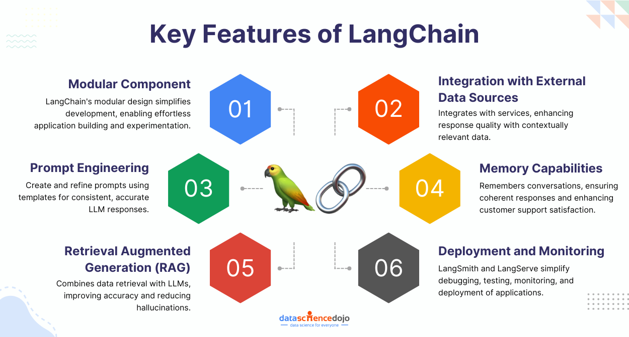
Key Features of LangChain -

Slide 4
LangGraph -
LangGraph is a framework built on top of LangChain designed for creating complex, stateful, and cyclic workflows using large language models (LLMs). It allows developers to build AI agents and multi-agent systems by defining them as graphs, where nodes represent computations (functions or Langchain runnables) and edges define the flow of execution and data. LangGraph is particularly useful for applications requiring fine-grained control over state management, branching, and cycles, as well as for coordinating multiple agents in complex tasks.
LangGraph overcomes several limitations of LangChain, primarily by providing a more robust and flexible framework for building complex, stateful agent workflows using graphs. While LangChain excels in building simple chains and integrating with various tools, LangGraph specializes in orchestrating multiple agents and managing state transitions in a more sophisticated manner, addressing some of LangChain's shortcomings in these areas.

Slide 5
Agents -
In LangChain, agents are systems that utilize a language model to determine a sequence of actions to take in order to achieve a specific goal. They differ from chains, where the sequence of actions is predetermined, by employing a language model as a reasoning engine to dynamically choose and order actions. This allows agents to interact with external tools, making them suitable for tasks requiring complex decision-making and adaptability.
How agents work –
  User Input - The agent receives an initial input or query from the user.
  Reasoning and Action Planning: The language model analyzes the input and decides on a sequence of actions to take.

Slide 6
  Tool Invocation - The agent may invoke specific tools or toolkits based on the planned actions.
  Observation - The agent receives feedback from the tool execution.
  Iteration - The agent may iterate through steps 2-4 until the task is complete or the language model determines that no further actions are necessary.
  In essence, agents in LangChain empower developers to build more intelligent and adaptable applications by leveraging the reasoning capabilities of language models and the power of external tools.

Slide 7
Tools -
LangChain tools are Python functions that LangChain agents can use to interact with the external world. They encapsulate specific actions and their associated input requirements, allowing agents to perform tasks beyond simple text generation. These tools can range from simple calculations to complex API interactions.
How to use LangChain tools –
  Define a tool - Create a tool by defining its name, description, and the underlying Python function.
  Create an agent - Use the defined tools when creating an agent. The agent will then decide which tool to use based on the task.
  Invoke the tool - The agent will invoke the selected tool with the appropriate inputs, and the tool will execute its defined action.

Slide 8
  Use the results - The output from the tool can be used by the agent to continue the conversation or complete the task.
  Key concepts related to LangChain tools:
    BaseTool - The base class for all LangChain tools.
    Tool - A class for creating simple tools that wrap a function.
    StructuredTool - A class for creating tools that can handle multiple inputs.
    Runnable Interface – LangChain tools implement the Runnable interface, which allows for various methods like invoke, etc.
    By utilizing LangChain tools, you can significantly expand the capabilities of your LLM-powered applications and create more powerful and versatile solutions.

Slide 9
Tool Calling in LangChain -
Tool calling in LangChain, when used with Google's Gemini models, allows the model to generate structured data representing a request to invoke a specific tool, rather than directly performing the action itself. This means the model decides when a tool is relevant and provides the necessary arguments, but the actual execution of the tool is handled by the user or application. LangChain provides interfaces for defining tools, passing them to the model, and representing tool calls.
In essence, tool calling in LangChain allows for a separation of concerns: the model handles the reasoning and decision-making about which tools to use, while the actual execution of those tools is managed by the user or application. This enables powerful, dynamic, and adaptable AI applications.

Slide 10
LangGraph Session
PART 2

Slide 11
How LangGraph works -
The functionality of LangGraph is based on several essential elements:
Nodes: These are functions or Langchain runnable items, like the agent’s tools.
Edges: Paths that define the direction of execution and data flow within the agent system, connecting nodes.
Stateful Graphs: LangGraph allows for persistent data across execution cycles by managing and updating state objects as data flows through the nodes.

Slide 12
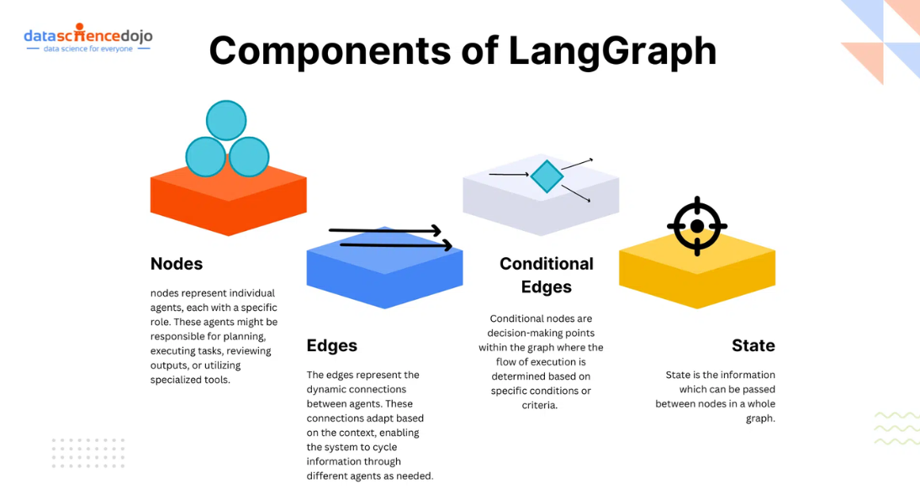
LangGraph Components -

Slide 13
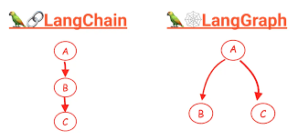
LangChain vs LangGraph -

Slide 14
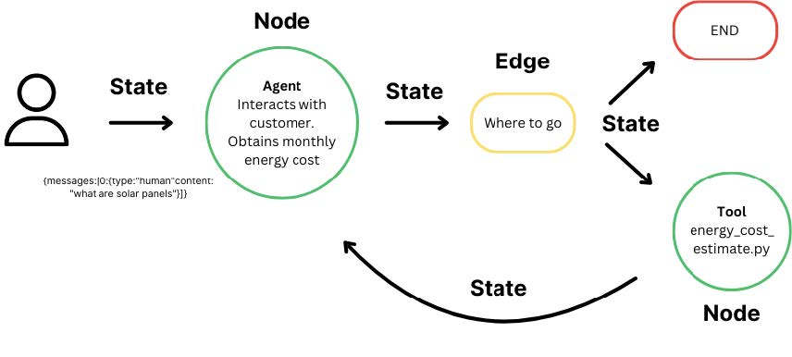
LangGraph example -

Slide 15
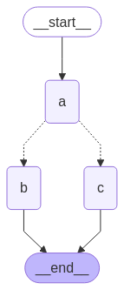
LangGraph Workflow -

Slide 16
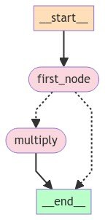

Slide 17
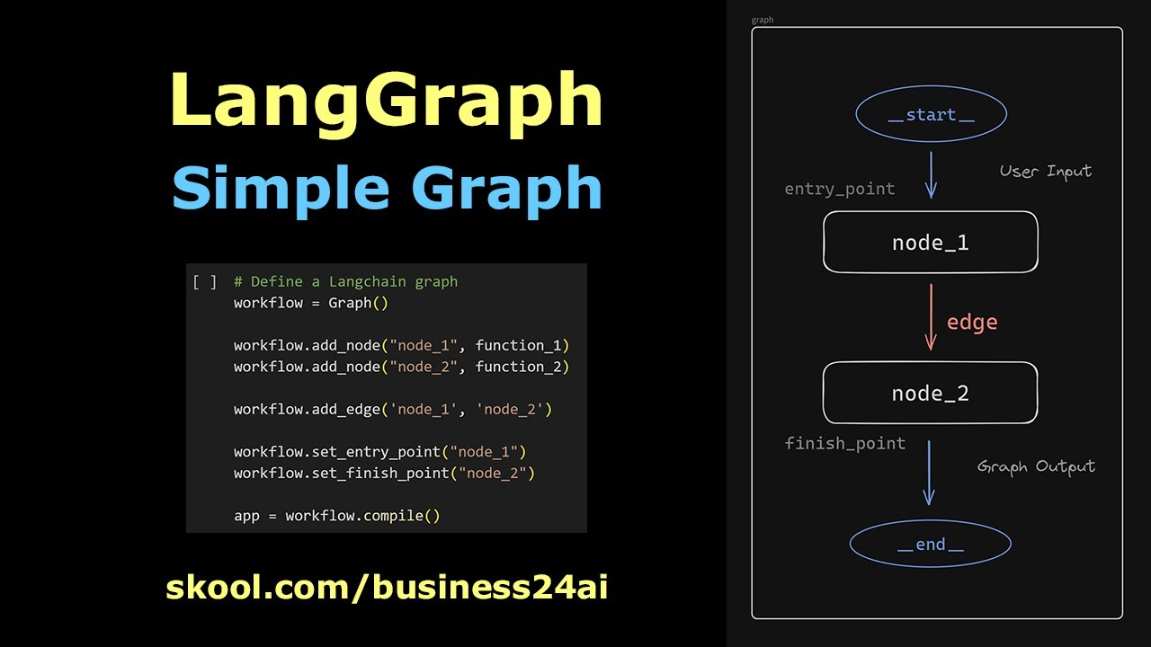
LangGraph simple graph -

Slide 18
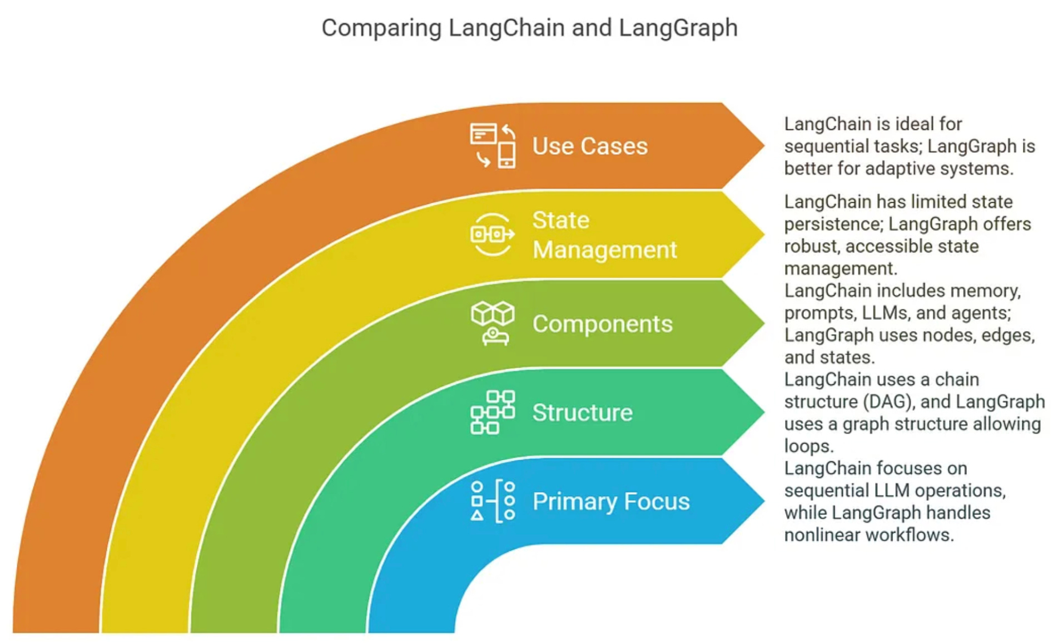
Comparing LangChain and LangGraph -

Slide 19
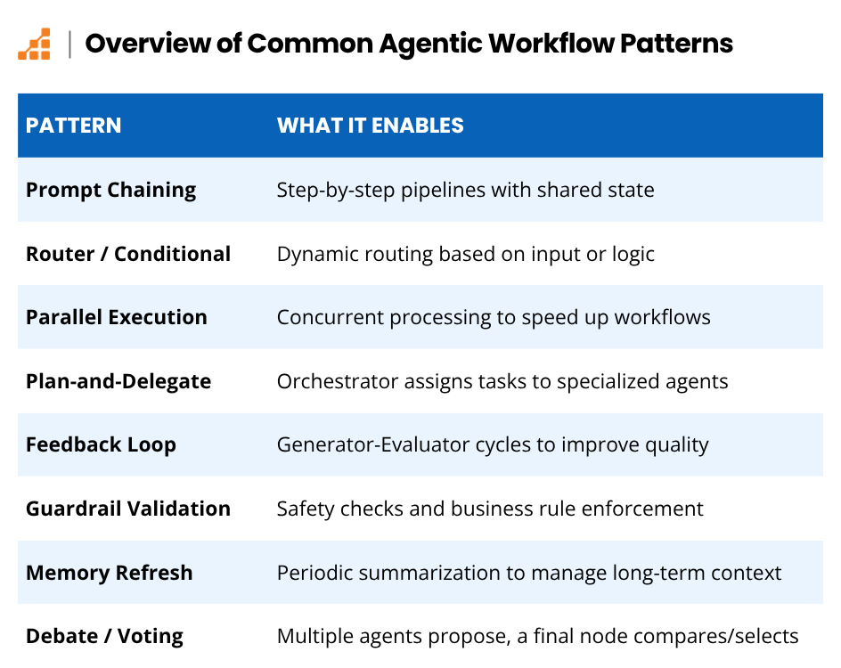

Slide 20
Thank you

