Slide 1



EV Vehicle/charging demand prediction

Slide 2

Learning Objectives
Understand EV trends and charging station needs.
Collect and preprocess data related to EV usage.
Explore data to find patterns and peak demand times.
Build predictive models to forecast EV/charging demand.
Apply time series analysis for accurate future predictions.
Deploy models (optional) for real-world applications.
Support smart planning of sustainable EV infrastructure.
GOAL
Source :
www.freepik.com/

Slide 3
Tools and Technology used
Python – Core programming language
Pandas & NumPy – Data handling and numerical operations
Matplotlib & Seaborn – Data visualization
Scikit-learn – Machine learning models
Streamlit – Web app development and model deployment
Jupyter Notebook – Development environment

Slide 4
Methodology
Problem Definition: Set the goal to predict EV vehicle and charging demand for better infrastructure planning.
Data Collection: Gather relevant datasets including EV usage patterns, charging station logs, timestamps, and possibly weather/location data.
Data Preprocessing: Clean missing values, convert time formats, and create useful features.
Exploratory Data Analysis (EDA): Visualize data to understand peak usage times, station loads, and demand patterns.
Model Building: Train machine learning models like Linear Regression, Random Forest.
Deployment Using Streamlit: Develop an interactive dashboard to visualize predictions and allow users to test scenarios.
Insights & Recommendations: Use model output to suggest optimal locations and times for charging station deployment.

Slide 5
Problem Statement:
With the rapid growth in Electric Vehicle (EV) adoption, accurately forecasting the demand for EVs and charging infrastructure is crucial for efficient energy planning and reducing range anxiety. However, unpredictable usage patterns and limited data-driven insights often lead to underutilized or overloaded charging stations.
This project aims to develop a predictive system that forecasts EV and charging station demand using machine learning techniques, helping city planners and service providers optimize infrastructure deployment and enhance user experience.

Slide 6
Solution:
This project presents a machine learning-based system to predict Electric Vehicle (EV) and charging station demand. The solution involves:
Collecting and preprocessing historical EV usage and charging station data.
Performing exploratory data analysis (EDA) to identify trends and peak demand periods.
Training predictive models such as Linear Regression, Random Forest, XGBoost, and ARIMA for accurate forecasting.
Evaluating model performance using MAE, RMSE, and R² Score.
Deploying the model via Streamlit, providing an interactive dashboard for users to input parameters and view demand forecasts.
Delivering actionable insights to support efficient infrastructure planning, reduce waiting times, and optimize energy distribution.
This data-driven solution empowers city planners and service providers to make informed decisions and promote sustainable EV infrastructure.

Slide 7
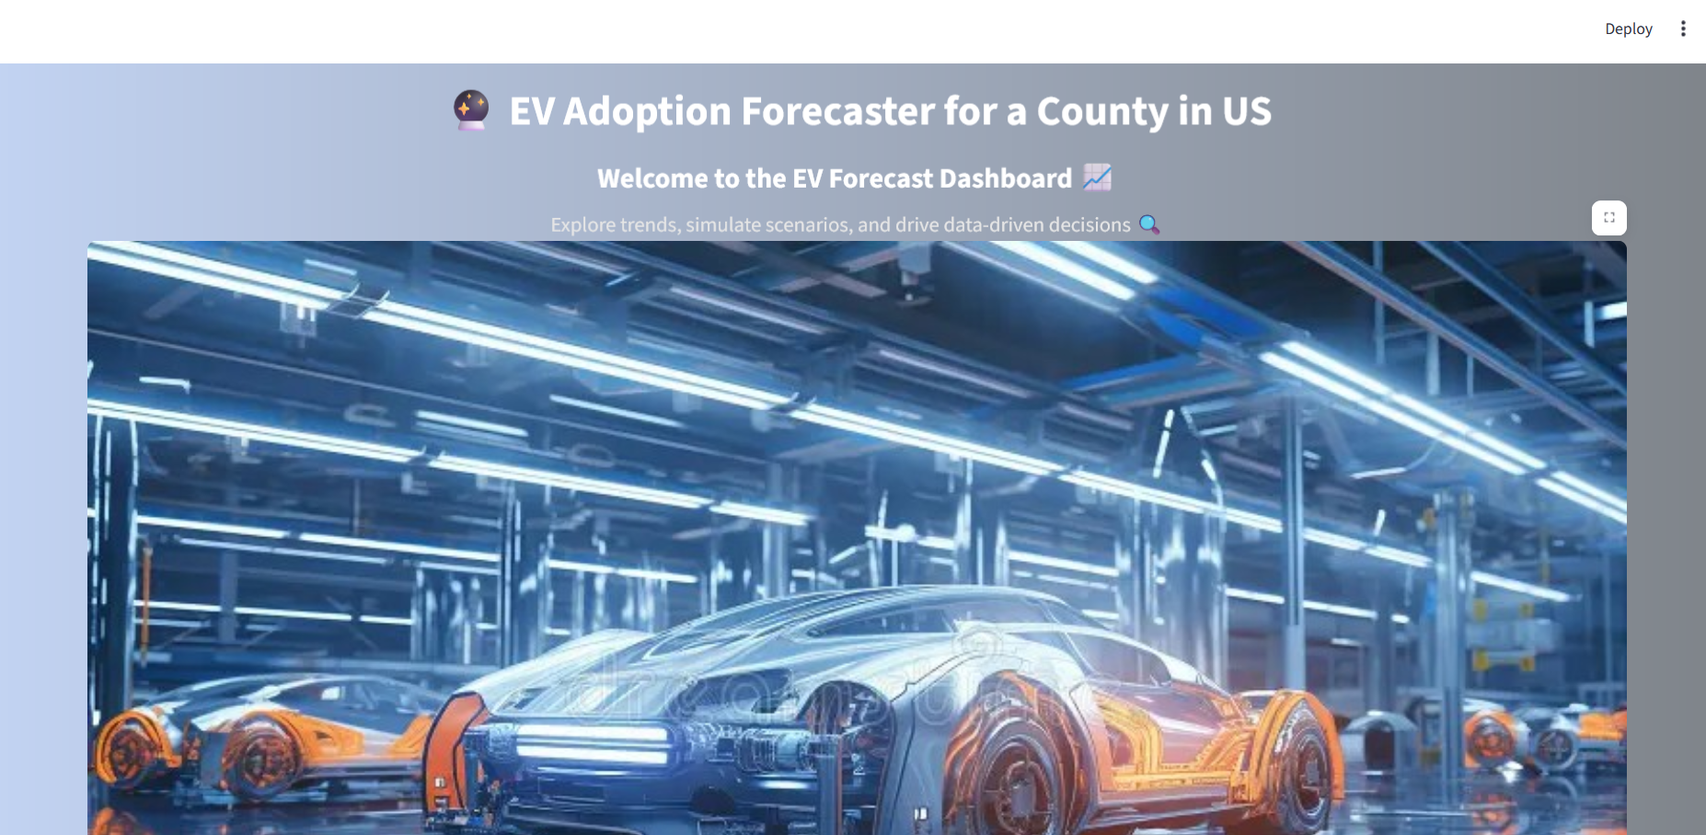
Screenshot of Output:

Slide 8
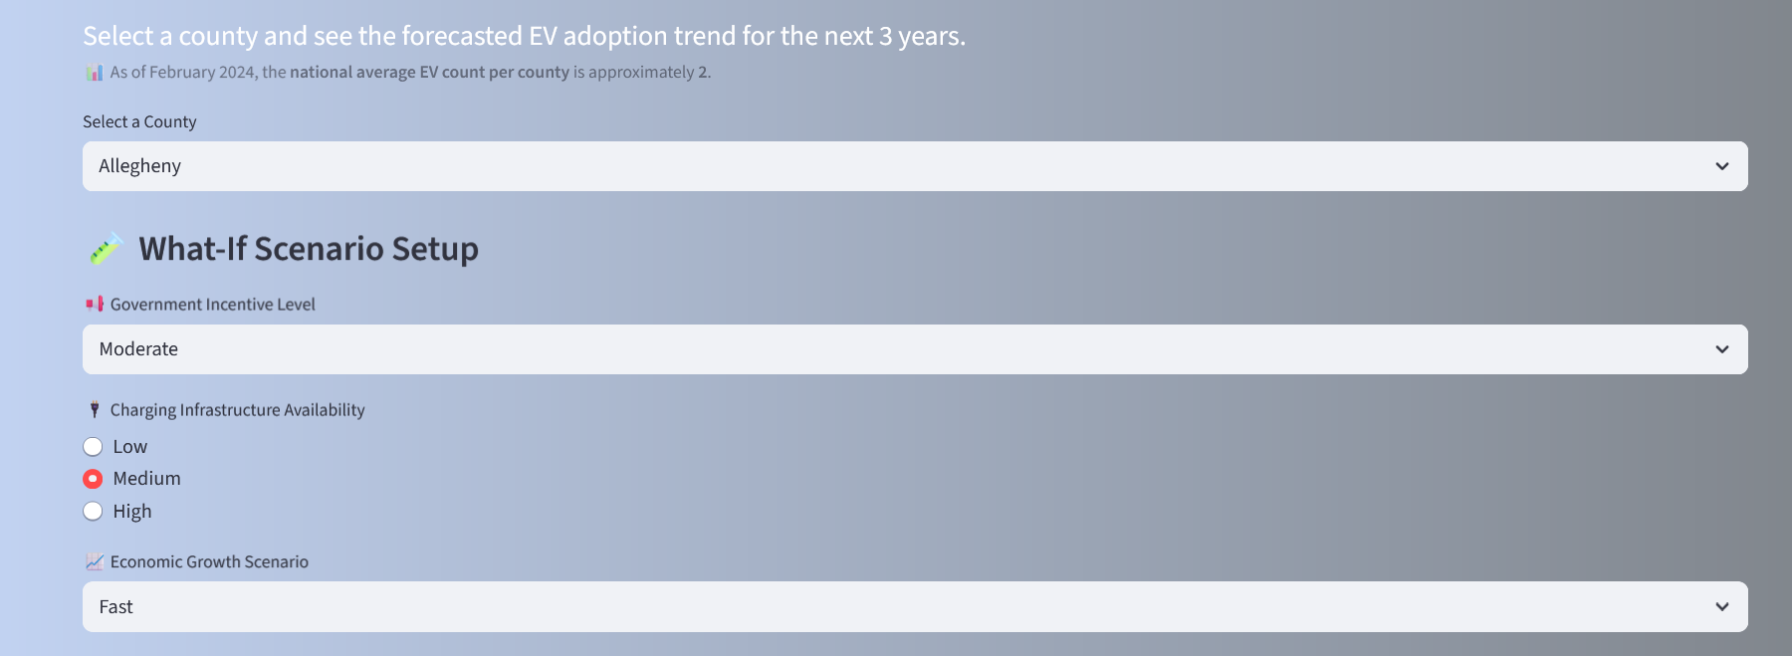

Slide 9
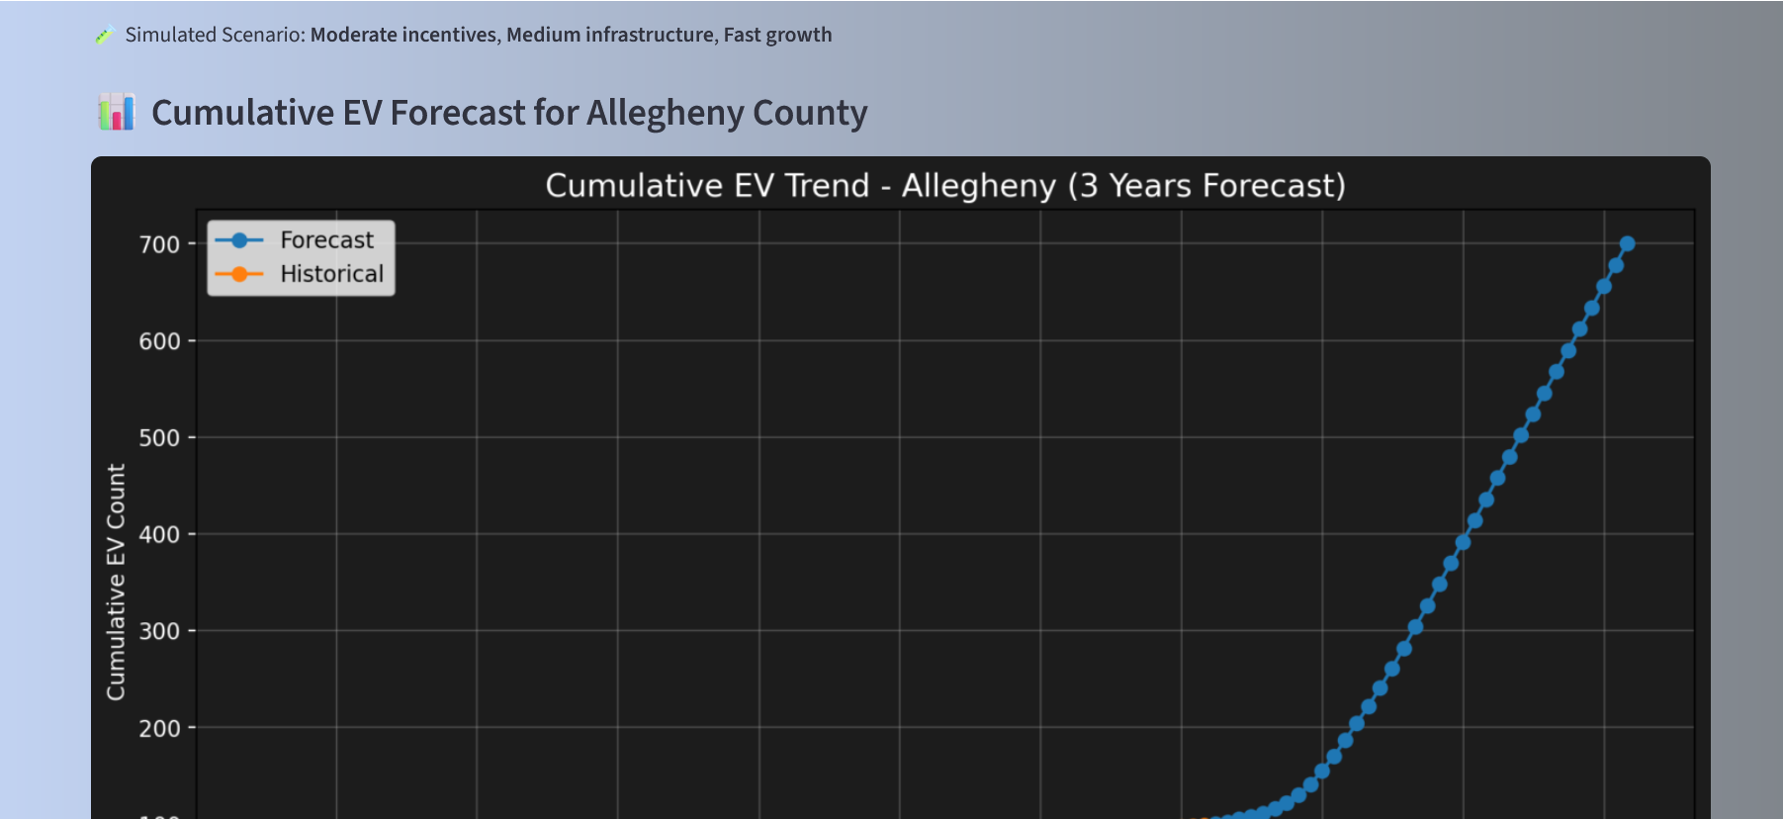
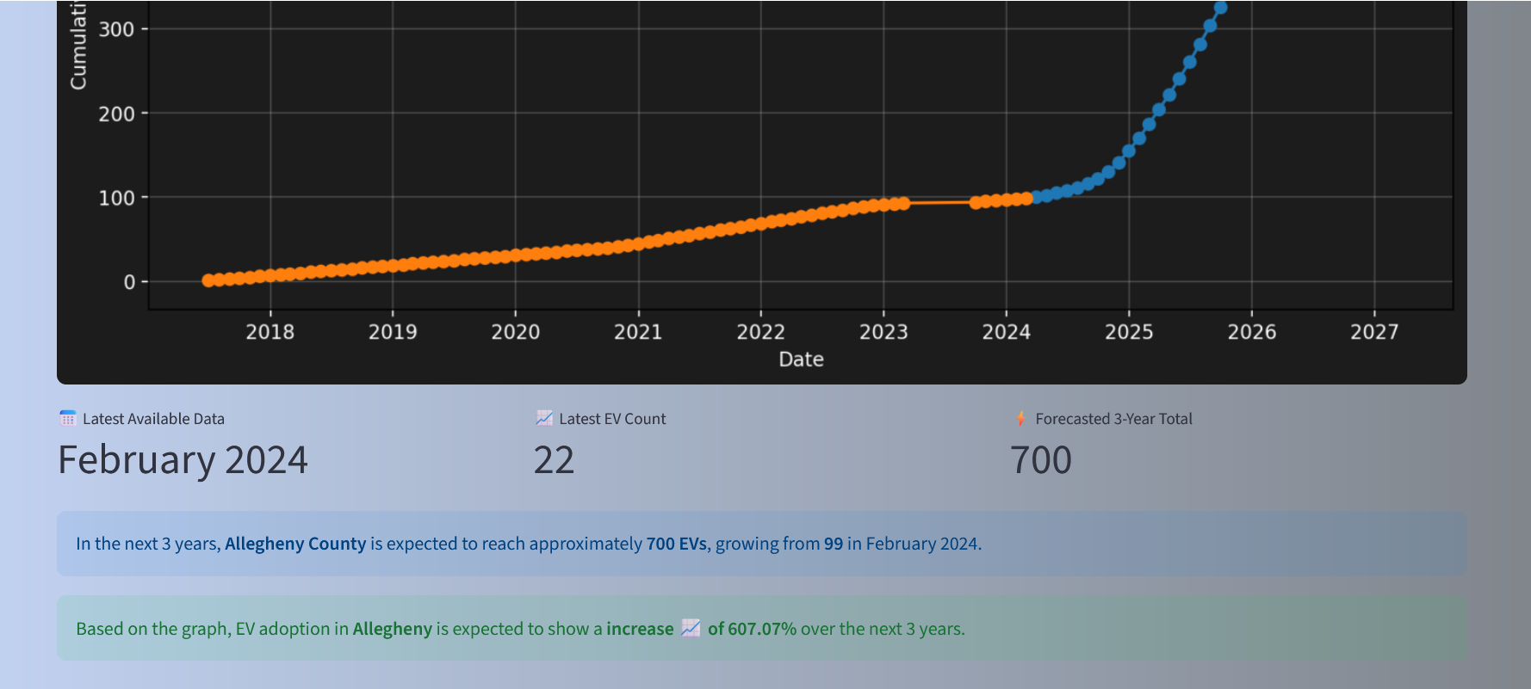

Slide 10
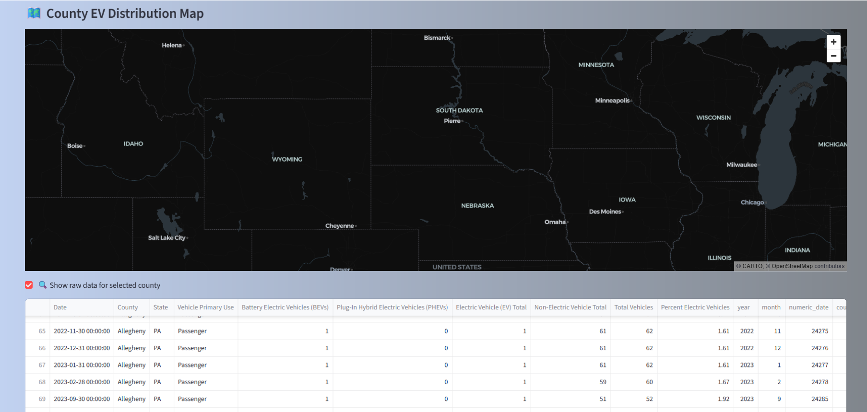

Slide 11
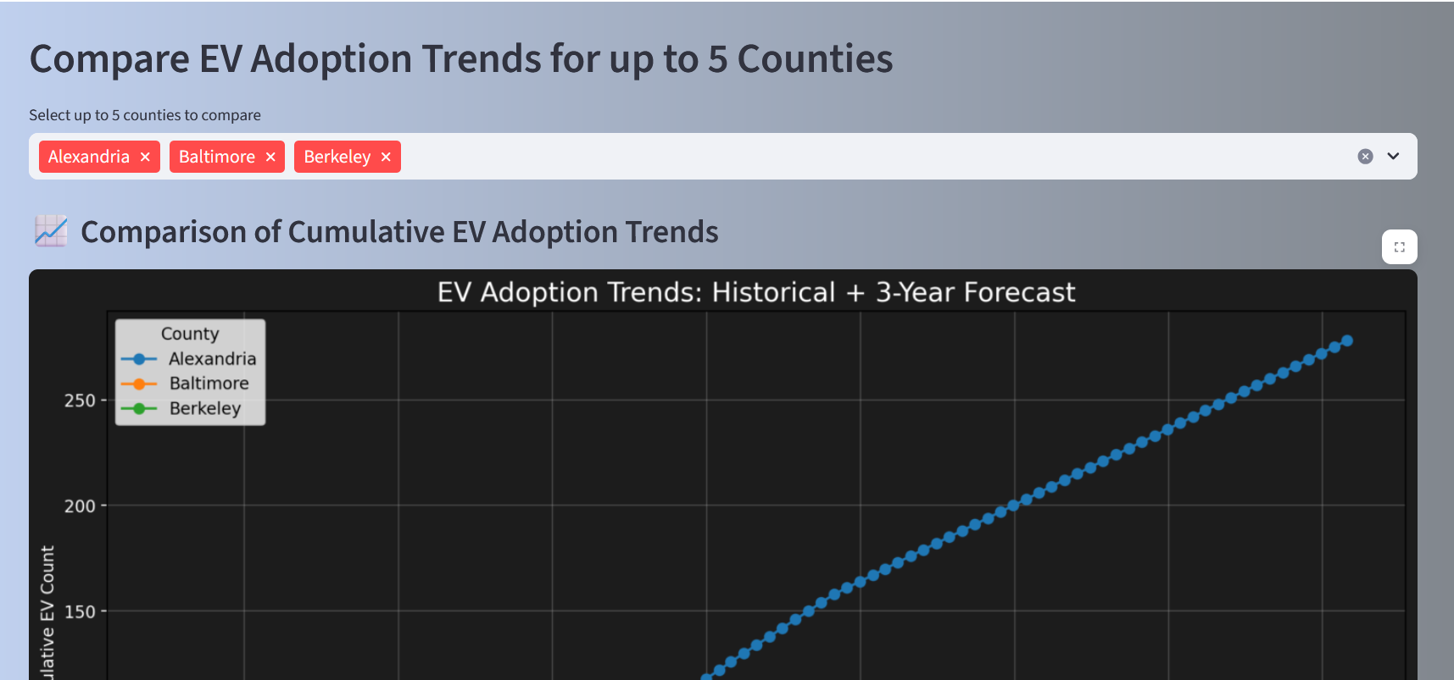
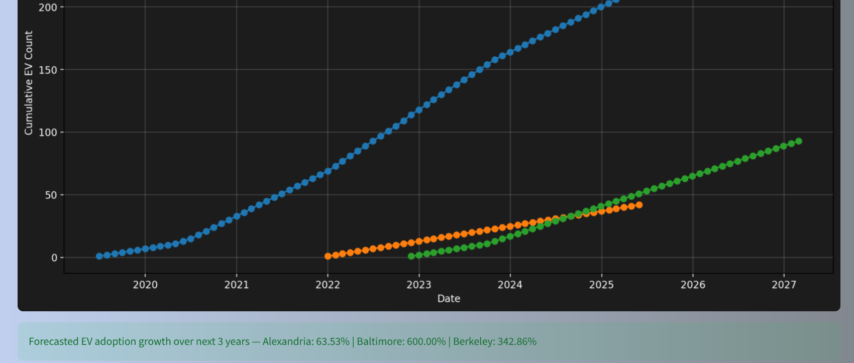

Slide 12


Slide 13
Conclusion:
The increasing adoption of Electric Vehicles (EVs) highlights the need for efficient and scalable charging infrastructure. This project successfully demonstrates how machine learning models can be leveraged to predict EV and charging demand by analyzing historical usage patterns.
By deploying the solution using Streamlit, it offers a user-friendly and interactive platform for visualizing forecasts and gaining insights, helping stakeholders make data-driven decisions. The approach not only improves the efficiency of resource allocation but also supports the development of smart, sustainable cities through intelligent infrastructure planning.

