Slide 1

Predicting Insurance Coverage Type Using Machine Learning
Multiclass Classification
Presented By - Shivangini Marjiwe
23 March 2025
Springboard

Slide 2

Problem Statement
Business Motivation
Springboard
Insurance companies offer multiple policies: Health, Life, Auto, Travel, Home
Challenge: Recommending the right policy to the right customer
Goal: Predict the specific policy type a customer is likely to purchase based on profile data
Improve policy match rate
Enhance sales and marketing efficiency
Increase customer satisfaction through personalization

Slide 3

Data Sources & Structure
Springboard
Datasets: train.csv + test.csv (Kaggle)
Combined & Cleaned: insurance_multiclass.csv
Target variable: policy_type

Slide 4
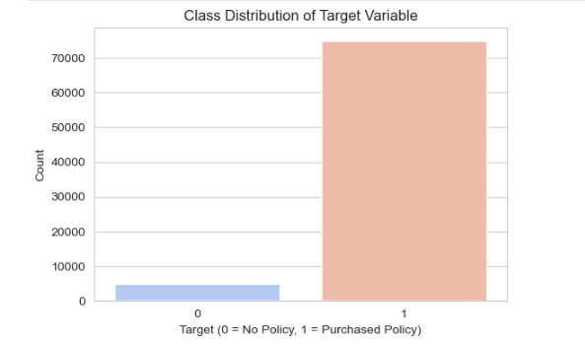
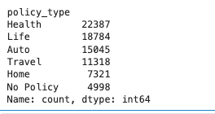
Data Wrangling
Springboard
Handling missing values:
Imputed application_underwriting_score using median.
Replaced missing late payment counts with 0.
Feature Engineering:
Derived age_in_years from age_in_days.
Log-transformed skewed Income.
Created new column : policy_type from existing binary target using mapping.
1 (Policy Purchased) -> one of ['Health', 'Life', 'Auto', 'Travel', 'Home'] randomly assigned
0 (No Policy) -> 'No Policy'
Added features: premium_to_income_ratio, late_payment_score, and age groups.
Saved, cleaned and labeled dataset as insurance_multiclass.csv.

Slide 5
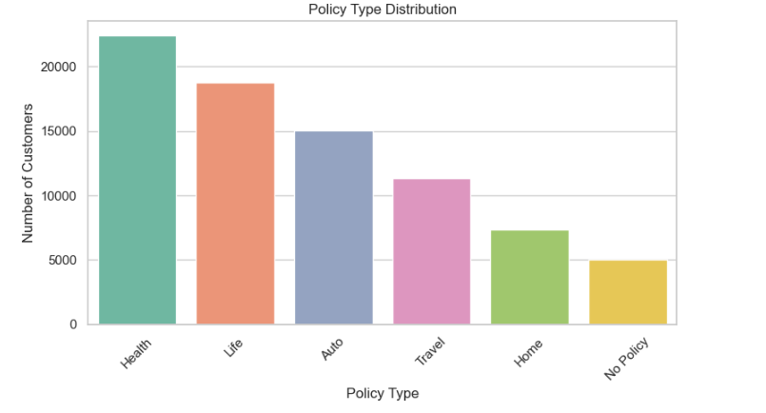
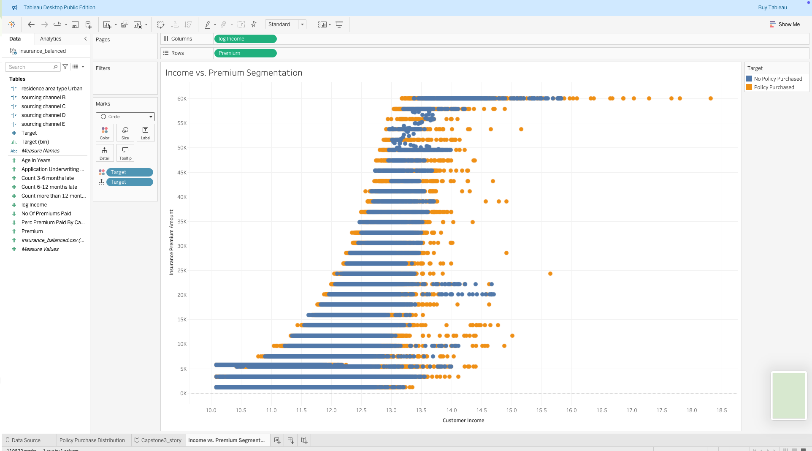
EDA in Python & Tableau
Springboard
Python :
Plotted distributions of premium, income, and age.
Correlation heatmap among numeric features.
Checked class distribution of new policy_type (imbalanced).
Tableau:
EDA from previous binary classification reused:
Age vs. purchase behavior
Income vs. premium
Late payments vs. policy interest
https://public.tableau.com/app/profile/shivangini.marjiwe/viz/Capstone3_EDA_story/Capstone3_story?publish=yes

Slide 6
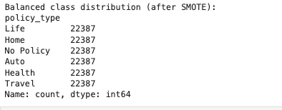
Preprocessing & Training Data
Springboard
Converted categorical variables to dummies.
Standardized numerical columns using StandardScaler.
Applied SMOTE to balance all six classes in policy_type.
Train-Test Split: 80/20 on SMOTE-balanced dataset.

Slide 7
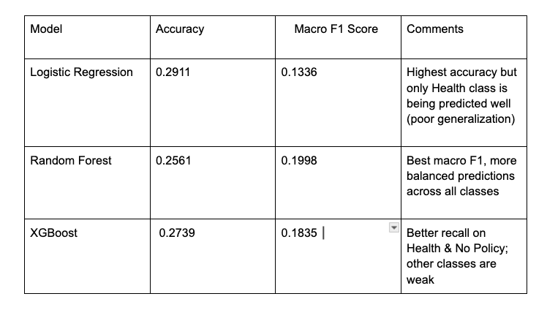
Model Selection & Evaluation
Springboard
Models Trained:
Random Forest
Logistic Regression
XGBoost Classifier
Metrics Compared:
Accuracy
Macro F1-score (to evaluate performance across all classes equally)
Final Model Selected: Random Forest Classifier
Best macro F1 score
Most balanced across underrepresented classes

Slide 8
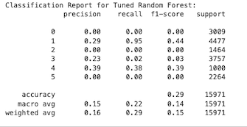
Hyperparameter Tuning (Random Forest)
Springboard
Used RandomizedSearchCV with 60 combinations
Parameters tuned: max_depth, n_estimators, min_samples_split, max_features
Tuned Model Results:
Accuracy: 0.29
Macro F1 Score: 0.14
Best Class Recall: Health (0.95)
Poor performance on Auto, Home, and Travel

Slide 9
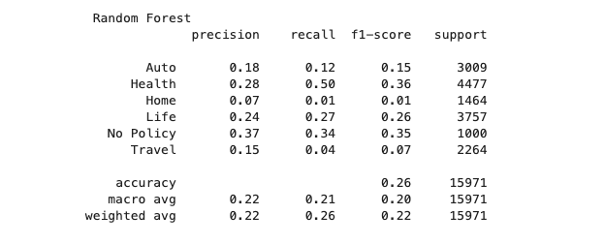
Random Forest
Springboard
After Feature Engineering After Hyperparameter Tuninng

Slide 10
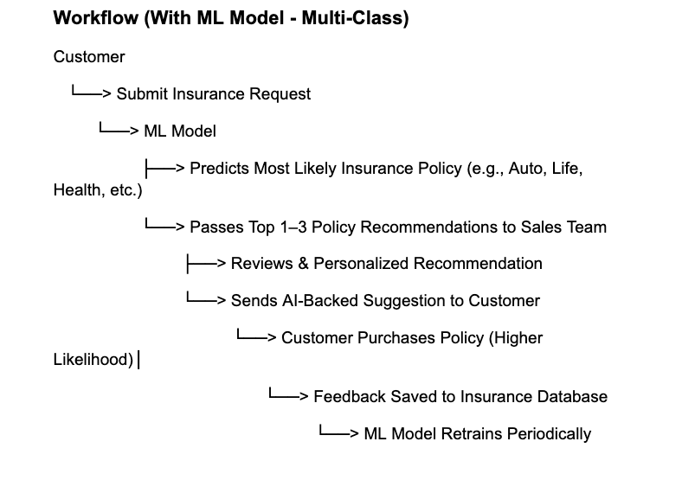
Business Workflow Integration
Springboard
Customer submits request
ML model predicts policy type
Sales team validates and explains prediction
Tailored recommendation sent to customer
Model trained using feedback loop

Slide 11
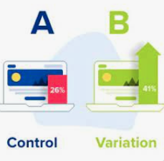
KPIs & A/B Testing Strategy
Springboard
Key Performance Indicators (KPIs):
% of correct policy type predictions (Top-1 accuracy)
Top-3 Recommendation Recall
Cross-sell and up-sell conversion rates
A/B Testing Strategy:
Control Group (A): Sales team without ML guidance.
Test Group (B): Sales team with ML-based recommendations.
Duration: 30 days
Success Metric: Increase in correct policy match & conversion.

Slide 12

Recommendations
Conclusion
Springboard
Integrate the ML Model into the Sales Workflow
Adopt a Top-N Recommendation Strategy
Collect Feedback and Retrain Regularly
Successful multiclass model built for policy prediction
Random Forest selected for deployment
Business integration strategy planned

Slide 13
THANK YOU!
Springboard

