Slide 1

SMART CALORIE
Under the Supervision of
Mr. Arvindhan M.,
Assistant Professor
School of Computing Science and Engineering
Greater Noida, Uttar Pradesh
Fall 2020 - 2021

Slide 2
GROUP No. BT5054
GROUP members:
Shivang Gupta - 18SCSE1010039
Vibhu Mishra
- 18SCSE1010052
Abhishek Dubey
- 18SCSE1010427

Slide 3

Software used: Android Studio for Windows
OS: Android v2.3 and up
Hardware:
System :32 bits
RAM :256MB of RAM
HDD :40 GB or higher
Monitor : SVGA COLOR
Keyboard : 108 keys
Mouse :3 button mouse

Slide 4
Introduction -:
Health tracking systems can be categorized based on technological advancement into two groups namely: traditional and electronic health tracking systems . In times past, individual’s health activity was measured in an analogue manner requiring the use of analogue scales and thermometers . As the readings were taken, they were recorded in the file of the individual at a given medical center . Such records were only found in the health facility where the readings were taken. The drawbacks of this approach includes among others : the difficult to comprehend handwriting of a number of health practitioners, the records soon become bulky and duplications are often inevitable. In addition, the records are not always readily available and accessible unless a visit is made to the medical center. Electronic health tracking systems overcame the limitations of the traditional health tracking systems and also heralded the advent of fitness tracking devices.

Slide 5
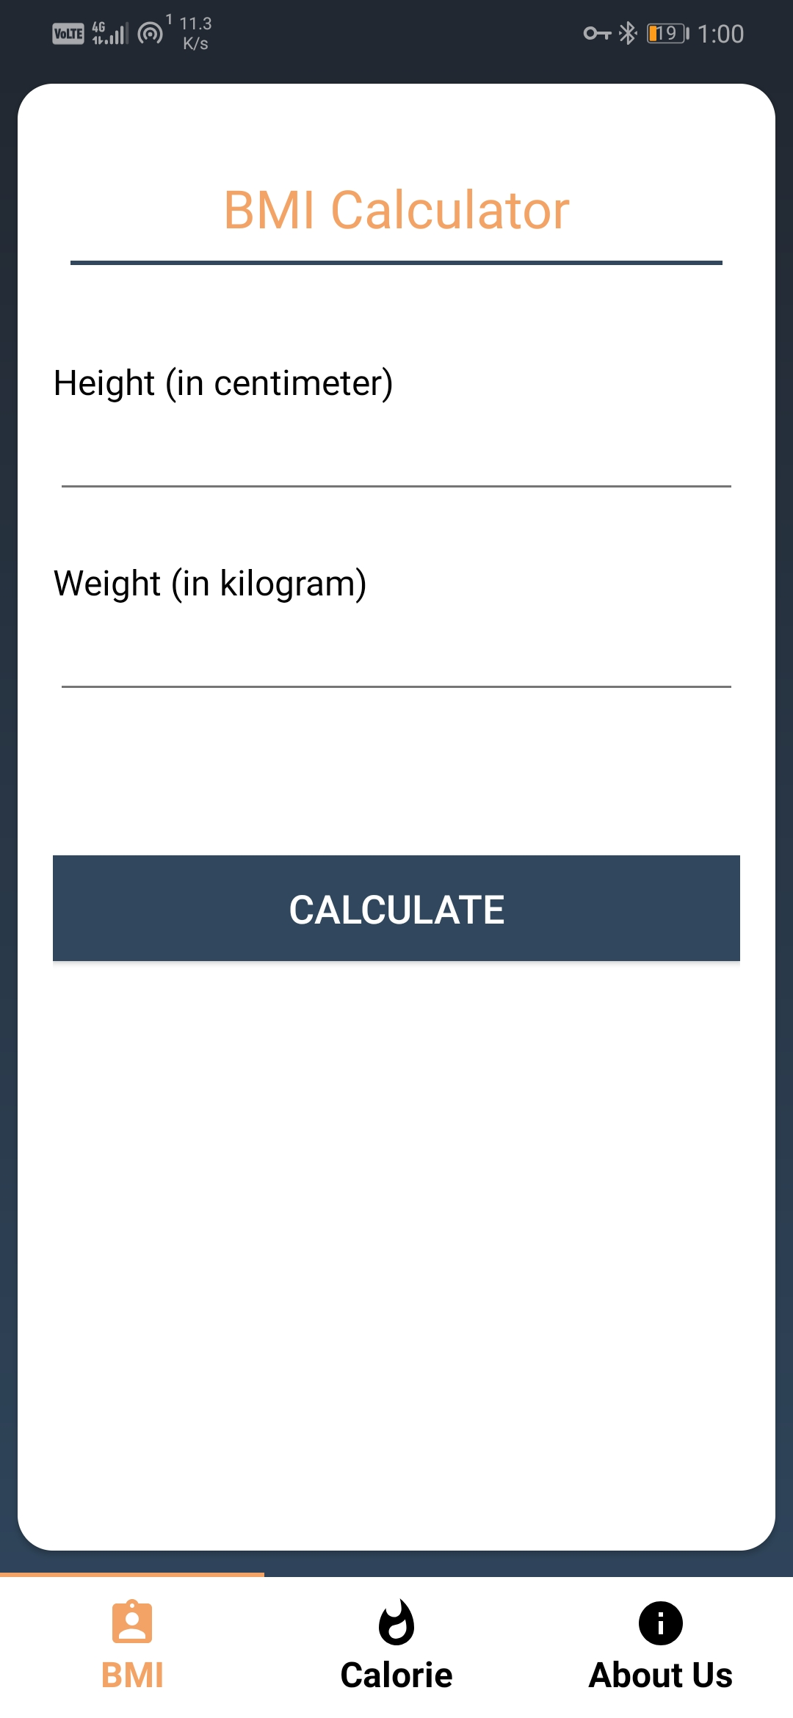
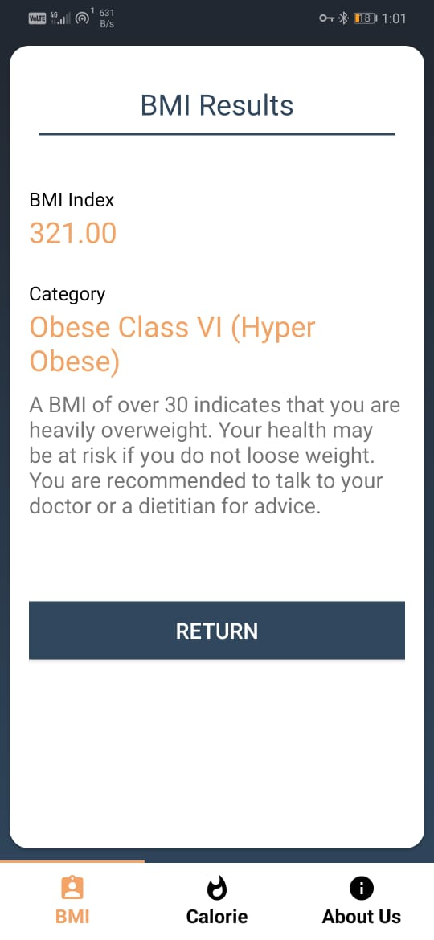
Module Description -:
BMI Calculator -
BMI refers to (Body Mass Index) is a value derived from the mass (weight) and height of a person. The BMI is defined as the body mass divided by the square of the body height, and is universally expressed in units of kg/m2, resulting from mass in kilograms and height in meters.
So, BMI is an important reading to know the health status so we developed this module very friendly manner, in our app more than the reading you would get suggestion that in what way you have to think on further.

Slide 6
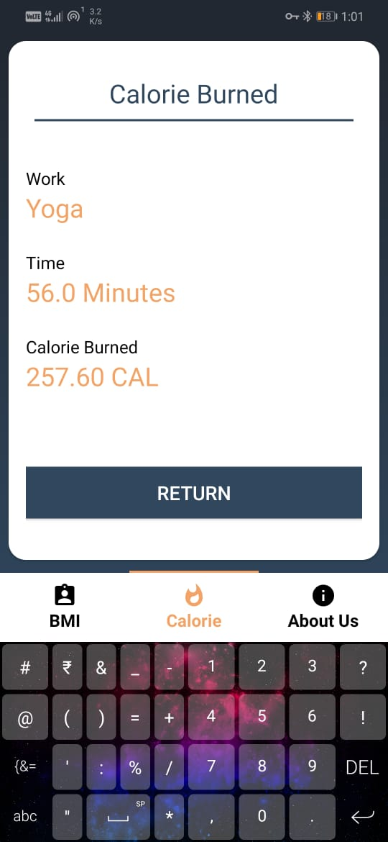
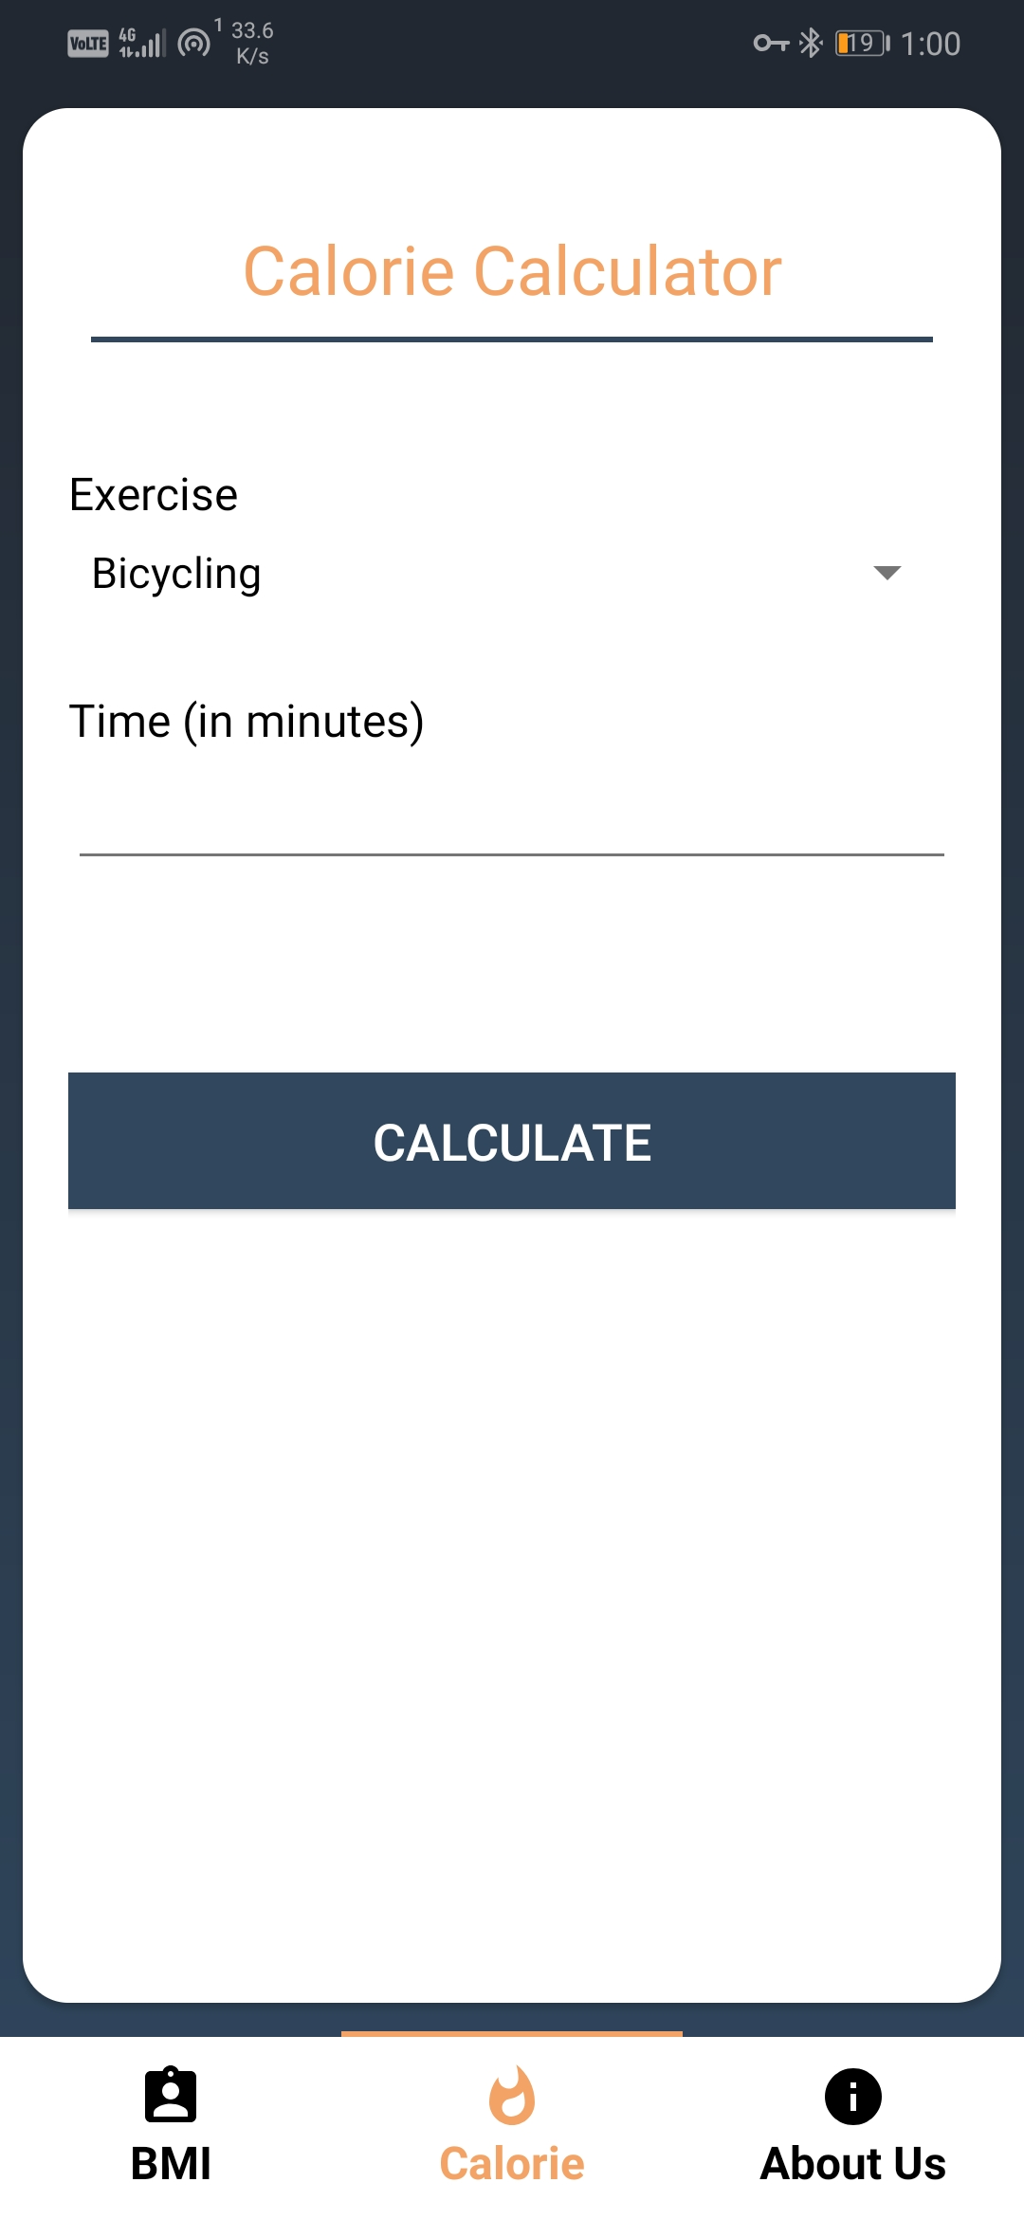
Calorie Calculator -:
If you got your BMI health index from our app, then its to time for exercise if you are fatty person then it also requires more. To help you we have developed this module, In this module you got some basic exercise which is feed on the basis of calories burned per minute. So, you can make your daily exercise plan.
The activities are:
Bicycling 2. Dancing 3. Yoga 4. Jumping Rope 5. Body Stretching 6. Swimming 7. Walking
We hope you regularly care for yourself by following some activities.

Slide 7
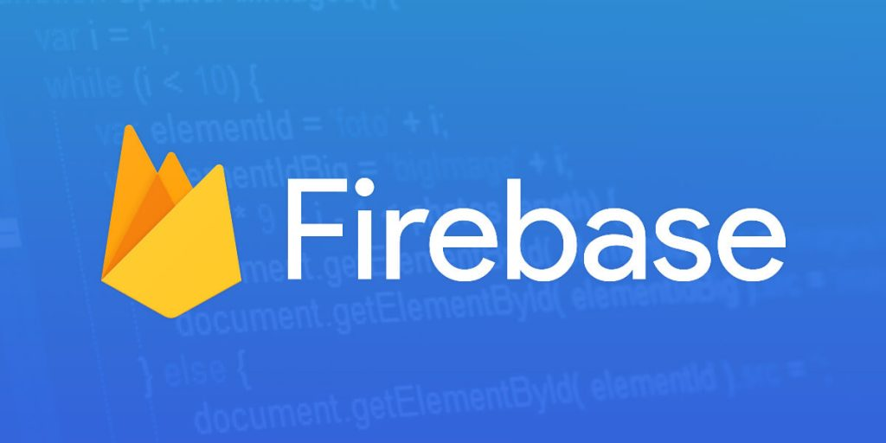
Firebase Database Benefits -:
Real-time Database Helps to Store and Synchronize Data
Firebase has Become Smarter with Google Analytics
Firebase Offers Facility of Crash Reporting to Fix Bugs Quickly
Fast and Secured Web Hosting
Firebase Authentication
Firebase Allows the Content Storage with Ease

Slide 8
Advantages:
system is easy to understand and user friendly.
user can also connect with their android device.
based on the food consumed by the user, the ai system automatically calculates bmi.
displays food consumed date wise and graphically.
required this kind of device who can help to take care of our health.
this system helps us to tell what to eat or not.
user can connect easily to the system

Slide 9
Disadvantages:
Requires an active internet connection.
System may provide inaccurate results if data entered incorrectly.
Doesn’t give out a diet plan, just suggestions.

Slide 10
Applications:
The system can be used by any users who are diet conscious and want to keep a track of the food consumed and how much more they should consume accordingly.
Secondly , people can look over the weight rather they are overweighted or underweighted and respectively control their health by different ways like cycling , yoga , jumping rope etc.

Slide 11

SUMMARY -:
✓ Health Control: This app helps in identifying and improving many overweighted or underweighted people.
✓ Easy access : This application can be accessed anytime and anywhere in the world.
✓ User friendly : This application will be user friendly since the user interface will be simple and easy to understand.

Slide 12
Thank You

