Slide 1



Power_Bi_Project
View in Power BI
Last data refresh:
1/10/2024 11:54:35 AM UTC
Downloaded at:
1/10/2024 12:00:36 PM UTC

Slide 2
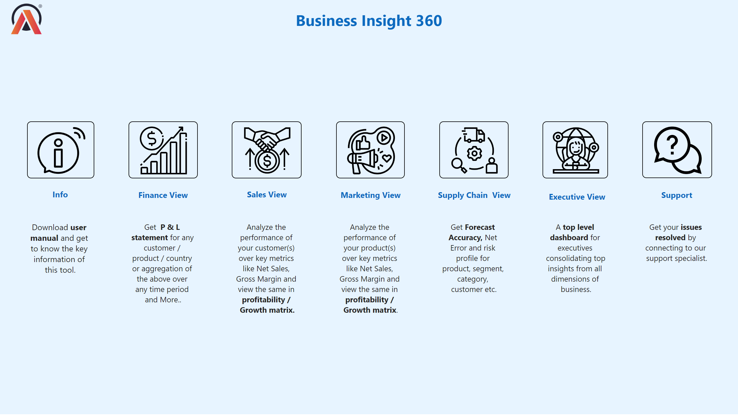
Home
Notes:
image
No alt text provided
image
No alt text provided
image
No alt text provided
image
No alt text provided
image
No alt text provided
image
No alt text provided
image
No alt text provided
textbox
No alt text provided
textbox
No alt text provided
textbox
No alt text provided
textbox
No alt text provided
textbox
No alt text provided
textbox
No alt text provided
textbox
No alt text provided
textbox
No alt text provided
textbox
No alt text provided
textbox
No alt text provided
textbox
No alt text provided
textbox
No alt text provided
textbox
No alt text provided
textbox
No alt text provided
textbox
No alt text provided
image
No alt text provided

