Slide 1
Breast Cancer Prediction

Slide 2

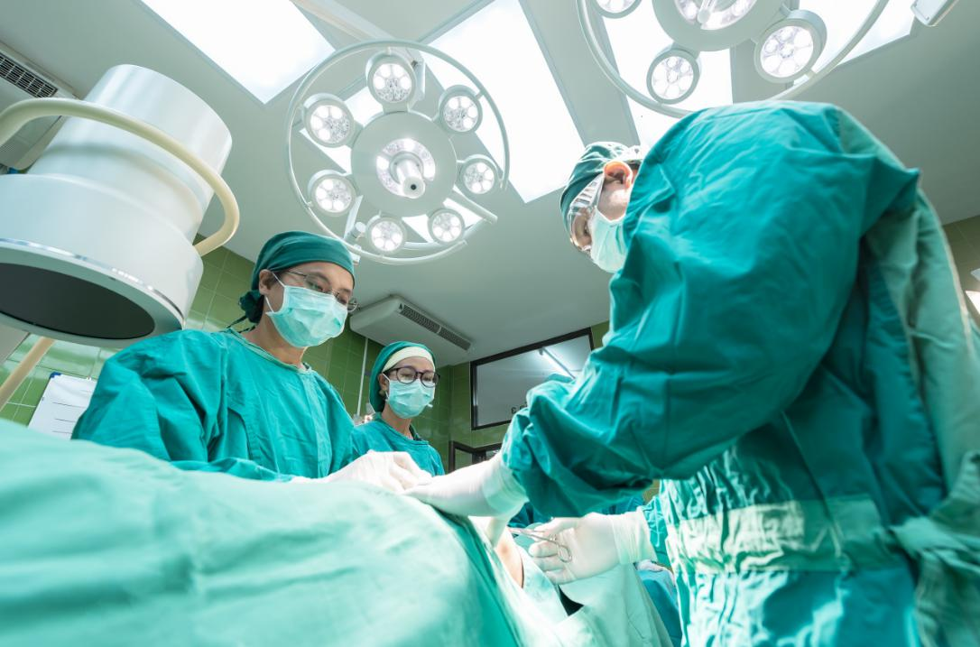
Problem Statement
Breast cancer is one of the most common cancers among women in the world. Early detection of breast cancer is essential in reducing their life losses. Build a predictive model using machine learning algorithms to predict whether the tumor is benign or malignant.
Aim
To find the optimal k value having the lowest misclassification error, highest accuracy and highest AUC.
Model Selection
Implement KNN algorithm on training data, predicting labels for dataset and printing the accuracy of the model for different values of K..

Slide 3
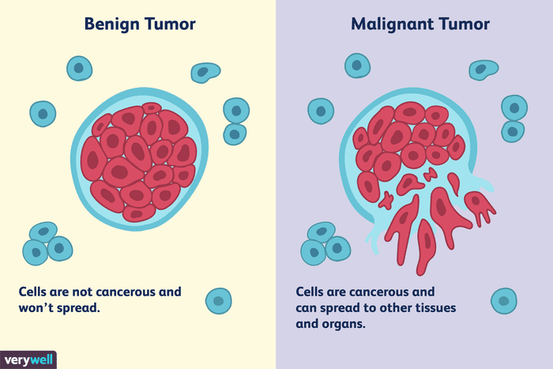
Benign Tumor:
If the tumor is benign , the cells are not cancerous.
It won't invade nearby tissues or spread to other areas of the body (metastasize).
Most grow slowly.
Benign tumors usually don't recur once removed, but if they do it is usually in the same place.
Malignant tumor:
Malignant means that the tumor is made of cancer cells, and it can invade nearby tissues.
Some cancer cells can move into the bloodstream or lymph nodes, where they can spread to other tissues within the body this is called metastasis.
Usually grow fairly rapidly.
May recur after removal, sometimes in areas other the original site

Slide 4
What is KNN?
KNN : K-Nearest Neighbour Algorithm
Supervised Learning Algorithm
Classification and Regression Algorithm
Used for Binary and Multiclass Classification
Works on Noisy Data
Works efficiently for datasets with less observations(5000-10000)
Known as Lazy Algorithm
Not affected by outliers
1
2
3
4
5
6
7
8

Slide 5
Algorithm
1
Load the Data
2
Select the value of K
3
For each point in data:-
1
Calculate the distance between the data point and other values using distance metrics like Euclidean,Minkowski,Hamming,etc.
2
Based on distance value,sort in ascending order.
3
Choose the top K rows from sorted array
4
Assign a class to the test point based on most frequent class of these rows.
4
End

Slide 6
Data Description
1
32 Variables & 569 Observations
2
Independent Variables:-
1.radius (mean of distances from center to points on the perimeter)
2.texture (standard deviation of gray-scale values)
3.perimeter
4.area
5.smoothness (local variation in radius lengths)
6.compactness (perimeter^2 / area - 1.0)
7.concavity (severity of concave portions of the contour)
8.concave points (number of concave portions of the contour)
9.symmetry
10.fractal dimension ("coastline approximation" - 1)
3
Dependent Variable:-
1.M : Malignant
2.B : Benign

Slide 7
Steps To Perform KNN
1
Data Cleansing
1
Feature Selection:- All variables are considered.
i2i
Missing Values:- df.isnull().sum()
3
Outlier Detection:- No need of outlier detection.
2
Converting Categorical Variables into Numeric:- LabelEncoder()
3
Creating X & Y variable:- X = br_df.values[ : , 1:]
Y = br_df.values[ : , 0]

Slide 8
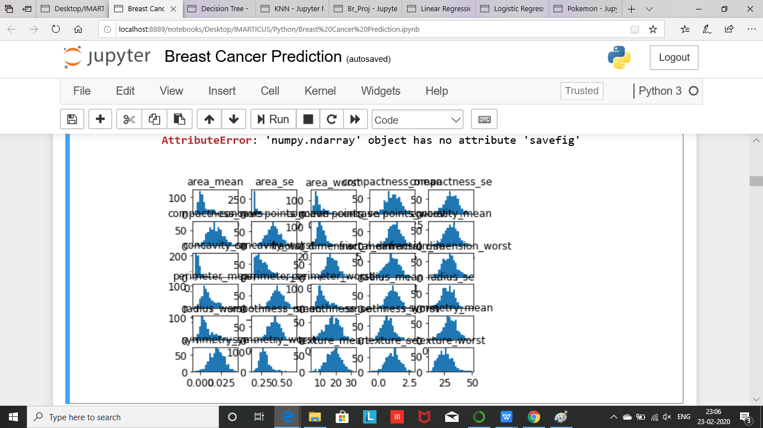
4
Skewness in Data

Slide 9
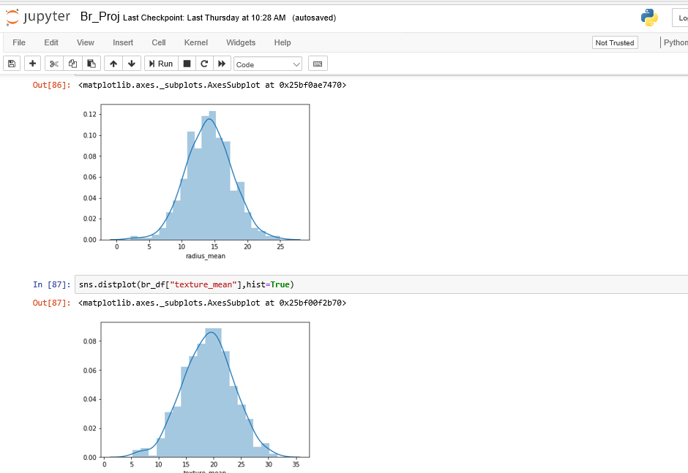
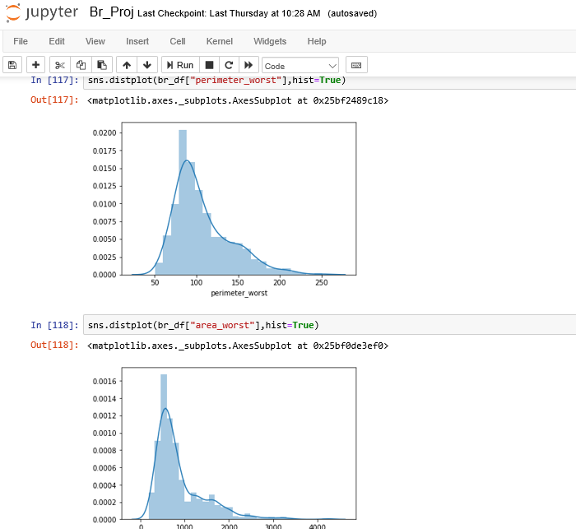
Histogram Plots

Slide 10
5
Scaling the Data:- StandardScaler()
6
Splitting the Data:- train_test_split()
7
Selecting k-value:-
i1i
By Sq Root Method
i2i
By Manually using Range
8
Building the model:-
i11
Create: model_knn=KNeighborsClassifier()
Train: model_knn.fit(X_train.Y_train)
i2i
i3i
Predict: Y_pred=model_knn.predict(X_test)
9
Evaluating the model:-
i11
Confusion Matrix: (Y_test,Y_pred)
i2i
Accuracy Score: accuracy_score(Y_test,Y_pred)
i3i
Classification_report()

Slide 11
10
AUC:-
1
AUC represents degree or measure of separability.
It tells how much model is capable of distinguishing between classes.
2
Higher the AUC, better the model is at predicting 0s as 0s and 1s as 1s.
3
Range of AUC should be between 0 and 1.
4
AUC Of Model: 0.9916239316239316

Slide 12
 | ACCURACY | TYPE 1 ERROR | TYPE 2 ERROR | RECALL (0) | RECALL(1)
KNN K=21 (Euclidean/Minkowski Distance) | 93.85% | 0 | 7 | 1.00 | 0.82
KNN K=21 (Hamming Distance) | 65.7% | 0 | 39 | 1.00 | 0.00
KNN K=21 (Manhattan Distance) | 95.61% | 1 | 4 | 0.99 | 0.90
KNN K=9 | 95.61% | 0 | 5 | 1.00 | 0.87
LOGISTIC | 97.36% | 2 | 1 | 0.97 | 0.97
SVM | 98.24% | 0 | 2 | 1.00 | 0.95
DT | 94.73 | 6 | 0 | 0.92 | 1.00

Slide 13
CONCLUSION Therefore we have built the aimed KNN model with optimal K-value K=9 giving the lowest misclassification error, highest accuracy and highest AUC. And further successfully classified the Benign and Malignant Tumour

Slide 14
Thank You

