Slide 1
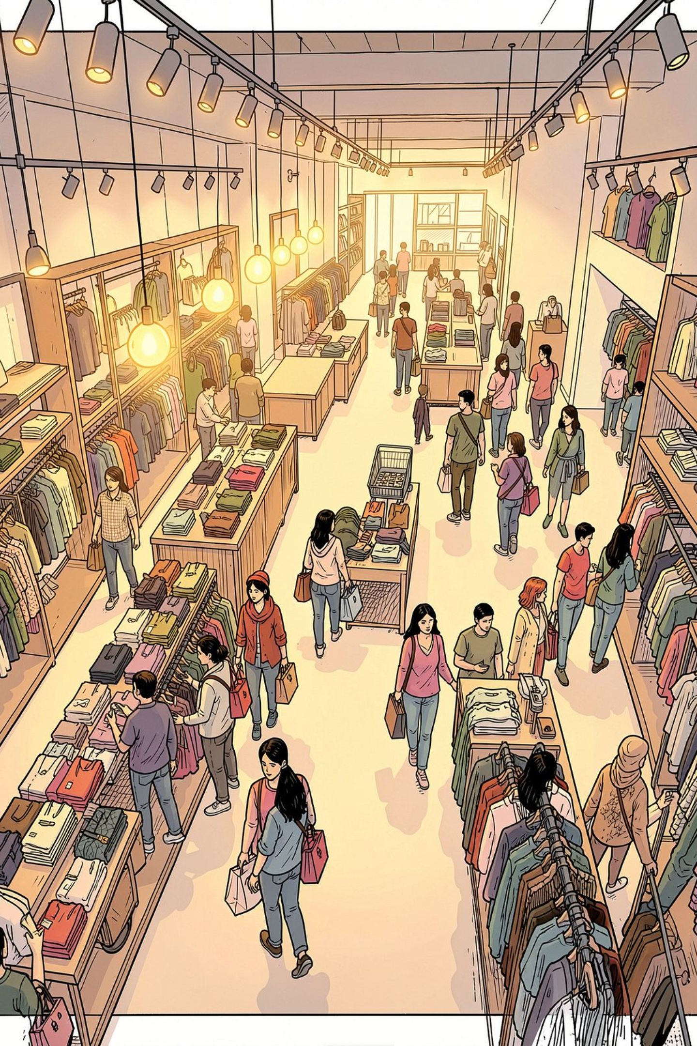
Customer Shopping Behavior Analysis
Uncovering insights from 3,900 transactions across demographics, product preferences, and spending patterns to guide strategic decisions.

Slide 2
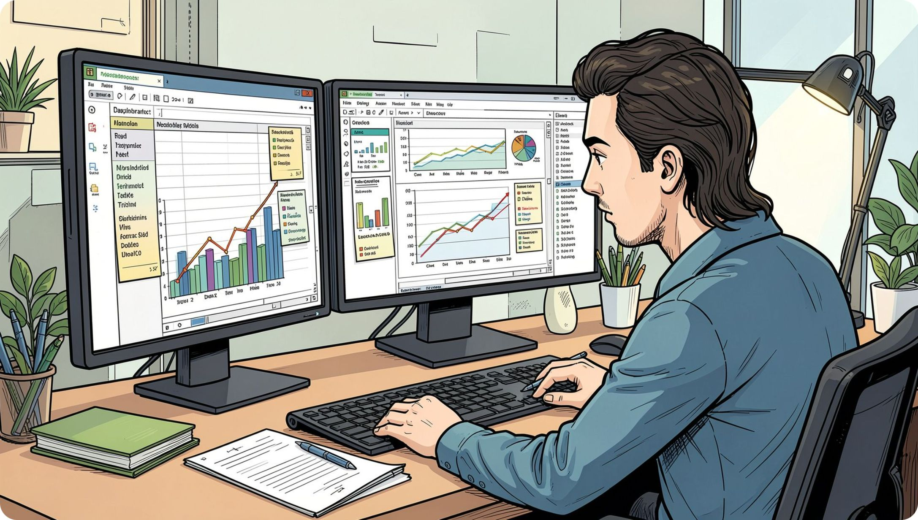
Dataset at a Glance
3,900
19
Total Purchases
Columns
70
$100
Max Age
Max Purchase
Key Data Fields
Demographics: Age, Gender, Location, Subscription
Purchases: Item, Category, Amount, Season
Behavior: Discount, Promo Code, Frequency, Review Rating

Slide 3

Data Preparation in Python
Clean & Load
Feature Engineering
Imported via pandas, checked structure with info() and describe()
Created age_group bins and purchase_frequency_days
Database Ready
Loaded cleaned DataFrame into PostgreSQL for SQL analysis

Slide 4
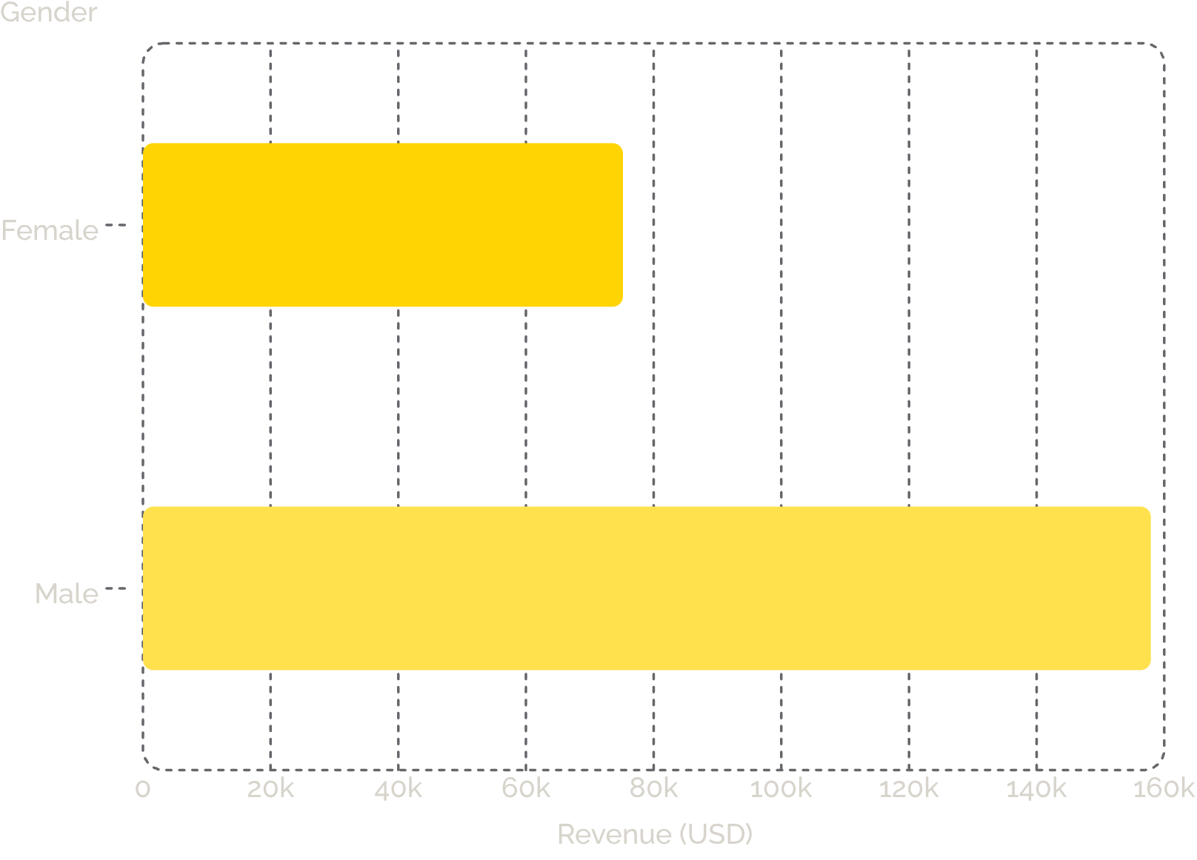

Revenue by Gender
Key Finding
Male customers generated 2.1× more revenue than female customers — $157,890 vs $75,191.
Opportunity to investigate gender-based marketing gaps.

Slide 5
Product & Discount Insights
Top Products by Rating
Most Discount-Dependent Products
Product
Avg Rating
Product
Discount Rate
Gloves
3.86
Hat
50.00%
Sandals
3.84
Sneakers
49.66%
Boots
3.81
Coat
49.07%
Hat
3.81
Sweater
48.17%
T-shirt
3.78
Pants
47.37%
839 customers used discounts yet spent above average purchase amounts.

Slide 6
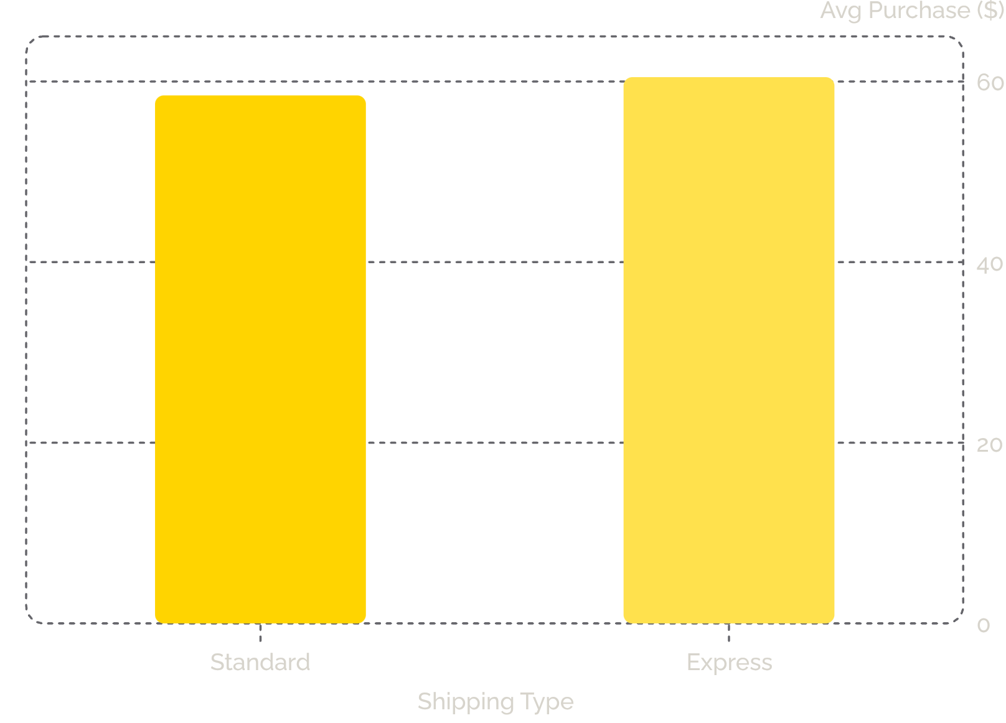
Shipping & Subscription Analysis
Subscribers vs Non-Subscribers
Status
Customers
Revenue
Yes
1,053
$62,645
No
2,847
$170,436
Repeat buyers (>5 purchases): 958 subscribers vs 2,518 non-subscribers

Slide 7
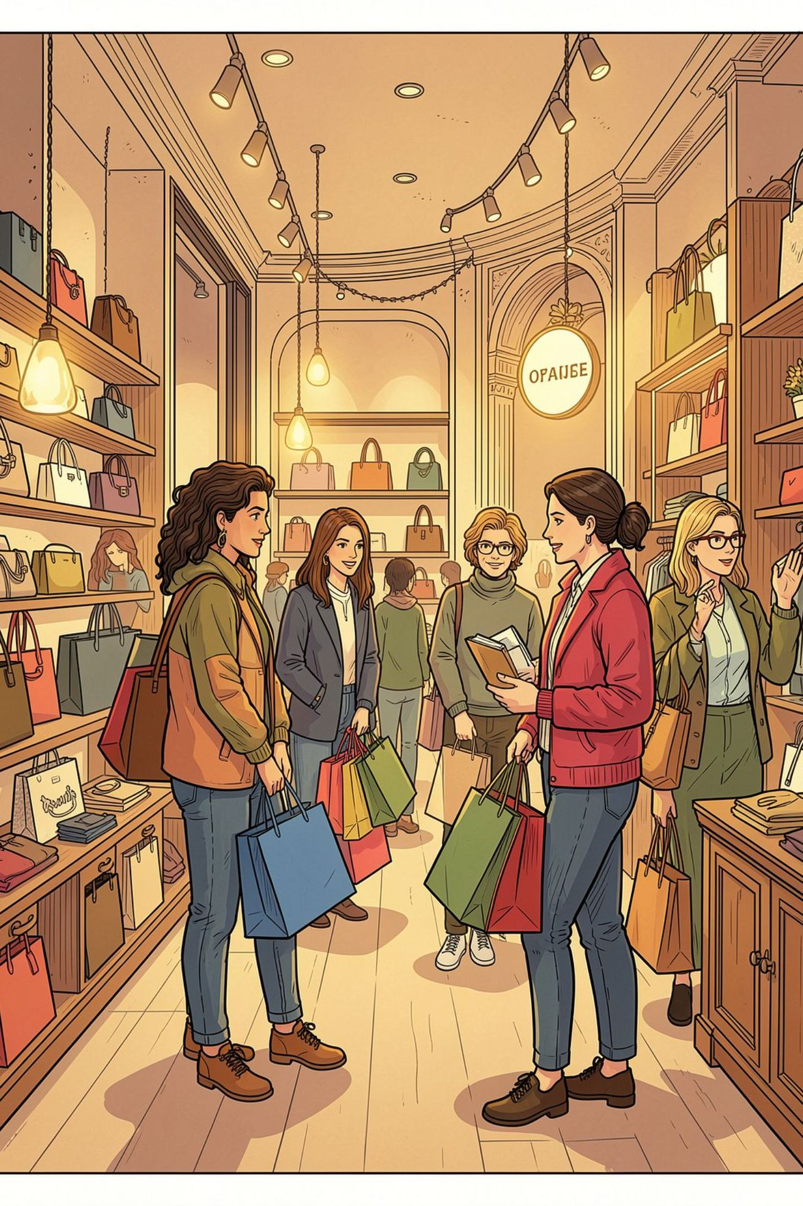
Customer Segmentation
🏆 Loyal
🔄 Returning
3,116 customers — the dominant segment
701 customers — growth opportunity
🆕 New
83 customers — smallest segment

Slide 8
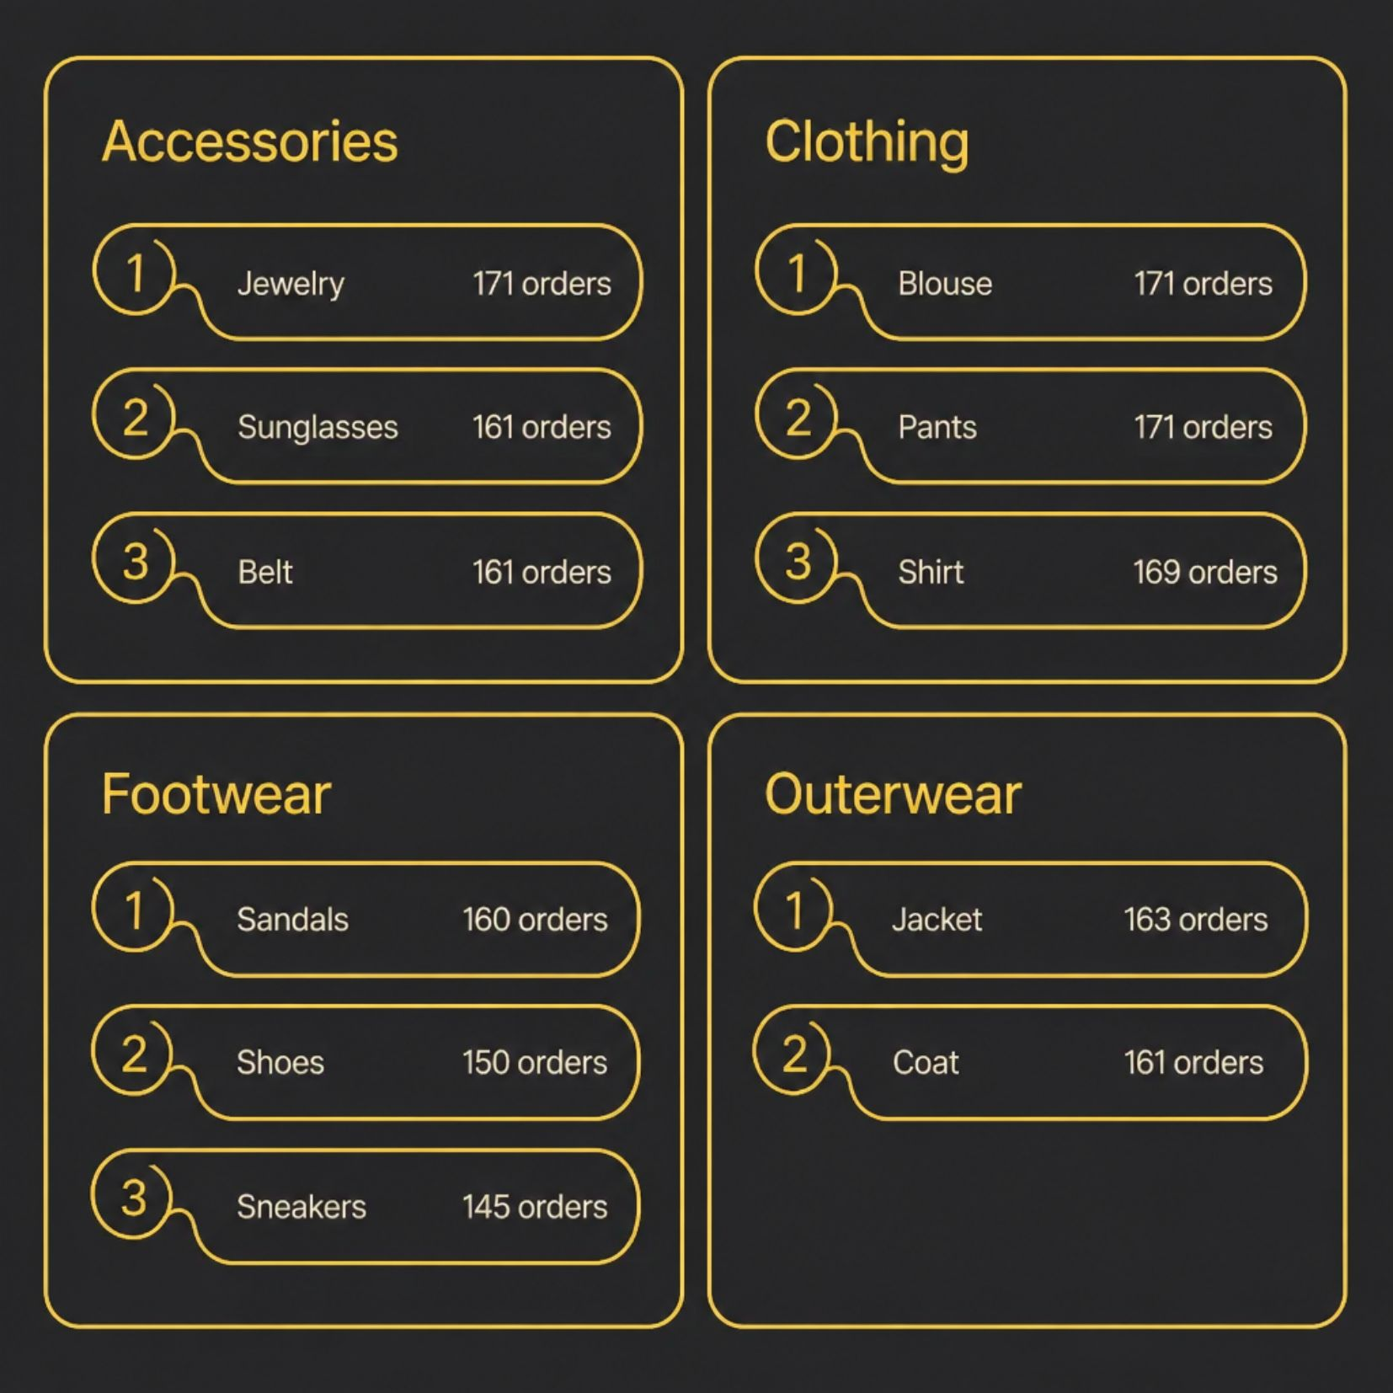
Top Products by Category
Category Leaders
Clothing — Blouse, Pants, Shirt lead orders
Outerwear — Jacket & Coat top sellers
Footwear — Sandals most purchased
Accessories — Jewelry leads the category

Slide 9
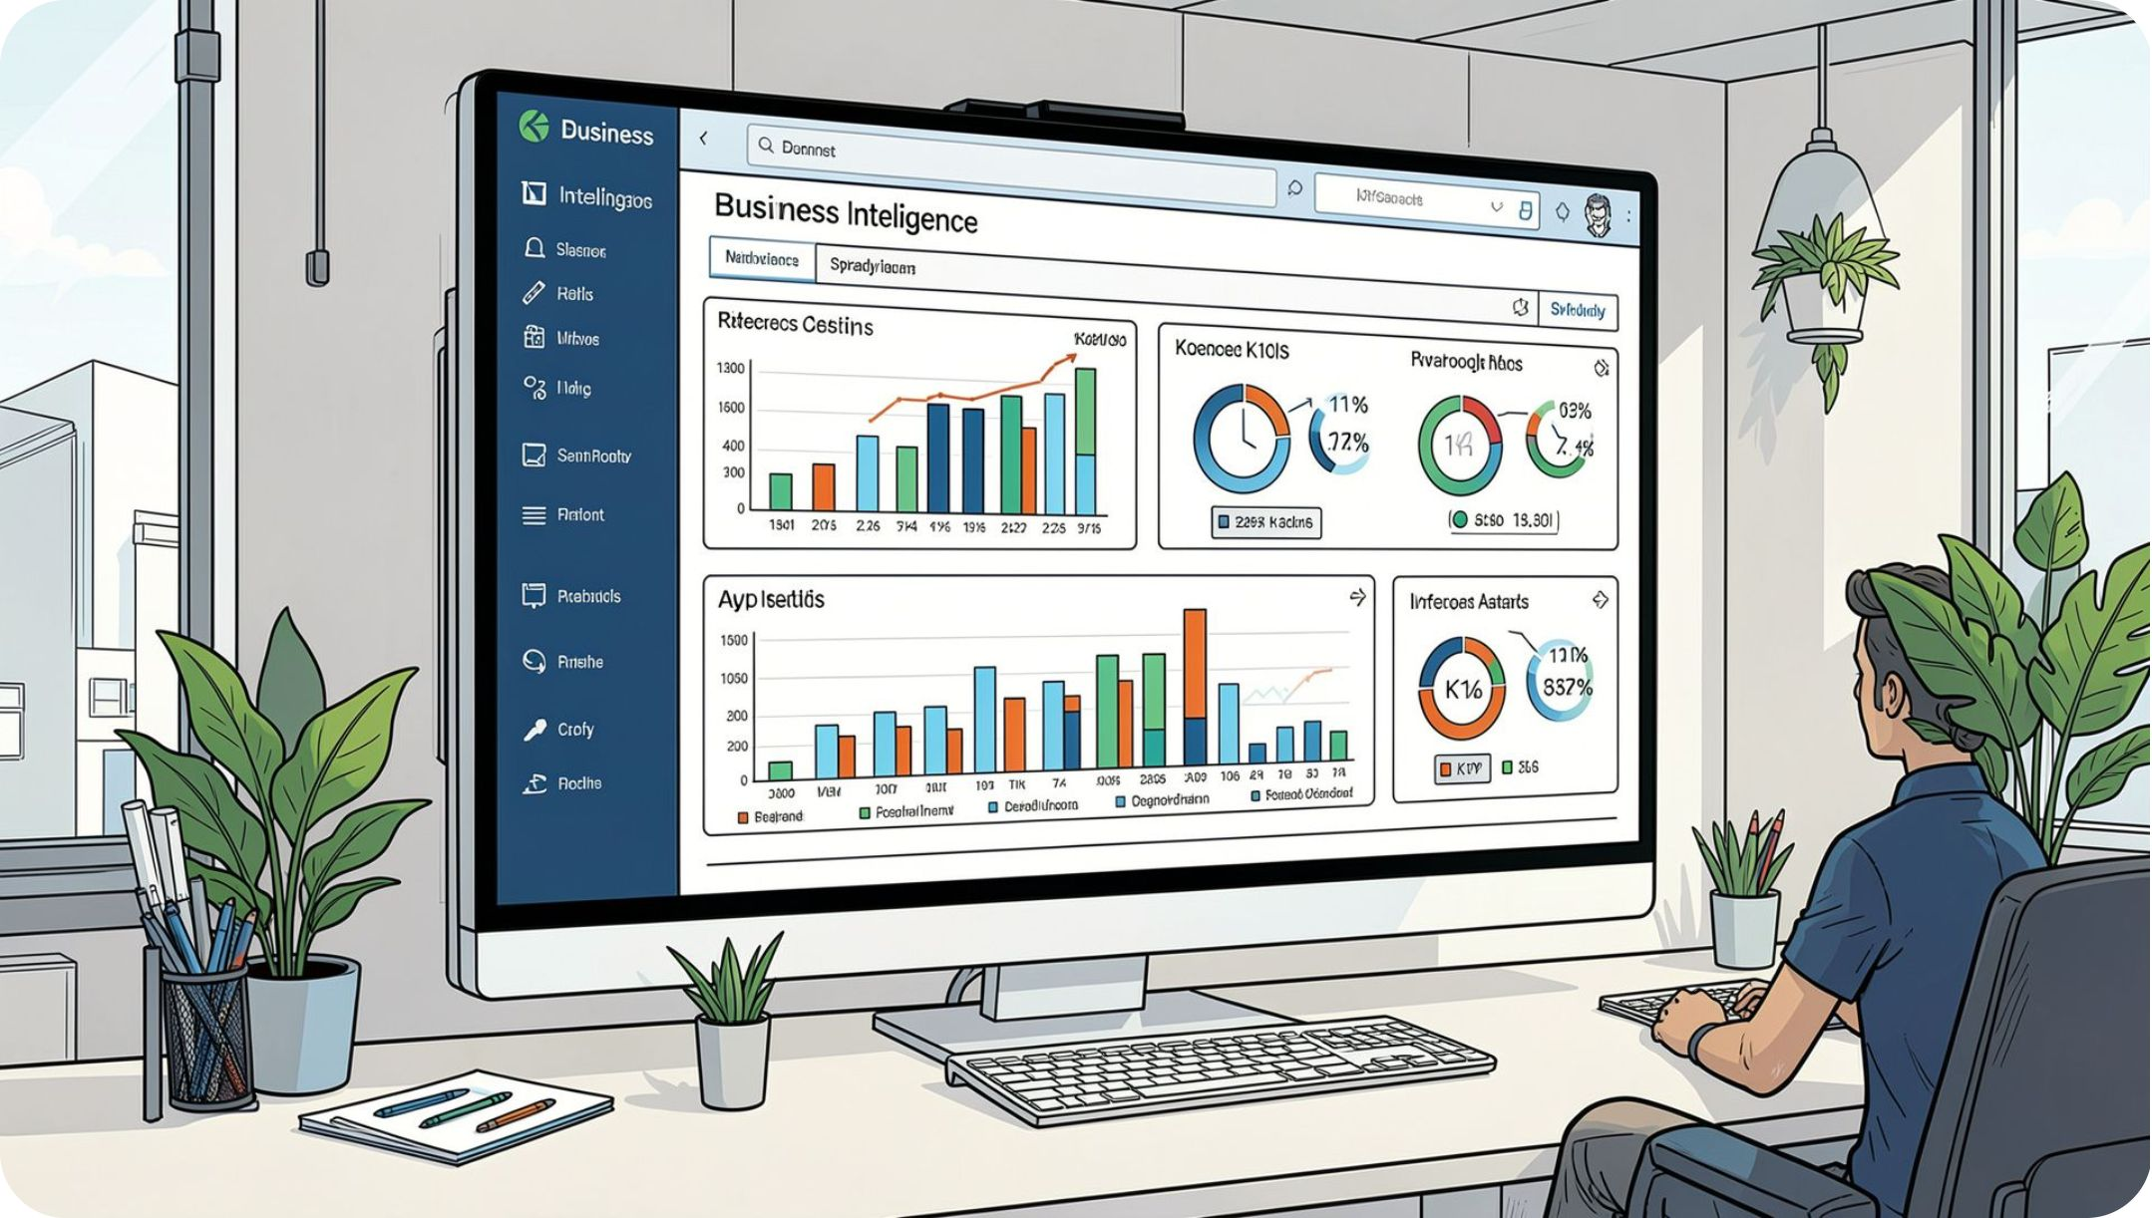
Power BI Dashboard
Dashboard Highlights
3.9K Customers
Avg purchase $59.76 · Rating 3.75
73% Non-Subscribers
Only 27% hold subscriptions
Clothing Dominates
Top category for revenue & sales
Young Adults Lead
Highest revenue & sales by age group

Slide 10
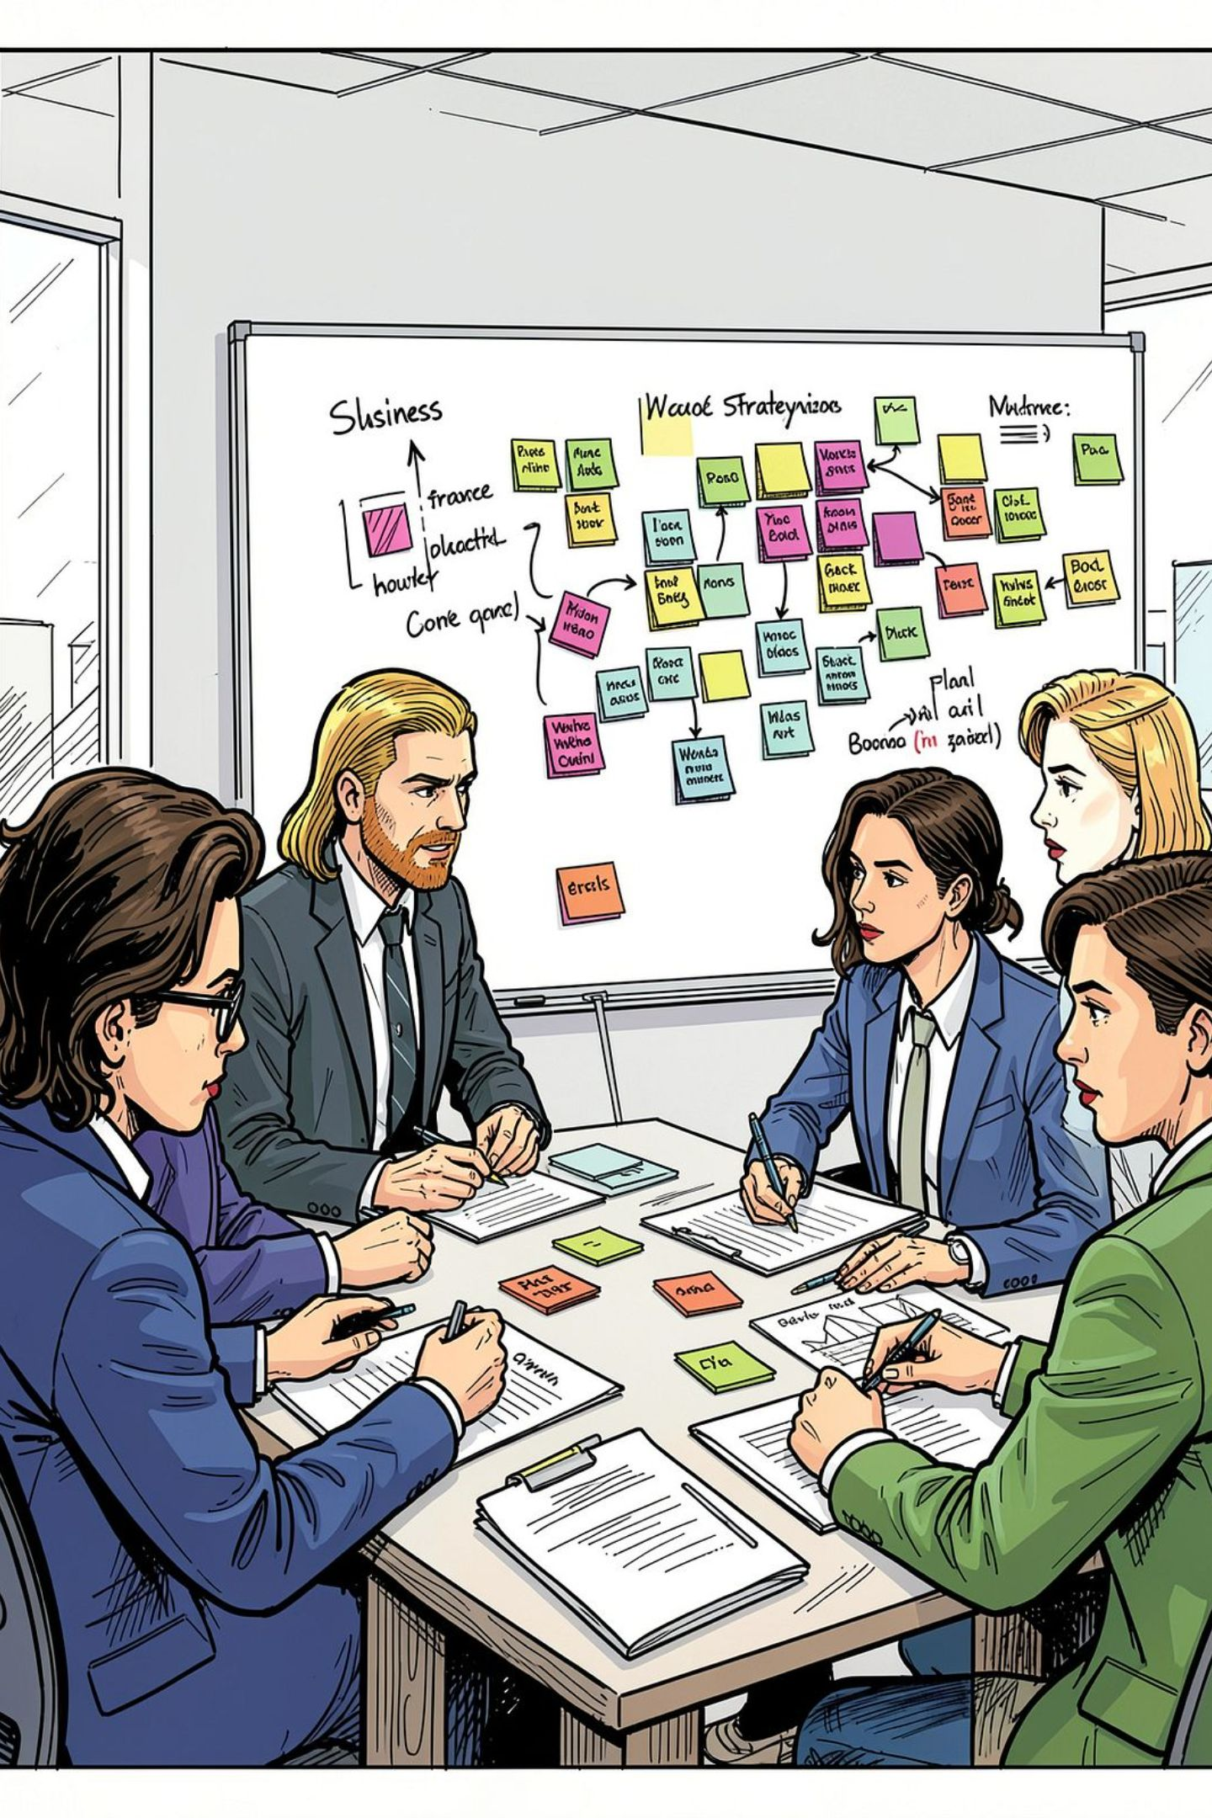

Business Recommendations
Boost Subscriptions
Promote exclusive subscriber benefits
Loyalty Programs
Reward repeat buyers → Loyal segment
Review Discount Policy
Balance sales lift with margin control
Targeted Marketing
Focus on Young Adults & Express shipping users

