Slide 1
Remodeling the Inventory Management System Of the Organization: Using Cloud based Solution
By
.Shivani(S20241662)
Unit – IT Project Management (ICT504)
Instructor’s Name – Dr. Azadeh R. Tabesh

Slide 2
agenda
Introduction
Problems Identification And Solutions
Project Proposal
Implementation Testing And Deployment
Conclusion

Slide 3
Introduction
The organization which is taken under consideration is a retail company which is specialize in selling Electronic items, home appliances including(furniture and kitchenware as well). It has a diverse sale locations and also does online business, due to this the organization manages a multiple inventory of sales/products.

Slide 4
Limitations
Manual Data Entry - Manual processes are prone to errors and lack real-time visibility. Modern systems ensure accuracy, provide instant stock insights, and give you complete control over your inventory across all locations.
Lack of Real-time Visibility - Because people have to type in all the information about the inventory, it's hard to know exactly how much stock there is at any given time. This makes it difficult for managers to make good decisions.
Not Efficient Processes - Manual data inventory tracking is a time suck, requiring significant manpower. This inefficiency doubles the problem: increased labor costs and decreased operational productivity. Moreover, manual processes are error-prone, which can lead to inaccurate inventory management.
Limited Scalability – The current IT system can’t support the business growth due to limited scalability. When the business expand this system can’t handle the increased volume of transactions.

Slide 5
Solutions
Inventory Management with Automation – By implementing the Inventory management system with automated data capture technologies like barcode scanners and RFID can significantly reduce the need for manual data entry. When a customer makes a purchase, the barcode is scanned, instantly identifying the item, retrieving its price, and recording the entire transaction. This provides us with a real-time record of all sales.
Scalable Solution – By selecting a scalable solution we can actually grow the business. Like, the cloud-based technology gives the flexibility to accommodate changing business requirements and growing business as well.
Cloud-Based Inventory Management System – By applying a cloud-based system business can manage the data across multiple locations. They also can access data from any location with the use of internet connection.
Using Automation Process – The new IT system will use the automation process for updating data like: restocking, order fulfillment, and reports. This will give less errors and minimize the manual intervention

Slide 6
Project proposal
I propose the implementation of remodeling the inventory management system for resolving these challenges. Here, are the key components of the projects:
Scope – The scope of the project is to build a Scalable Cloud Solution for Inventory Management which includes design, development and implementation phase. It will give the advantages like automatically tracking the inventory processes, provide real-time visibility into stock levels, support scalability for future growth.
Objectives –
Leverage automated data capture (barcode scanning, RFID) for unmatched accuracy, preventing stock-outs and ensuring customer satisfaction.
Improve operational efficiency through the automation of inventory replenishment procedures and the optimization of warehouse configurations.

Slide 7
Deliverables Milestones
This project will deliver a functional cloud-based inventory management system which will be deployed in production environment.
Gathering requirements/User documentation and training material.
Post-Launch support
services.
Solid Foundation(2 Month): Requirements gathering and analysis complete, ensuring a system designed to meet your specific needs
Building for Success(1 Month): Finalization of system design and development, laying the groundwork for a powerful solution.
Rigorous Testing(2 Month): Successful testing and quality assurance, guaranteeing a reliable and error-free system.
Seamless Launch(1 Month): Deployment of the new system, transitioning smoothly into your operations.
Empowered Users: Comprehensive user training and transition to live operations, ensuring user confidence and efficient workflows.
Continued Optimization: Ongoing support and optimization, maximizing the value of your investment.

Slide 8
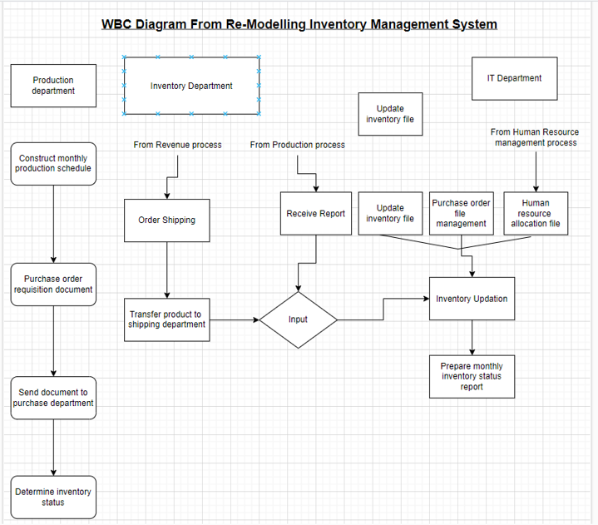
WBS(Work break down structure)
The key things about WBS – It’s a Tree-Like Structure, Provides Clarity, “Deliverable-Oriented

Slide 9
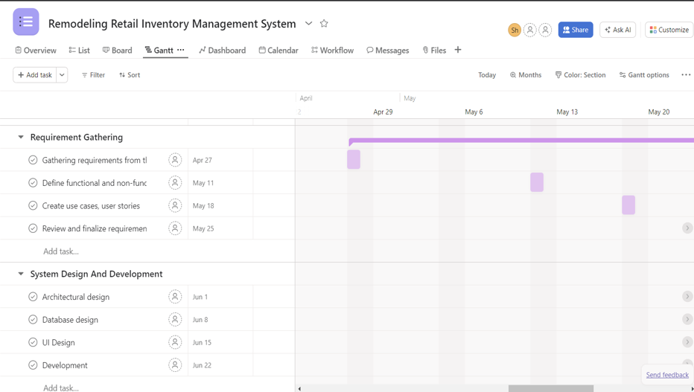
Gantt Chart
It’s a popular tool used to show all the tasks of project in graph like structure giving us a clear view of what needs to happen and when.

Slide 10
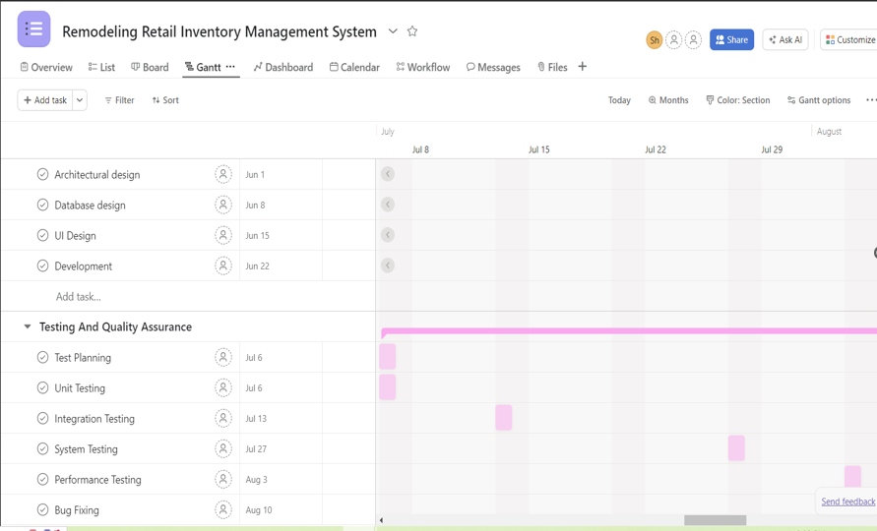

Slide 11
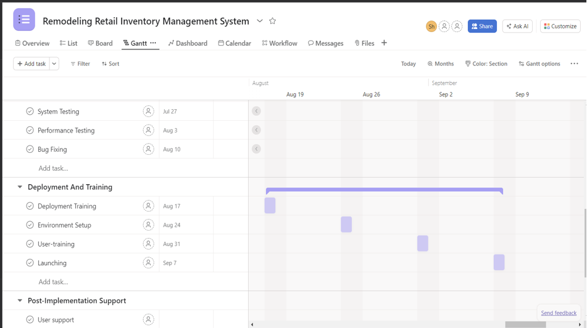

Slide 12
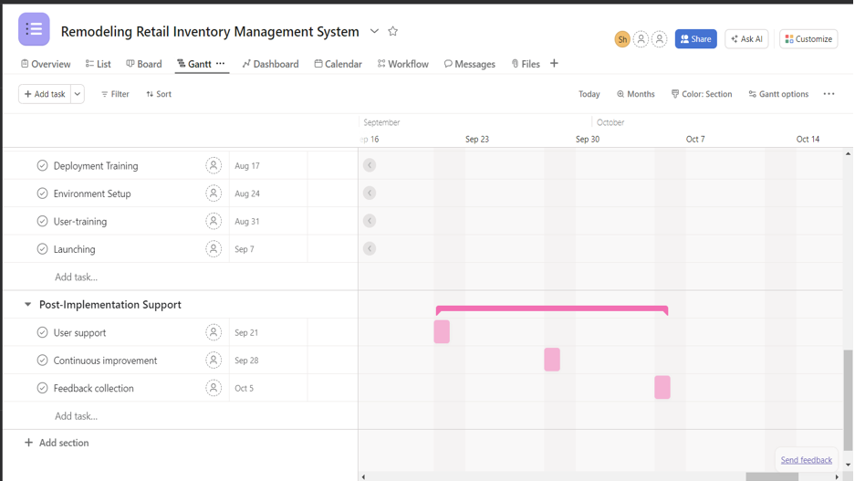

Slide 13
Implementation, Testing and deployment
Building the Blueprint: We'll collaboratively craft a detailed plan for the new system, meticulously outlining the system's architecture to ensure scalability and performance. The database design will be optimized for efficient data storage, retrieval, and analysis, empowering you to generate insightful reports and make data-driven decisions. Furthermore, the user interface will be designed with user experience in mind, prioritizing intuitive navigation, clear functionality, and ease of use. This user-centric approach ensures that your team can quickly adapt to the new system and leverage its full potential.
Bringing Your Vision to Life: Our development team will meticulously implement the system based on the plan, ensuring seamless integration with existing systems and a robust infrastructure.
Unified Ecosystem: For a holistic view of your operations, we'll ensure flawless integration with your ERP, CRM, or accounting software, guaranteeing smooth data flow.
User Confidence from Day One: Comprehensive user training will be provided, empowering your team to confidently navigate the new system and maximize its efficiency.

Slide 14
Testing
Solid Foundations: Through meticulous unit testing of individual system components, we'll ensure they function flawlessly, laying a solid foundation for a reliable and robust system.
Seamless Collaboration: Integration testing will verify that all modules work together in perfect harmony, guaranteeing a smooth and efficient user experience.
Putting it All Together: Comprehensive system testing will validate the entire system's functionality, performance, and security, ensuring it meets the highest standards and delivers exceptional results.
Real-World Validation: User Acceptance Testing (UAT) empowers your team to test the system in a real-world environment, mimicking their everyday workflows. This hands-on approach allows them to validate the system meets their needs and expectations, fostering user confidence and ensuring a smooth transition.

Slide 15
deployment
Strategic Rollout: We'll develop a meticulous deployment plan outlining the rollout strategy, including clear timelines and effective user communication. This plan will also detail potential fallback options to ensure we're prepared for any unforeseen circumstances, minimizing disruption and maximizing user confidence.
Real-World Validation: A pilot test involving a small group of users or a designated test environment will validate the system's performance in a real-world setting. This pilot allows us to gather valuable feedback from early adopters, refine the system if needed, and ensure a smooth full deployment.
Confident System Launch: Following the successful pilot, we'll execute a comprehensive roll-out of the system to all users or locations according to the deployment plan. This phased approach allows for controlled implementation and minimizes disruption to daily operations.
Empowering Your Team: We'll provide additional training sessions as needed to ensure users remain confident and proficient in utilizing the new system's full potential. Furthermore, we'll keep documentation updated to reflect any system changes or new functionalities, empowering your team for long-term success.

Slide 16
conclusion
In conclusion, the modernization of our inventory management system stands as a pivotal step towards transforming our operational landscape. By embracing innovative technologies and streamlined processes, we have successfully overcome the limitations of our previous system, paving the way for enhanced efficiency, accuracy, and scalability. This strategic initiative not only strengthens our internal operations but also positions us to better serve our customers and adapt to the ever-changing demands of the market.

Slide 17
Thank you
.Shivani(S20241662)
+61432809137

