Slide 1
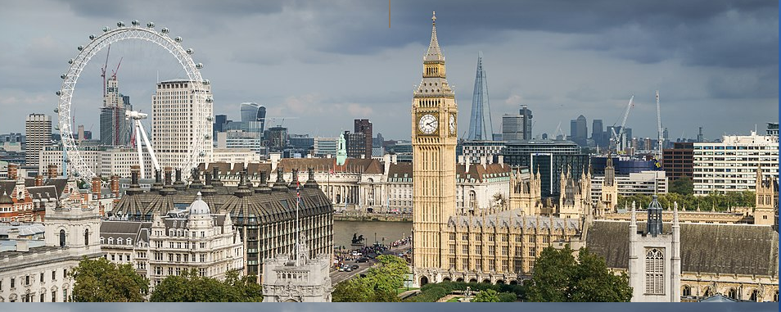
Capstone Project - The Battle of Neighborhoods 2
Predicting some good locations for a restaurant business in London

Slide 2
Introduction : Business Problem
Opening up a restaurant is an entrepreneur’s dream or passion. To share the joy with patrons who end up relishing the ambiance, food and services is fulfillment of its own. However, only the owner knows what all efforts they have put in before opening up a restaurant. Developing and executing a solid business strategy for the restaurant is extremely important in order to make the business successful.

Slide 3
What do we need to Predict ?
This project is for who is planning to open a Restaurant in London, UK. It suggests the best locations for a restaurant in London. To make it quite difference, we will predict some cuisines along with the location.
This report explores which location of London have the most as well as the best restaurants.
Also, this project answers the questions “Where should I open a restaurant?” and “What should be the cuisines or theme ?” to make it more precise such as coffee house, Bakery, Bar & Restaurant, Family Restaurant, snacks corner and many more.

Slide 4
What are the requirements to make this happen ?
Data & Its sources - The first thing you need to do is put a system in place for collecting area data through every channel possible. This should includes List of areas of London -
https://en.wikipedia.org/wiki/List_of_areas_of_London or
https://en.wikipedia.org/wiki/List_of_London_boroughs
https://en.wikipedia.org/wiki/Wikipedia:WikiProject_London
https://foursquare.com/holden_cfield/list/london-restaurants
as long as you’re collecting data, you’re on the right path.

Slide 5
Methodology
Project Characteristics Quadrants by Goal and Solution Uncertainty —
Linear Strategy:
A linear strategy consist in sequential phases with no feedback loops. The project solution is not released until the final phase is reached. This strategy is characterized by clearly defined goal solution and requirements, zero or few change request of the scope, routine and repetitive process inside the project, use of pre-established formulas and templates.

Slide 6
Incremental Strategy & Iterative Strategy (e.g. Scrum or Feature-Driven Development)
Similar to incremental strategy but consistent of a number of repeated phases. This strategy includes a feedback loop after a group of phases is completed. The loop stops when customer is satisfied, that is the strategy uses several intermediate solutions as a pathway to discover how the final solution should be.
Adaptive Strategy (e.g. Adaptive Project Framework or Adaptive Software Development)
An iteration may create a partial solution to the customer. This strategy is adaptive because the final solution is only partially known by the customer, so the success depend on the ability to allocate frequent changes. Here planning is done in just-in-time manner.

Slide 7
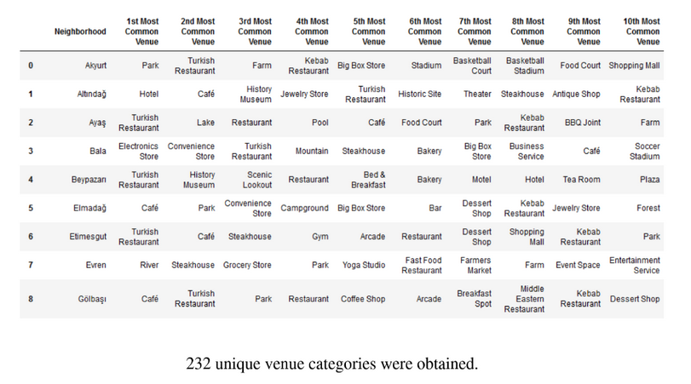
Exploratory Data Analysis

Slide 8
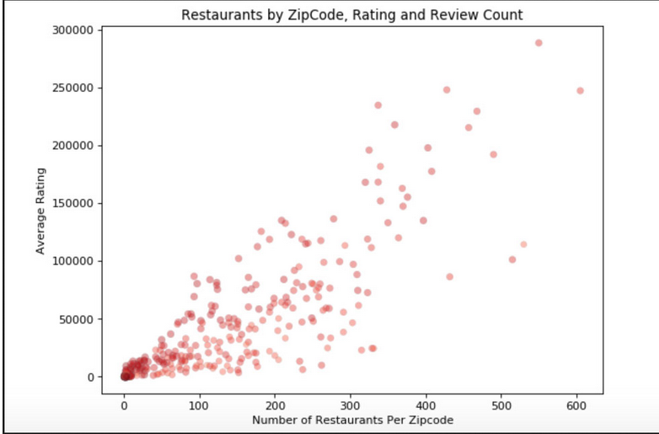
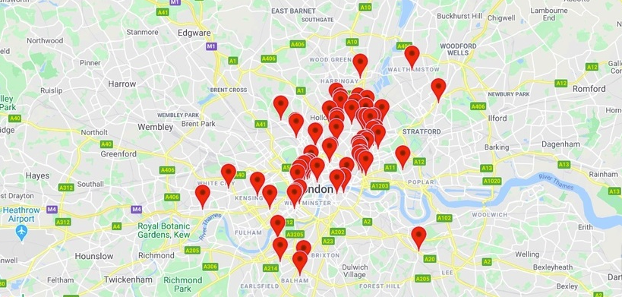
Data Visualization

Slide 9
Observations & Results
Now, deciding when and where to open new restaurants is largely a subjective process based on the personal judgement and experience of development teams. This subjective data is difficult to accurately extrapolate across geographies and cultures. new restaurant sites take large investments of time and capital to get up and running. When the wrong location for a restaurant brand is chosen, the site closes within 18 months and operating losses are incurred.
Finding a mathematical model to increase the effectiveness of investments in new restaurant sites would allow TFI to invest more in other important business areas, like sustainability, innovation, and training for new employees. Using demographic, real estate, and commercial data, this competition challenges you to predict the annual restaurant sales of 100,000 regional locations.
Python Folium library was used to visualize map of Ankara and its districts. In order to get Latitude and Longitudes of Ankara, geopy and geocoder are used. The map below was obtained.
In order to explore and categorize places Foursquare API was used. Limit was set to 100 and Radius was set to 500. Here is a head of the list Venues name, category, latitude and longitude information from Forsquare API. 15 venues are returned.
There are common venues in districts, so unsupervised K-means algorithm was used to cluster districts. K-Means cluster was set to 3 clusters, to reach optimum accuracy.
Cluster 0: “Cafe” and “Plaza”
Cluster 1: “Café” “Restaurant” and “Park”
Cluster 2: “Turkish Restaurant” and “Bistro
Master data which includes “District”, “Latitude” and “Longitude” information of Ankara.
Master data which includes “District”, “Latitude” and “Longitude” information of Ankara.

Slide 10
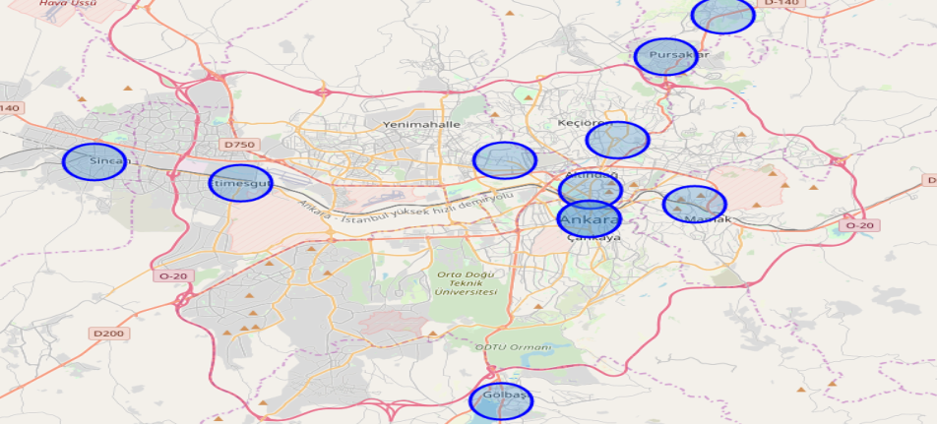
Result

Slide 11
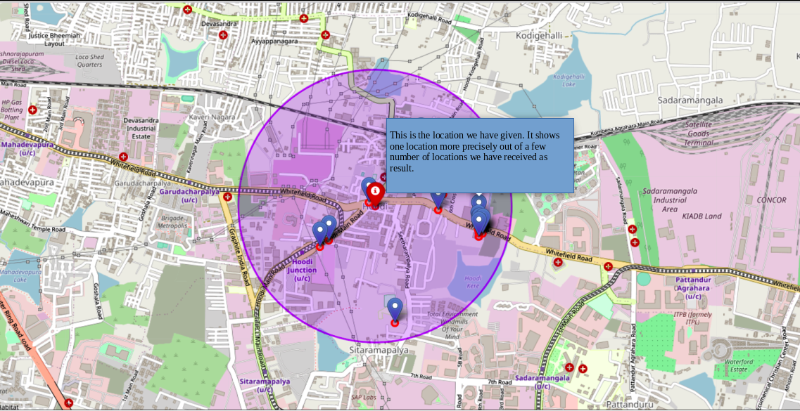
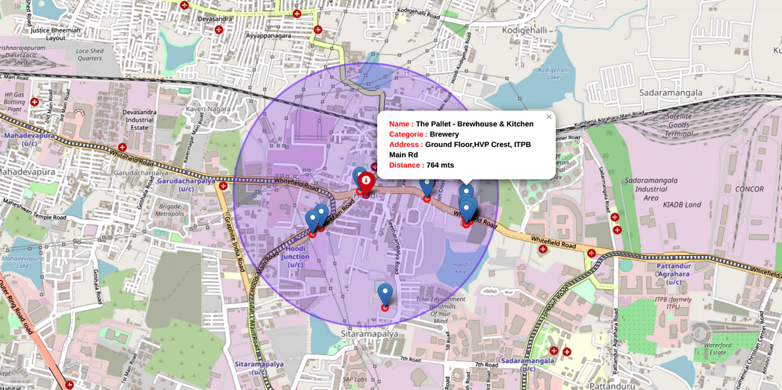
Result

Slide 12
Discussion & Conclusion
Kmeans algorithm was used as part of this clustering study. K value was set to 3. For more detailed and accurate guidance, the data set can be expanded, and the details of the neighbourhood or street can also be drilled.
It is obvious that Cluster 1 is the most viable clusters to open a restaurant. Especially Cluster 1 locations which have most common venues not Café such as Ayaş and Akyurt.

Slide 13

Thank You

Slide 14
Master data which includes “District”, “Latitude” and “Longitude” information of Ankara.
Python Folium library was used to visualize map of Ankara and its districts. In order to get Latitude and Longitudes of Ankara, geopy and geocoder are used. The map below was obtained.
In order to explore and categorize places Foursquare API was used. Limit was set to 100 and Radius was set to 500. Here is a head of the list Venues name, category, latitude and longitude information from Forsquare API. 15 venues are returned.

Slide 15
There are common venues in districts, so unsupervised K-means algorithm was used to cluster districts. K-Means cluster was set to 3 clusters, to reach optimum accuracy.
Cluster 0: “Cafe” and “Plaza”
Cluster 1: “Café” “Restaurant” and “Park”
Cluster 2: “Restaurant” and “Bistro”

