Slide 1
IBM University Engagement Project Submission
“Exploring the Power of Agentic AI with IBM Granite and LangFlow”

Slide 2

Project Tile – AI Agent for Smart Farming Advice
Domain of Project – Agriculture
Student Name | Recent Passport Photo | Email ID | Mobile number [WhatsApp]
Kumari Shivani Verma |  | shivaniv1402@gmail.com | 9472503021

Slide 3
Problem Statement -
Problem Statement : AI Agent for Smart Farming Advice
The Challenge
Small-scale farmers struggle with crop selection, pest control, irrigation timing, and fair market prices. Farming information is scattered across many sources and mostly in English. Without localized, real-time guidance in their own language, farmers face higher risk, lower yields, and reduced income.
The Objective
Build an AI-powered Smart Farming Agent using RAG and IBM Granite that delivers personalized, data-driven farming advice to farmers and agricultural advisors. The solution should:
Crop Recommendations – Suggest crops based on season, location, and soil.
Agri Data RAG Retrieval – Summarize crop practices, soil care, and government schemes from trusted sources.
Weather Advisory – Turn local forecasts into actions like when to irrigate or spray.
Pest & Disease Management – Suggest organic and chemical control measures.
Market Price Intelligence – Show live mandi prices (min, max, modal).
Multilingual Support – Answer in 10 Indian languages.
Multi-Agent System
Agri Knowledge Agent (RAG data retrieval)
Crop Recommendation Agent (season-based advice)
Weather Advisory Agent (forecast-based actions)
Pest & Soil Health Agent (diagnosis and prevention)
Market Price Agent (mandi rates)
Interactive Dashboard – Weather, prices, sources, and confidence scores in one place.

Slide 4
Proposed Solution -
Proposed Solution: AI-Powered Smart Farming Agent
The proposed solution is a multi-agent AI-powered Smart Farming Agent built using IBM watsonx.ai, Granite Models, and LangChain to give small-scale farmers personalized, real-time agricultural guidance in their own language. The system addresses challenges in crop selection, pest control, irrigation timing, and market price discovery through an intelligent, modular architecture.At its core, the solution uses a Retrieval-Augmented Generation (RAG) pipeline to fetch accurate farming knowledge on crop practices, soil health, pest management, and government schemes. This data is embedded using sentence embeddings and stored in a ChromaDB vector database, so the system can retrieve and summarize relevant information using Granite models.
The system consists of five key agents:
Agri Knowledge Agent retrieves and summarizes crop, soil, and scheme information using RAG.
Crop Recommendation Agent generates season- and location-based crop advice.
Weather Advisory Agent converts live Open-Meteo forecasts (rainfall, temperature, wind, humidity) into practical actions such as when to irrigate or spray.
Pest & Soil Health Agent identifies likely pests and diseases from farmer descriptions and suggests organic and chemical control measures.
Market Price Agent fetches current mandi prices (min, max, modal) from Agmarknet / data.gov.in to guide selling decisions.
The solution includes a user-friendly Streamlit dashboard that shows live weather, mandi prices, quick questions, source references, and confidence scores, with support for 10 Indian languages (Hindi, Marathi, Telugu, Tamil, Kannada, Gujarati, Punjabi, Bengali, Odia, and English).
Each query is classified by category and routed to the right agent, while Granite models power reasoning, summarization, and personalization. Overall, this solution delivers an end-to-end intelligent farming assistant that reduces risk, increases yield, and boosts farmer income through localized, data-driven recommendations.

Slide 5
Technology Used
LangChain framework – For building the RAG pipeline, prompt templates, and orchestrating the multi-agent workflow.
IBM Granite model – for eg – ibm/granite-4-h-small – For natural language understanding, reasoning, and generating personalized farming advice.
IBM Cloud – It provides the infrastructure to build, deploy, and scale the Smart Farming Agent efficiently. IBM Cloud Lite enables a reliable, secure, and scalable environment for hosting the AI services.
RAG – RAG to fetch real agricultural data first, then generate intelligent answers, making the Smart Farming Agent more trustworthy and effective.
IBM watsonx.ai – For Granite model deployment, text generation, and AI governance.
Vector Database (ChromaDB) – For storing sentence embeddings and RAG-based retrieval of crop, soil, pest, and scheme knowledge.
Open-Meteo API – For real-time weather and 7-day forecasts, including rainfall, temperature, wind, and humidity.
Agmarknet / data.gov.in API – For current mandi prices (min, max, modal) of crops.
Streamlit – For the interactive multilingual dashboard where farmers chat with the agent.
Deep Translator – For multilingual support across 10 Indian languages.

Slide 6
Langchain component Used -
1) Chat Input – Interface where farmers enter their queries, location, and preferred language (text input in 10 Indian languages).
2) IBM watsonx AI Agent – Classifies each query (weather, crop, pest, soil, market) and routes it to the right agent. It then uses Granite models to generate personalized farming advice.
3) Name of IBM Granite model – ibm/granite-4-h-small → Fast, efficient for real-time crop, pest, and weather recommendations.
4) Chat Output – Displays AI-generated responses such as crop advice, pest control measures, mandi price tables, 7-day forecasts, source references, and confidence scores.
5) Knowledge Base / Vector Store component – Stores and retrieves crop practices, soil health, pest management, and government scheme data as embeddings in ChromaDB for RAG retrieval.
6) Other components used:
RAG Retriever & Embeddings – Fetches the most relevant knowledge chunks before the answer is generated.
Weather API component – Open-Meteo for live weather and 7-day forecasts.
Market Price API component – Agmarknet / data.gov.in for current mandi prices.
Language Translation component – Deep Translator for multilingual responses.

Slide 7
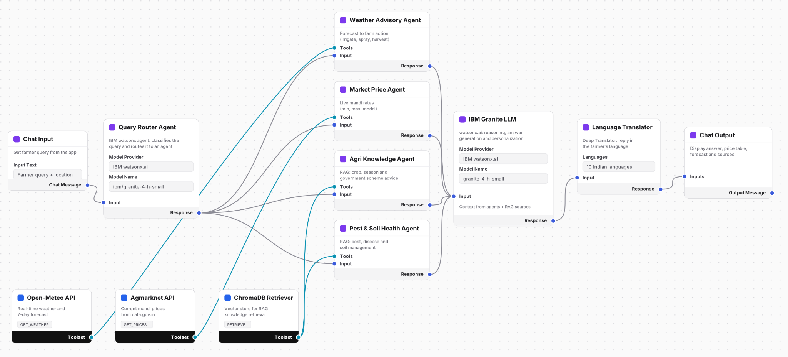
Langflow workflow -

Slide 8
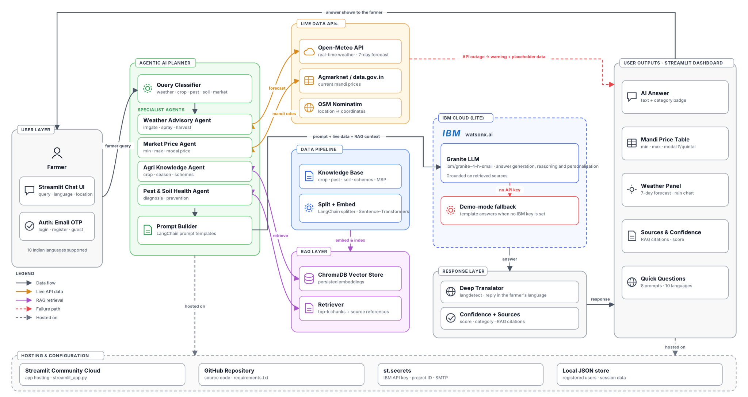
Architecture blueprint

Slide 9
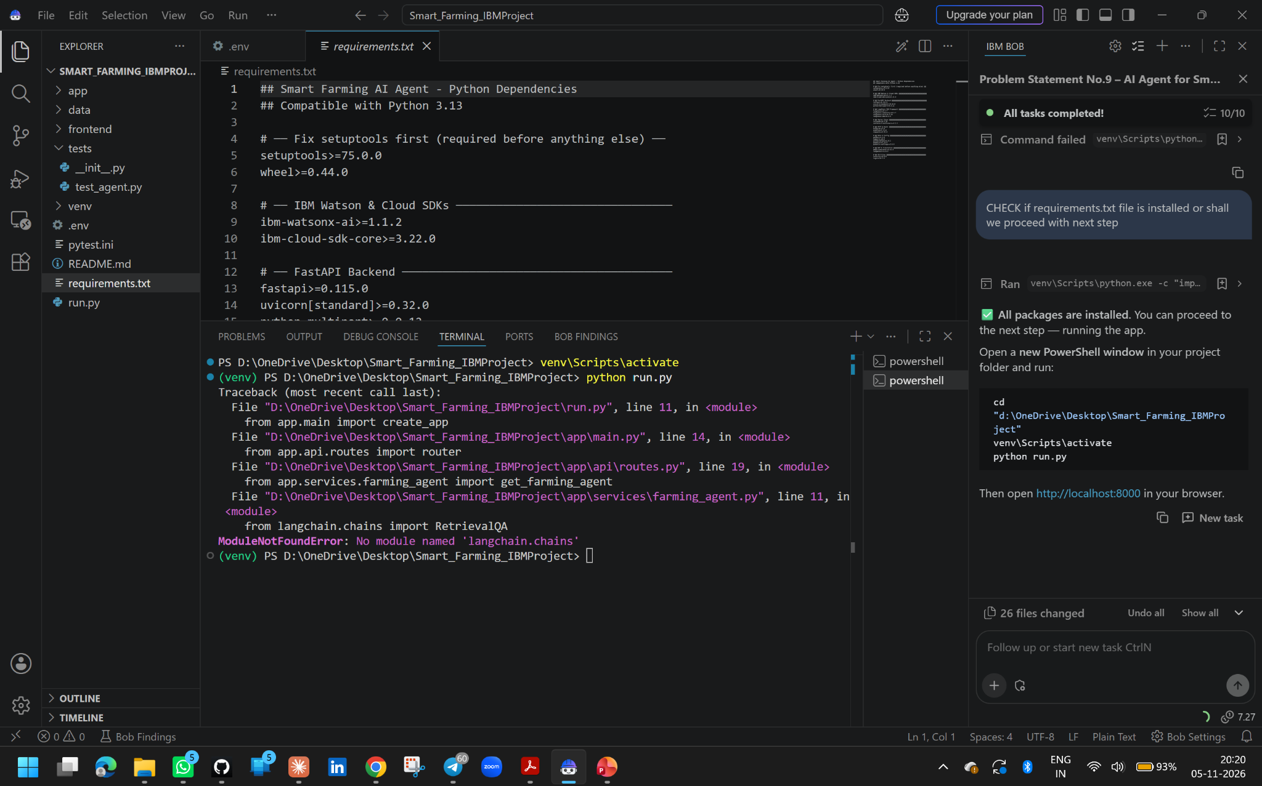

Slide 10
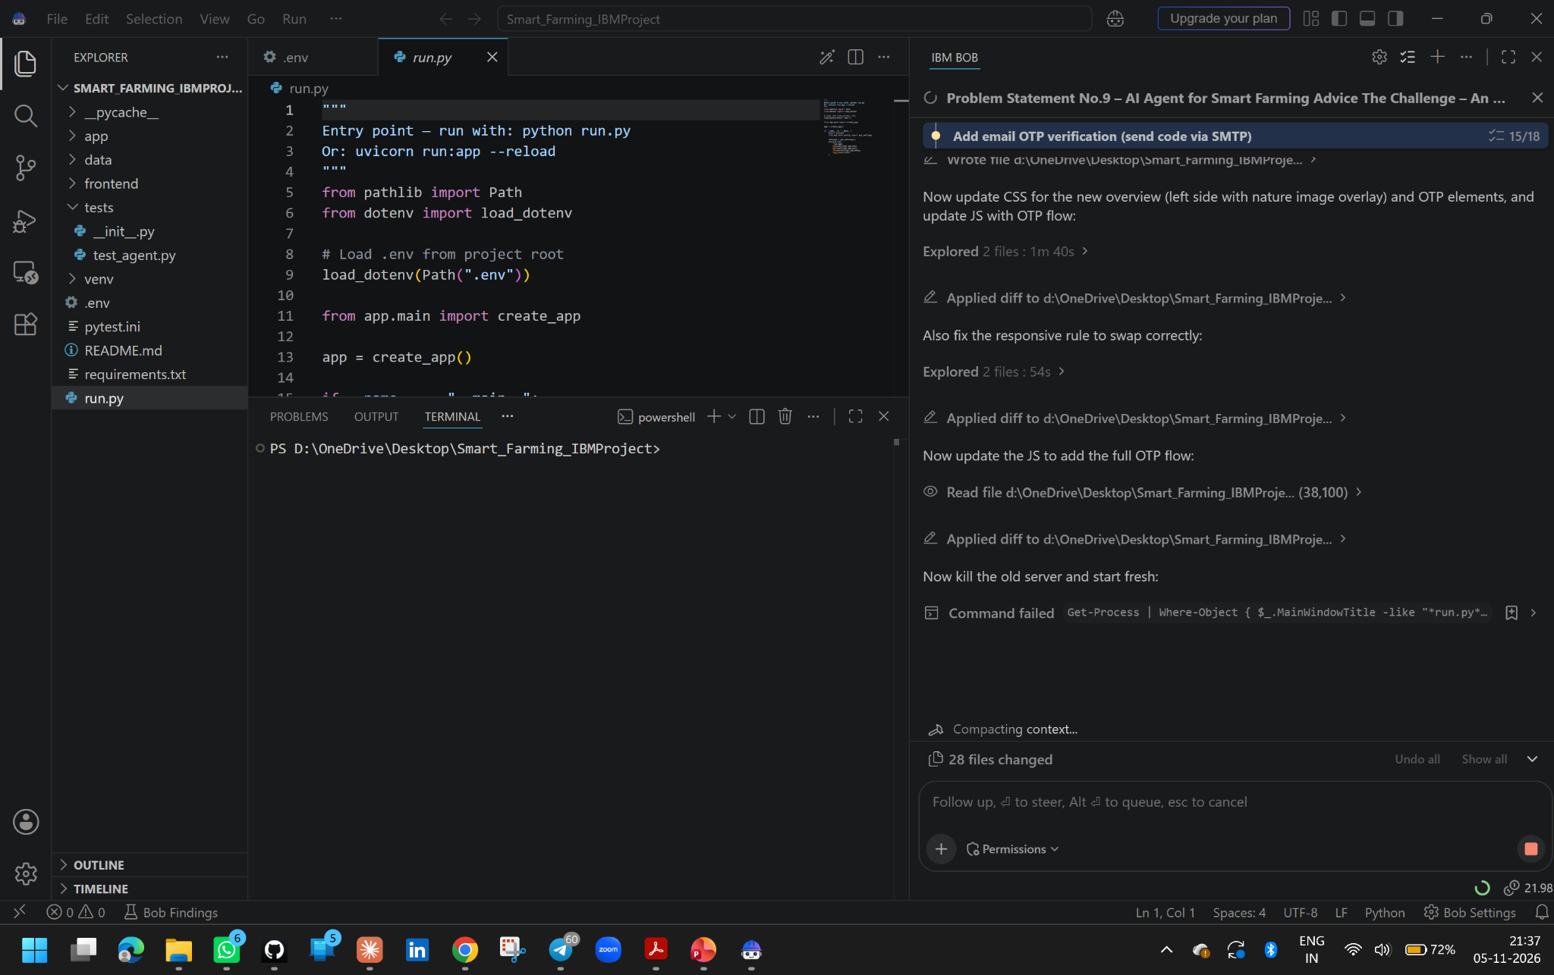

Slide 11

Role of Agentic AI in the solution
Role of Agentic AI in the Smart Farming Agent
Agentic AI enables the Smart Farming Agent to function as an intelligent, autonomous system rather than a simple chatbot. Using IBM watsonx.ai and IBM Granite models, it coordinates multiple specialized agents to deliver personalized farming guidance.
Each agent performs a specific role, such as fetching live weather, retrieving mandi prices, searching crop and pest knowledge, and diagnosing soil and plant problems, while working collaboratively. This multi-agent approach ensures efficient task execution and accurate results.
Agentic AI also brings context awareness, understanding details like the farmer’s location, season, crop, and language to generate tailored recommendations. It supports real-time adaptation, continuously updating advice based on live weather forecasts and current market prices. Additionally, a query classifier routes each question to the right agent, and the agents’ outputs are combined into one grounded answer with sources and a confidence score.
Overall, Agentic AI makes the system proactive, localized, and goal-driven, acting like a smart digital agronomist that helps farmers reduce risk, increase yield, and boost income.

Slide 12
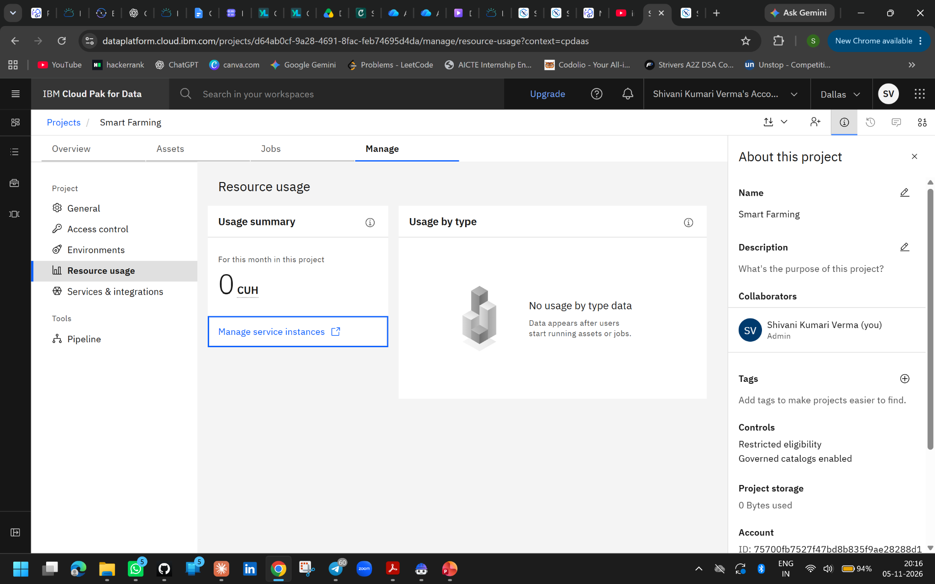
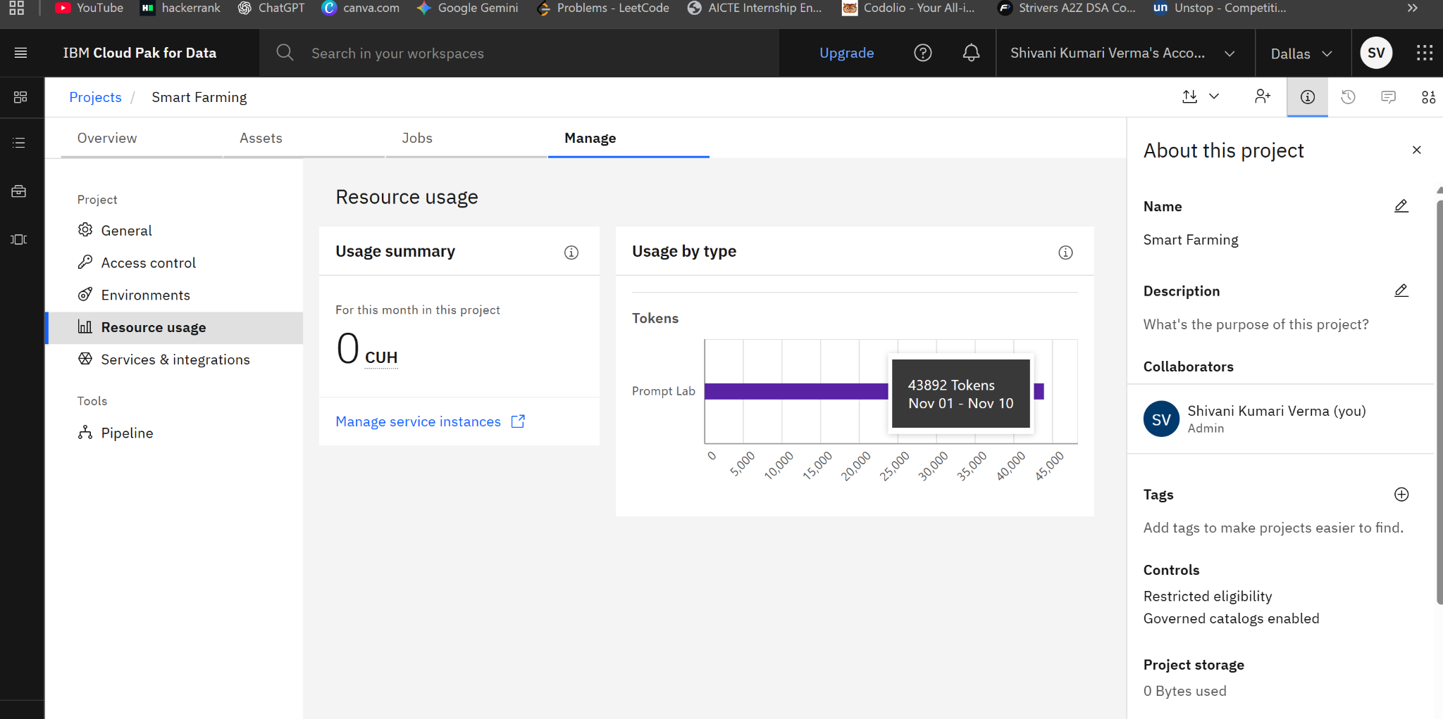
Token Usage
43,892 token are used
Before Prompt
After the Prompt
·
·

Slide 13
Novelty and Uniqueness
The proposed Smart Farming Agent stands out by combining Agentic AI, RAG, live data, and multilingual access into a single intelligent system built for small-scale farmers.
Multi-Agent Intelligence – Instead of a single chatbot, specialized agents for weather, market prices, crop knowledge, and pest and soil health collaborate to deliver accurate, context-aware farming guidance.
RAG-Based Accuracy – Integrates trusted agricultural knowledge retrieval with AI generation, reducing misinformation and ensuring trustworthy, source-backed recommendations.
Real-Time Data Integration – Combines live Open-Meteo weather forecasts and current mandi prices, so advice reflects today’s conditions, not outdated information.
Multilingual Access – Farmers can ask questions and receive answers in 10 Indian languages, and the whole interface switches to their language.
Hyper-Localization – Tailors advice to the farmer’s exact location, season, crop, and local weather.
Transparent Answers – Every response shows its category, confidence score, and source references, so farmers can trust the advice.
Scalable & Enterprise-Ready – Built on IBM watsonx.ai with IBM Granite models, ensuring reliability, governance, and a demo-mode fallback when the model is unavailable.
This makes the solution a smart, adaptive, and proactive digital agronomist, not just a static information lookup tool.

Slide 14
Git Hub Link
GitHub Repo Link : https://github.com/Shivani-alt395/AI-Agent-for-Smart-Farming-Advice
StreamLit Link : https://ai-agent-for-smart-farming-advice-cfrruwxvrjkjtnffouhirj.streamlit.app/
·
·

Slide 15
Future Scope
1. Integration with IoT Sensors & Satellite Data –
The system can be integrated with low-cost field sensors (soil moisture, temperature, humidity) and satellite imagery to collect real-time data about crop and soil health. This will enable the Smart Farming Agent to provide more accurate and dynamic advice based on actual field conditions instead of general regional data.
2. AI-Powered Voice Assistant & Wider Language Support –
Enhancing the system with a voice-enabled assistant, including voice input and spoken replies, and support for more regional dialects will improve accessibility. Farmers can interact naturally in their preferred language, making the solution more inclusive and suitable for farmers with limited literacy or varied linguistic backgrounds.
3. Crop Disease Detection from Images –
Farmers can upload photos of affected leaves or plants, and the agent can identify diseases and pests using computer vision, then suggest suitable treatments.
4. Mobile App & Offline Access –
A lightweight mobile app, with SMS and WhatsApp alerts, can reach farmers with low internet connectivity and send timely weather and price notifications.

Slide 16
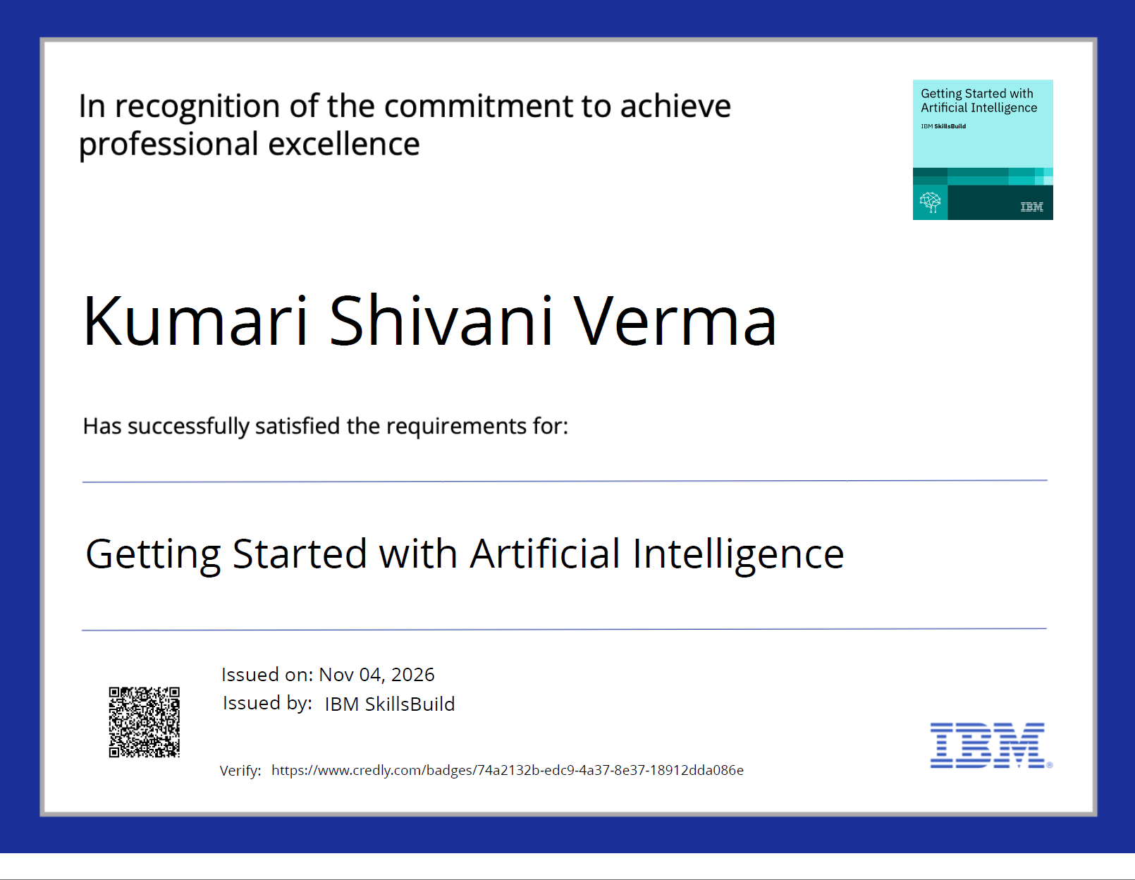
Certificates Earned:
Please add your credly certificate

Slide 17
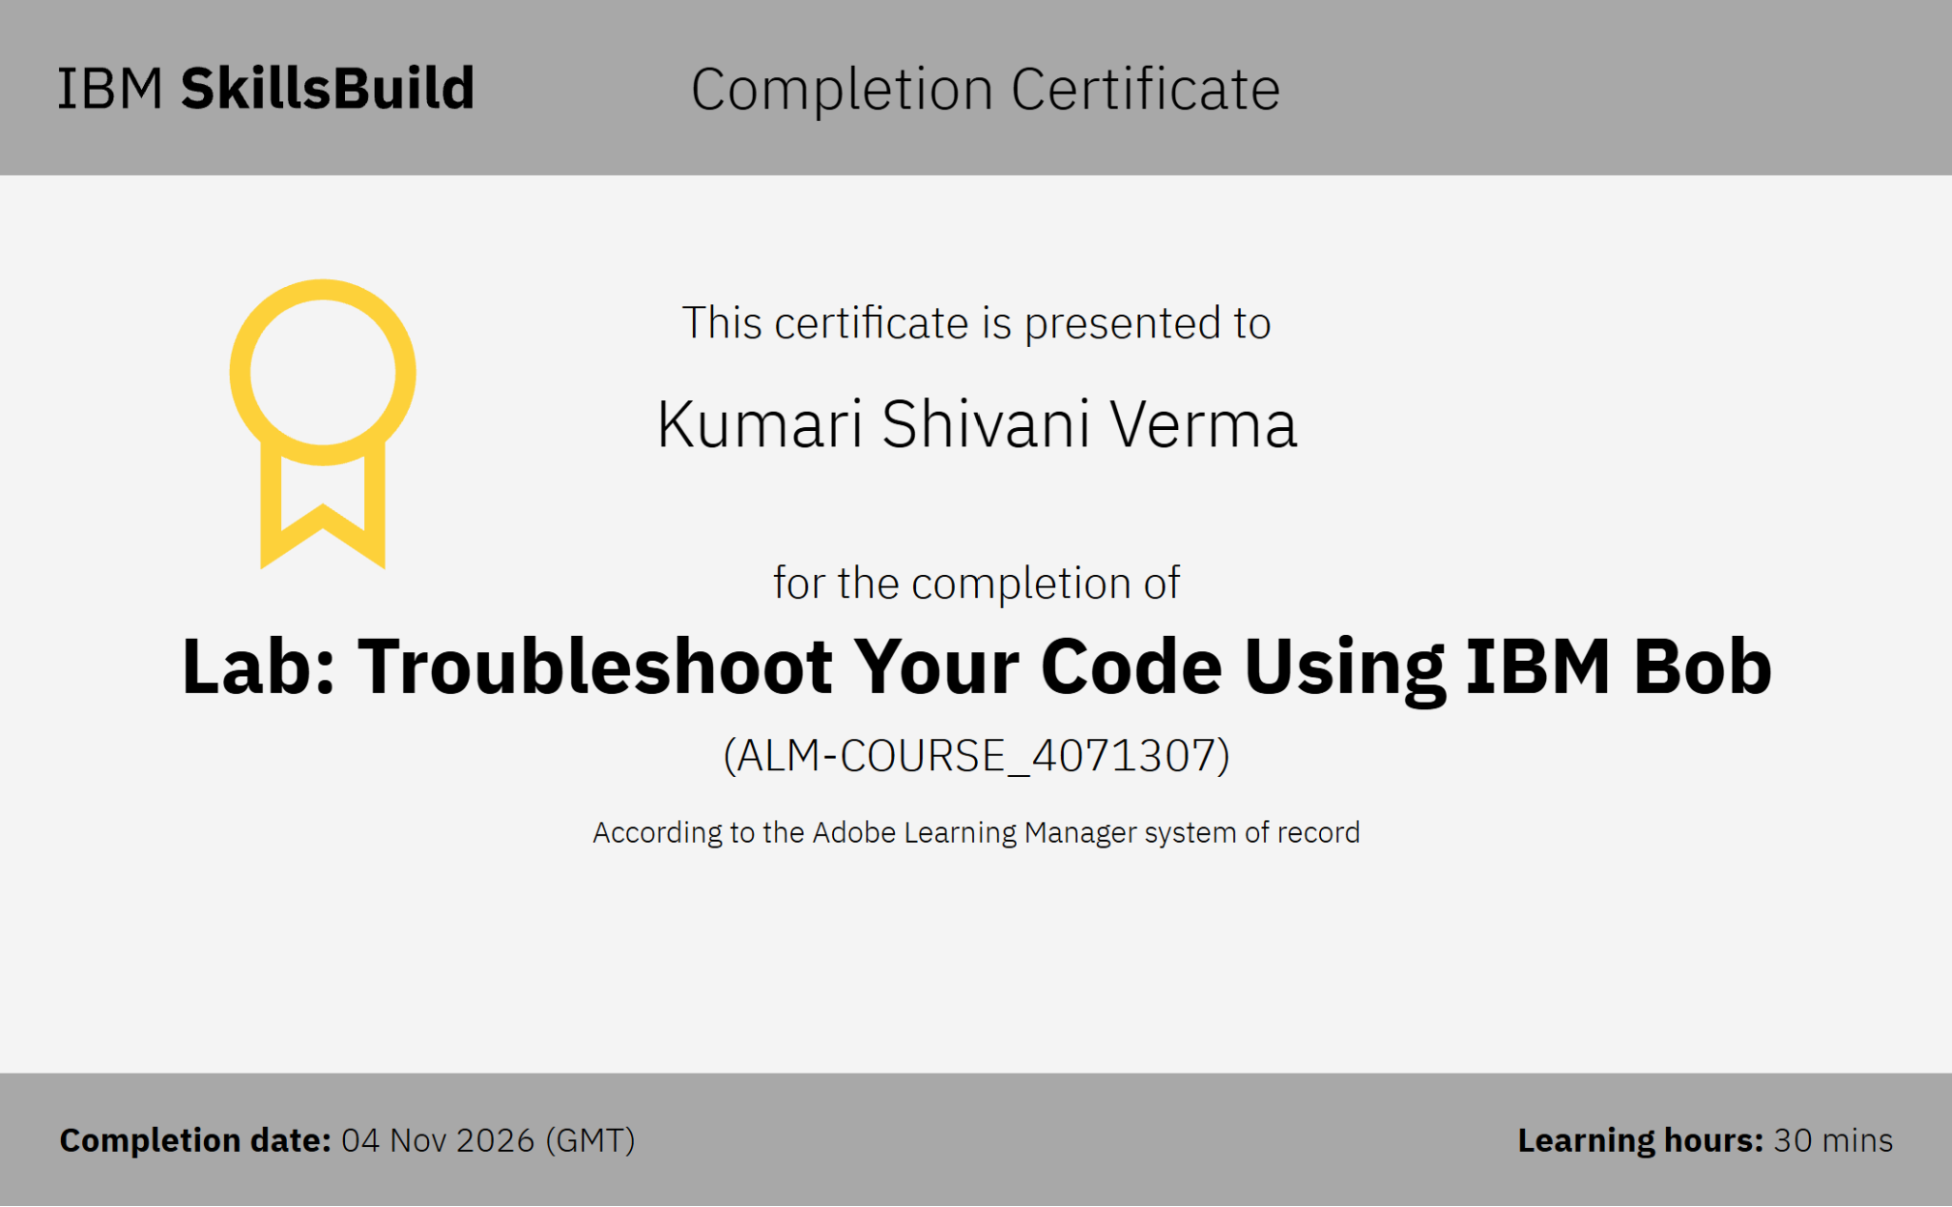
Certificates Earned:​
Add your IBM BOB Certificate

Slide 18


