Slide 1

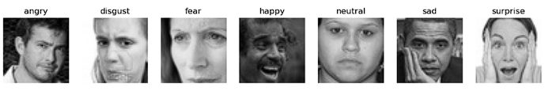
Facial Expression Recognition Using Machine Learning
Facial Expressions
By: Shivani Saran | Roll No: 242CD022 | MA722 Foundation of Machine Learning Algorithms Guided By –A. Senthil Thilak

Slide 2
Introduction
Facial Expression Recognition (FER) identifies human emotions based on facial expressions.
Applications:
Human-computer interaction,
Psychological studies
Robotics and security.
Goal: Classify facial expressions into seven categories using CNNs.

Slide 3
Motivation
- Enhances human-machine interaction.
- Supports healthcare and mental health monitoring.
- Future potential in bridging emotional AI responses.

Slide 4
Preliminary Requirements
- Skills:
Machine Learning
Deep Learning (CNNs)
Python programming.
- Libraries:
Keras
TensorFlow
OpenCV
- Key Concepts:
Dataset preprocessing
model building
real-time video processing

Slide 5
Literature Survey
- Traditional Methods: LBP, HOG with SVM/k-NN; struggled with lighting, pose, occlusion.
- Deep Learning:
CNNs automate feature extraction and classification
handle variations.
- Dataset: FER2013

Slide 6
Existing Methods
- Traditional Methods: Manual feature extraction, limited robustness.
- Deep Learning: Superior performance, automatic feature learning.
- Challenges: Expression variability, noise, occlusion, lighting inconsistencies.

Slide 7
Justification for CNNs
- Automatic feature extraction without manual intervention.
- High accuracy and scalability for larger datasets or classes.
- Handles real-world complexities (lighting, pose).

Slide 8
Methodology
1. Dataset Preparation.
2. Data Preprocessing (resize, grayscale, normalization).
3. Label Encoding.
4. CNN Model Architecture.
5. Real-time Emotion Detection.

Slide 9
Dataset Preparation
Dataset Source: Labeled facial images stored in directories representing emotion categories.
Processing: Images are split into training and testing datasets.

Slide 10
Data Preprocessing
Steps:
Resize images to 48x48 pixels.
Convert images to grayscale for simplicity.
Normalize pixel values to [0, 1] range.
Purpose: Reduce complexity and standardize input format.

Slide 11
Label Encoding
Objective: Convert emotion labels to numerical format.
Method:
from sklearn.preprocessing import LabelEncoder
from keras.utils import to_categorical
le = LabelEncoder()
le.fit(train['label'])
y_train = le.transform(train['label'])
y_test = le.transform(test['label'])
y_train = to_categorical(y_train, num_classes=7)
y_test = to_categorical(y_test, num_classes=7)

Slide 12
CNN Model Architecture
Layers:
Convolutional Layers (feature extraction)
MaxPooling (downsampling)
Dropout (regularization)
Flattening and Dense Layer (classification)

Slide 13
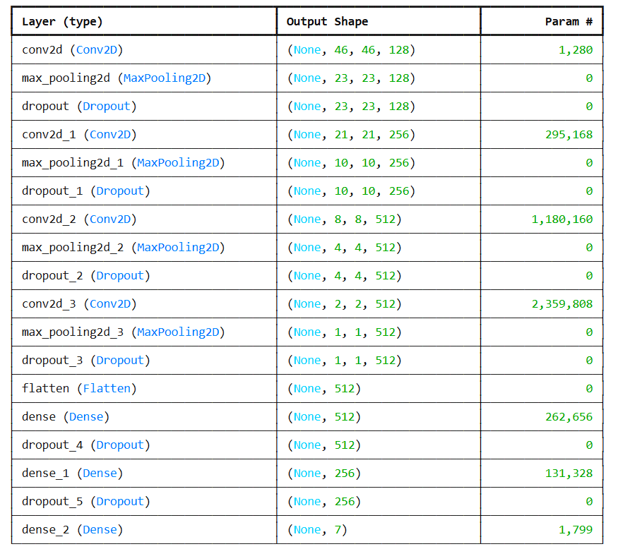
CNN Model Summary

Slide 14
Results and Discussion
- Training Accuracy: 71.03% | Validation Accuracy: 62.72%.
- Challenges: Insufficient data, lighting variations, model simplicity
- Improvements: Data augmentation, transfer learning, deeper architectures.

Slide 15
Real-Time Emotion Detection
Implementation:
Use OpenCV for real-time video capture and face detection.
Predict emotion labels using the trained model.

Slide 16
Applications
- Healthcare: Emotion monitoring in mental health.
- HCI: Responsive AI systems.
- Surveillance: Behavior analysis in security.
- Marketing: Real-time customer sentiment analysis.

Slide 17
Limitations
- Dataset bias affects generalization.
- Performance drops under occlusions (e.g., masks).
- Sensitivity to extreme lighting conditions.

Slide 18
Conclusion
- CNNs effectively classify facial expressions.
- Real-time systems feasible but need robust models
- Future scope: Transfer learning, expanded datasets, multi-modal systems.

Slide 19
References
1. Simonyan, K., & Zisserman, A. (2015). Very Deep Convolutional Networks for Large-Scale Image Recognition.
2. Bartlett, M., Cohn, J., & Lee, H. (2001). Facial Expression Recognition: A Survey.
3. Krizhevsky, A., Sutskever, I., & Hinton, G. (2012). Imagenet Classification with Deep Convolutional Neural Networks.

Slide 20
Thank you

