Slide 1

RT 524 – Digital Agriculture and Advanced Analytics
Mini Project
Fully Wireless Sensor with NodeMCU
Submitted by:
Shivani Agrawal (254154007) & Vivek Sharma(256154006)
School of Agro and Rural Technology (SART)
IIT Guwahati (781039)
Submitted to:
Dr. Dipankar Mandal
Assistant Professor

Slide 2
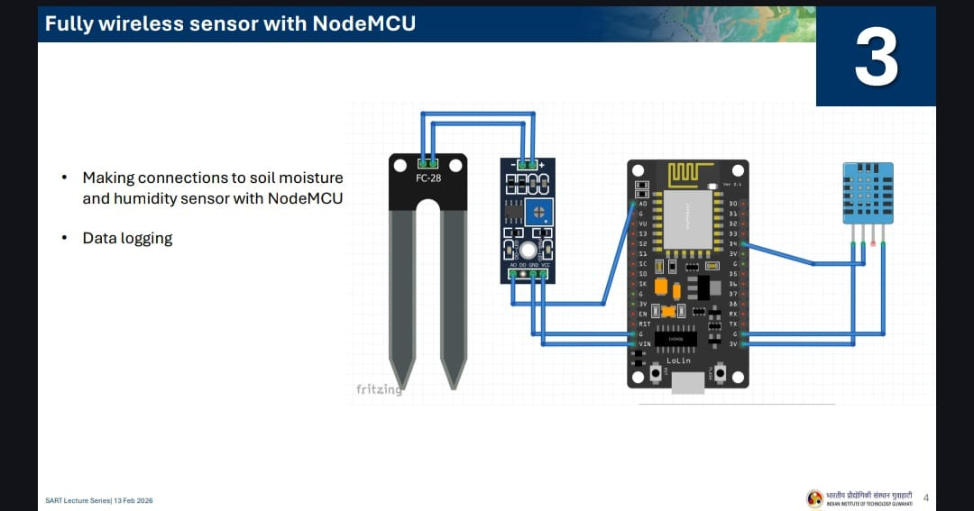
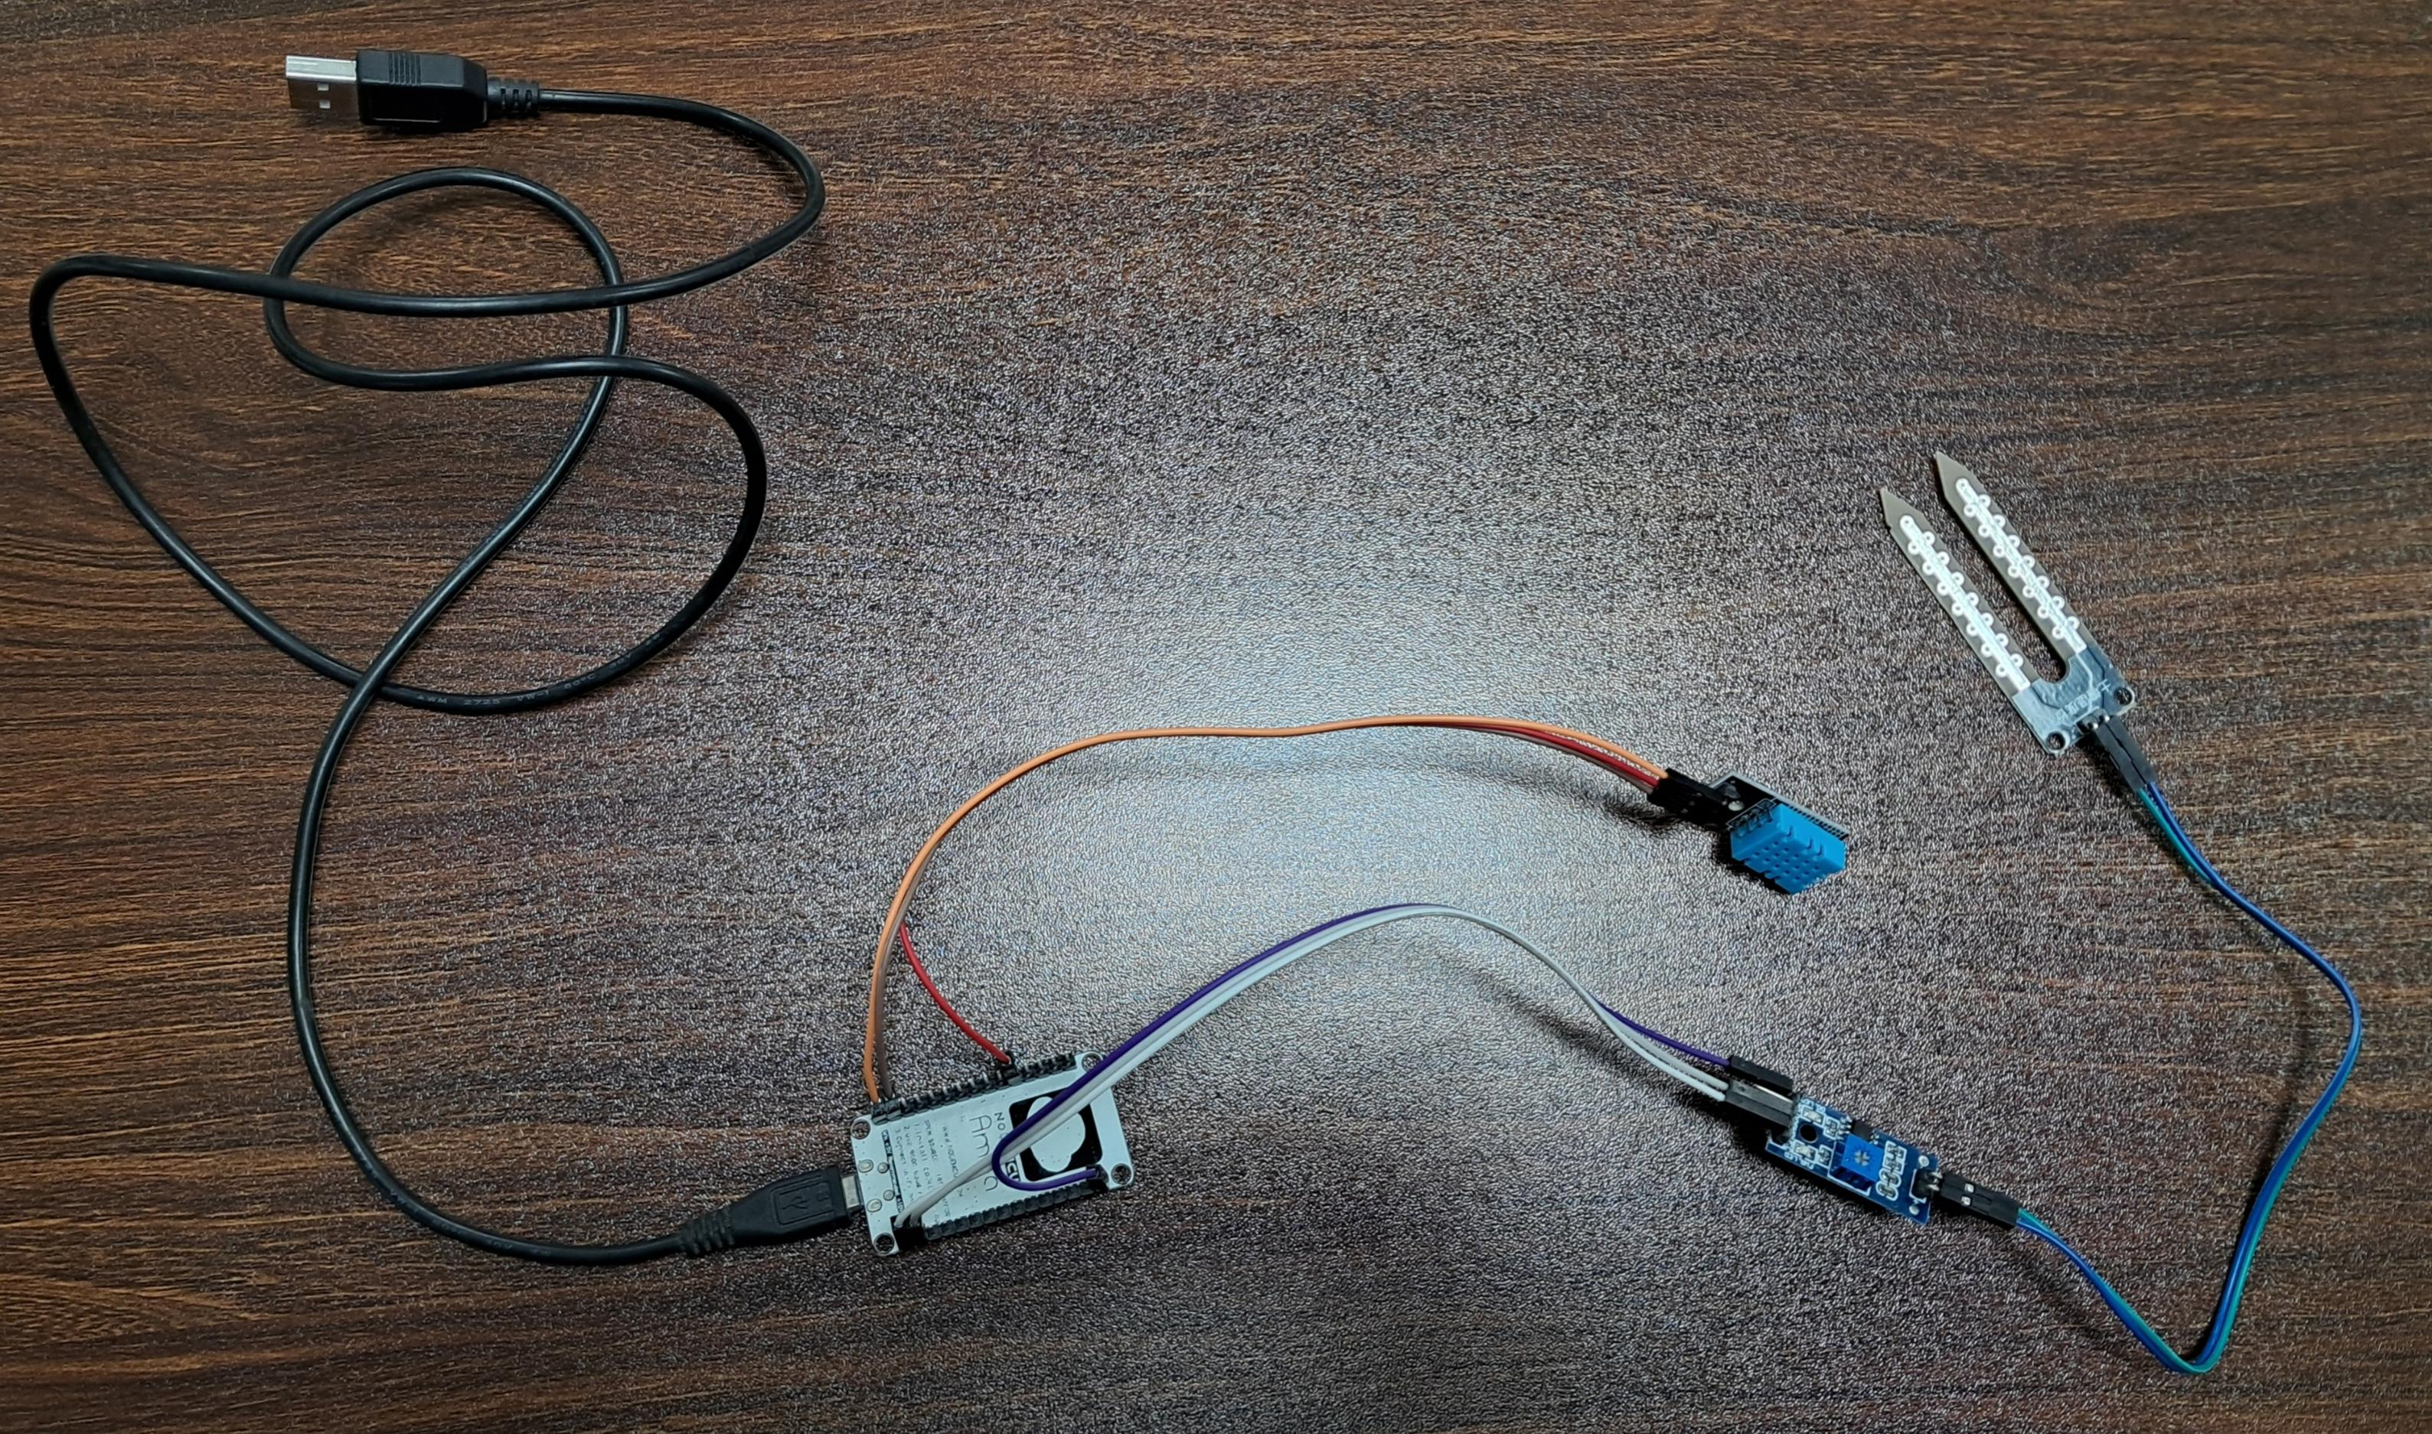
Circuit Connections — Fritzing Diagram
​4. DHT11 Temperature & Humidity Sensor ​The small blue grid-like component on the right is a DHT11 sensor. ​Function: Unlike the FC-28 which measures the ground, this measures the ambient air. It provides two readings: temperature and relative humidity.
​1. FC-28 Soil Moisture Probe
​It consists of two large exposed pads that act as variable resistors.
​How it works: When the soil is wet, it conducts electricity more easily (lower resistance). When the soil is dry, it conducts poorly (higher resistance).
​2. Soil Moisture Control Module (Comparator) ​This is the small blue board connected directly to the FC-28 probe. It processes the raw signal from the probe before sending it to the microcontroller.
​3. NodeMCU ESP8266 ​The large black board in the centre is the “brain” of the project. It is a Wi-Fi-enabled microcontroller based on the ESP8266 chip. ​Function: It reads the data from the sensors, processes the values, and can transmit that data over Wi-Fi to a phone app or a cloud dashboard.

Slide 3
Project Overview
🎯 Objective
🔌 Key Components
Build a fully wireless sensor system using NodeMCU (ESP8266) to monitor soil moisture and ambient temperature & humidity in agricultural fields.
NodeMCU ESP8266 • FC-28 Soil Moisture Sensor • DHT11 Temperature & Humidity Sensor
📡 What Makes it Wireless
📊 Output
NodeMCU has built-in WiFi (ESP8266 chip). Sensor data can be transmitted over WiFi for remote monitoring and data logging.
Real-time sensor readings displayed in Arduino Serial Monitor at 115200 baud. Values: Soil Moisture %, Temperature °C, Humidity %.

Slide 4
Pin Connection Details
FC-28 Soil Moisture Sensor → NodeMCU
DHT11 Temperature & Humidity Sensor → NodeMCU
Sensor Pin | NodeMCU Pin | Purpose
AO (Analog Out) | A0 | Analog moisture reading
VCC | VIN | Power supply
GND | G | Ground
Sensor Pin NodeMCU Pin Purpose
Sensor Pin | NodeMCU Pin | Purpose
VCC | 3V | Power supply
GND | GND | Ground
DATA | D4 (GPIO2) | Temperature & Humidity data
Sensor Pin NodeMCU Pin Purpose

Slide 5
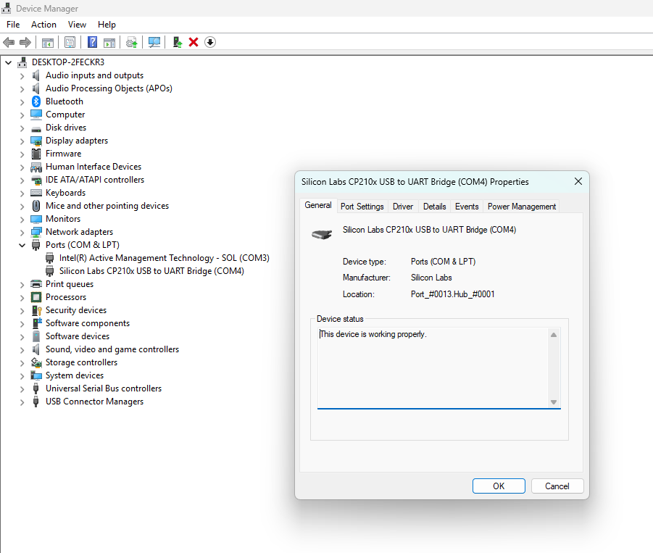
Step 1 — Install Silicon Labs CP210x USB to UART Bridge Driver
Why is this needed?
NodeMCU uses a CP210x chip to convert USB signals to UART (serial). Without the driver, your computer cannot detect or communicate with the NodeMCU board.
1
2
Run Installer
Download Driver
Visit Silicon Labs website → search 'CP210x USB to UART Bridge VCP Drivers'. Download for your OS (Windows / Mac / Linux).
Extract the zip file. Run the .exe (Windows) or .dmg (Mac). Follow the installation wizard and complete setup.
3
Connect NodeMCU
4
Verify Detection
Plug NodeMCU to computer via Micro-USB cable. Windows: Check Device Manager → Ports (COM & LPT). A new COM port should appear.
On Windows: Device Manager → Ports → 'Silicon Labs CP210x USB to UART Bridge (COMx)'. This confirms driver is working correctly.

Slide 6
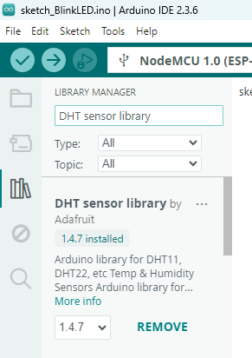
Step 2 — Install Libraries in Arduino IDE
Two libraries must be installed to use NodeMCU's WiFi and DHT sensor features:
📶 ESP8266WiFi.h
🌡 DHT.h (DHT sensor library)
Purpose: Gives NodeMCU its WiFi superpowers. How to install: Arduino IDE → Tools → Manage Libraries → search 'ESP8266WiFi' → Install Package: Part of ESP8266 board package by esp8266 community
Purpose: Enables reading from DHT11/DHT22 sensors. How to install: Arduino IDE → Tools → Manage Libraries → search 'DHT sensor library' by Adafruit → Install Note: Also install 'Adafruit Unified Sensor' if prompted
📌 How to Add ESP8266 Board to Arduino IDE
1. File → Preferences → Paste this URL in 'Additional Boards Manager URLs':
http://arduino.esp8266.com/stable/package_esp8266com_index.json
3. Tools → Board → Boards Manager → search 'esp8266' → Install 'esp8266 by ESP8266 Community'

Slide 7
Step 3 — Select Board & Port in Arduino IDE
🖥️ Select the Board
🔌 Select the Port
Go to: Tools → Board → ESP8266 Boards → select 'NodeMCU 1.0 (ESP-12E Module)'. This tells Arduino IDE which microcontroller you are using.
Go to: Tools → Port → Select the COM port where NodeMCU is connected. On Windows it appears as COM3, COM4, etc.
▶ Tools → Board → ESP8266 Boards → NodeMCU 1.0
▶ Tools → Port → COMx
⚙️ Upload Speed
✅ Verify Selection
Tools → Upload Speed → 115200. This matches the Serial.begin(115200) in your code. Mismatched baud rates cause garbled output in monitor.
Bottom bar of Arduino IDE shows current board & port. Example: 'NodeMCU 1.0 (ESP-12E Module) on COM4'. Now you are ready to upload code.
▶ Tools → Upload Speed → 115200
▶ Bottom bar → NodeMCU 1.0 on COMx

Slide 8
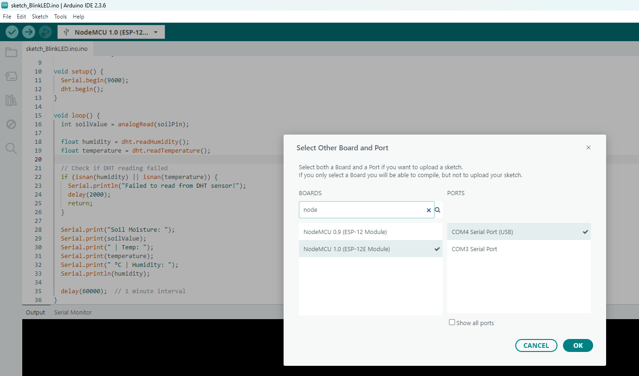
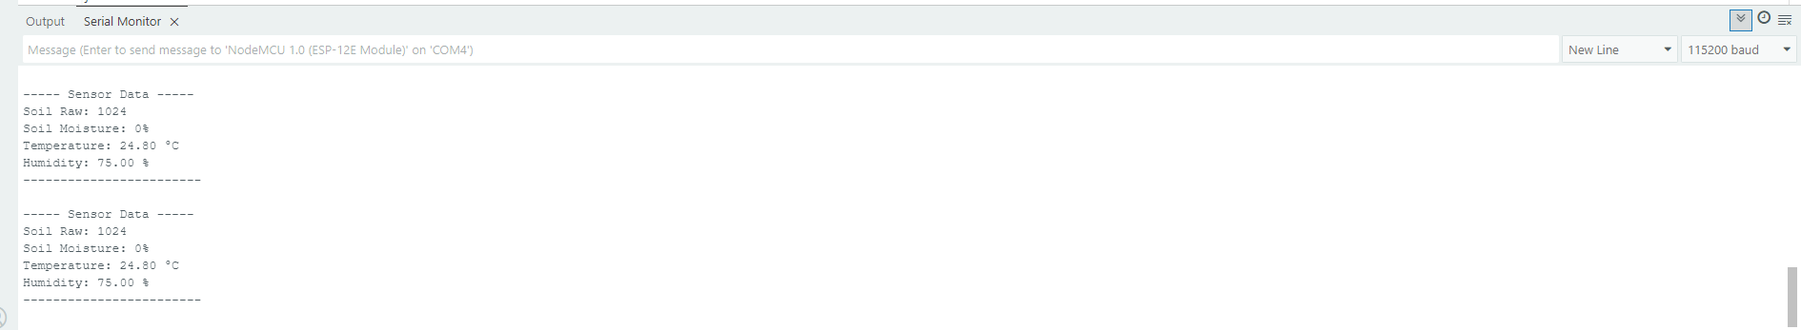
Selection of Board and port in Arduino IDE:
Setting of baud rate in serial monitor to 115200:

Slide 9
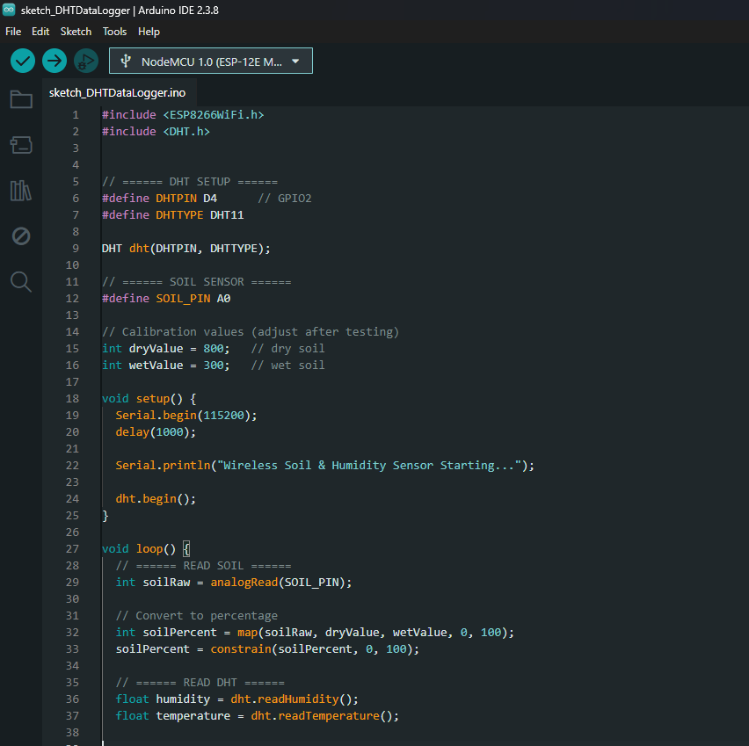
Step 4 — Write Code

Slide 10
Including Libraries in the Code
Every Arduino sketch begins by importing the libraries it needs. Here's what each line does:
#include <ESP8266WiFi.h>
#include <DHT.h>
ESP8266WiFi.h
Activates WiFi features for NodeMCU (ESP8266). This library contains all functions needed to connect your board to the internet — scanning networks, connecting, sending data, and more. Without this line, your NodeMCU is just a regular Arduino with no wireless capability.
DHT.h
// DHT Sensor Configuration
#define DHTPIN D4
#define DHTTYPE DHT11
DHT dht(DHTPIN, DHTTYPE);
Adds support for DHT family sensors (DHT11, DHT22, DHT21). Provides easy functions:
• dht.readTemperature() → returns °C
• dht.readHumidity() → returns %

Slide 11
DHT Sensor Configuration in Code
Line-by-line explanation of DHT11 sensor setup:
#define DHTPIN D4
Define DHT Data Pin
This tells the program: 'DHT sensor's data wire is connected to D4 on NodeMCU'.
#define DHTTYPE DHT11
Define Sensor Type
Specifies which DHT model you are using. DHT11 is the basic blue sensor.
DHT dht(DHTPIN, DHTTYPE);
Create DHT Object
Creates a controller named 'dht' for your sensor. Think of it as registering your sensor: telling the code which pin it's on and what type it is.

Slide 12
Soil Moisture Sensor Configuration
The FC-28 soil sensor outputs an analog voltage. NodeMCU reads it on pin A0 (the only analog input).
#define SOIL_PIN A0
int dryValue = 800;
int wetValue = 300;
#define SOIL_PIN A0
dryValue = 800
Defines the analog pin A0.
Soil sensor gives analog voltage.
NodeMCU has only ONE analog pin (A0), so the soil sensor must always use A0.
When soil is completely DRY, the sensor outputs ~800 (raw ADC value). This is the reference for 0% moisture.
wetValue = 300
Why Calibrate?
When soil is WET/soaked, sensor outputs ~300. This is the reference for 100% moisture.
Values are inverted — lower = wetter.
Different soils & sensors have different raw ranges. Calibration maps raw numbers (300–800) to readable % (0–100) for humans.

Slide 13
The setup() Function
Runs ONCE when the board powers on. Initializes everything before the main loop begins.
void setup() {
Serial.begin(115200);
delay(1000);
Serial.println("Wireless Soil & Humidity Sensor
Starting..."
);
dht.begin();
}
Start Serial Communication
Opens a communication channel between NodeMCU and your computer at 115200 bps. This is required to see output in the Serial Monitor.
Wait 1 Second
Gives the system time to stabilize after power-on. Prevents sensor reading errors immediately after startup.
Print Startup Message
Sends a startup confirmation to Serial Monitor. Useful for debugging — confirms the board is running your code.
Initialize DHT Sensor
Starts the DHT11 sensor. Without this, all calls to dht.readTemperature() and dht.readHumidity() will return NaN (error).

Slide 14
The loop() Function & Reading Soil Moisture
The loop() function runs forever, continuously reading and printing sensor data:
void loop() {
int soilRaw = analogRead(SOIL_PIN);
int soilPercent = map(soilRaw,dryValue,wetValue,0,100);
soilPercent = constrain(soilPercent, 0, 100);
Read Raw Soil Value
Reads analog voltage on A0 (0–1023). Wet soil → ~300. Dry soil → ~800. The value represents electrical conductivity of soil.
Convert Raw to Percentage
map() translates one number range to another. 800 becomes 0%, 300 becomes 100%.
Clamp to Valid Range
Prevents out-of-range values (-5%, 120%) caused by extreme conditions. Forces: minimum = 0%, maximum = 100% always.

Slide 15
Reading Temperature & Humidity (DHT11)
float humidity = dht.readHumidity();
float temperature = dht.readTemperature();
if (isnan(humidity) ||
isnan(temperature)) {
Serial.println("Error!");
return;
}
dht.readHumidity()
Returns relative humidity as a float (e.g. 65.5%). Stored as 'float' because the sensor gives decimal precision. Range: 20–90% RH for DHT11.
dht.readTemperature()
Returns temperature in Celsius as a float (e.g. 28.3°C). Range: 0–50°C for DHT11. Use readTemperature(true) for Fahrenheit.
isnan() — Check for Errors
DHT sensors sometimes fail to read and return NaN (Not a Number). isnan() detects this. If error detected → print message + return (skip rest of loop).

Slide 16
Step 5 — Setting Baud Rate to 115200 in Serial Monitor
Baud rate is the speed of communication between NodeMCU and your computer.
📟 What is Baud Rate?
⚠️ Why Must They Match?
Baud rate = bits per second (bps). 115200 means 115,200 bits are transmitted per second. It controls how fast data flows from NodeMCU to Arduino Serial Monitor.
Code uses Serial.begin(115200). Serial Monitor must also be set to 115200.
🔧 How to Set in Serial Monitor
✅ What You'll See (Correct Output)
Open Serial Monitor: Tools → Serial Monitor (or Ctrl+Shift+M). Bottom-right dropdown → select '115200 baud'.
Wireless Soil & Humidity Sensor Starting...
Soil Moisture: 62%
Temperature: 28.30°C
Humidity: 65.10%
---

Slide 17
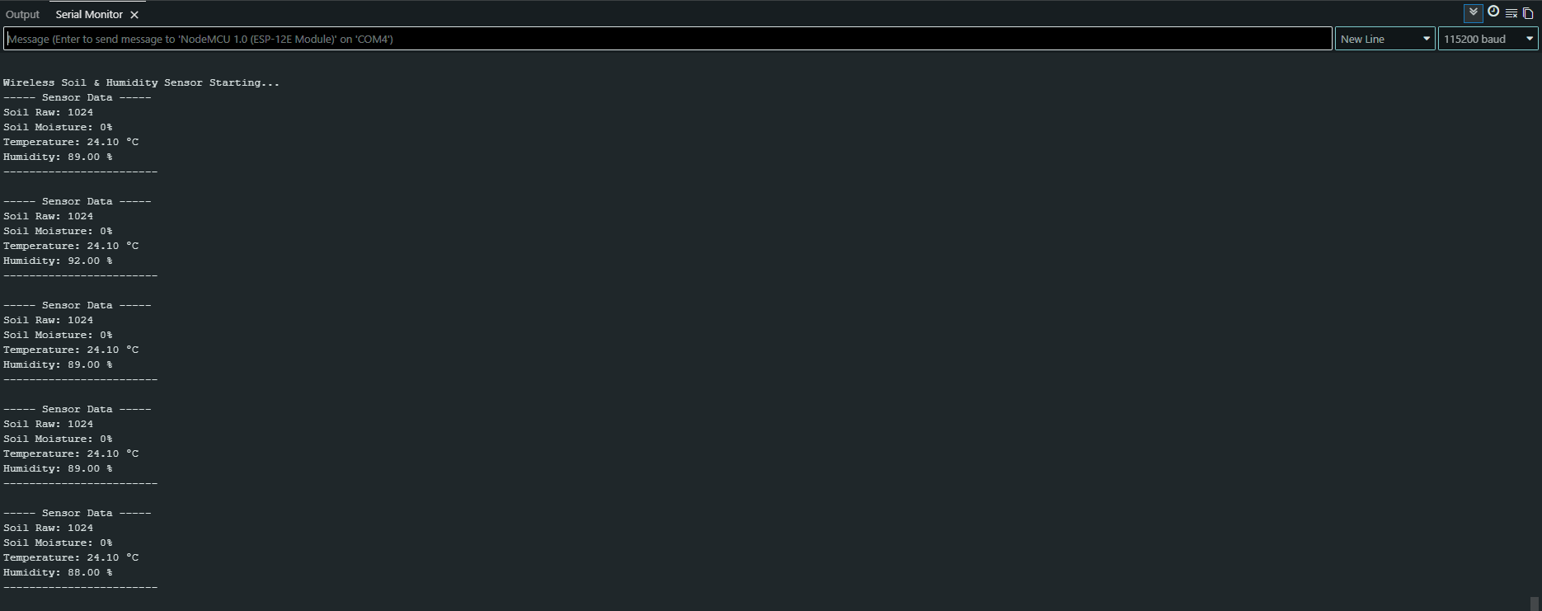
Step 6 — Result
Expected Serial Monitor output and sensor behavior during testing:
📟 Serial Monitor Output (115200 baud)

Slide 18
THANK YOU

