Slide 1

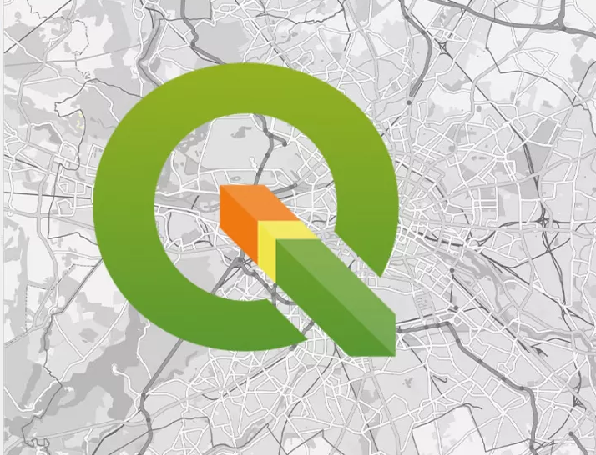
RT-508
GEOSPATIAL TECHNOLOGY IN AGRO AND RURAL SECTOR
MINI PROJECT:
Gram Panchayat level utility assessment
(Spatial Assessment)
PRESENTED BY –
CHANSA RAINGAM (254154003)
SHIVANI AGRAWAL (254154007)
School of Agro and Rural Technology
Indian Institute of Technology Guwahati (781039)

Slide 2
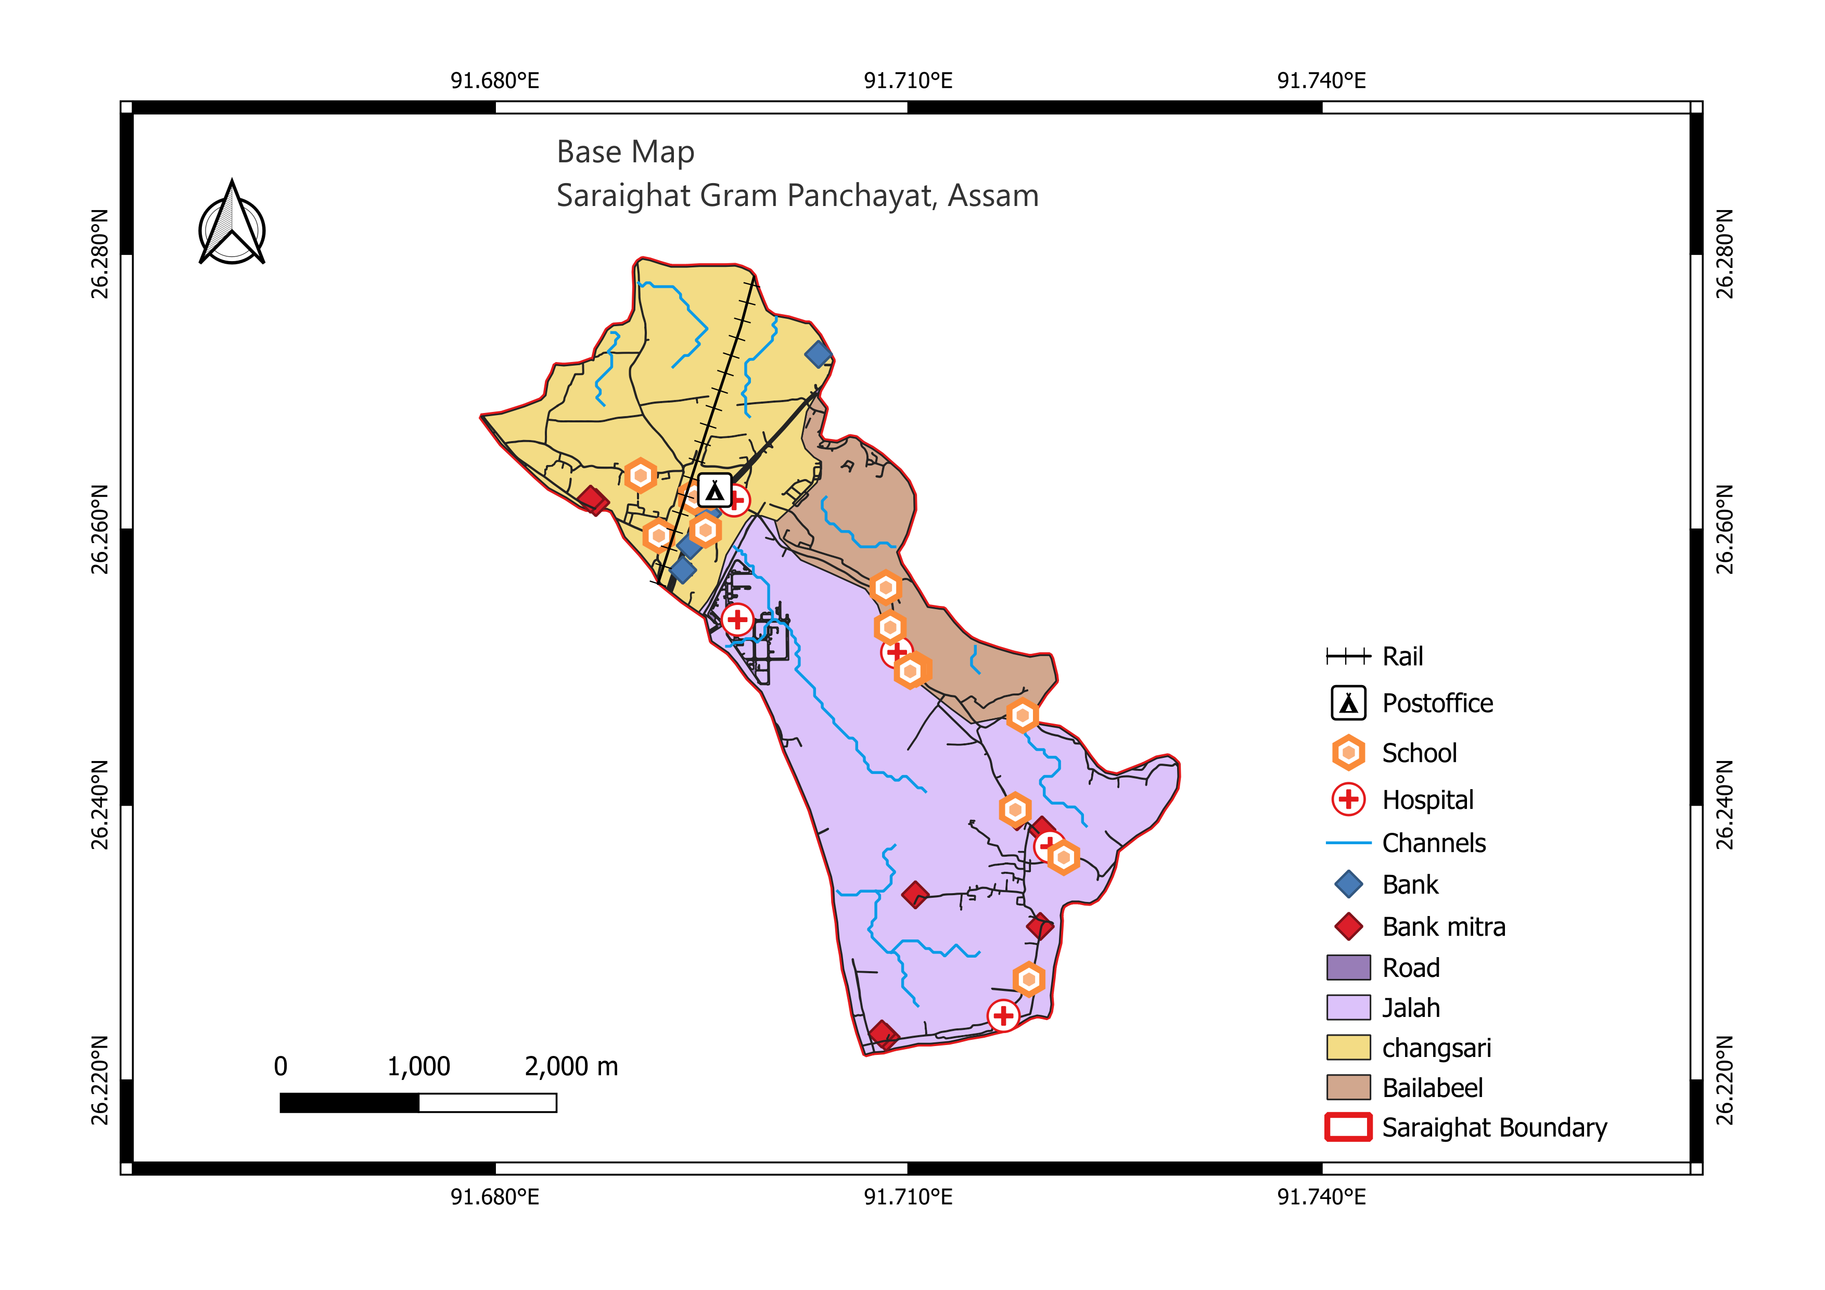
INTRODUCTION
Saraighat GP is located under Bezera block in Kamrup district of Assam State, India.
The Saraighat GP consists of three villages : Changsari, Balaibeel, and Jalah.
The total area is spread over 12.13 sq. km.
Geographical extent of latitude is 26°13’ N – 26°17’N & longitude is 91°40’ E – 91°44’ E.

Slide 3

OBJECTIVES
To identify the most suitable location for proposing a new hospital site within the Saraighat Gram Panchayat, Assam, using spatial analysis techniques in QGIS

Slide 4
METHODOLOGY
DATA ,SOURCE AND TOOLS
LOCATION:
Saraighat Gram Panchayat, Assam
Three village: Changsari, Jalah, Balaibeel
Width= approx. 2000m, Length = approx. 6000m
UTILITIES:
Schools 12
Hospitals 5
Railway 1
Banks 9
Postoffice 1
SOURCE:
Space-based Information Support for Decentralized Planning (SISDP) Bhuvan Panchayat portal and Bharatmaps NIC portal,
LULC map temporal satellite data set (Sentinel-2 imagery on 22-10-2024 and 24-02-2025
TOOLS:
QGIS software 3.40
Weighted Multi-Criteria Analysis(WMCA)
Scale= 1:50000

Slide 5
QGIS Tools
QGIS Tool/Step | Primary Purpose in Suitability Analysis
Buffer | Defines zones of inclusion or exclusion around.
Rasterize (Vector to Raster) | Converts vector data (points, lines, polygons) into a grid/raster format, which is required for cell-by-cell calculations like Weighted Multi-Criteria Analysis.
Fill No Data | Addresses missing or ‘No Data' cells in a raster layer by filling them with a specific value (e.g., 0) to prevent calculation errors during subsequent overlays.
LULC & Warp/Reproject | Ensures spatial consistency by standardizing the Coordinate Reference System (CRS), resolution, and extent of all input layers (like Land Use/Land Cover) for accurate overlay.
Weighted Multi-Criteria Analysis (Overlay) | The core analysis: combines prepared, reclassified raster layers, multiplying each by its relative importance (weight), and summing them to create the final suitability map.
Mask Layer (Clip Raster by Mask Layer) | Trims the final suitability raster to the precise boundary of the study area removing extraneous data and making results project-relevant.

Slide 6
BASE MAP
GENERATION
Insert the utilities shapefiles in QGIS
Generate a base map for the gram panchayat
Scale 1:50000

Slide 7
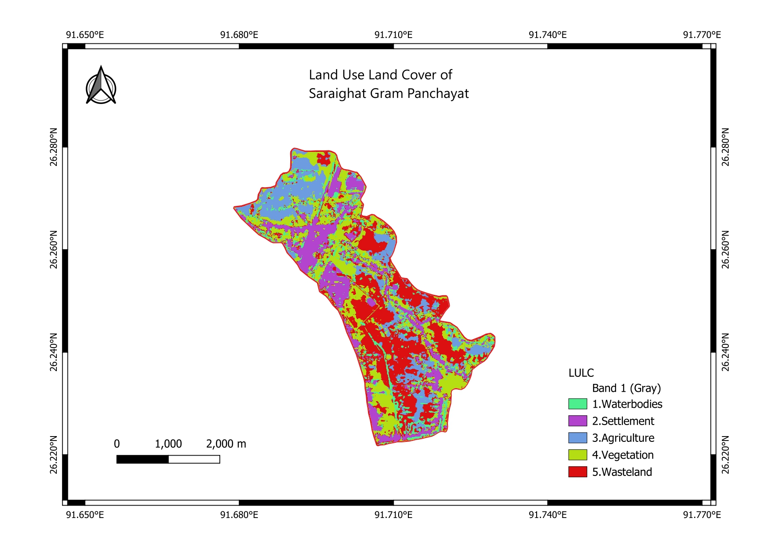
LULC Analysis
Use the LULC band and analyze the Land Use Land Cover classifications

Slide 8
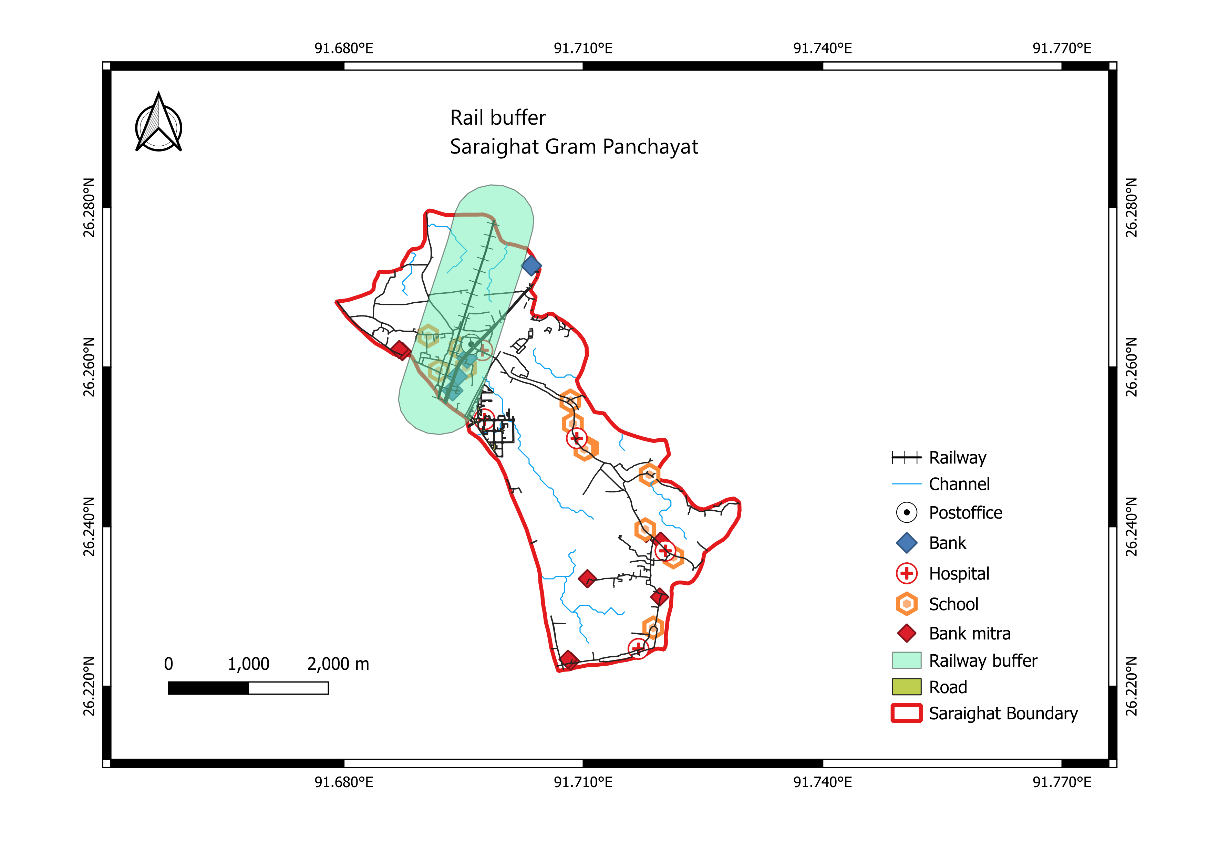
RAILWAY BUFFER
500 meter buffer
Avoidance Constraint: To minimize noise, vibration, and safety hazards, making areas within the buffer unsuitable

Slide 9
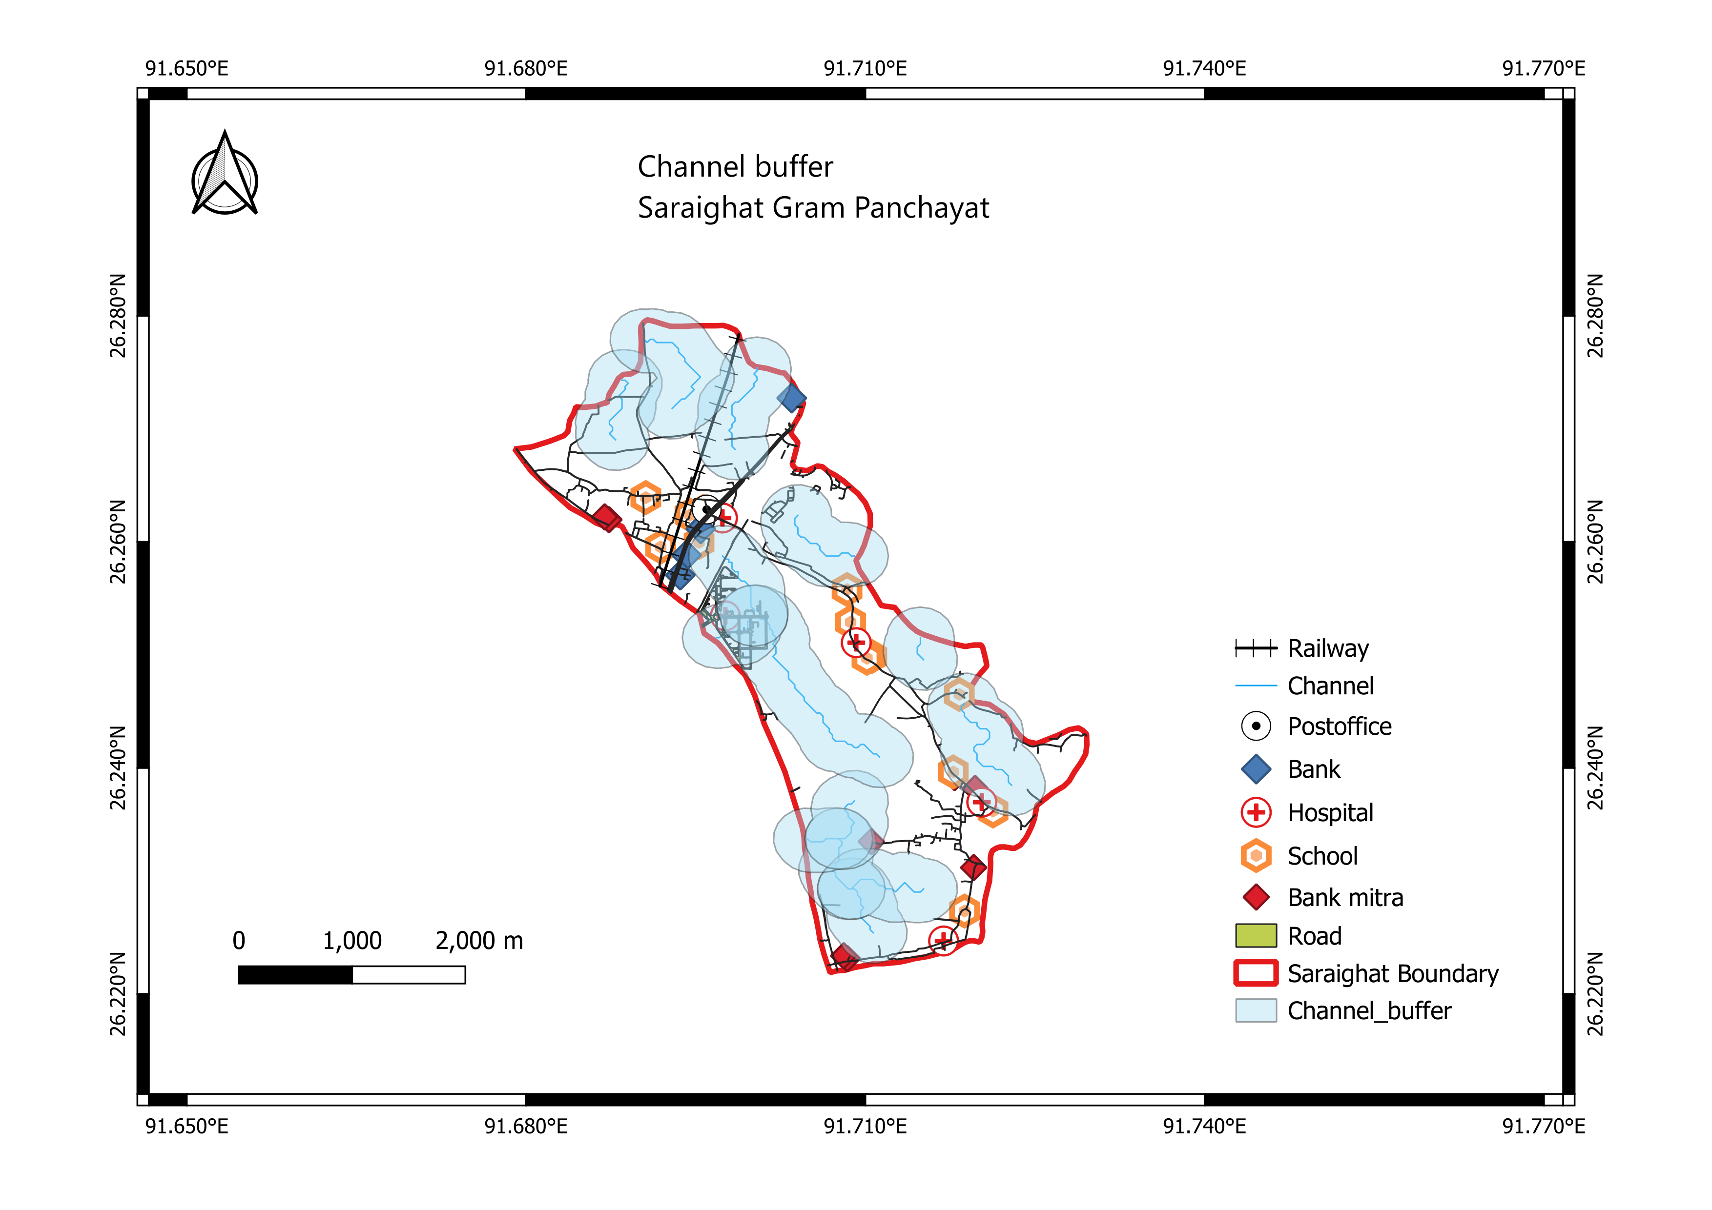
CHANNEL BUFFER
300 meter buffer
Avoidance Constraint: To prevent construction in flood-prone areas and preserve riverbank zones.

Slide 10
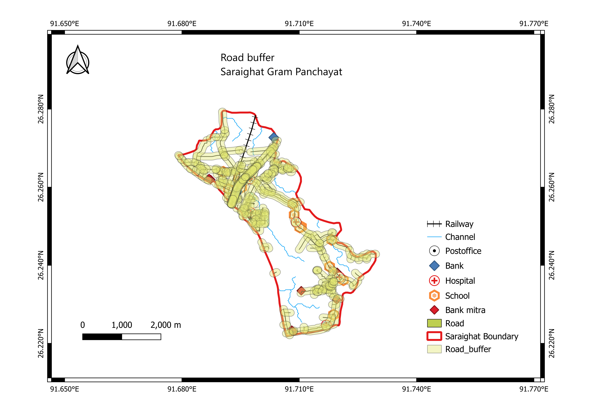
ROAD BUFFER
100 meter buffer
Proximity Requirement: To ensure high accessibility for patients, ambulances, and staff.
Research Lab

Slide 11
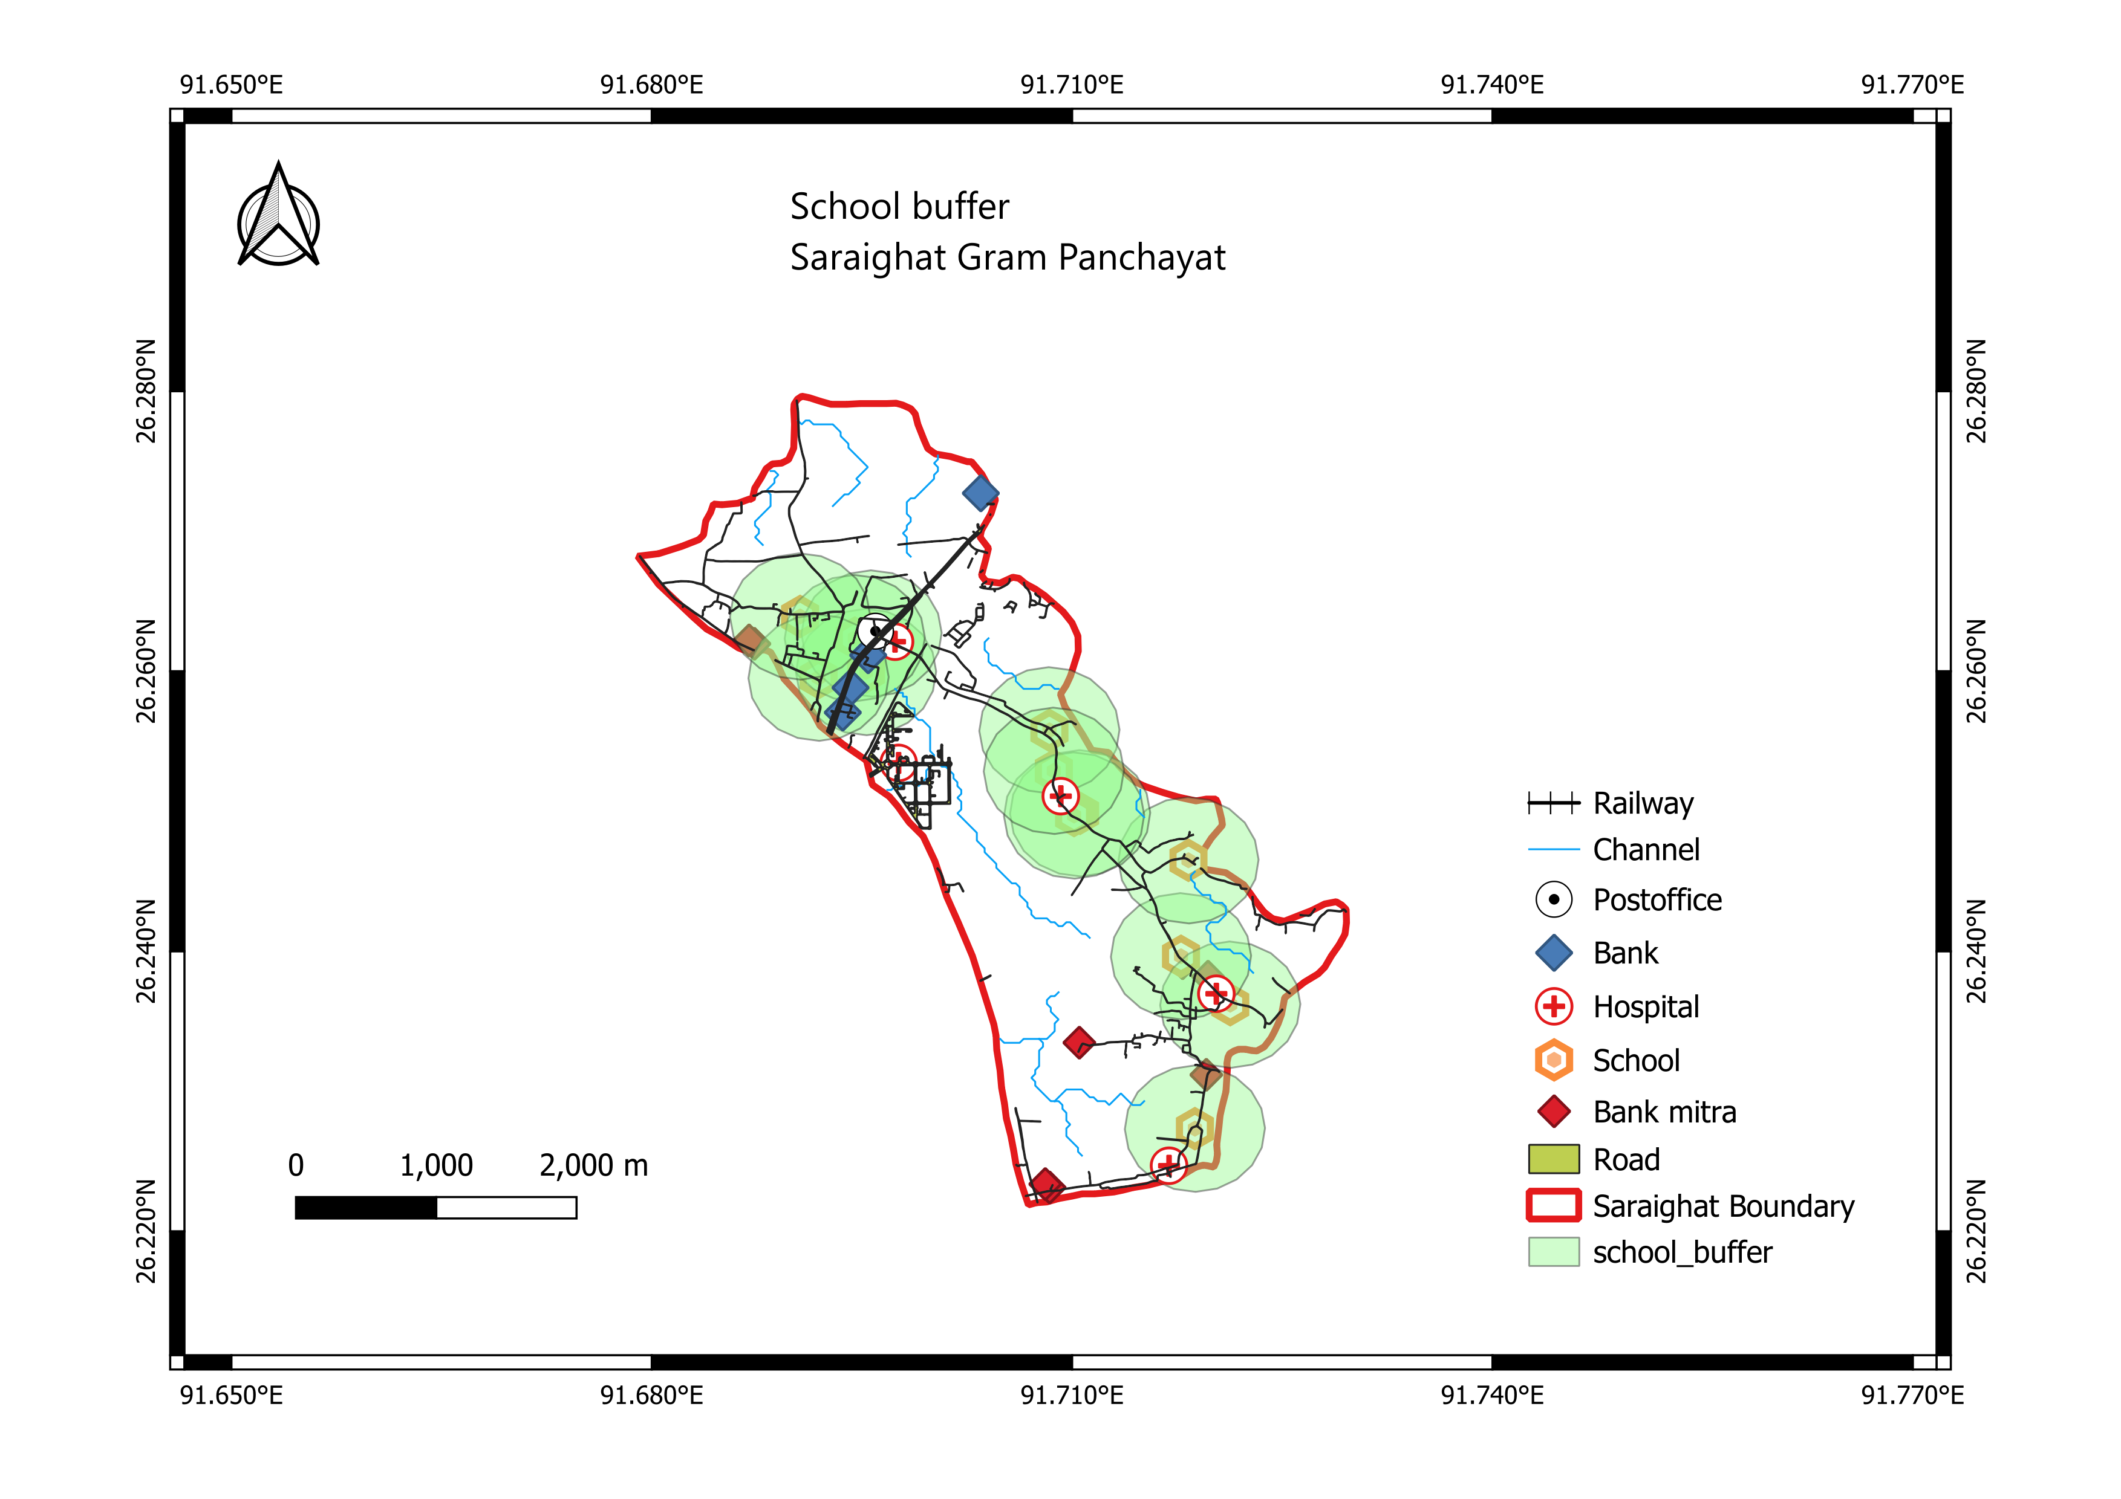
SCHOOL BUFFER
500 meter buffer
Avoidance Constraint: To reduce noise and traffic congestion in educational zones.

Slide 12
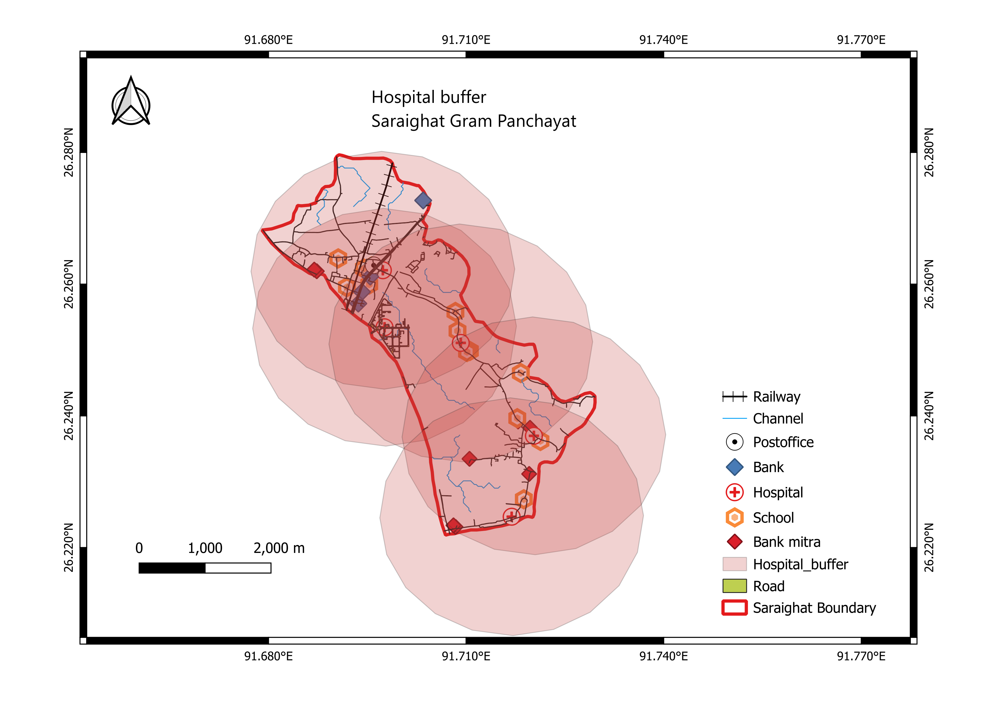
EXISTING HOSPITAL BUFFER
2000 meter buffer
Avoidance Constraint: To ensure the new hospital serves an unserved or underserved area (minimizing overlap with existing service areas).

Slide 13
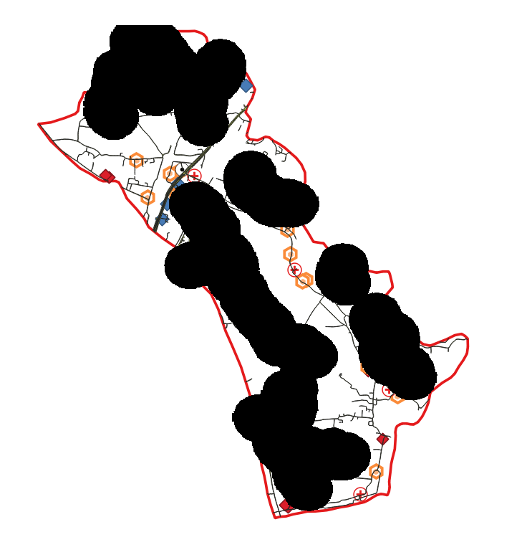
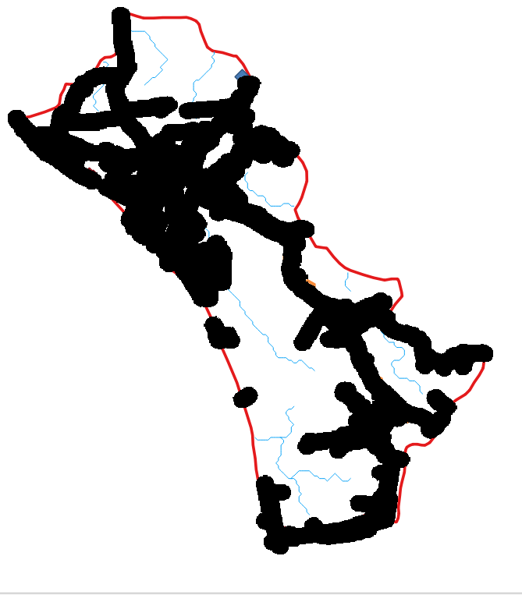
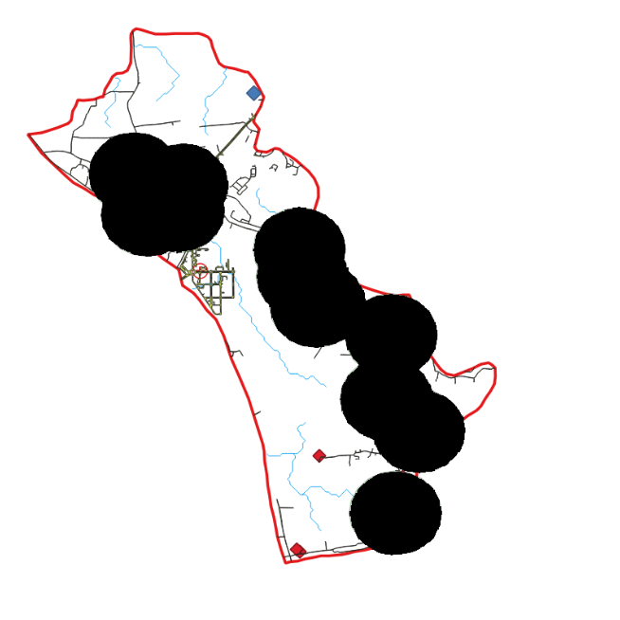

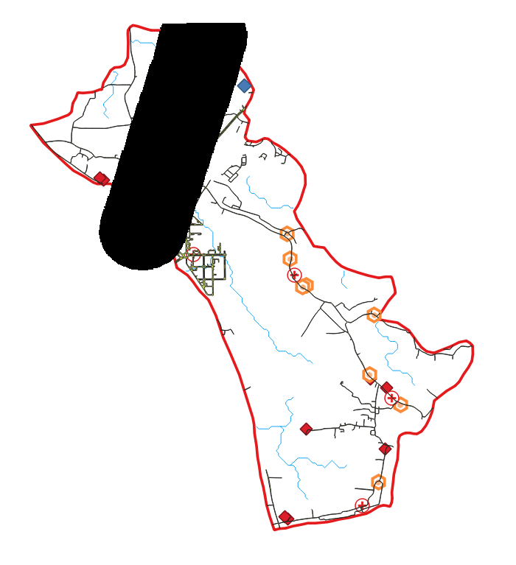
RASTERIZE (Vector to Raster)
Prepare data for the Weighted Multi-Criteria Overlay.
All vector buffer layers must be converted to raster format
This conversion creates a grid of cells (pixels)
Each cell is assigned a simple pixel value (1 for inside the buffer, 0 for outside) representing the criterion.
.
(a) Railway
(b)Channel
(c) Road
(d) School
(e) Hospital

Slide 14

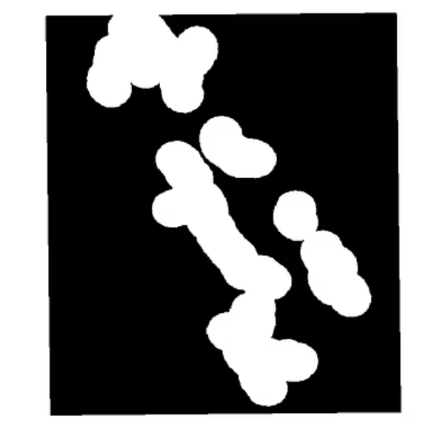
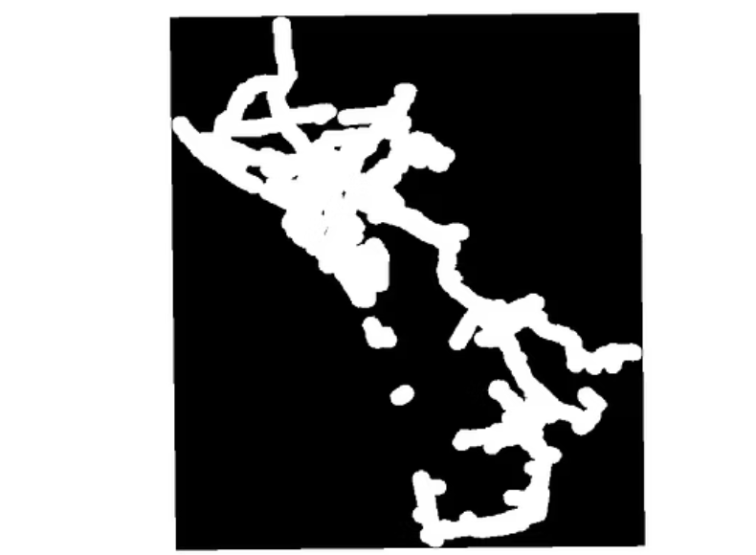
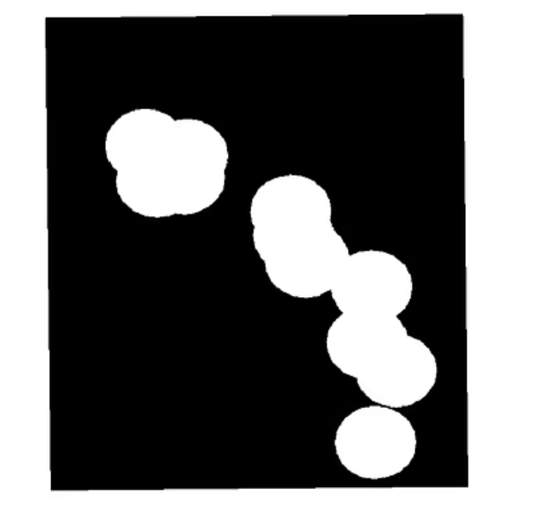

RASTER FILL
Explicitly fill the ‘No Data' areas with a specific value (e.g., 0).
(a) Railway
(b)Channel
(c) Road
(d) School
(e) Hospital

Slide 15
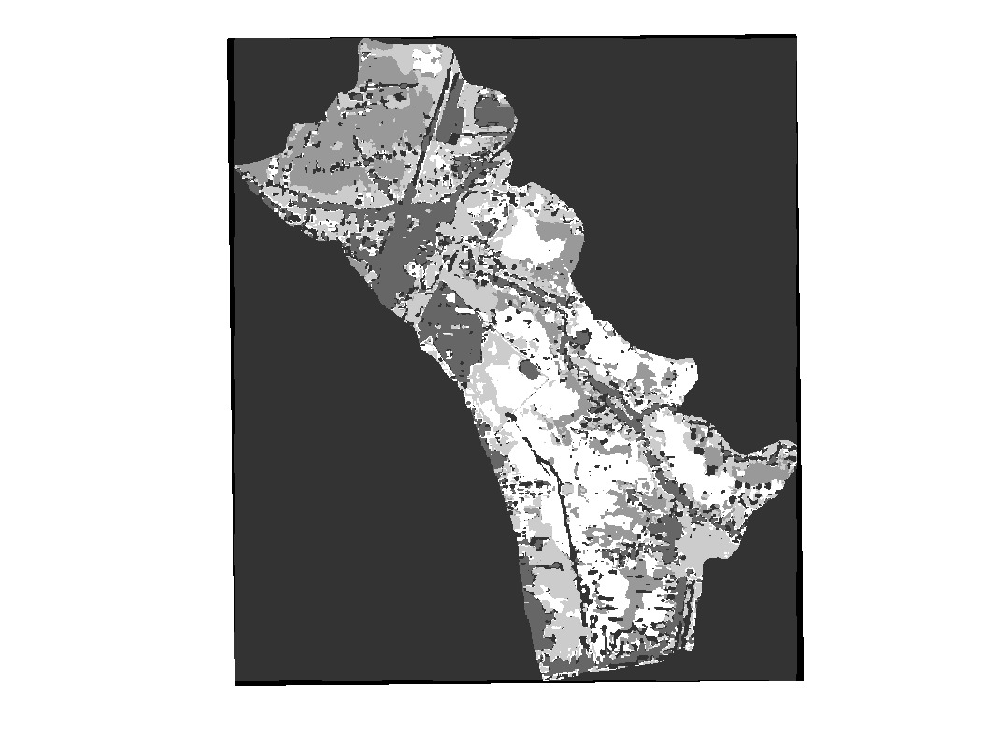
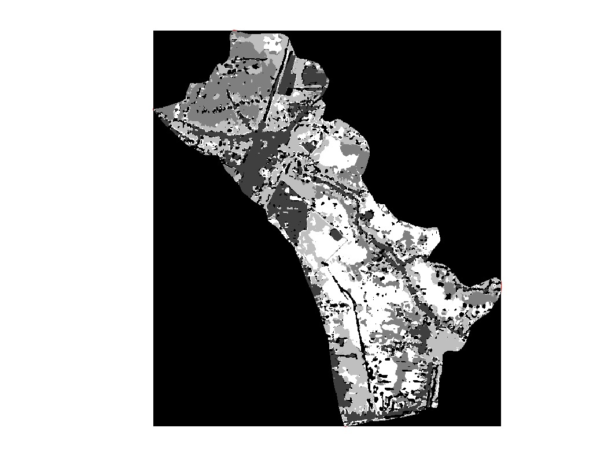
RASTER REPROJECT
Raster layers (for LULC) were ensured to have the same Cell Size, Extent, and Coordinate Reference System (CRS) to align perfectly for the final calculation.
Raster Fill for LULC
Raster Reprojected for LULC

Slide 16
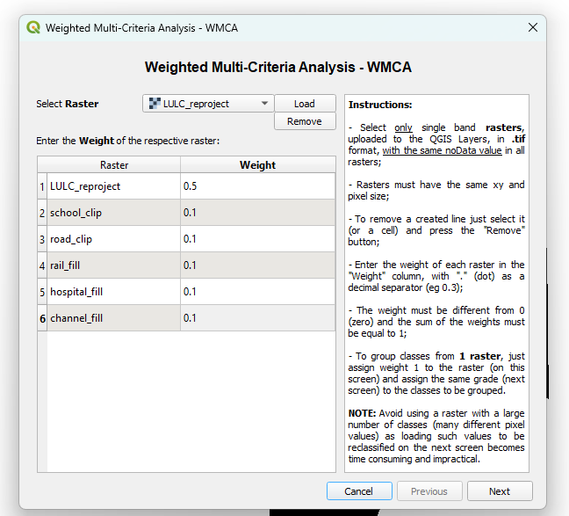
Weighted Multi-Criteria Analysis - WMCA
It combines all the prepared, reclassified raster criteria layers based on their relative importance (weight).
Each layer is multiplied by its weight, and the resulting layers are summed up to produce a final suitability map, where higher values indicate a more suitable location.

Slide 17
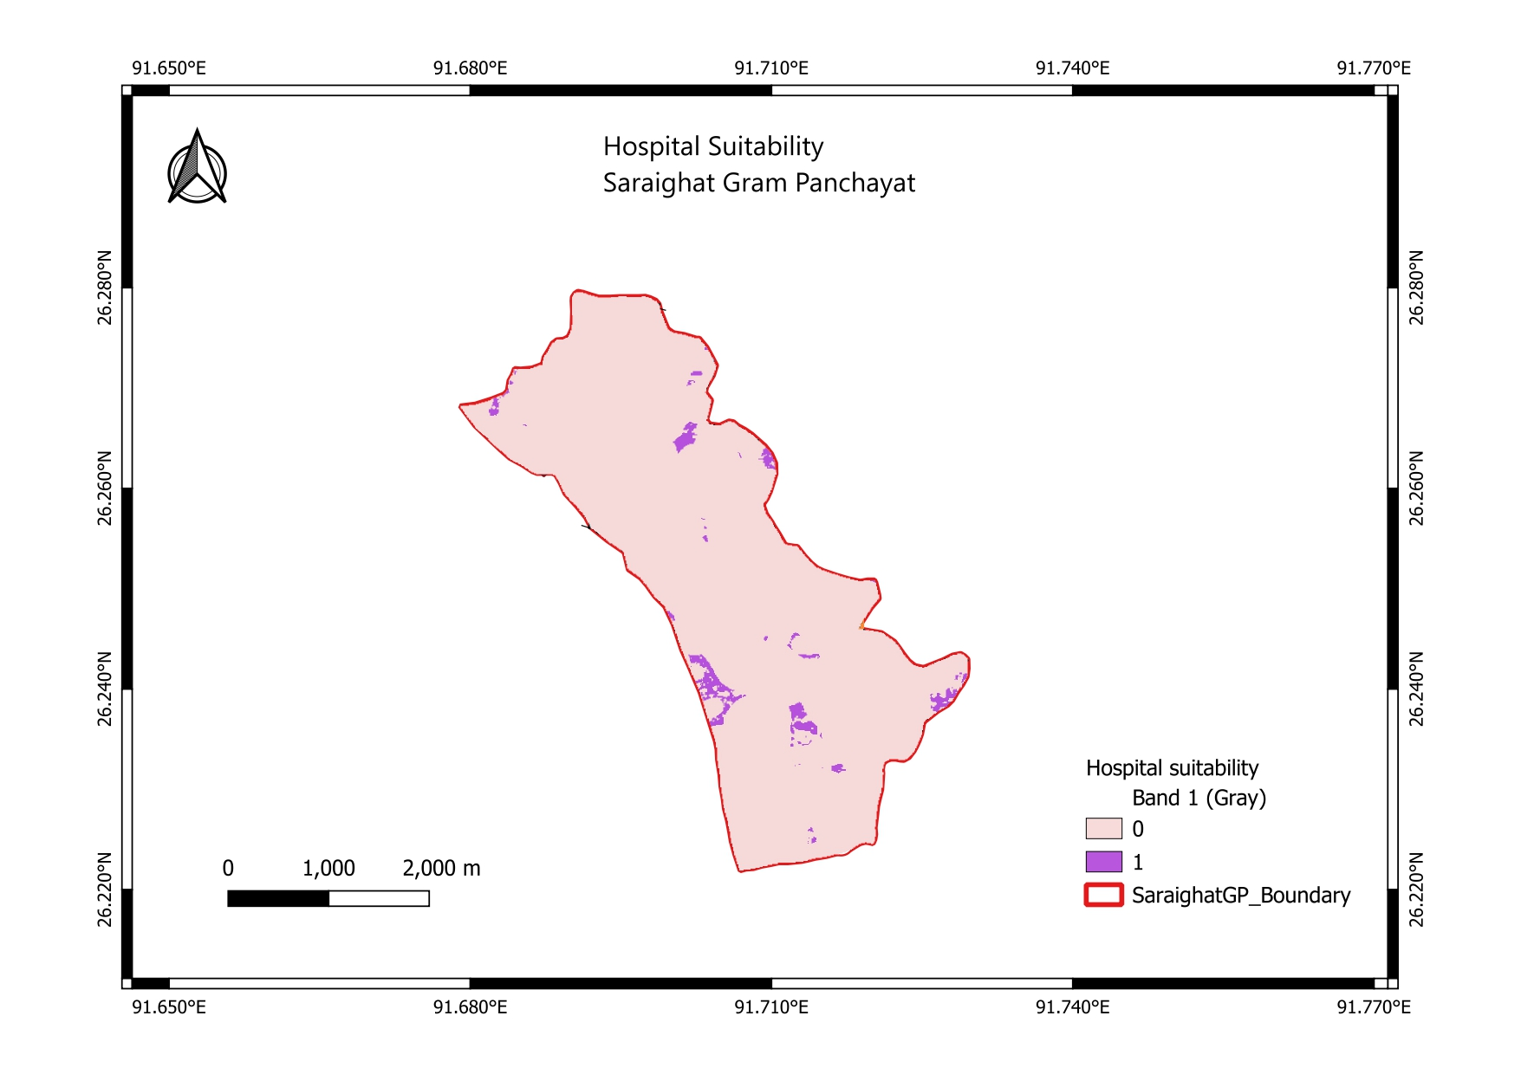
SUITABLE AREA
Indicates suitable area
Clip by mask layer
The final raster was clipped using the Saraighat Gram Panchayat boundary as a mask layer to show results only within the study area.

Slide 18
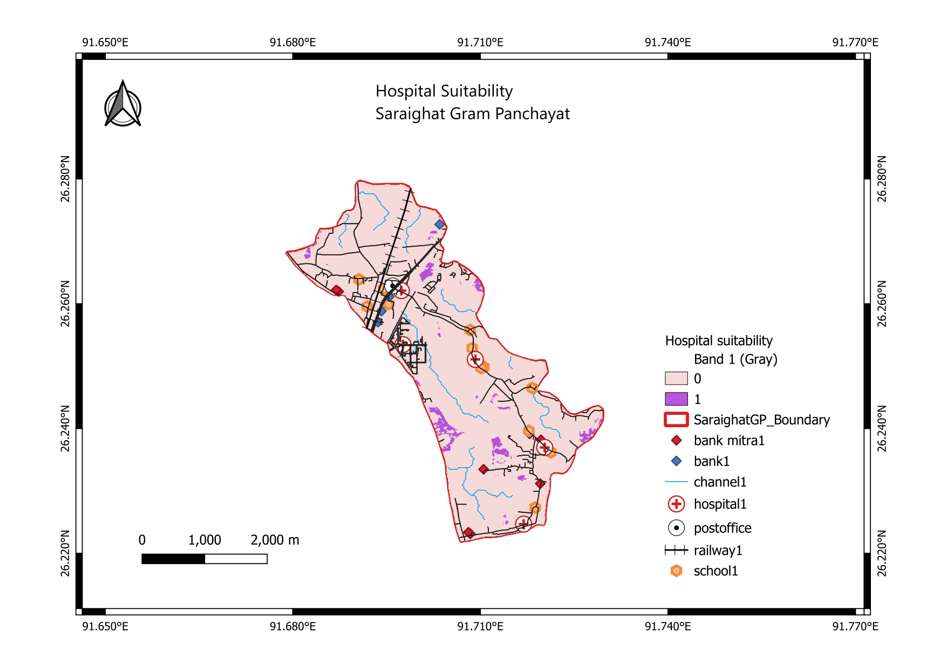
RESULT
FINAL LAYOUT MAP
The suitable areas were overlaid with the utility layers for visual analysis and site identification.

Slide 19
CONCLUSION
The analysis successfully identified multiple suitable land parcels (indicated by purple on the map) that meet all defined criteria and constraints.
These sites are far from existing hospitals, close to the road network, and avoid major constraint areas like waterways and railways.
The best proposed site is located.

Slide 20
THANK YOU

