Slide 1
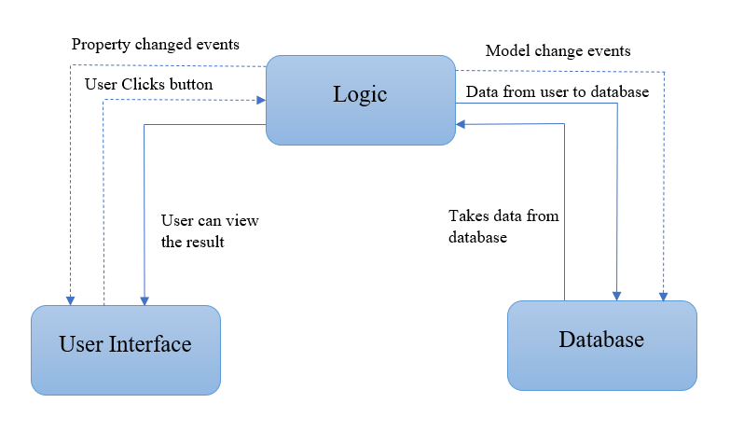
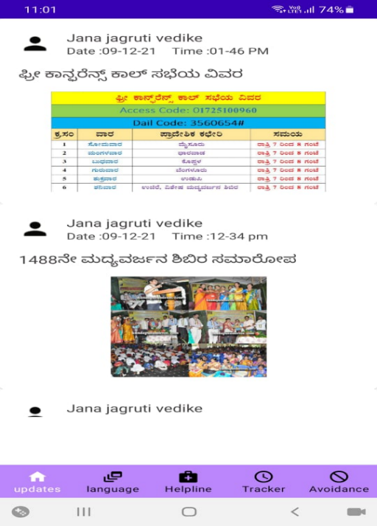
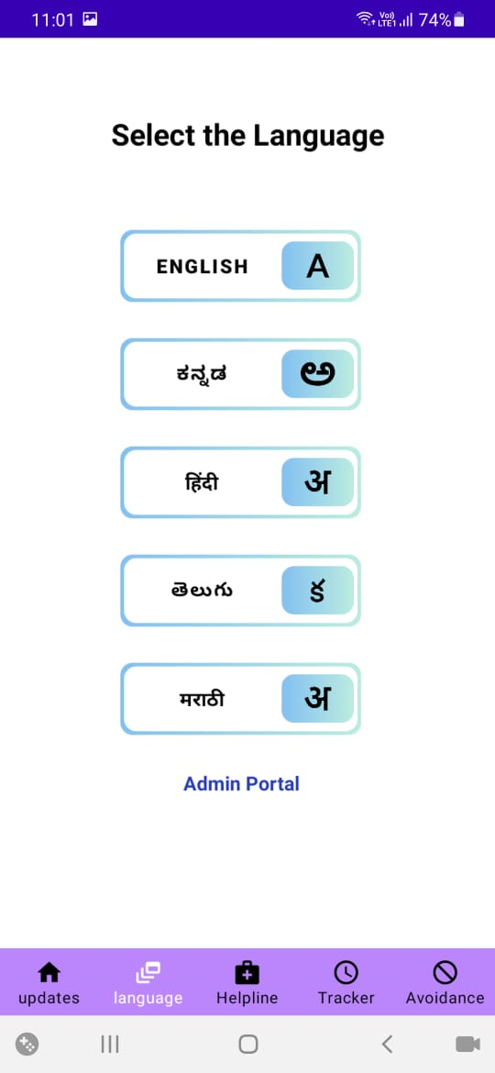
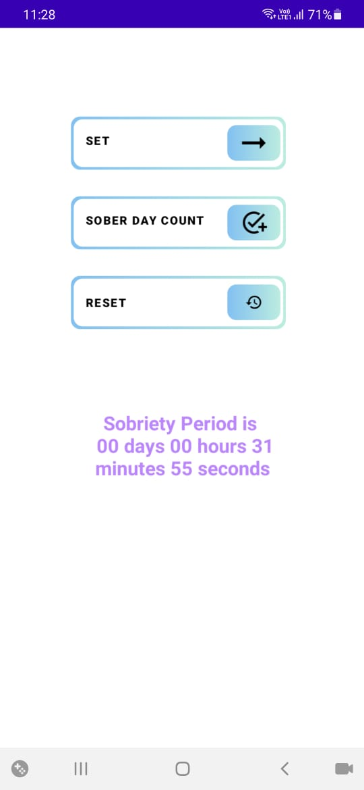
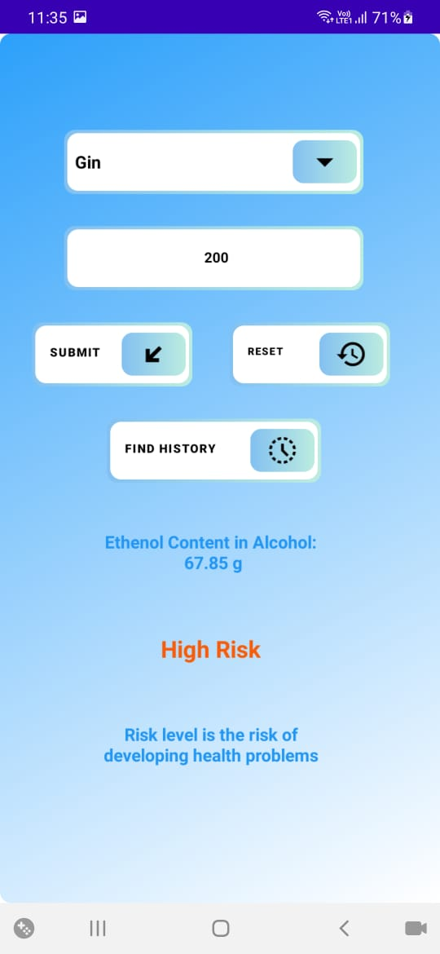
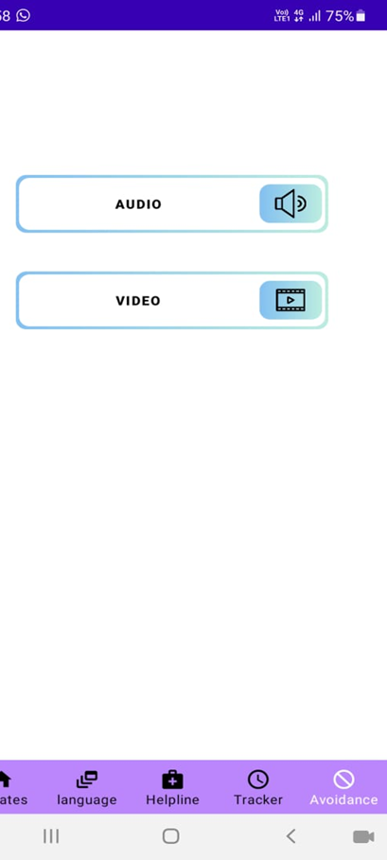
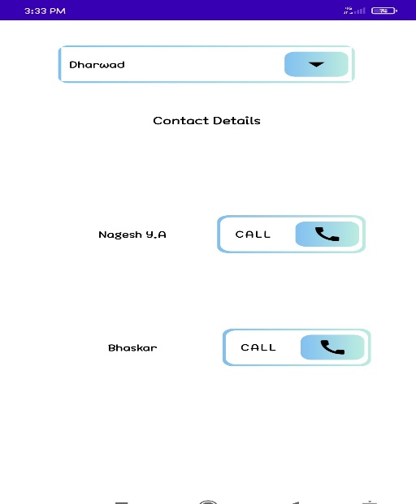
Avoid Relapse Stay Sober Android Application
Problem Domain
Methodology
The application uses MVVM architecture. It is one of the most industrially used architectures.
The architecture mainly contains 3 major components: Model, View and View Model.
Model and view model helps to get the data from the user and save it. View takes the user’s actions and sends this information to ViewModel so it is the main input point and it does not contain any application logic.
UI events related details are sent to ViewModel. ViewModel reads the data from the Model whenever it is required.
This architecture helps in easy modification of the application. This architecture simplifies the addition and removal of application features.
Results
Android Project
Problem statement
Develop an android application that helps people to find a way to avoid alcohol, calculate their risk level, find information regarding rehabilitation camps, helpline numbers, trigger avoidance techniques and track their sober days.
.
Objectives
To develop an app in different languages to help rural people.
To develop risk calculator using formula provided by WHO.
To find sober period to motivate sober people.
To provide rehab centers details in one component so that it helps rural people.
Conclusion
Motivation
Android application is developed in five different rural languages to help the alcoholics to lead a sober life by keeping a count of sobriety days, computing the alcohol risk level, and avoiding relapse triggers by using techniques like audios, videos of atmavalokhana talks, bhajans and motivational talks.
This application is developed in collaboration with SDM De-addiction Center Ujjire.
This application will be released on 15th January 2022 for the people who have completed the treatment in the SDM De-addiction Center.,
There are many applications developed to control alcoholism, but they are not in regional languages.
Applications lack with helpline required for the people and the information about the alcohol risk level .
Most of them don’t have proper trigger avoidance techniques.

