Slide 1


DOCTOR-PATIENT RECORD MANAGEMENT SYSTEM
PRESENTED BY:
SIRAVENI SHIVANI

Slide 2
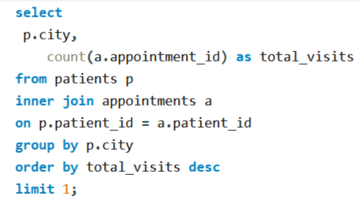

Write a query to find the city with the highest number of patient visits.
Delhi is the most active city in terms of hospital visits, with a total of 6 appointments.

Slide 3
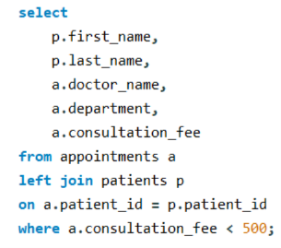
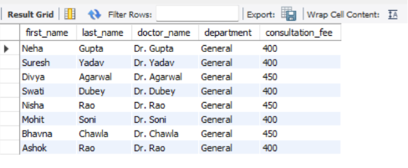
Find the department that has the highest number of appointments where the consultation fee is less than ₹500.
The General department recorded 8 appointments with consultation fees below ₹500, making it the department with the highest number of low-cost consultations.

Slide 4
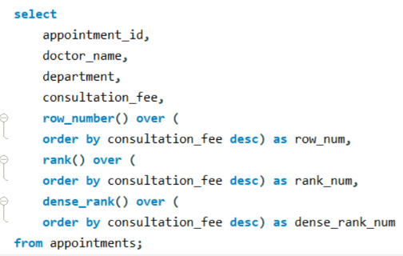
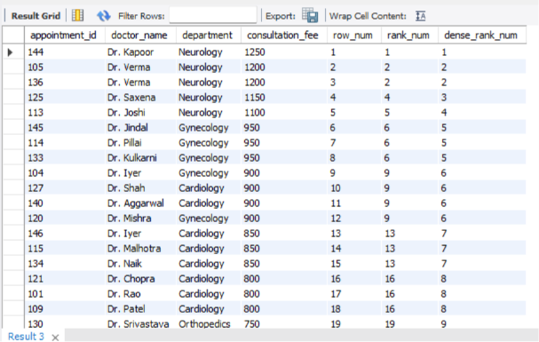
Write a query to assign ROW_NUMBER(), RANK(), and DENSE_RANK() based on the consultation fee in the appointments table.
ROW_NUMBER() gives unique positions, RANK() allows ties with gaps, and DENSE_RANK() allows ties without gaps, making them useful for different ranking scenarios.

Slide 5
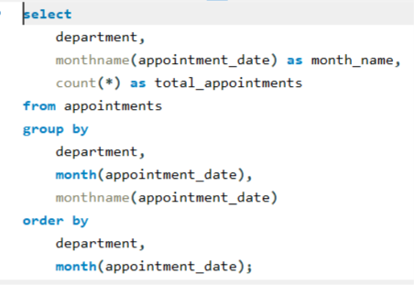
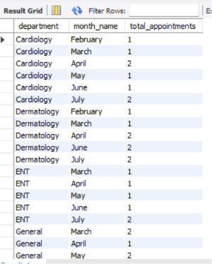
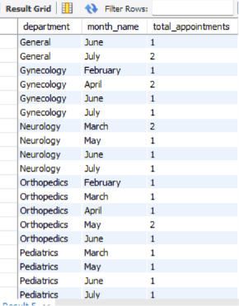
Write a query to show the number of appointments in each month for every department.
The result provides a monthly breakdown of appointments for each department, helping identify departments with higher patient activity.

Slide 6
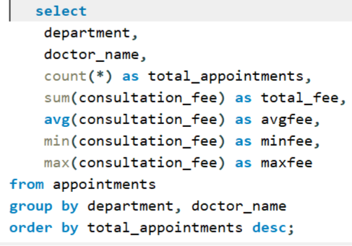
Write a query to find the total, average, maximum, minimum consultation fee, and total appointments for each doctor in each department. Display the result in descending order of total appointments.

Slide 7
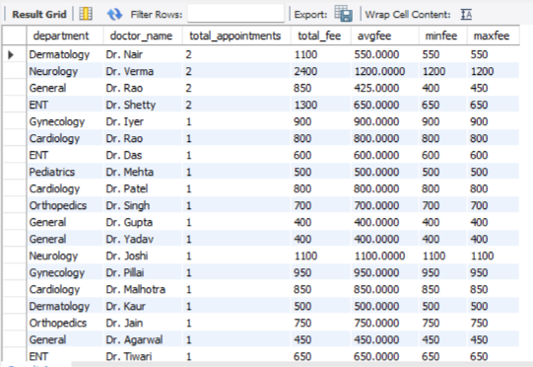
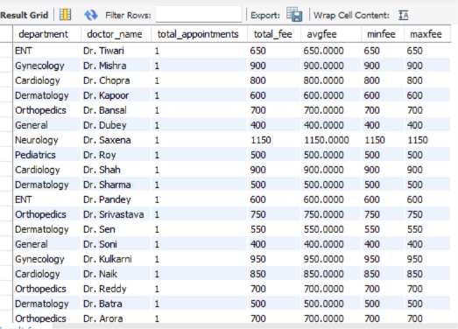
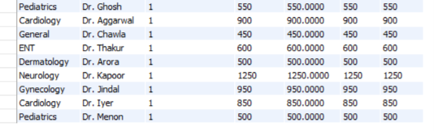
Result
The query helps identify the busiest doctors and compare their consultation fee details across different departments.

Slide 8
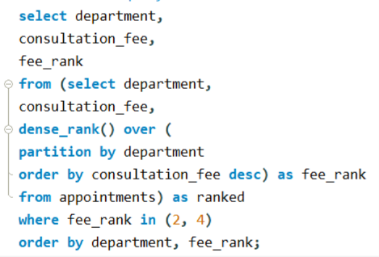
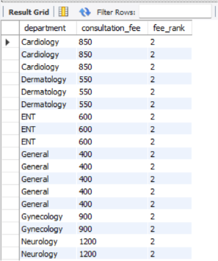
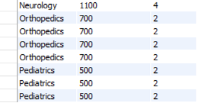
Write a query to find the 2nd and 4th highest consultation fees in each department from the appointments table.
It helps identify important consultation fee levels by ranking fees within each department.

Slide 9
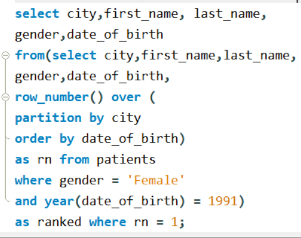

Write a query to find all female patients from each city who were born in the year 1991.
It provides a city-wise list of female patients born in 1991, making it easy to analyze patient records based on gender and birth year.

Slide 10
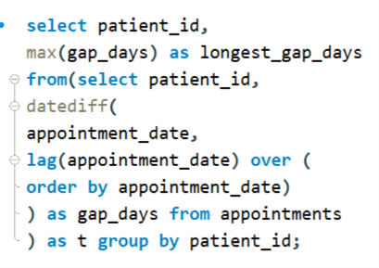
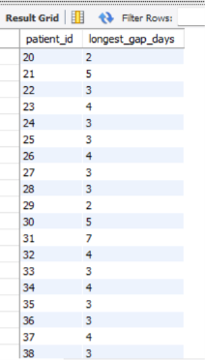
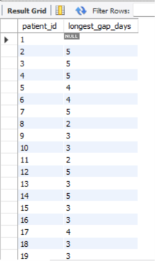
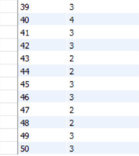
Write a query to find the longest gap (in days) between two consecutive appointments for each patient.
It identifies the maximum number of days between consecutive appointments for each patient, helping track the time interval between patient visits.

Slide 11
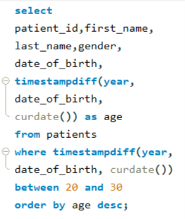
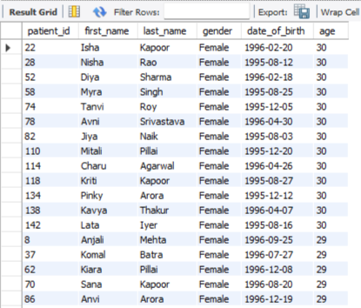

Write a query to find patients whose age is between 20 and 30 years.
It retrieves all patients aged between 20 and 30 years, making it easier to analyze patients within a specific age group.

Slide 12
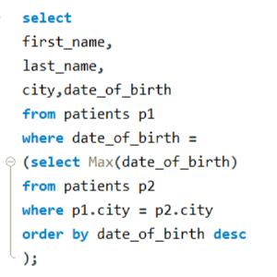
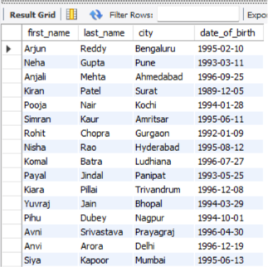
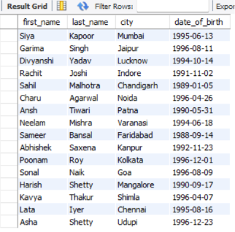
Write a query to find the youngest patient in each city using a subquery.
It uses a subquery to identify the youngest patient in each city by selecting the latest date of birth.

Slide 13
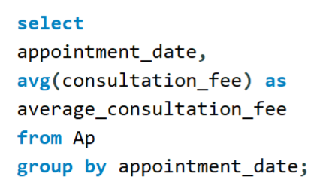


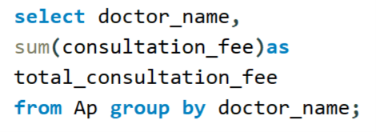
Create views to simplify data retrieval by displaying all patient records, General department patient details, doctor-wise total consultation fee, average consultation fee by appointment date.
VVVV

Slide 14
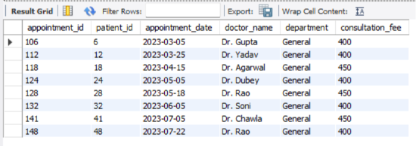
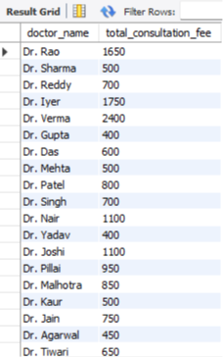
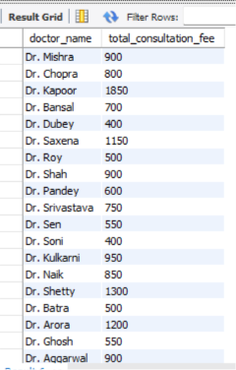
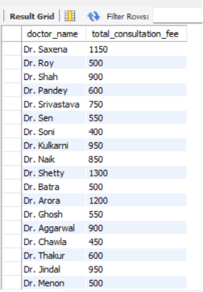
Result

Slide 15
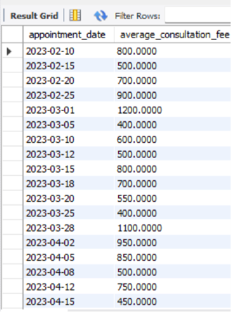
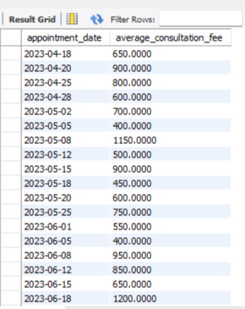
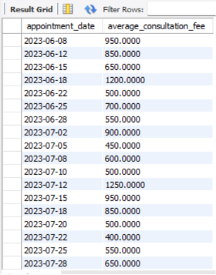
Result

Slide 16
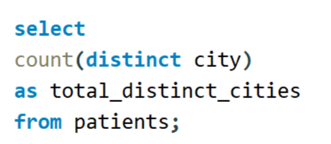

Write a query to find the total number of distinct cities in the patient table.
It counts only unique city names, providing the total number of different cities represented in the patient table.

Slide 17
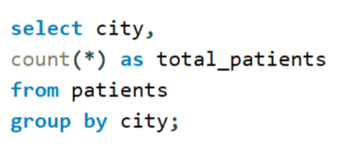
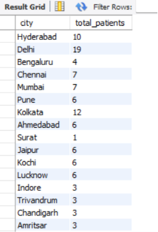
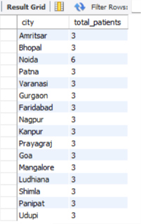
Write a query to display each city along with the number of patients living in that city.
It provides a city-wise patient count, making it easy to identify which cities have the highest and lowest number of patients.

Slide 18
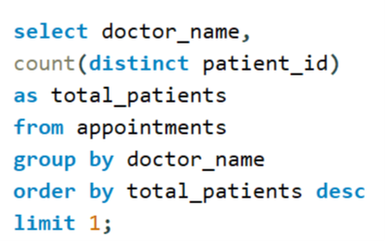

Write a query to find the doctor who treated the maximum number of patients.
It identifies the doctor who treated the maximum number of patients, highlighting the busiest doctor based on patient visits.

Slide 19
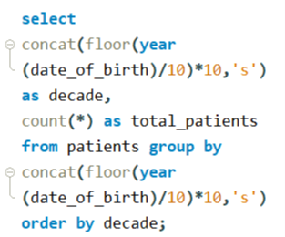
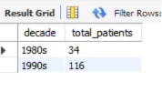
Write a query to find the number of patients born in each decade.
It provides a decade-wise summary of patients, making it easy to understand the distribution of patients across different birth decades.

Slide 20
THANK YOU

