Slide 1
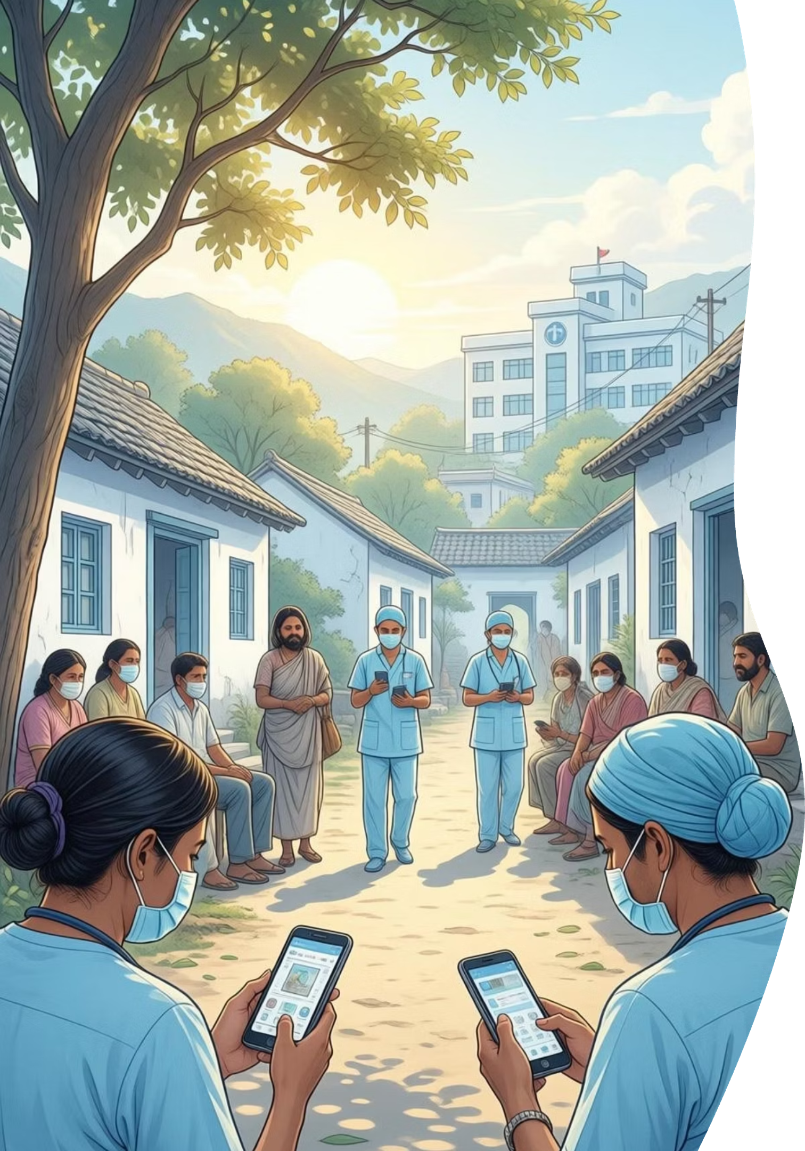
Telemedicine Access for Rural Healthcare in Nabha
Problem Statement ID: 25018
Thrust Area: Mobile/Web application
Team Members
1602-23-737-172 Shivani
1602-23-737-318 Vyshnavi
1602-23-737-159 Pragathi

Slide 2
Problem Statement
173 villages in the Nabha region face severe healthcare access challenges that disproportionately affect daily wage earners, farmers, and elderly populations.
Specialist Shortage
Travel Burden
Wage Loss
Limited availability of qualified doctors and specialists in rural PHCs and sub-centers
Patients travel 20-50 km to district hospitals only to find specialists unavailable
Daily workers lose ₹300-500 per trip when appointments are missed or medicines unavailable
Medicine Gaps
No Records
Inconsistent drug supply at local facilities forces additional trips to pharmacies
Lack of digital medical records prevents continuity of care and treatment tracking

Slide 3
Motivation & Context
Rural healthcare delivery in India faces systemic challenges. With over 65% of India's population residing in rural areas, the doctor-to-patient ratio remains critically low at 1:1,456 against WHO recommendations.
The COVID-19 pandemic accelerated telemedicine adoption, yet existing solutions remain urban-focused. Nabha's 173 villages lack region-specific telemedicine infrastructure, forcing patients into a cycle of travel, wage loss, and delayed treatment.
Early diagnosis and timely intervention can prevent complications, reduce hospitalizations, and save lives. A rural-first telemedicine platform addresses this critical gap.
65%
1:1,456
20-50km
Rural Population
Doctor-Patient Ratio
Average Travel
India's rural demographic requiring healthcare access
Above WHO recommended standards
Distance to district hospitals

Slide 4
Project Abstract
This telemedicine-first mobile application addresses rural healthcare access challenges in Nabha's 173 villages through a comprehensive digital health platform.
01
02
Objective
Identified Gap
Enable appointment-based remote consultations, symptom guidance, digital health records, and real-time medicine availability
Existing telemedicine solutions lack rural-first design, low-bandwidth optimization, and integrated pharmacy systems
03
04
Proposed Solution
Expected Impact
Unified mobile platform with adaptive video consultation, rule-based symptom checker, and real-time drug inventory tracking
Reduce unnecessary hospital visits by 60%, save 2-3 hours per consultation, and minimize wage loss for rural patients

Slide 5
Existing Solutions & Gap Analysis
Current Market Solutions
Platform
Key Features
Target Audience
eSanjeevani
Government telemedicine portal
Urban & semi-urban
Practo
Multi-specialty appointments
Urban professionals
Apollo TeleHealth
Enterprise healthcare
Private patients
Gap Identified in Existing Systems
No Rural-First UX
No Low-Bandwidth Optimization
Complex interfaces unsuitable for low digital literacy users
Requires stable high-speed internet unavailable in rural areas
No Medicine Integration
No Local Deployment
Lacks real-time pharmacy inventory tracking
Generic models not customized for Nabha's specific healthcare infrastructure

Slide 6

Key Features & Technology Stack
System Features
Online Appointment Booking
Low-Bandwidth Video Consultation
Schedule consultations within 2 minutes with doctor availability visibility
Adaptive bitrate video calls optimized for 2G/3G networks
Digital Health Records
E-Prescription with QR
Secure medical history retrieval within 5 seconds
Verified prescriptions with pharmacy integration
Medicine Availability
Priority System
Real-time tracking across local pharmacies
Emergency consultation queue for critical cases
Technology Stack
Frontend
Database
Security
Flutter (Mobile App)
MongoDB
OTP + JWT Authentication
Role-based access control
Backend
Video Layer
Node.js + Express.js
WebRTC-based service
Notifications
Push notification service

Slide 7
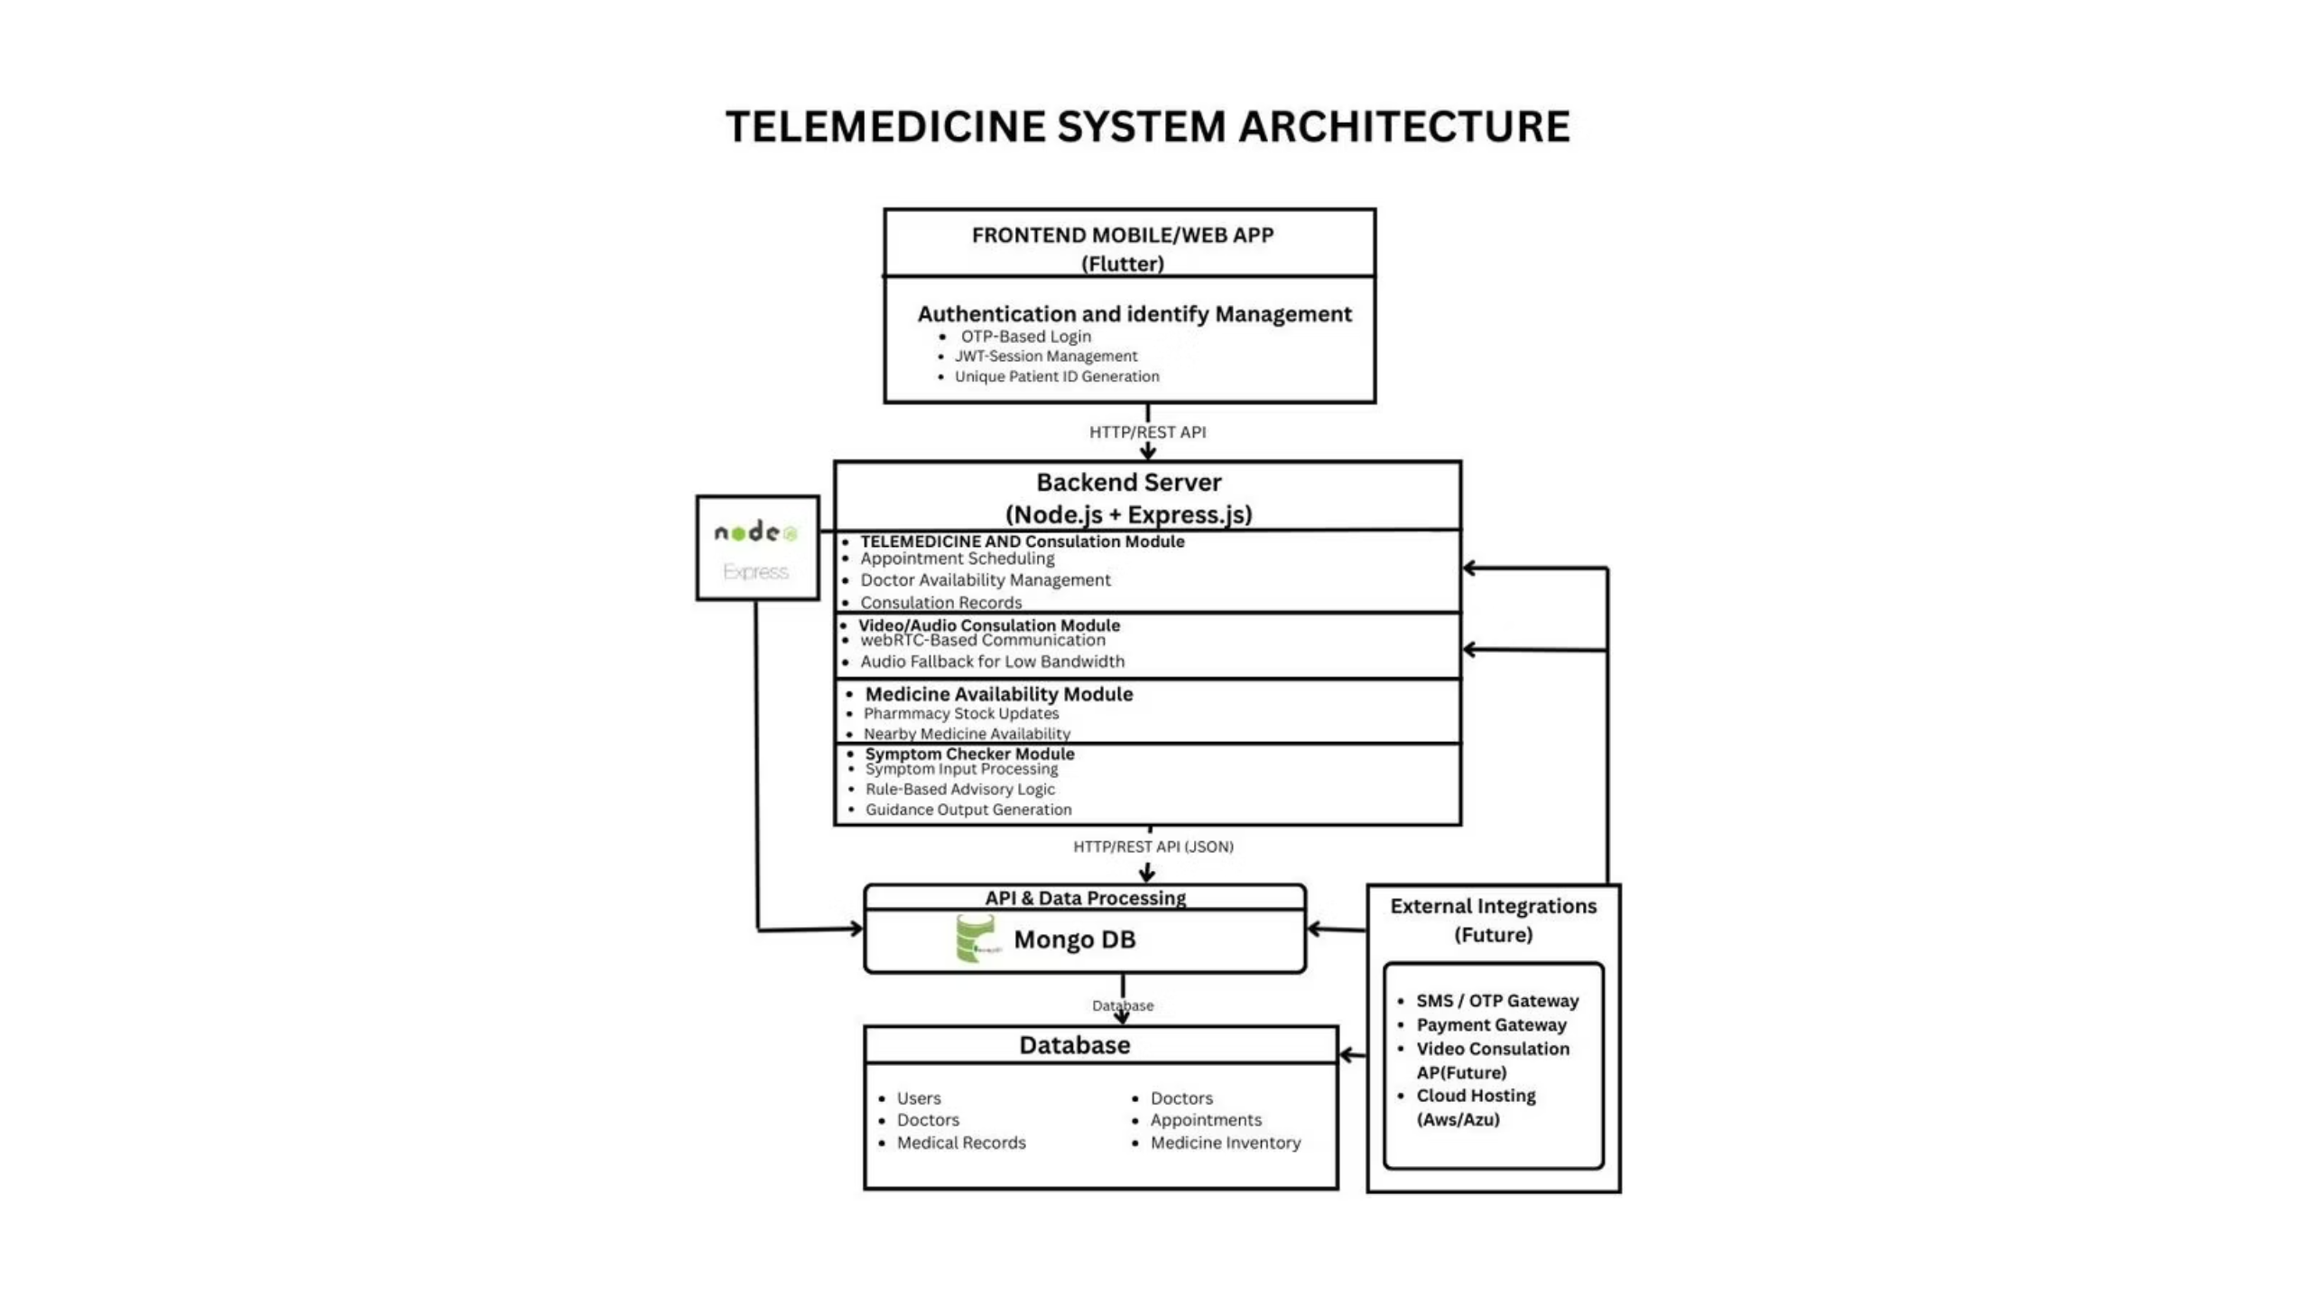
System Architecture
The system follows a scalable three-tier architecture with secure authentication and encrypted data storage. Patient consultations flow through the mobile app to backend APIs, store in MongoDB, and enable doctor access with real-time prescription delivery.

Slide 8
Feasibility & Viability
Technical Feasibility
Operational Feasibility
Economic Feasibility
Uses widely adopted, stable technologies with no specialized hardware required. Cloud-based deployment ensures scalability.
Appointment-based model optimizes limited doctor availability. Simple interface with minimal steps and regional language support.
Low development and deployment cost suitable for phased rollout. Government healthcare integration reduces operational expenses.
Potential Challenges & Mitigation
Challenge
Mitigation Strategy
Low digital literacy
Simple UI with large icons, minimal text, voice guidance
Internet connectivity
Low-bandwidth symptom checker, offline mode for records
Doctor availability
Appointment scheduling, priority queue for emergencies
Data security
Secure authentication, encrypted data storage, compliance with telemedicine guidelines

Slide 9
Impact & Benefits
Impact
Benefits
Reduced unnecessary hospital visits and long-distance travel
Minimized wage loss for daily workers and farmers
Improved utilization of limited healthcare staff
Virtual consultations alleviate pressure on overburdened facilities
Continuity of care through digital records
Proven model adaptable to other rural communities
Quick medical guidance reduces treatment delays
Real-time drug availability ensures prompt medication access
Secure medical history tracking prevents treatment gaps
Appointment visibility prevents wasted trips
Low-bandwidth video enables consultations from remote areas

Slide 10
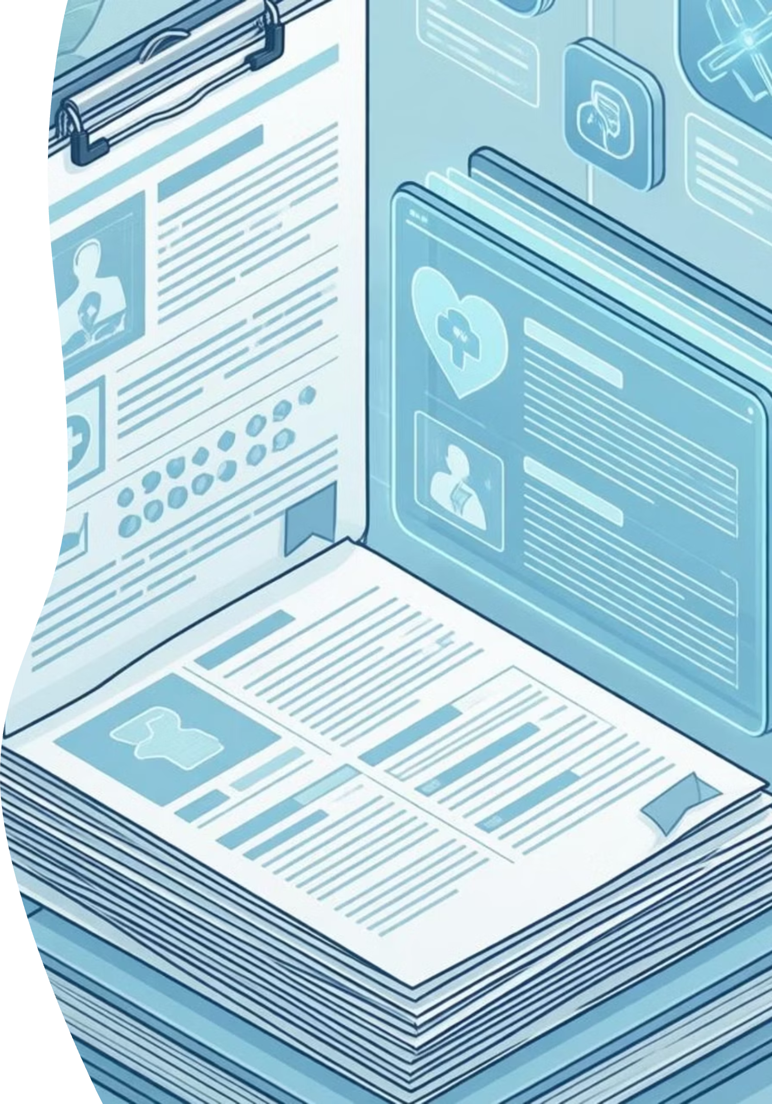
Research & References
Government of India – Telemedicine Practice Guidelines
Rural healthcare accessibility reports (Punjab Health Statistics)
Studies on telemedicine adoption in India (2020–2025)
WHO digital health and telemedicine frameworks
Academic literature on mobile health systems and rural healthcare delivery

